Slide 1



Slide 2

Surface Series:
Authorized Service Provider
Presented by:
Mahvish Khan
Supervisor of Business Development - Surface Devices, Hubs and MTR
TD SYNNEX Canada
Gurbir Singh
Business Development Manager - Surface Devices and Hubs
TD SYNNEX Canada

Slide 3
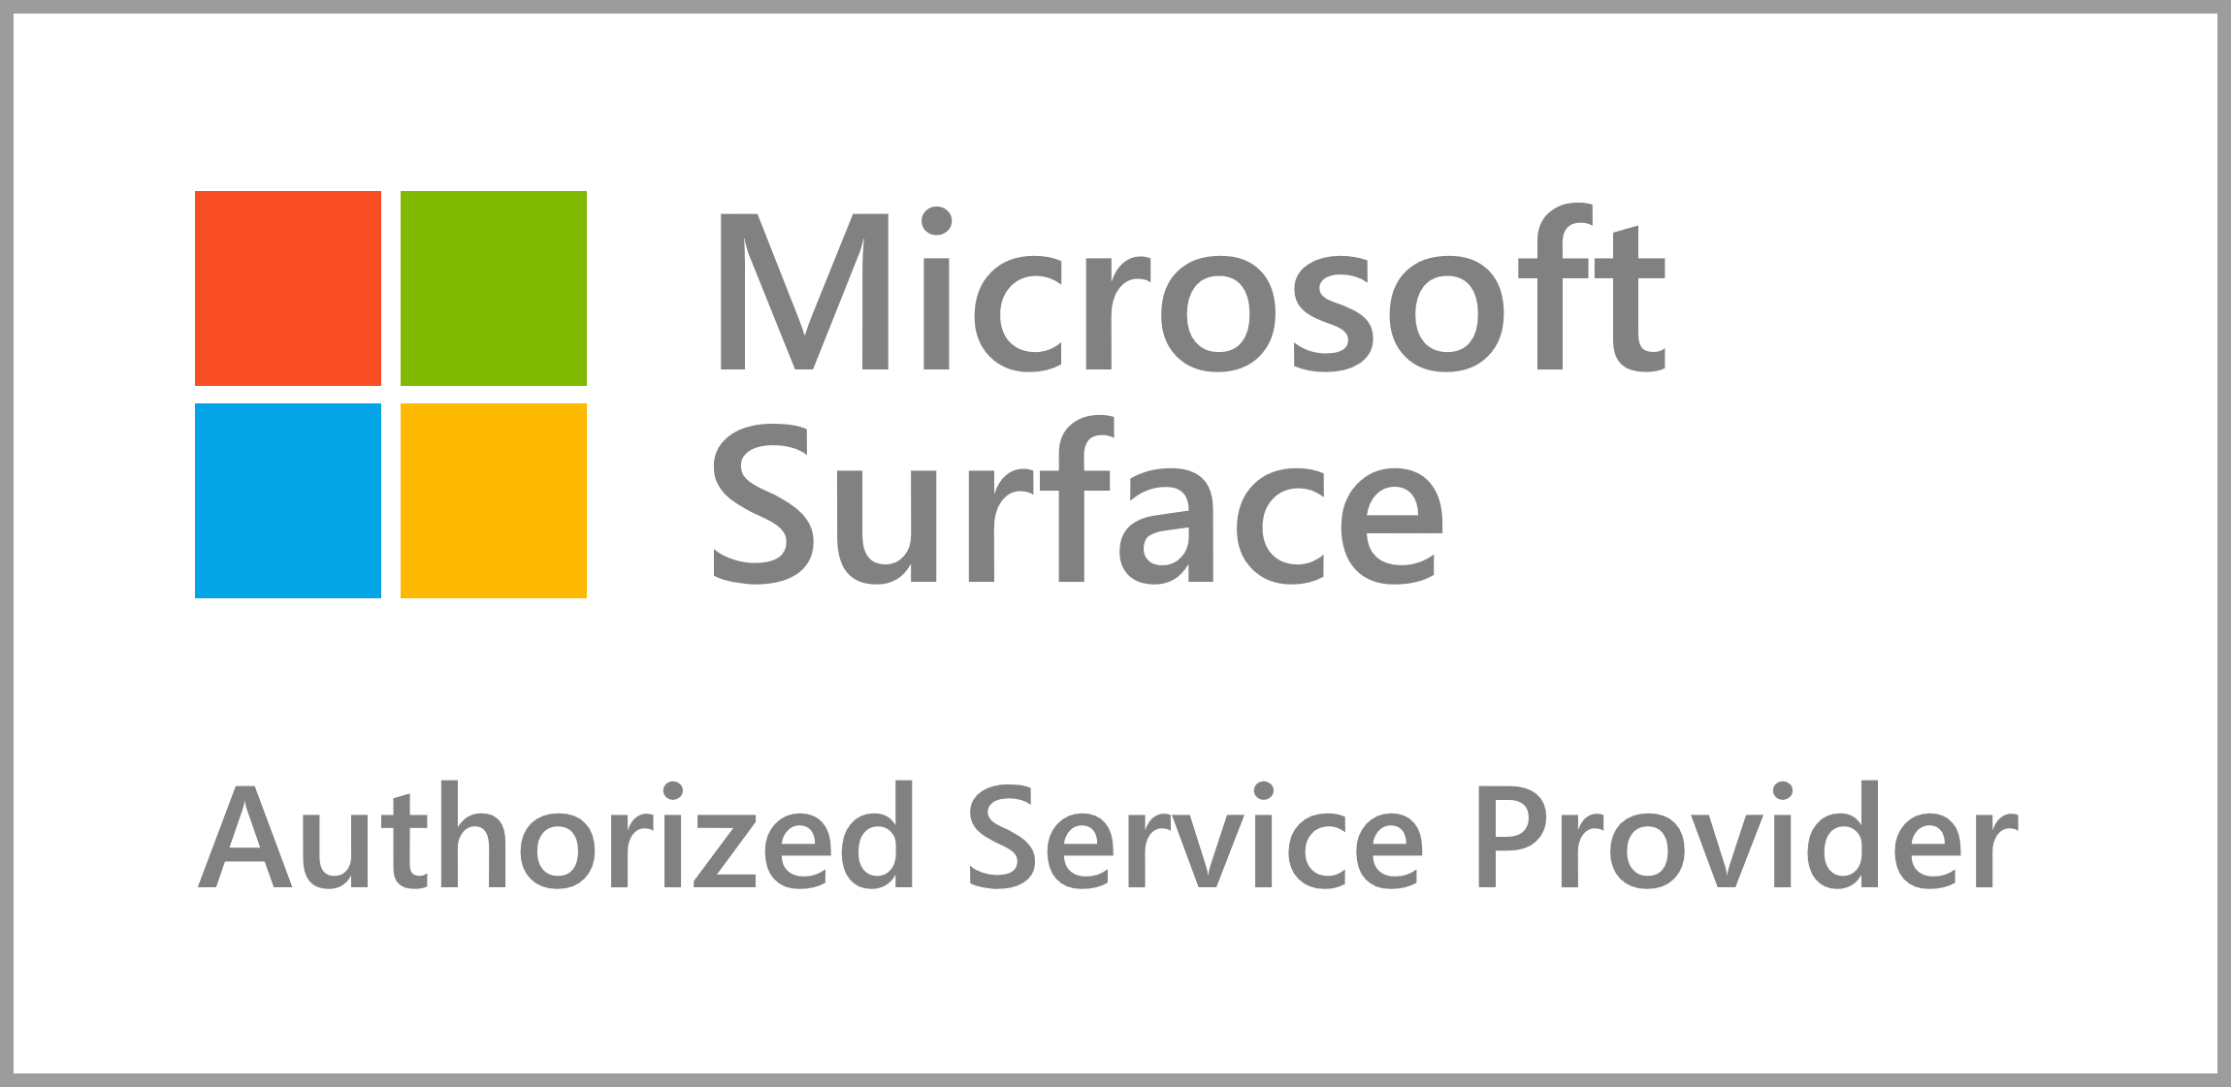
Services and Repair
In-House Warranties
TD SYNNEX Canada is a Microsoft-Authorized Service Provider (ASP).
We work closely with Microsoft to help resolve issues that may occur with customer’s Microsoft devices. As an ASP, we are trained and have acquired certifications to perform repairs on behalf of Microsoft, we have direct access to Microsoft support, and we use genuine Microsoft parts.
As an Authorized Service Provider (ASP), we also provide our own in-house Surface warranties as an alternative option for customers who missed the 45-day period to purchase Microsoft-branded Surface warranties.
What's the difference?
Customers can purchase our in-house warranties within 90-days from device ship date. Currently, we only offer the equivalent of Microsoft’s Extended Hardware Service Plan (2, 3 or 4 years) which covers manufacturing defects.
Pricing will also be different. Since you can purchase our in-house warranties within a longer period from device ship date, cost is higher.
How to request service?
Customers can either send us an email or call our dedicated hotline.
Email us at Microsoft.ASP.CA@tdsynnex.com
Call us at 833.581.2568
Service Center
We cover entire Canada, but our service center is in our Guelph facility. Customers will pay one-way shipping fee. We cover the return shipping fee.
Interested?
Contact your TD SYNNEX sales rep/team now. Our in-house warranty SKUs are also available in the monthly Surface Cheat Sheet.

Slide 4
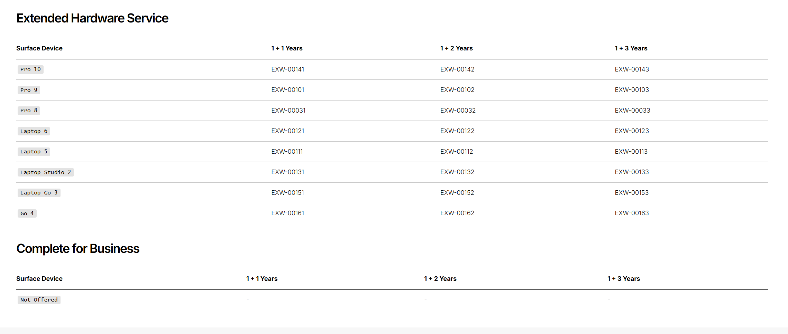
In-house Protection Plans

Slide 5
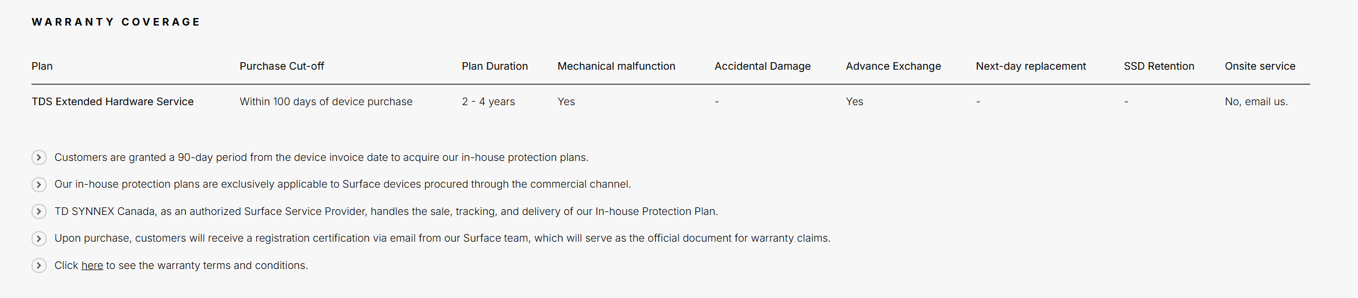
In-house Protection Plans T&C's

Slide 6
Questions? Email us at
MicrosoftSurfaceCA@tdsynnex.com

