Slide 1



Slide 2

Surface Series:
Microsoft Surface Warranty and
TD SYNNEX Warranty Options
Presented by:
Mahvish Khan
Supervisor of Business Development - Surface Devices, Hubs and MTR
TD SYNNEX Canada
Gurbir Singh
Business Development Manager - Surface Devices and Hubs
TD SYNNEX Canada

Slide 3
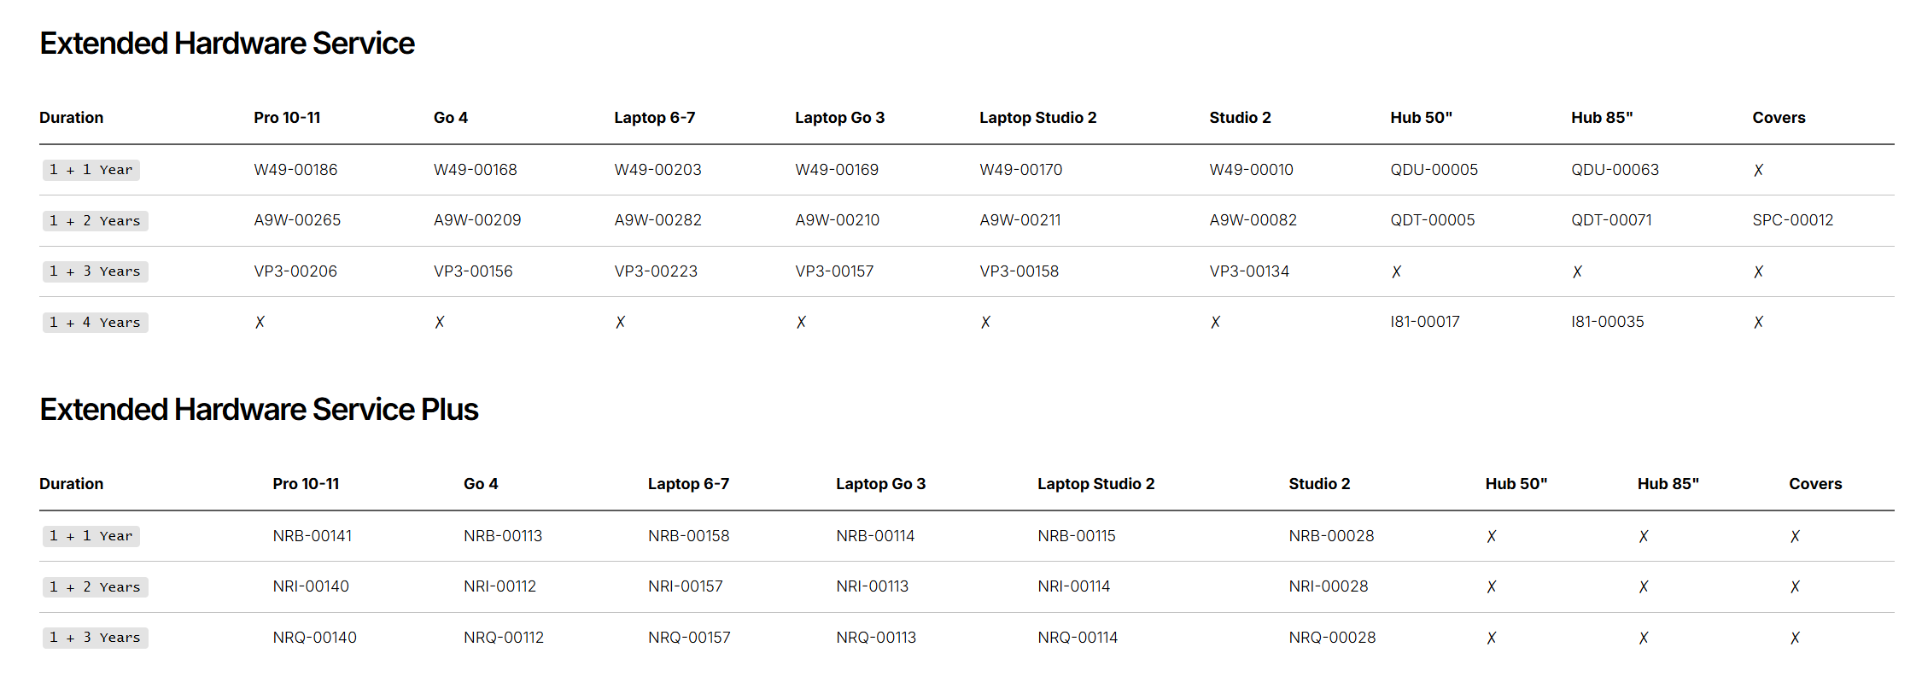
Microsoft Surface Warranties
reminders:
Resellers who have not completed the onboarding process are not authorized to sell Surface warranty protection plans.
A warranty protection plan for a Surface device must be sold within 45 calendar days of the device's distributor invoice date.
An end-user email address is required for all warranty orders; reseller email addresses cannot be used on behalf of the end user.
Microsoft strictly enforces these rules and will decline any orders placed after the allowed period or missing end-user information.

Slide 4
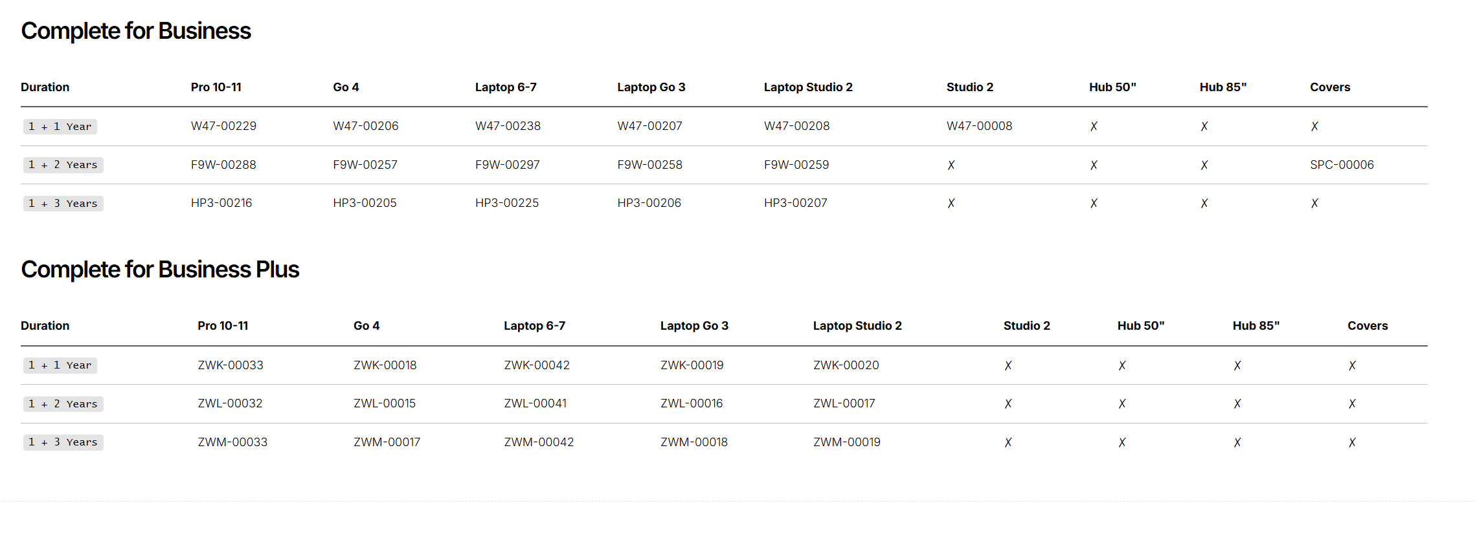
Microsoft Surface Warranties
reminders:
Resellers who have not completed the onboarding process are not authorized to sell Surface warranty protection plans.
A warranty protection plan for a Surface device must be sold within 45 calendar days of the device's distributor invoice date.
An end-user email address is required for all warranty orders; reseller email addresses cannot be used on behalf of the end user.
Microsoft strictly enforces these rules and will decline any orders placed after the allowed period or missing end-user information.

Slide 5
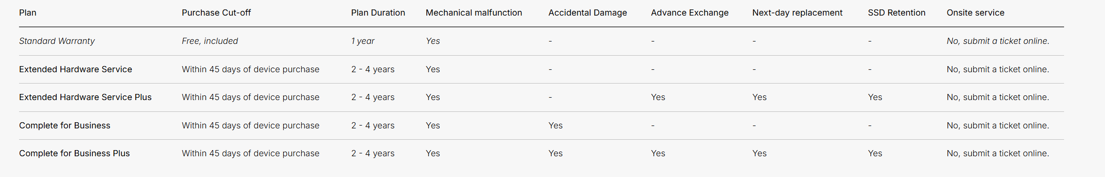
Warranty Plan Comparison

Slide 6
Questions? Email us at
MicrosoftSurfaceCA@tdsynnex.com

