Slide 1
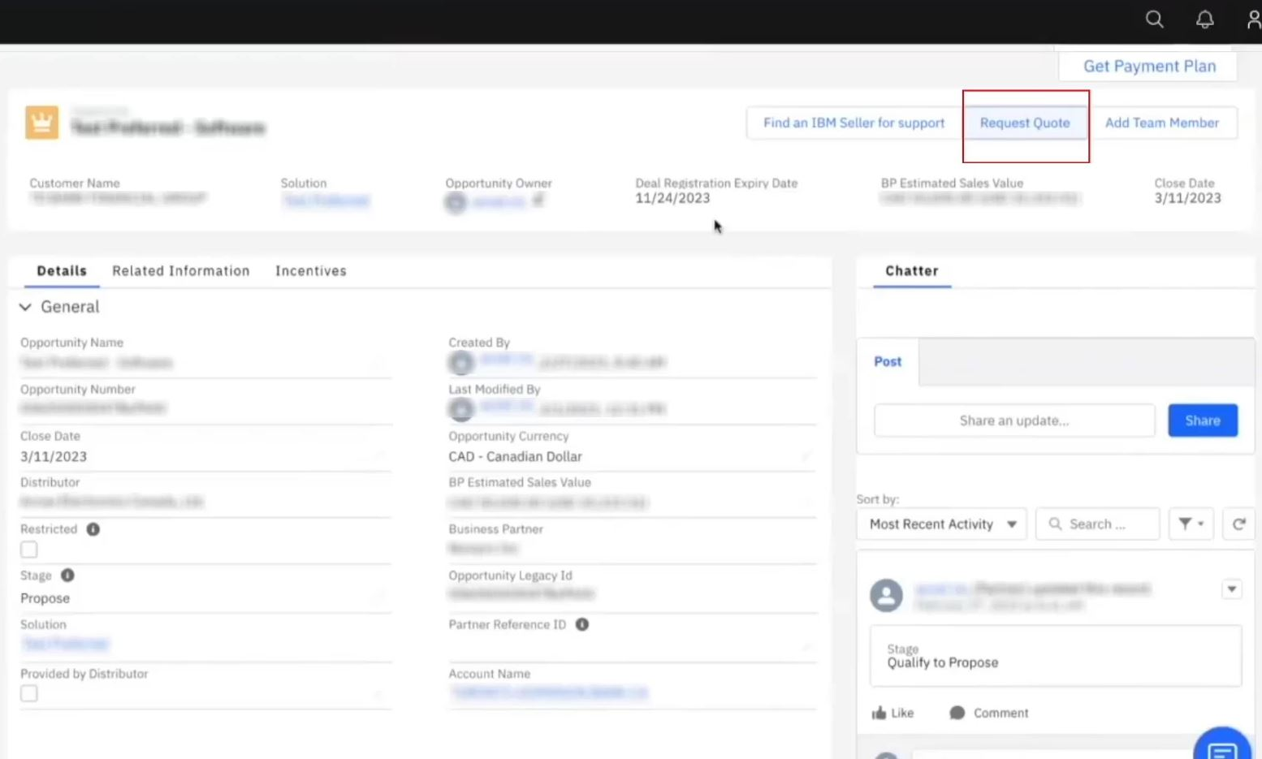
1. Select “Request Quote” in the top left from within your approved Deal Registration
Notes:
IBM Partner Packages: IBM direct discounted demo packages. A group of like licenses that you can use for demo and training.
IBM PartnerWorld Competences: Can be used in leu of certs/badges

Slide 2
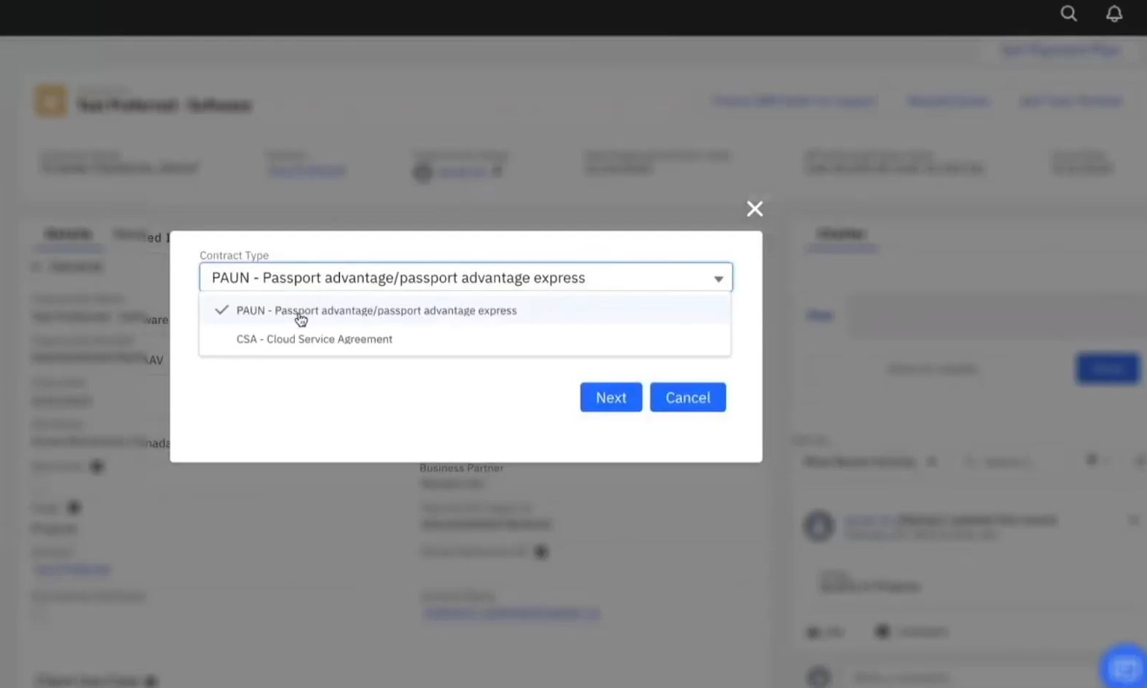
2. Select “PAUN – Passport Advantage” then select “Next”.
Notes:
IBM Partner Packages: IBM direct discounted demo packages. A group of like licenses that you can use for demo and training.
IBM PartnerWorld Competences: Can be used in leu of certs/badges

Slide 3
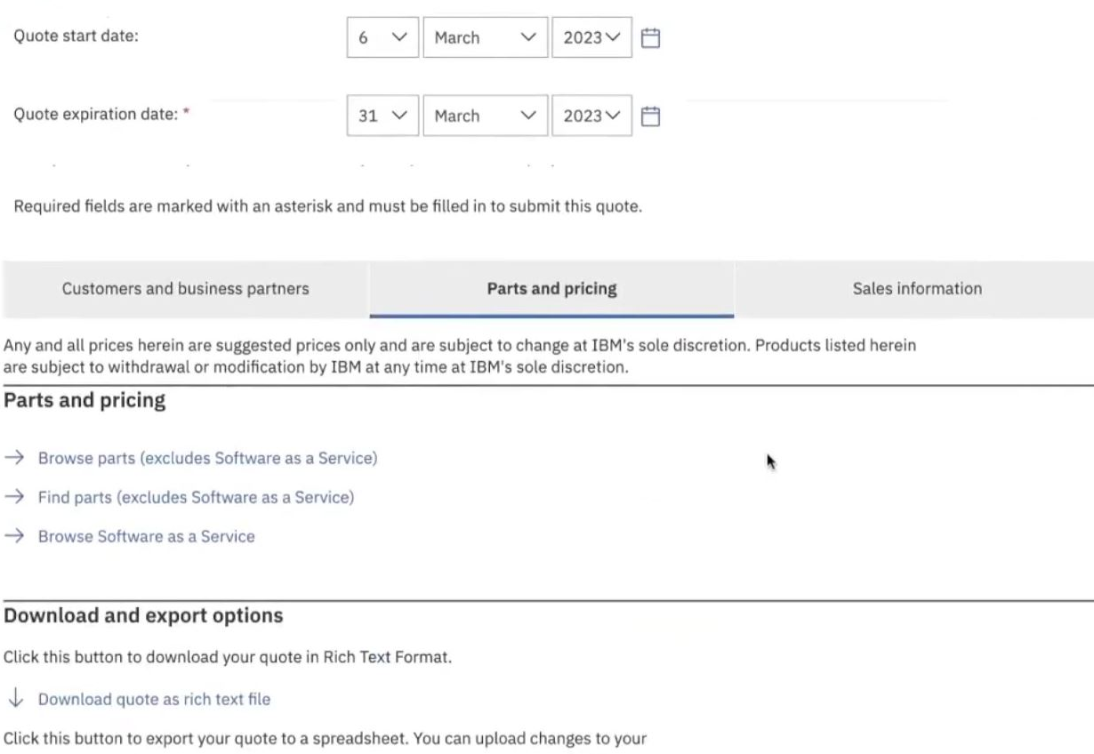
Please note: The system should pull your customer information directly from your approved Deal Registration and start you on the “Parts and Pricing” tab. In some cases however, the BP is still prompted to input their customer info. If that happens, copy the customer number from your Deal Registration to locate your customer.
3. Select the quote expiration date. We recommend choosing a date at the end of the quarter to give yourself plenty of time.
Notes:
IBM Partner Packages: IBM direct discounted demo packages. A group of like licenses that you can use for demo and training.
IBM PartnerWorld Competences: Can be used in leu of certs/badges

Slide 4
4. Select “Find parts” to search for your product by part number.
Notes:
IBM Partner Packages: IBM direct discounted demo packages. A group of like licenses that you can use for demo and training.
IBM PartnerWorld Competences: Can be used in leu of certs/badges

Slide 5
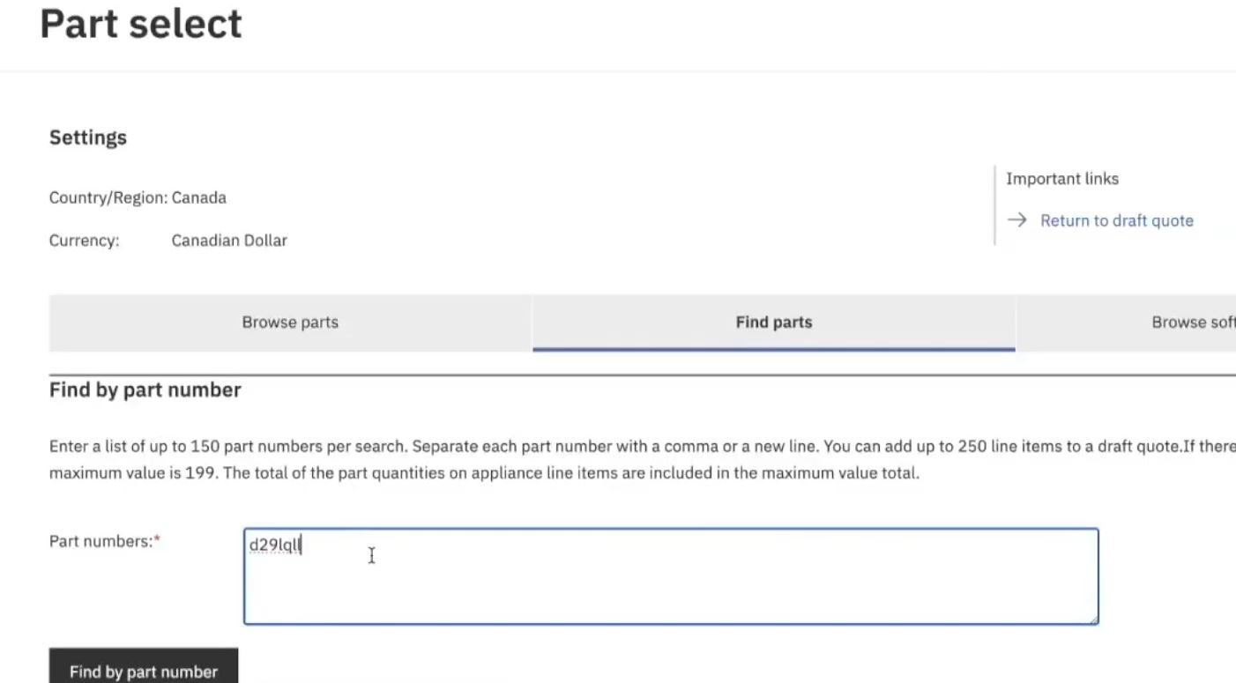
5. Type in the part number and click “Find by part number”. For multiple part numbers, simply separate by a comma or new line.
Notes:
IBM Partner Packages: IBM direct discounted demo packages. A group of like licenses that you can use for demo and training.
IBM PartnerWorld Competences: Can be used in leu of certs/badges

Slide 6
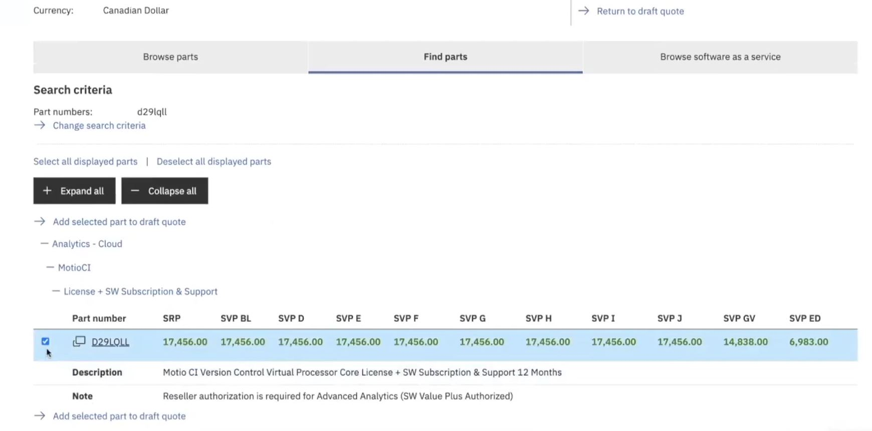
6. Check the box next to your part number then click “Add selected part to draft quote”
Notes:
IBM Partner Packages: IBM direct discounted demo packages. A group of like licenses that you can use for demo and training.
IBM PartnerWorld Competences: Can be used in leu of certs/badges

Slide 7
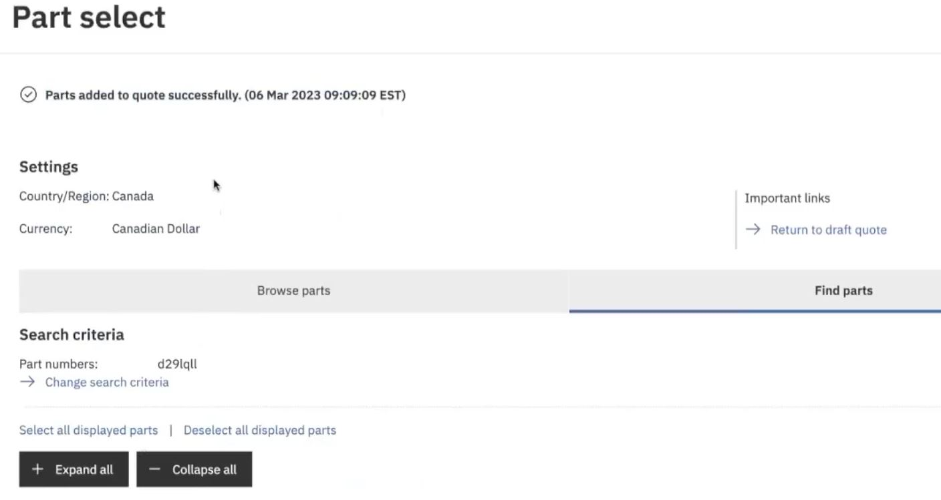
7. Your part number(s) should now populate below.
Select “Return to draft quote”
Notes:
IBM Partner Packages: IBM direct discounted demo packages. A group of like licenses that you can use for demo and training.
IBM PartnerWorld Competences: Can be used in leu of certs/badges

Slide 8
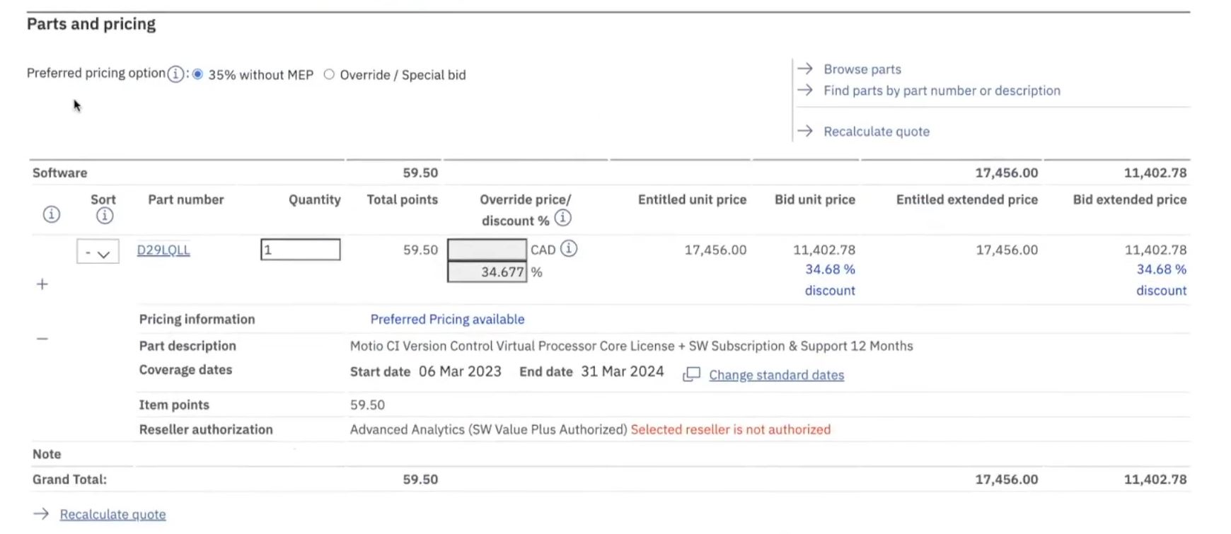
8. In the “Parts and Pricing” tab your quote price will populate. If you have approved deal registration, “preferred pricing” will show and approved discount.
Notes:
IBM Partner Packages: IBM direct discounted demo packages. A group of like licenses that you can use for demo and training.
IBM PartnerWorld Competences: Can be used in leu of certs/badges

Slide 9
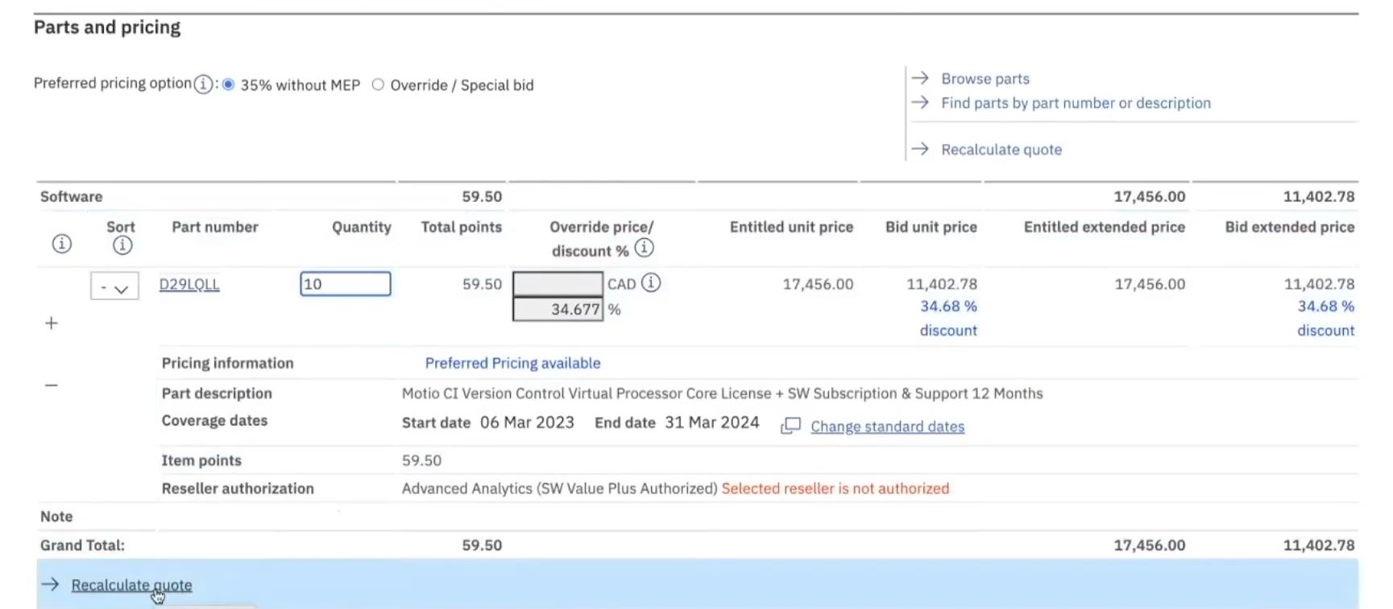
9. Please note: The pricing A.I. considers 20+ different factors when calculating a preferred pricing discount. One of the factors is the quantity of part numbers. When adjusting quantities make sure you click “Recalculate quote”.
Notes:
IBM Partner Packages: IBM direct discounted demo packages. A group of like licenses that you can use for demo and training.
IBM PartnerWorld Competences: Can be used in leu of certs/badges

Slide 10
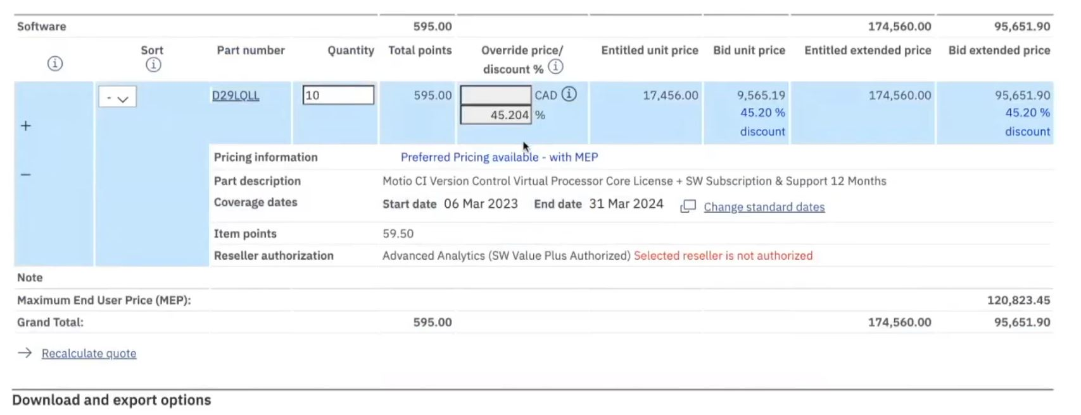
10. In this example, the increased quantity amount to 10 caused a higher discount and a “MEP (maximum end user price) to populate). MEP is the highest amount a BP can sell the product for. This is a good way to further boost front end margins. Please note: not all quotes will qualify for an MEP.
Notes:
IBM Partner Packages: IBM direct discounted demo packages. A group of like licenses that you can use for demo and training.
IBM PartnerWorld Competences: Can be used in leu of certs/badges

Slide 11
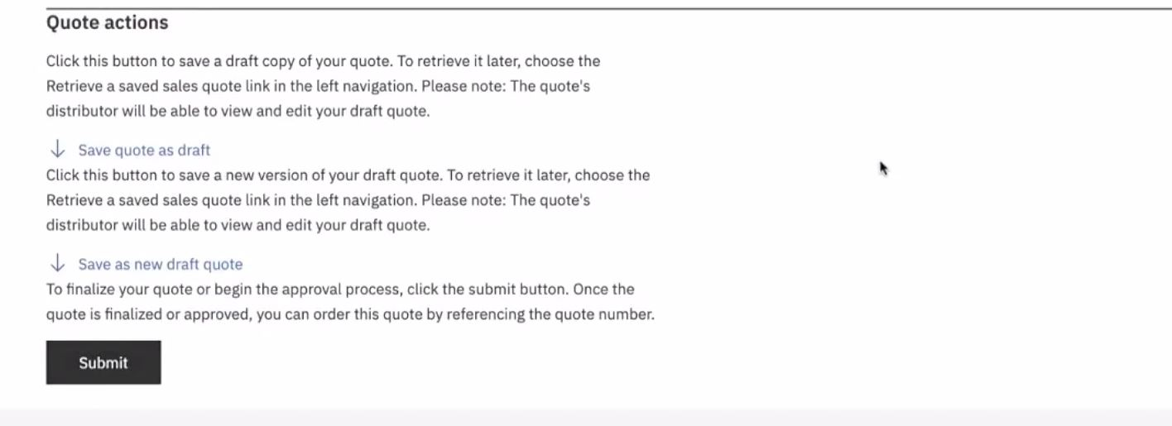
11. When finished, scroll down and select “Submit” under the “Quote Actions” section.
Please note: Once submitted the quote will be sent to your VSR to be generated into a TD SYNNEX quote. Your VSR will then email you the final TD SYNNEX quote to send to your end user.
Notes:
IBM Partner Packages: IBM direct discounted demo packages. A group of like licenses that you can use for demo and training.
IBM PartnerWorld Competences: Can be used in leu of certs/badges

