Slide 1
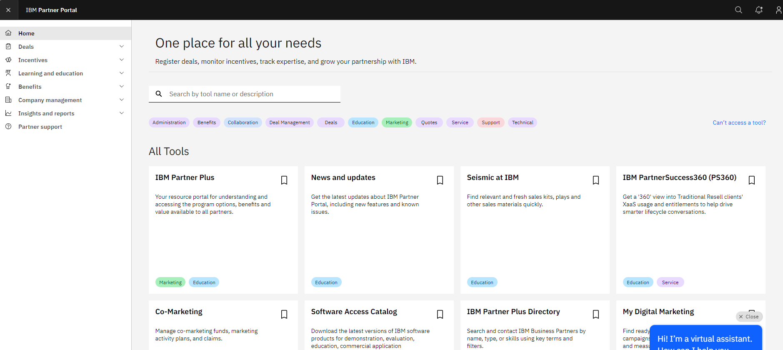
1. Login to Home - IBM Partner Portal
Please Note: The company APA is the only person that can add an employee.
If you don’t know who your company APA is, please have someone with an IBM ID submit a ticket through the Partner Support Page at IBM Partner Plus Support | IBM Partner Plus
In the ticket, you must request that IBM reaches out to your company APA and has them contact you. IBM will not share the APA’s info due to privacy reasons.
Notes:
IBM Partner Packages: IBM direct discounted demo packages. A group of like licenses that you can use for demo and training.
IBM PartnerWorld Competences: Can be used in leu of certs/badges

Slide 2
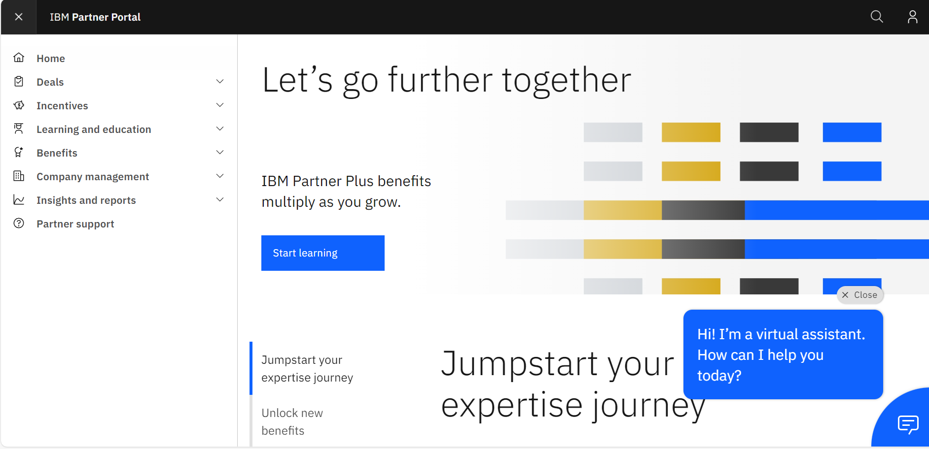
2. Click on “Company Management” on the left hand side.
Notes:
IBM Partner Packages: IBM direct discounted demo packages. A group of like licenses that you can use for demo and training.
IBM PartnerWorld Competences: Can be used in leu of certs/badges

Slide 3
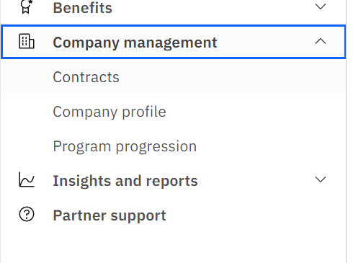
3. Click on “Company Profile”.
Notes:
IBM Partner Packages: IBM direct discounted demo packages. A group of like licenses that you can use for demo and training.
IBM PartnerWorld Competences: Can be used in leu of certs/badges

Slide 4
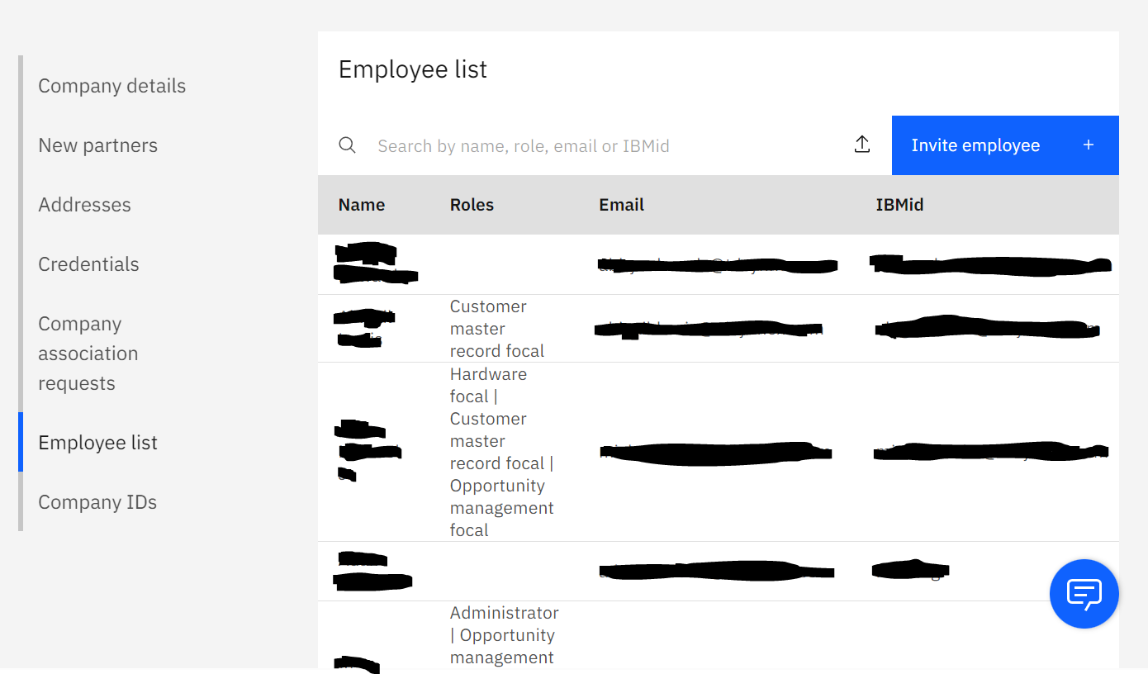
4. Scroll down to the “Employee List” section.
5. Click on the “invite employee” blue box.
Notes:
IBM Partner Packages: IBM direct discounted demo packages. A group of like licenses that you can use for demo and training.
IBM PartnerWorld Competences: Can be used in leu of certs/badges

Slide 5
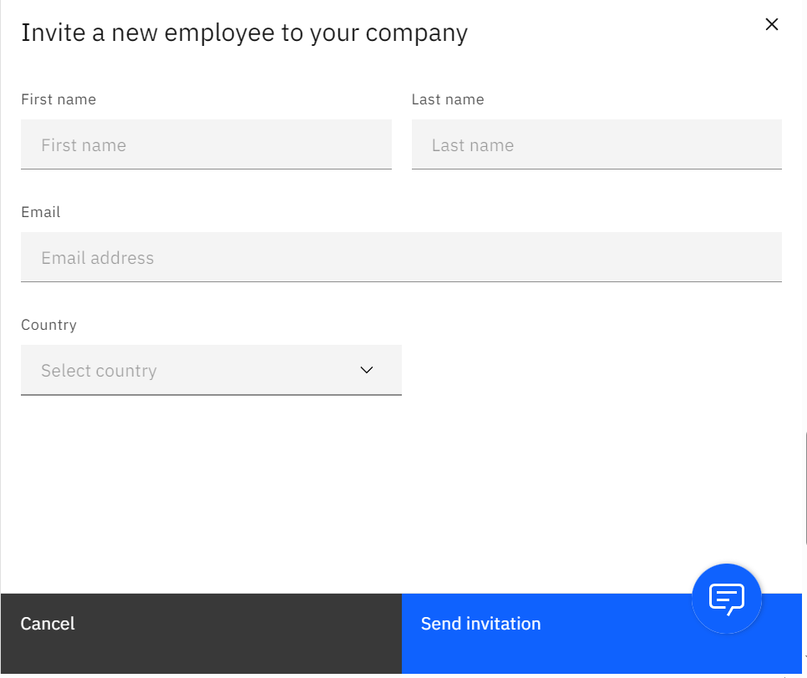
6. Fill in the required info then click “send invitation”
Please Note: An automated IBM invite email will be sent to your employee within 24 hours. Make sure they check their spam folder. Once they complete their registration the portal will take 24 hours to update and show the new employee on your listing.
Notes:
IBM Partner Packages: IBM direct discounted demo packages. A group of like licenses that you can use for demo and training.
IBM PartnerWorld Competences: Can be used in leu of certs/badges

