Slide 1
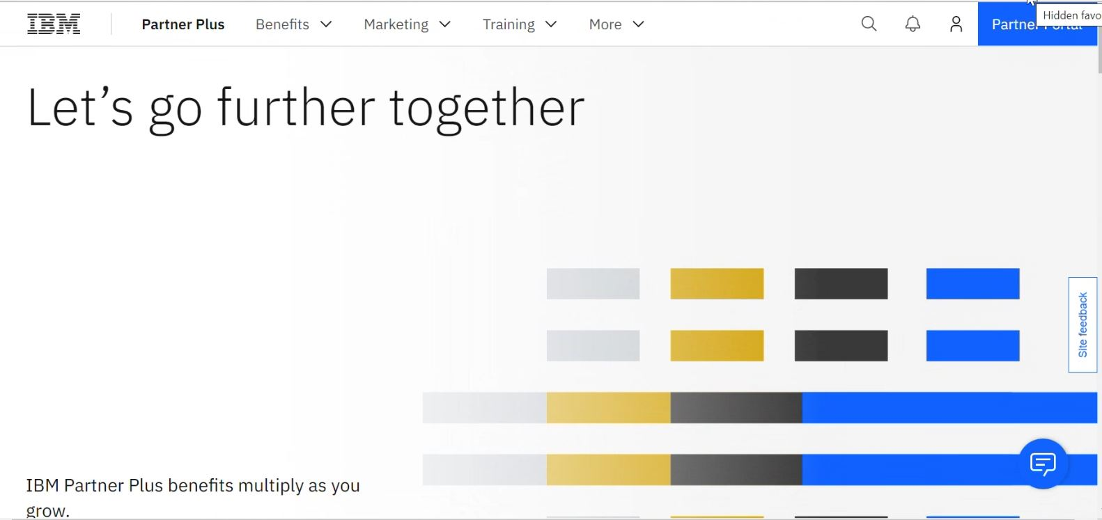
1. Login to IBM Partner Plus Once logged in, click on the blue “Partner Portal” box in the top right of the screen.
Please Note: The company APA is the only person complete this action. If you don’t know who your company APA is, please have someone with an IBM ID submit a ticket through the Partner Support Page at IBM Partner Plus Support | IBM Partner Plus
In the ticket, you must request that IBM reaches out to your company APA and has them contact you. IBM will not share the APA’s info due to privacy reasons.
Notes:
IBM Partner Packages: IBM direct discounted demo packages. A group of like licenses that you can use for demo and training.
IBM PartnerWorld Competences: Can be used in leu of certs/badges

Slide 2
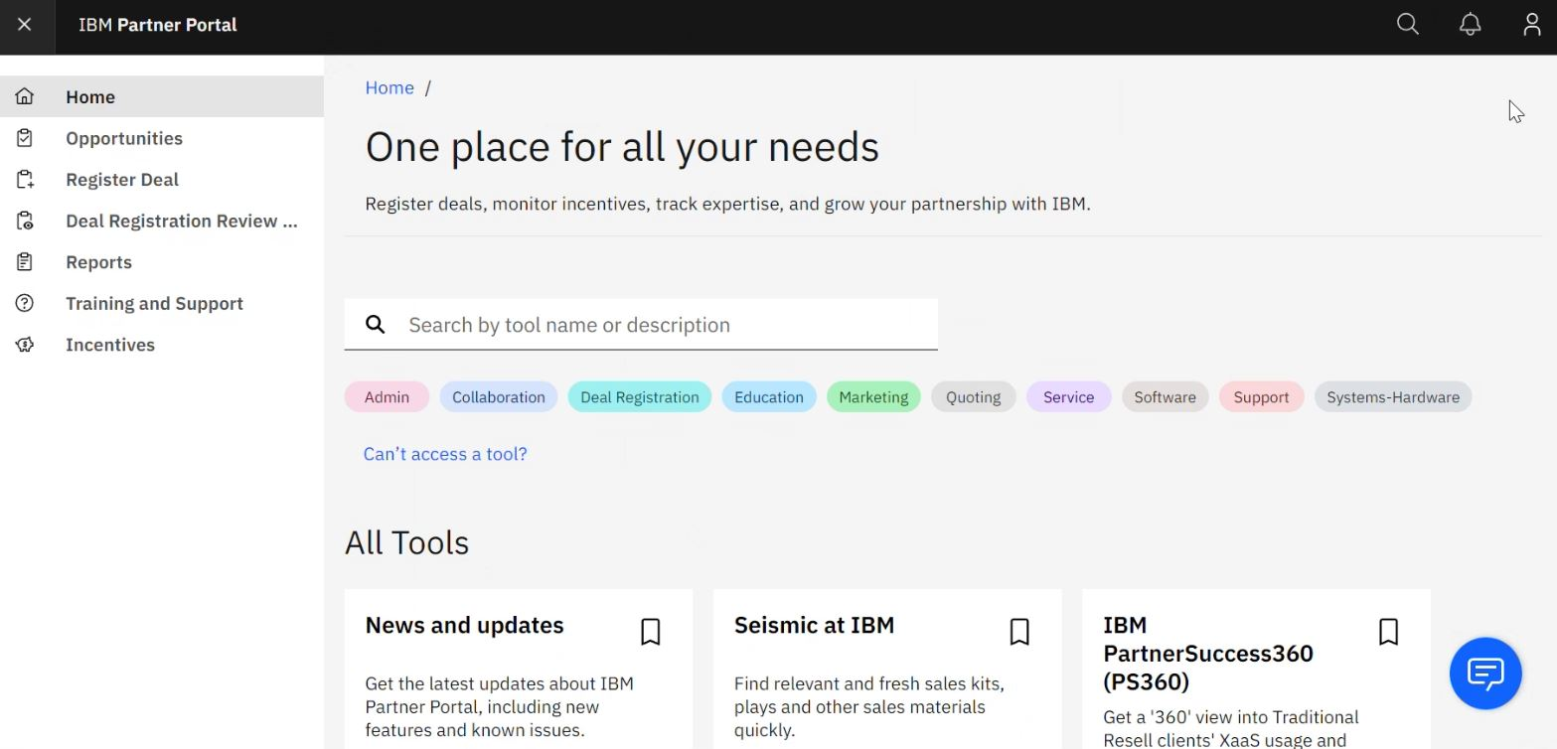
2. Click on the light red “Admin” bubble under the search bar.
Notes:
IBM Partner Packages: IBM direct discounted demo packages. A group of like licenses that you can use for demo and training.
IBM PartnerWorld Competences: Can be used in leu of certs/badges

Slide 3
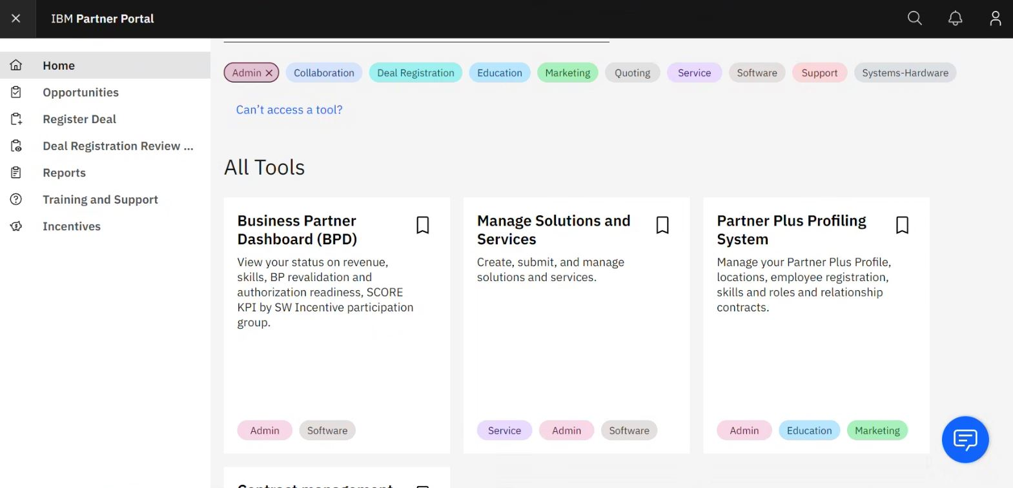
3. Click anywhere in the “Partner Plus Profiling System” box.
Notes:
IBM Partner Packages: IBM direct discounted demo packages. A group of like licenses that you can use for demo and training.
IBM PartnerWorld Competences: Can be used in leu of certs/badges

Slide 4
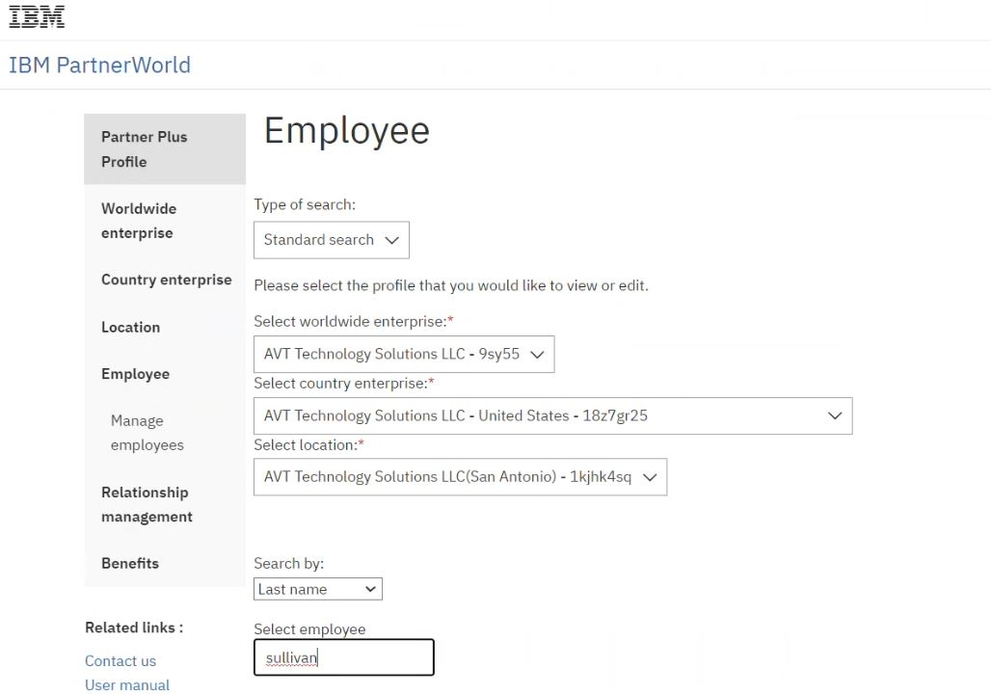
3. Select “Employee” on the left hand side.
4. Select the country enterprise and location the employee belongs to that you wish to give deal registration access to.
5. Enter the name of the employee you want to give access to into the “Select employee” section.
Notes:
IBM Partner Packages: IBM direct discounted demo packages. A group of like licenses that you can use for demo and training.
IBM PartnerWorld Competences: Can be used in leu of certs/badges

Slide 5
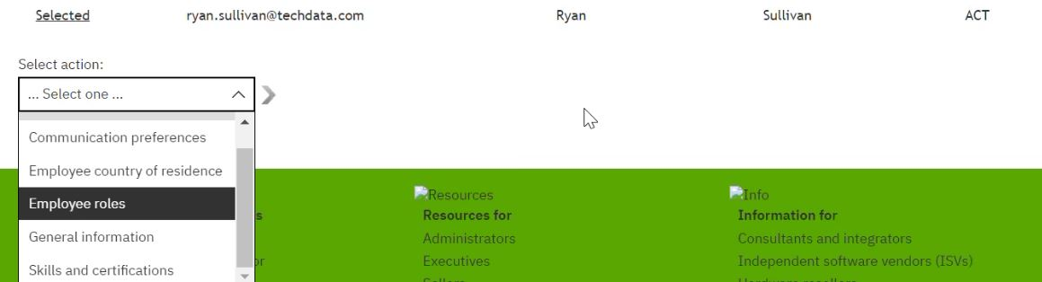
6. Click “Select” by the highlighted employee’s name.
7. On the drop down select “Employee roles” and click the arrow next to the drop down.
Notes:
IBM Partner Packages: IBM direct discounted demo packages. A group of like licenses that you can use for demo and training.
IBM PartnerWorld Competences: Can be used in leu of certs/badges

Slide 6
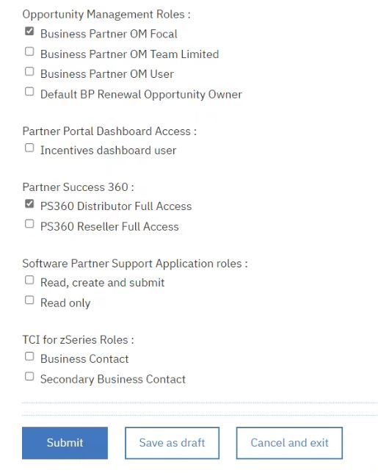
8. Scroll down to the “Opportunity Management Roles” section and check the box for “Business Partner OM Focal”.
9. Click “Submit” and you’re all set.
Please Note: The employee will be able to access the partner portal for deal registration 1 business day after this task has been completed.
Notes:
IBM Partner Packages: IBM direct discounted demo packages. A group of like licenses that you can use for demo and training.
IBM PartnerWorld Competences: Can be used in leu of certs/badges

