Slide 1
Windows 365 Link Microsoft Warranty & Protection Plans
Americas
April 2026

Slide 2
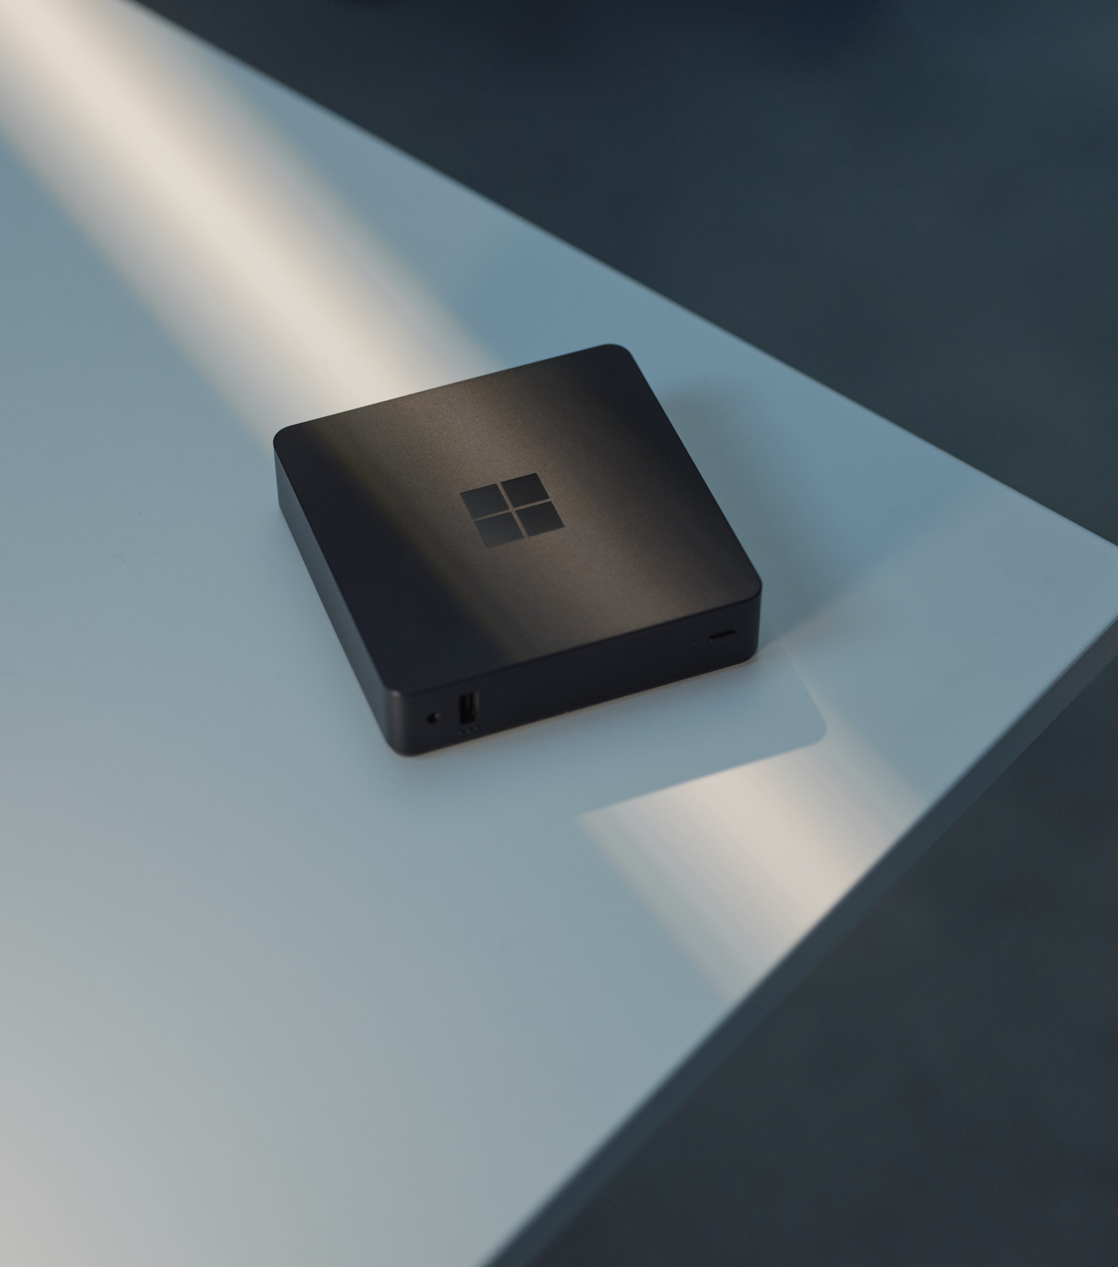
Microsoft Warranty and Protection Plans
Americas
Protection Plan Benefits
Warranty and Protection Plans
Disclaimers

Slide 3
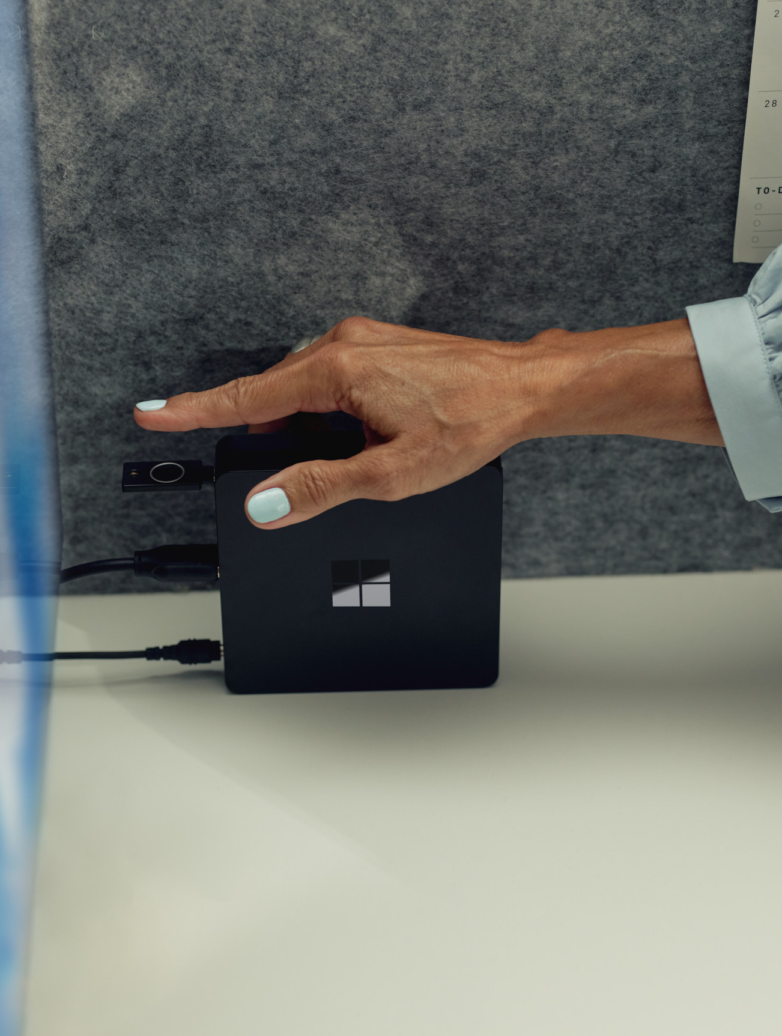
Investment protection
Windows 365 Link comes with a 1-year Microsoft Limited Hardware Warranty.* Customers who want to maximize and protect their investments beyond the warranty can opt to purchase one of the available Microsoft Protection Plans. The extended coverage protects their device investment and helps extend the use of Windows 365 Link and avoid unplanned expenses.
Warranty and Protection Plan benefits:
Customer-centric support for service and repair.
Ongoing access to Microsoft’s robust online support articles and communities.
Option for accidental damage protection – protection from drops, spills, and cracked screens.
* Without prejudice to any legal (statutory) rights to which you may be entitled under your local law, Microsoft Limited Hardware Warranty covers your device or replacement component from the date of original purchase from Microsoft or an authorized reseller. Exclusions and limitations apply. Please refer to Microsoft's Limited Hardware Warranty and Agreement.

Slide 4
Windows 365 Link Warranty & Protection Plans
United States, Canada
✓ For Extended Hardware Support (EHS), protection plan start date remains tied to Device Invoice Date. EHS coverage begins upon expiration of Microsoft’s Limited Hardware Warranty.
✓ For Compete for Business (CfB), protection plan start date begins on the Protection Plan Purchase Date.
Features | Microsoft Limited Hardware Warranty | Microsoft Extended Hardware Support (EHS) | Microsoft Complete for Business (CfB)
Coverage Availability – plan duration (varies by country) | 1 year | Up to 2, 3, or 4 years | Up to 2, 3, or 4 years
Prepaid return shipment – providing ease of shipping wherever you are to get you back up and running quickly | ✓ | ✓ | ✓
Technical support – contact Microsoft Support with your questions even after your warranty runs out (fees may apply). | ✓ | ✓ | ✓
Unlimited Mechanical breakdown – protecting your devices against unintended hardware defects and malfunctions. | ✓ | ✓ | ✓
In-Region Repair, or Standard Exchange | ✓ | ✓ | ✓
Accidental Damage – protection from drops or spills. |  |  | ✓
NOTES:
$0 deductible on commercial warranties and protection plans.
Standard Exchange is the expected replacement model if In-Region Repair is unavailable.
Warranty and Protection Plans vary by market. Please visit the Warranty and Protection Plan for Windows 365 Link page to see availability.
Resources:
Warranty and Protection Plan for Windows 365 Link
Warranty and Protection Plan Terms & Conditions

Slide 5

Warranty and Protection Plans Disclaimers
Without prejudice to any legal (statutory) rights to which you may be entitled under your local law, Microsoft’s Limited Hardware Warranty covers your device for one year from the date of original purchase from Microsoft or an authorized reseller. Restrictions apply. Please refer to Microsoft’s Limited Hardware Warranty and Agreement here.
Additional extended coverage for mechanical breakdown and accidental damage protection is available through the purchase of Microsoft protection plans. If the plan provides additional Mechanical Breakdown coverage, that coverage begins upon expiration of the manufacturer’s original warranty and continues for the remainder of the term shown on the Holder’s Proof of Purchase. Accidental damage protection begins immediately upon purchase. Restrictions apply. For all Protection Plans, please reference the terms and conditions for the limit of liability and the applicable exclusions of the Protection Plan.
Advanced Exchange is only available in supported markets. Restrictions apply. See warranty page for AES terms and conditions and list of supported markets.

