Slide 1
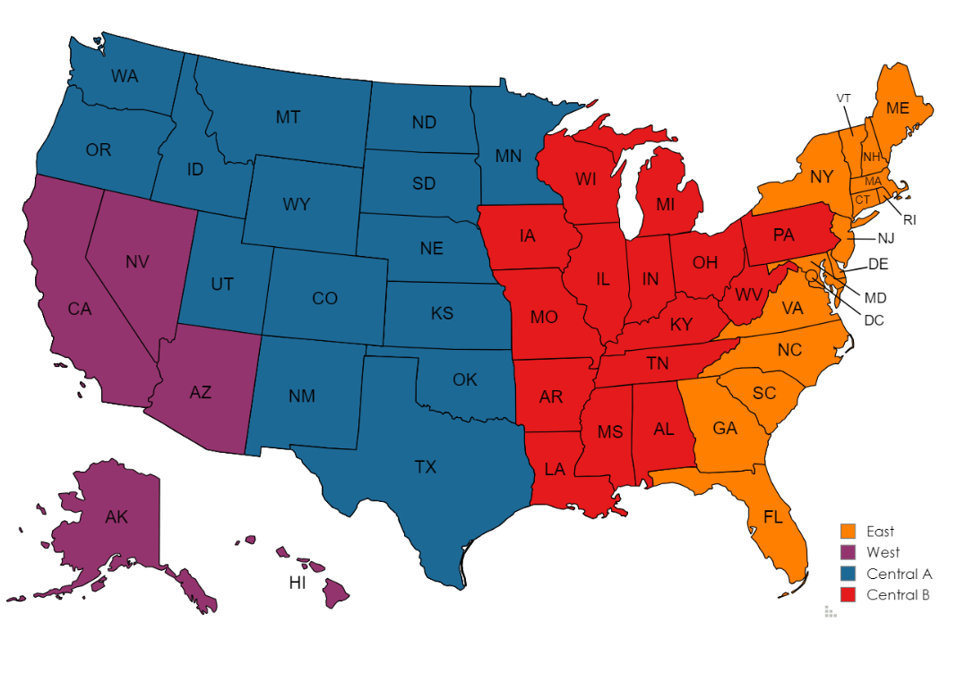
TD SYNNEX Cohesity Team
Leadership
Phillip Privett
Sr. Vice President, Vendor Solutions Phillip.Privett@tdsynnex.com
480-215-4381
Greg Krukonis
Sr. Director, Vendor Solutions
Gregory.Krukonis@tdsynnex.com
727-251-9613
Amy Bush
Sr. Manager, Vendor Solutions
Amelia.Bush@tdsynnex.com 303-248-0535
Michael Graham
Manager, Vendor Solutions
Michael.Graham@tdsynnex.com
480-936-2786
Warren Bond
Manager, Solution Architects
Warren.Bond@tdsynnex.com
(727) 510-5020
Maritza Marin
Manager, Vendor Marketing
Maritza.Marin@tdsynnex.com
(905) 286-6800
Inside Sales
April Kilpatrick – BDR I
April.Kilpatrick@tdsynnex.com
TBH (2) – BDR I
Strategic Business Management:
Chad Halfpop – SBM West
Chad.Halfpop@tdsynnex.com
Natalie Heath – SBM Central A
Natalie.Heath@tdsynnex.com
Christee Tedesco - SBM Central B
Christee.Tedesco@tdsynnex.com
Andrea Mattson – SBM East
Andrea.Mattson@tdsynnex.com
Sam Melant – SBM Nationals
Sam.Melant@tdsynnex.com
Cody Williams – SBM Federal / SLED
Cody.Williams@tdsynnex.com
Sales Operations – Quotes & Orders
Cohesity-Orders@tdsynnex.com
Cohesity-Quotes@tdsynnex.com
Lisa Johnson– Sales Operations Team Lead
Lisa.Johnson2@tdsynnex.com
9 additional team members – Quotes & orders
Marketing
Ella-Marie Brixey, Sr. Vendor Marketing Mgr
Ella-Marie.Brixey@tdsynnex.com
(210) 944-6159
Vendor Mgmt
Rhannon Hartz – SBM III
Rhannon.Hartz@tdsynnex.com
Victoria Everhart - VBM III
Victoria.Everhart@tdsynnex.com
Technical Resources
Kurt Waibel- Solutions Architect
Kurt.Waibel@tdsynnex.com
480-201-1254
Terrence Willis- Solutions Architect
Terrence.Willis@tdsynnex.com
703-283-7242
Specialty Sales
Jim Monaghan - Public Sector Specialist
Jim.Monaghan@tdsynnex.com
(781) 820-5428
LeighAnn Hranka - Field Account Executive, CDW
LeighAnn.Hranka@tdsynnex.com
(815) 520-5758

