Slide 1

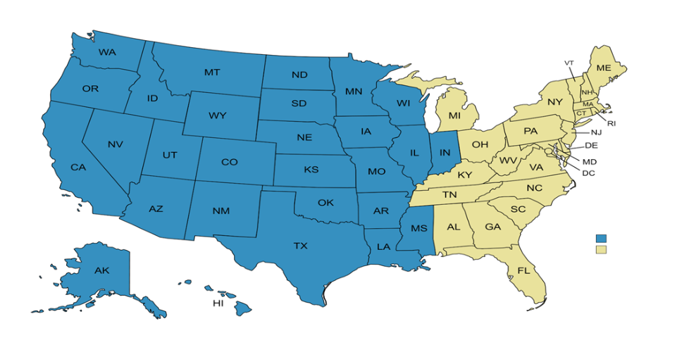
TD SYNNEX Extreme Team
Leadership
Mike Allers
Vice President, Security & Networking Mike.Allers@tdsynnex.com
John Maillis
Director, Vendor Teams
John.Maillis@tdsynnex.com
Thomas Will
Manager, Vendor Teams
Thomas.Will@tdsynnex.com
Charlie Will
Manager, Technical Design
Charlie.Will@tdsynnex.com
Al Lehocky
Manager, Field Solution Architects
Allbert.Lehocky@tdsynnex.com
Michelle Usher
Manager, Vendor Marketing
Michelle.Usher2@tdsynnex.com
Business Development Team
Team Pod Email Boxes:
Team East: ExtremeEast@tdsynnex.com
Team CenWest: ExtremeCenWest@tdsynnex.com
Team Majors: ExtremeMajors@tdsynnex.com
Team Majors, all Extreme DIAMOND Accounts
Not sure partner level? Ask any team!
Katelyn Steele – BDR Central West
ExtremeCenWest@tdsynnex.com
TBD – BDE Central West
Michael Meister - BDR East
ExtremeEast@tdsynnex.com
Mike Vitagliano – BDE East
Michael.Vitagliano@tdsynnex.com
Steven Zewicky – BDR Major Accounts
ExtremeMajors@tdsynnex.com
Mike Diamond – BDE Extreme CDW
Mike.Diamond@tdsynnex.com
Terry Smith – Extreme Public Sector BDR
Terry.Smith@tdsynnex.com
Thomas Stasney – Partner Enablement Manager
Thomas.Stasney@tdsynnex.com
CenWest
East
SALES FAQ’s
First level of engagement – ExtremePM@TDSYNNEX.com
SLAs
PM Team: Standard SLA: 4 Hours
Pod Boxes (Business Development: 4 Hours
Any Operational support: SPAs, DA Quote Status, Returns, Order Help – ExtremePM@TDSYNNEX.com
Any Business Development support: Buddy calls, Partner Onboarding, Extreme Partner Program Support, Extreme Vendor AE account mapping: Team Pod Email Boxes (top of box to the left).
Not sure where to go? Start with ExtremePM@tdsynnex.com to guide you.
Sales Operations – Quotes & Orders
ExtremePM@tdsynnex.com
Andrew Zimmerman – Operations Escalations
ExtremePM@tdsynnex.com
+11 additional team members – Quotes & orders
Technical Resources
Armaghan Afzal – Field Solutions Architect
Extremese-box@tdsynnex.com
Lucas Bendus – Systems Engineer
Extremese-box@tdsynnex.com

