Slide 1



Navigating the PC Market:
A Comprehensive Guide
 | Good Modern PC | Better AI PC | Best Copilot+ PC
Platform | Intel® Core™ Processors with Windows 11 Pro. | Intel® Core™ Ultra processors with an NPU, increased battery life and Windows 11 Pro. | Intel® Core™ Ultra processors with Windows 11 Pro, offering all-day battery life and top performance in a thin, light form factor.
Features | Fast startup, enhanced security with the power to run standard office applications cost effectively. | Ability to run and develop local AI applications. Enhanced AI features in M365, Copilot and most optimized applications. | Enhanced AI PC capabilities with increased NPU, GPU, and CPU performance, and the ability to run all Copilot+ features and applications.

Slide 2


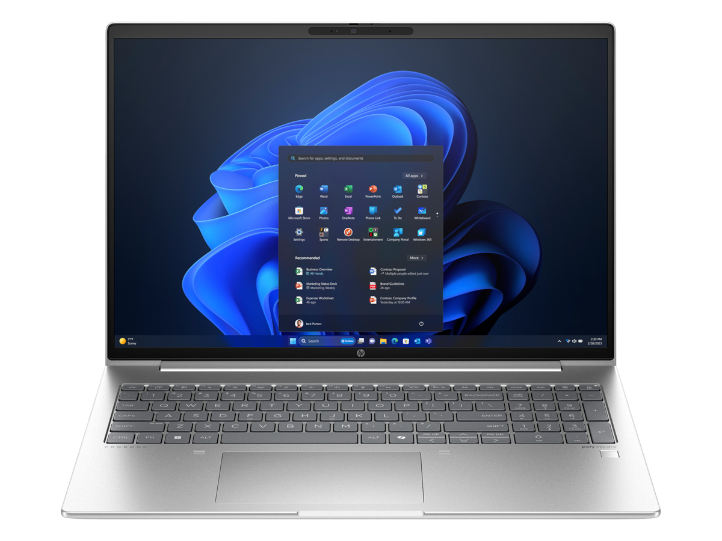
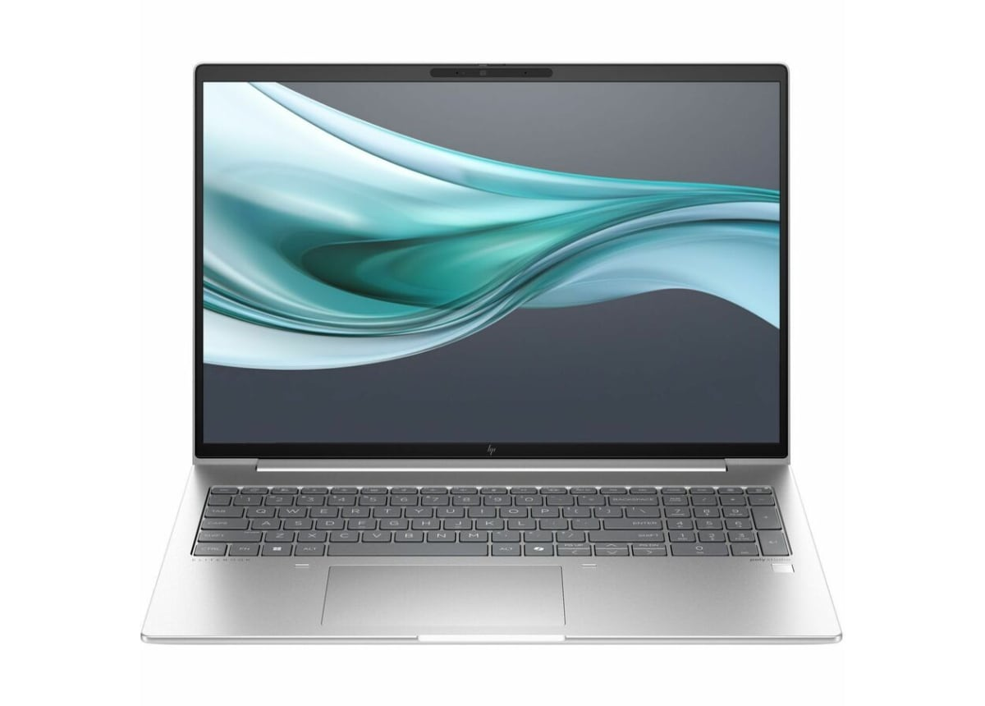
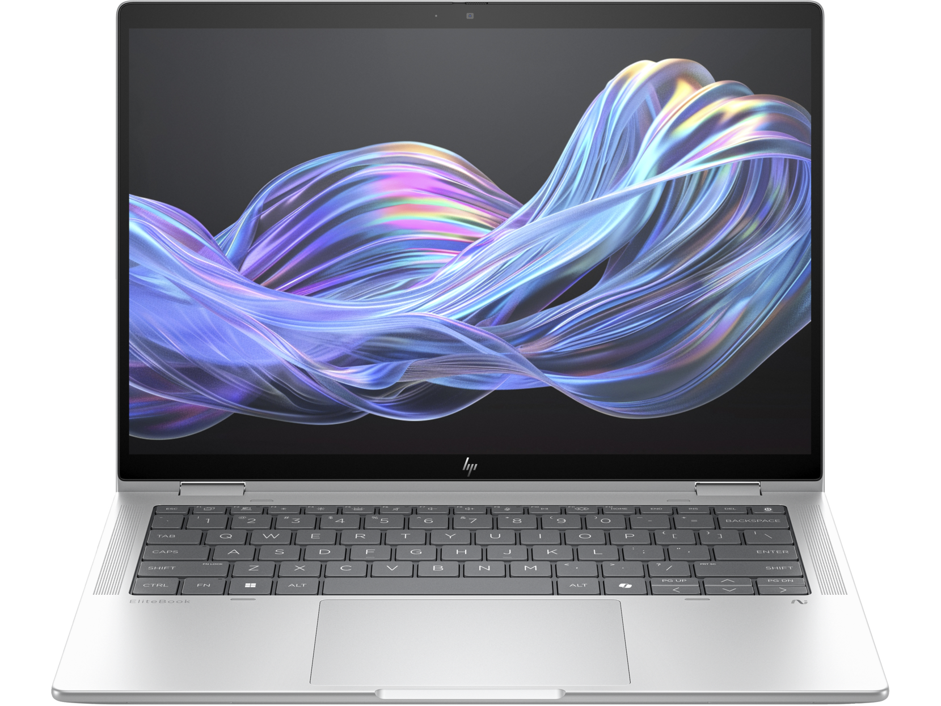


Featured Products
Good Better Best
AI PC AI PC Copilot+ PC
HP ProBook 460 G11
A1LD5UT#ABA / SKU# 9569243
HP EliteBook 660 G11
A6UC4UT#ABA / SKU# 9706527
HP EliteBook X Flip G1i
B86CGUT#ABA / SKU# 14461171
Intel® Core™ Ultra 5
LED Anti-Glare
16 GB of DDR5 RAM
256 GB SSD
Intel Wi-Fi 6e
Windows 11 Professional
Intel® Core™ Ultra 7 vPro® Edition
LED Anti-Glare
16 GB of DDR5 RAM
512 GB SSD
Intel Wi-Fi 6e
Windows 11 Professional
Intel® Core™ Ultra 7 (Series 2) vPro®/EVO™ Edition
Intel® ARC™ Graphics
Copilot+ Certified
LED Anti-Glare / Touchscreen
16 GB of DDR5 RAM
512 GB SSD
Intel Wi-Fi 7
Windows 11 Professional
Click on any highlighted sku to see pricing in ECExpress

Slide 3
Top Selling Skus
Intel vPro® can help protect your business with the best security and remote management capabilities. Learn more here.
Good / AI PC / Core™ Ultra 5 Better / AI PC / Core™ Ultra 7 Best / Copilot+ PC
Device | ECExpress | IPA Points | vPro
ProBook 460 | A1LD7UT#ABA | 25
ProBook 460 | A6VH3UT#ABA | 25
ZBook Firefly 14 | A6TE1UT#ABA | 25
EliteBook 860 | A1LD3UT#ABA | 25
ProBook 460 | A1LC2UT#ABA | 25
EliteBook 860 | A6TD9UT#ABA | 25 | Yes
ZBook Firefly 14 | A6UJ7UT#ABA | 25 | Yes
EliteBook 840 | A6SZ8UT#ABA | 25 | Yes
EliteBook 640 | A6TN7UT#ABA | 25 | Yes
EliteBook 840 | A6SZ3UT#ABA | 25 | Yes
Device | ECExpress | IPA Points | vPro
ProBook 460 | A1LH5UT#ABA | 35
ProBook 440 | A1LC3UT#ABA | 35
ZBook Firefly 16 | A6UF5UT#ABA | 35
EliteBook 840 | A6SY8UT#ABA | 35
EliteBook 660 | A6UC8UT#ABA | 35
ZBook Firefly 14 | A6UK7UT#ABA | 35 | Yes
ZBook Firefly 14 | A6VJ5UT#ABA | 35 | Yes
EliteBook 640 | A6TP0UT#ABA | 35 | Yes
EliteBook 860 | A6TE2UT#ABA | 35 | Yes
ZBook Firefly 14 | A6UK9UT#ABA | 35 | Yes
Device | ECExpress | IPA Points | vPro
EliteBook X Flip G1i | B8GE7UT#ABA | 40 | Yes
EliteBook X Flip G1i | B85MSUT#ABA | 40 | Yes
EliteBook X Flip G1i | B85MWUT#ABA | 40 | Yes
EliteBook X Flip G1i | B8GE6UT#ABA | 30 | Yes

Slide 4
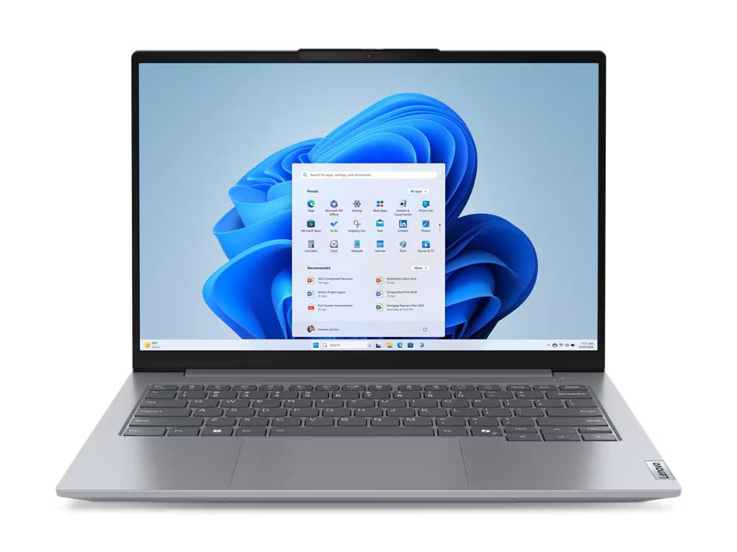
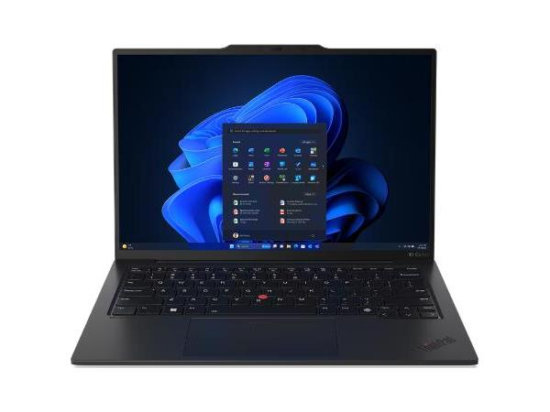
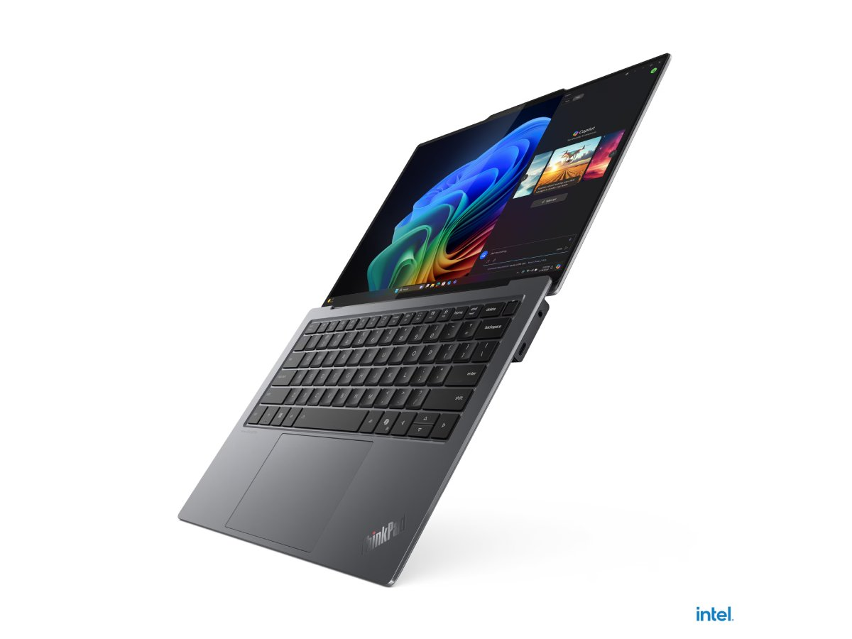

Featured Products
Good Better Best
Modern PC AI PC Copilot+ PC
Lenovo ThinkPad E14 G5
21JK0052US / SKU# 7310355
Lenovo ThinkPad X1 Carbon G12
21KC00A8US / SKU# 9504897
Lenovo ThinkPad X9 14 G1
21QA0006US / SKU# 14454337
Intel® Core™ i5
LCD Anti-Glare
16 GB of DDR4 RAM
512 GB SSD
Intel Wi-Fi 6
Windows 11 Professional
Intel® Core™ Ultra 7 / EVO™ Edition
LCD Anti-Glare
16 GB of DDR5 RAM
512 GB SSD
Intel Wi-Fi 6e
Windows 11 Professional
Intel® Core™ Ultra 7 (Series 2) vPro®/EVO™ Edition
Intel ARC™ Graphics
Copilot+ Certified
OLED Anti-Glare
32 GB of DDR5 RAM
1 TB SSD
Intel Wi-Fi 7
Windows 11 Professional
Click on any highlighted sku to see pricing in ECExpress

Slide 5
Top Selling Skus
Intel vPro® can help protect your business with the best security and remote management capabilities. Learn more here.
Good / Modern PC Better / AI PC Best / Copilot+ PC
Device | ECExpress | IPA Points | vPro
ThinkPad E16 i5 | 21JN003YUS
ThinkPad E16 i5 | 21JN0040US
ThinkBook 16 G6 i5 | 21KH000AUS
ThinkPad E16 i7 | 21JN0073US
ThinkPad E1 i5 | 21JK0084US
ThinkPad E14 i7 | 21JK0053US
ThinkPad E16 i7 | 21JN003XUS
ThinkBook 16 i7 | 21KH000FUS
V15 G4 IRU i3 | 83A10028US
ThinkPad P16 i9 | 21FA002NUS |  | Yes
Device | ECExpress | IPA Points | vPro
ThinkPad T16 | 21MN005MUS | 25
ThinkPad T1 | 21ML0089US | 35
ThinkBook 16 | 21MS0067US | 25
ThinkPad T16 | 21MN00AHUS | 35
ThinkPad P14s | 21G2001VUS | 35
ThinkPad X1 Carbon | 21KC00B1US | 35 | Yes
ThinkPad X13 | 21LU0066US | 35 | Yes
ThinkPad P16s | 21KS0043US | 35 | Yes
ThinkPad P14s | 21G2001PUS | 35 | Yes
ThinkPad T14 | 21ML008NUS | 35 | Yes
Device | ECExpress | IPA Points | vPro
ThinkPad X9-14 | 21QA0004US | 30
ThinkPad X9-15 | 21Q60026US | 20
ThinkPad X9-15 | 21Q60027US | 30
ThinkPad X9-14 | 21QA0005US | 30
ThinkPad X9-14 | 21QA0000US | 20
ThinkPad X1 Carbon G13 | 21NS0014US | 30
ThinkPad X1 Carbon G13 | 21Q60025US | 40 | Yes

Slide 6
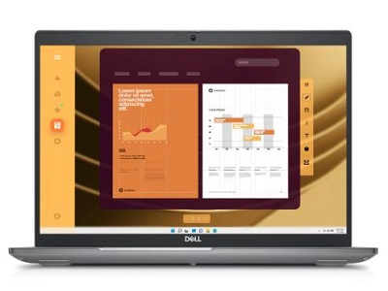
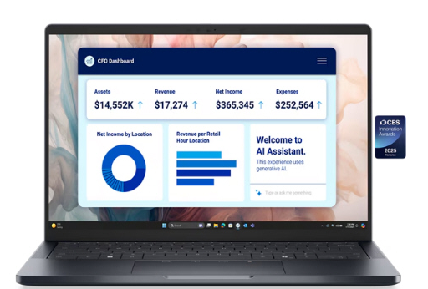
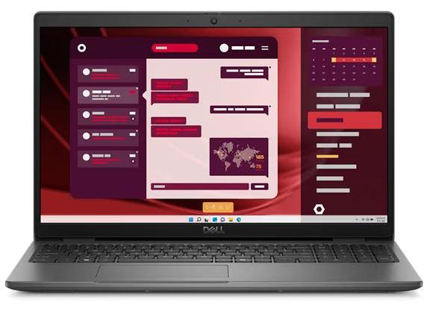

Featured Products
Good Better Best
Modern PC AI PC Copilot+ PC
Dell Latitude 3550
XF12R / SKU# 9569996
Dell Latitude 5550
VFR3R / SKU# 9506563
Dell Pro 13 Premium
JWP67 / SKU# 14469103
Intel® Core™ i7
LCD Anti-Glare
16 GB of DDR5 RAM
256 GB SSD
Intel Wi-Fi 6e
Windows 11 Professional
Intel® Core™ Ultra 7
LCD Anti-Glare
16 GB of DDR5 RAM
512 GB SSD
Intel Wi-Fi 6e
Windows 11 Professional
Intel® Core™ Ultra 7 (Series 2) vPro®/EVO™ Edition
Intel® ARC™ Graphics
Copilot+ Certified
LCD Anti-Glare
32 GB of DDR5 RAM
512 GB SSD
Intel Wi-Fi 7
Windows 11 Professional
Click on any highlighted sku to see pricing in ECExpress

Slide 7
Top Selling Skus
Intel vPro® can help protect your business with the best security and remote management capabilities. Learn more here.
Good / Modern PC Better / AI PC Best / Copilot+ PC
Device | ECExpress | IPA Points | vPro
Latitude 3550 i5 | F51GH
Latitude 3450 i5 | T7NMH
Latitude 3550 i5 | GCW0D
Latitude 3550 i7 | 7CCG9
Latitude 3450 i5 | 6CT3N
Precision 7680 i9 | JCJH4 |  | Yes
Mobile Precision i9 | PMTF1 |  | Yes
Mobile Precision i7 | 091RP |  | Yes
Mobile Precision i7 | T2M08 |  | Yes
Mobile Precision i9 | 3GCR6 |  | Yes
Device | ECExpress | IPA Points | vPro
Latitude 5550 | CN62X | 25
Latitude 5450 | 3H85P | 25
Latitude 5450 | HK9VF | 35
Latitude 5550 | K3CP1 | 35
Latitude 5550 | CT1GY | 25
Latitude 7450 | VPWD0 | 25 | Yes
Latitude 7450 | 7M9WG | 35 | Yes
Latitude 5450 | N2Y94 | 35 | Yes
Latitude 5550 | F6W06 | 35 | Yes
Latitude 5450 | YRT5D | 35 | Yes
Device | ECExpress | IPA Points | vPro
XPS 13 (9350) | YNK15 | 30
XPS 13 (9350) | F487J | 30
Pro 14 Plus | 2YM1D | 30 | Yes
Pro 14 Premium | FK5CT | 40 | Yes
Pro 14 Plus | V8Y3R | 30 | Yes
Pro 14 Plus | 437NW | 40 | Yes
Pro 16 Plus | GCY30 | 40 | Yes

