Slide 1

NA Go-To-Market Playbook Channel Initiatives- Conversation Cards
Q3FY23

Slide 2




Fast Facts
Supports collaboration, communication, productivity across rooms of all sizes no matter where you are
The way we work is changing
60% of employees prefer to work from home at least half the time
82% of respondents reported that investing in a “cohesive collaboration solution” allowed their organization to stay competitive during the pandemic
84% of IT decision makers are looking at a Hybrid work model
Smart Collab Conversation Card
Elevator Pitch
Smart Collab makes hybrid work, work; Fueling innovation in a hybrid world
Collaboration is an integral and essential part of organizational success. Employees need the flexibility to collaborate anytime and anywhere, the physical space to connect with colleagues in person, and the technology to enable it all. Lenovo can help you promote work life balance with your most important resources – your employees. Our solutions are easy to deploy, manage (even remotely), but most importantly it’s easy to use one button operation will keep your team in the game!
Customer Type
Why Lenovo
Discovery Questions/Door Openers
Facilities Management/Real Estate: usually owns the conference room and therefore has immense power in the control of hardware decisions
Seek solutions that can meet the needs of any size conference room and collaboration space. Prefer products to be about compatibility with existing in-room controllers.
Hub is physically secure and easily hidden.
IT Department: key decision maker on the collaboration platform.
Smart Collab solutions are turnkey and globally scalable; they are easy to deploy and manage
Remote management and diagnostics are made easy through the ThinkSmart Cloud portal
End-User: KEY group to find – they are often the decision maker
Everywhere -Promotes work life balance, systems are easy to manage and monitor, easy deployment
Everyone - Easy for customers to use, breaks down barriers between executives & employees, overcomes proximity bias
Every time - Limits need for customer support calls, Maximizes up time, offers interoperability with existing in-room controls
Lenovo compute has been the brains in the legacy AV solutions (Poly, Logi, Crestron). Positioned to take advantage of our economies of scale and provide holistic, turnkey solutions.
Smart Collab provides:
Support for the collaboration platform of your choice
Remote manageability
Security against evolving threats (ThinkShield) Flexible support options
Saved time with one point of contact for purchase, services, and global support (Premier Support)
Great versatility for any room size
What to listen for:
Meetings are starting late
Frustrations around complexity of design/setup, cost of parts, ease of use, no established companywide standards, poor audio/video etc.
Challenges with remote collaboration
Lack of remote participant equity in meetings
Discovery Questions:
What is your return to office strategy?
If pursuing a hybrid approach, how will they extend that Hybrid work experience to your conference rooms (supporting Teams or Zoom or Google platform)?
How are the meeting rooms currently equipped?
Are they 100% video enabled?
Adding Focus Rooms / Huddle Spaces, smaller personal reservable spaces?
What’s the ease of use, (ie one-click join, laptop driven)?
How will hybrid workers choose workspace for in-office days?
Is your org considering or deploying other platforms (i.e. M365, Workspace, etc.)?
In a perfect world, what would your meeting spaces look like? What would the technology be able to do?
What pain points are you experiencing that you would like your conferencing technology to address?
Hybrid work transition, what worked well? Lessons learned?
2022 Lenovo Internal. All rights reserved.

Slide 3

Smart Collab Mini Campaign
Product Overview – brief blurb and video link
Link to Richard LeBennett product overview video
Link to Lenovo Product guide
Link to Collab-portfolio guide 2
Link to ThinkSmart Customer Presentation_Channel
Smart Collab Micro-Credential
Specs
Link to ThinkSmart Portfolio One Pager
Link to ThinkSmart Core Room Kits Battle Card
Link to ThinkSmart Core Kits with Microsoft Teams Solution Guide
Link to Google Meet Series Kits Solution Guide
Link to Battlecard_ThinkSmart_Cam
Link to Battlecard_ThinkSmart_Core
Link to Battlecard_ThinkSmart_Bar
Case studies
Link to Softbank Customer Story
Link to Topdanmark Customer Story
Link to Michelin Customer Story
2022 Lenovo Internal. All rights reserved.

Slide 4

ThinkPad Conversation Card
Fast Facts
MIL-STD standard tested*
Portfolio-wide EPEAT Gold certification reflecting Lenovo's overall efforts to adhere to the guidelines of environmentally-friendly attributes as defined by the Global Electronics Council.
Even an Excel power user running large complex spreadsheets could have improved user experience with a Workstation
Elevator Pitch
The answer to the hybrid work environment powering human connections with portability and performance.
Customer Type
Why Lenovo
Discovery Questions/Door Openers
Engineering Professionals
Software Development and Analytics
Creative Professionals
The ThinkPad family comes with available 4K UHD displays that feature built in factory color calibration (FCC) and Dolby Vision HDR. The exceptional color accuracy enables artists, designers, and architects to create their best work.
Education (Creative Arts, Engineering, Computer Science)
Industry leading reliability
Lenovo diagnostics
Lenovo Performance tuner
Security has always been part of our strategy as an industry leading vendor. Our ThinkPad heritage fosters many industry firsts, including:
The first to put a security chip in a PC
The first put a finger reader in a PC
The first to do BIOS based security
ISV-certified with the most popular professional applications to accelerate business results
Highest performing, lowest latency, most scalable remote workstation experience allowing companies to access their workstation investments anytime, anywhere.
What to listen for:
Computer freezes
Operations slow to open or load
Takes a while to run a job
Sluggish performance
End user frustration and systems outgrowing usefulness
Discovery Questions:
How are machines currently performing?
How are machines currently used/what needs would need to be fulfilled?
What kind of users will be using the machine and what is their workload?
Do you have anyone who is a power user of a specific application?
Have you added applications that require additional performance?
Is your laptop struggling to handle your everyday workload?
Have you experienced lag or slow performance when using your frequent applications?
Have you been wondering if there’s anything more powerful out there that can perform your tasks faster?
2022 Lenovo Internal. All rights reserved.

Slide 5
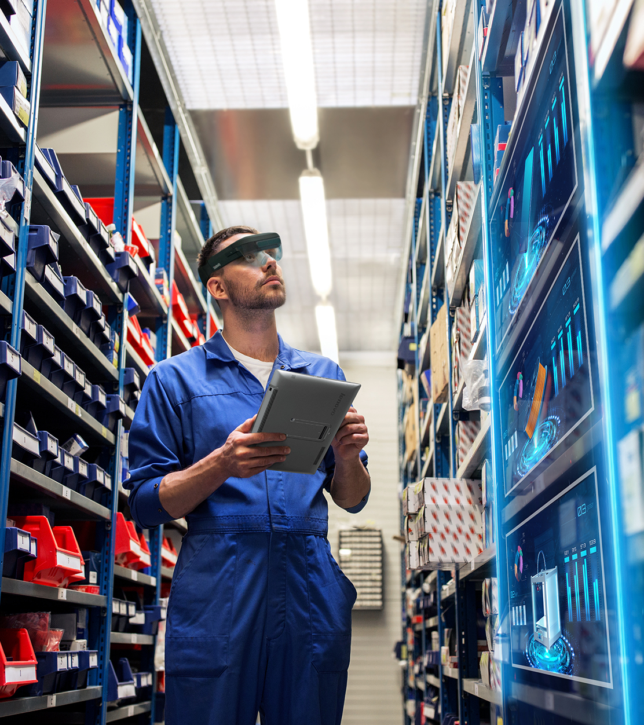
ThinkPad Mini Campaign
Link to ThinkPad Portfolio and Sustainability video
Link to Lenovo ThinkPad 16 video
Link to One Pagers (product specs) below
P14s Gen 3
P16s i Gen 1 Intel
P16s Gen 1 AMD
P15v i Gen 3
P1 Gen 5
P16 Gen 1
Testimonials/Examples:
Link to Marlon Nuñez
Link to Dreamworks Bad Guys
Link to Bad Flamingos Studio
2022 Lenovo Internal. All rights reserved.

Slide 6

Thinkstation Conversation Card
Fast Facts
#1 most reliable WorkStation
#1 fastest growing WorkStation manufacturer
Lenovo WorkStations are available in over 150 countries
ThinkStation P Series results show up to 60% cooler temperatures than other workstation manufacturers
Elevator Pitch
Lenovo believes in the creative power of passionate people. That power is amplified with the right tools. Tailored to the needs of specific users, we combine hardware, software, and expertise to help unleash the user’s potential. Thoughtfully designed hardware allows for unparalleled performance, usability, and reliability. Software tools are built to optimize performance and increase productivity. A team of workstation experts provide customers with unmatched expertise and support.
Customer Type
Why Lenovo
Discovery Questions/Door Openers
Architectural, Engineering, Construction, Product development
Lead Architect, designer, or engineer, Architecture Principal / C-staff, Decision makers BIM, CAD and IT Directors, Visualization Specialists
Media and Entertainment
CTO- Senior executive in charge of managing the technological requirements of the studio, IT Manager- Parameters and security for device requirements, Technical Director- Senior artist
Oil and Gas
IT / Procurement: Geology, Geophysics, Reservoir Engineering, Petro Physics, Tech Logging, Finance, Mechanical Engineering
Finance
IT Standards (Responsible for HW Certification and Governance), Trade Floor Technology, Real Estate, Wealth Management
Data Science
C-Suite, Digital Transformation User Roles, IT leadership, Research and development, Business Analytics
Lenovo is the fastest growing workstation provider in the industry. Our workstations are also the most reliable in the industry (2019 TBR reliability study). Reliability means saved time and money for customers
Lenovo has a unique team of technical experts who work directly with customers to help make sure customers are getting the most of their workstation investment.
Our portfolio is also designed to empower emerging technologies. AR/VR and Artificial Intelligence are becoming business requirements and are necessary to keep business competitive. The Lenovo workstation portfolio is full of machines that will help a customer start implementing AI in their business
What to listen for:
We have a miss-match between our software/workflow and hardware
We are planning to refresh our hardware/software soon
We are seeing increased complexity and size within our BIM, CAD, CAE models (Architectural, Engineering, Construction, Product development)
Discovery Questions:
What is your workflow? What solutions and applications do you use at each stage?
What are your workflow pain points?
Why aren’t Lenovo Workstations part of your solution set today?
Do you see infrastructure evolving over the next 3-5 years?
When was your last workstation refresh?
What expectations do you have for your workstation vendor? (media/entertainment)
How are you embracing AI within your organization today? (Data Science)
Are you facing any specific AI workflow challenges? (Data Science)
2022 Lenovo Internal. All rights reserved.

Slide 7
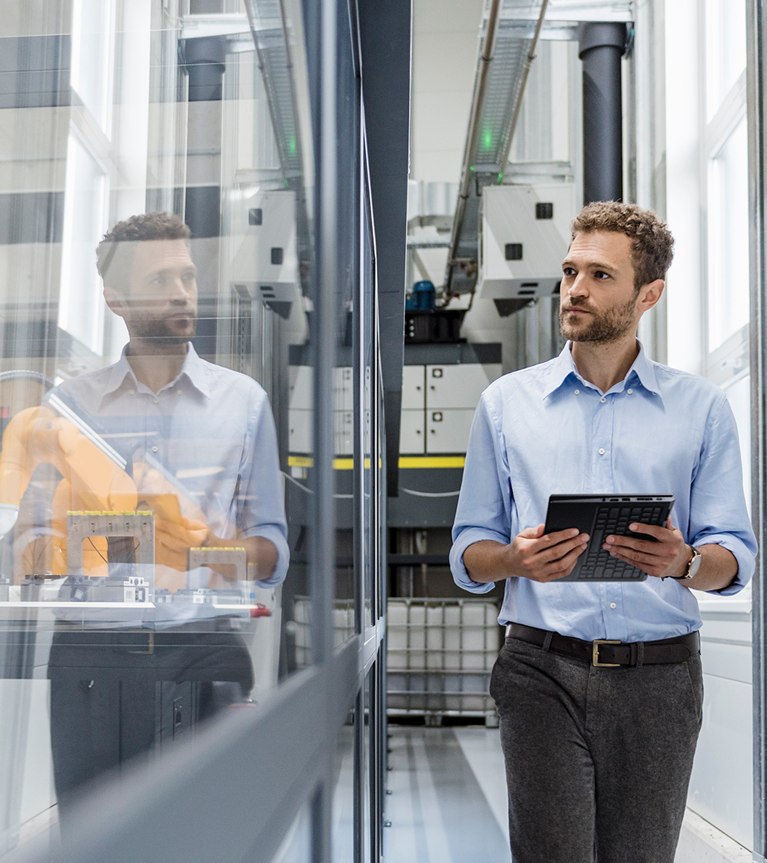
ThinkStation Mini Campaign
Product Overview – brief blurb and video link
Link to Lenovo Product guide
Link to Lenovo Workstation Virtual Briefing Center
Link to Lenovo Workstation Sales Presentation
Link to ThinkStation P620 Product Tour Video
Link to Dream works Bad Guys
Link to Competitive Battlecard (Internal Use Only)
Link to Competitive PowerPoint (Internal Use Only)
Specs
Link to ThinkStation P360 Tiny Datasheet (External)
Link to ThinkStation P360 Ultra Datasheet (External)
Link to ThinkStation P620 PDF (External)
Link to P series Workstations Customer Briefing (Internal Use Only)
Case studies
Link to ThinkStation P620 Customer Disclosure (see slides 43-46)
Link to Predator Cycling Customer Story (P620)
Link to ThinkStation Customer Testimonials
Dreamworks
Aston Martin
Gnomon
2022 Lenovo Internal. All rights reserved.

Slide 8




ThinkSystem Storage Conversation Card
Fast Facts
Lenovo is the price/performance leader in the industry
The Lenovo DE Series of storage arrays is based upon a hardware and software architecture that has been deployed for many years, and has proven to deliver up to 99.9999% availability
Lenovo ThinkSystem servers consistently achieve the lowest down time
Lenovo is the fastest growing All Flash vendor
Lenovo is the 1st to market with End to End NVMe-oF
Lenovo is the Fastest growing WW storage vendor
Elevator Pitch
Transform your IT to gain value in a data driven world
Data growth mandates a digital transformation. It’s estimated that there will be 30 billion smart devices connected to the internet by 2025 - all collecting, analyzing or sharing data. The challenge will be how to manage data to maximize the value. You will need simplified management, fast and efficient data storage, and straightforward execution. Data management is no longer just limited to the data center, it is integrated on premises and within hybrid clouds.
Lenovo offers several storage options to help with data collection and data management. This includes data protection:
Data encryption - Protect your data on-premises, in flight, and in the cloud with both hardware and software-level encryption capabilities
Data replication - Synchronous replication for rapid, transparent application failover, and asynchronous replication for granular backup
Data restoration - Rapidly remediate ransomware/ malware threats utilizing integrated and partner real-time ransomware detection
Customer Type
Why Lenovo
Discovery Questions/Door Openers
DE Series
High-performance databases
Web and security applications
Data analytics
Video Surveillance
Backup and Disaster Recovery
Technical Computing
Big Data Analytics
“What appealed to us most was the inherent flexibility of Lenovo ThinkSystem servers. Compared to other vendors, Lenovo offers greater scalability and value. We were confident that the Lenovo solution would ensure consistently reliable performance across our multi-cloud infrastructure. We were also very impressed with Lenovo’s storage offering. Not only does the ThinkSystem DM7100F all-flash array deliver top performance, it’s also simple to scale and easy to administer.” – DETASAD CEO & President
DE Series
Do you have databases which require high performance→ Offers high performance ideal for big data, technical computing or OTP databases.
You have a HCI based environment today, how are you backing up your clusters?→Snapshots on a HCI cluster won’t sufficiently protect your data- DE Series storage arrays for external backup & archive provides an extra layer of protection
Do you have large data-lakes that contain large amounts of meta-data?→ Range of options available so can use the higher-performance & capacity arrays for main data, and a smaller DE system for meta-data storage.
How are you addressing your general backup & archive environment today?→ Lenovo has partnered with leading software vendors (ex:Veeam) to deliver optimized solutions using the DE Series of hybrid arrays for reliable, cost-effective backup.
DE Series Provides:
High-performance Block storage which gives fast access to data and rapid response from applications.
A wide range of drive, chassis, and connectivity options, allowing a large amount of flexibility
Features to protect and secure customer data
DM Series
Enterprise Applications
Consolidation and Virtualization
Hybrid Cloud
Virtualization
Artificial Intelligence and Big Data Analytics
OLTP
DevOps
DM Series Provides:
The DM Series offers a superior unified data management suite providing the capability to manage Block, File and Object data
Support for latest NVMe Technology: Acceleration of read-centric workloads with the high-speed, low-latency onboard NVMe SSD caching
Comprehensive Storage Features: Includes quality of service, compression, deduplication, encryption, disk-based backup, quick data recovery, and asynchronous mirroring​
DM Series
Does your organization have the ability to meet changing business requirement→ delivers a data management solution that provides the agility, scale, protection and operating efficiency
Can you respond quickly to business changes on premises or in the cloud? → provides a foundation that seamlessly connects different data management environments across disparate clouds into a cohesive, integrated whole
Is any of your environment virtualized? If so, how much and what is virtualized?→Data efficiency technologies for de-duplication, compression & Snapshots are perfect complements to virtualized workloads, reducing the amount of physical storage required to store VMs and VDI instances
What cloud providers do you use now, or plan to use in the future?→Allows tiering to the Cloud with multiple popular Cloud vendors such as Amazon & Microsoft, as well as tiering to private clouds and facilitates data mobility between data centers
Lenovo Smart Data Management
Efficient – Unique solutions to manage the growing diversity and quantity of data (Versatile, flexible, simple)
End-to-end – Lenovo solutions and managed support ensures expert consistent support across the world (remote deployment, data migration, premiere support)
Secure – secure data management with Lenovo solutions
2022 Lenovo Internal. All rights reserved.

Slide 9

ThinkSystem Storage Mini Campaign
Product Overview
Link to Choose Your Storage Solution (Internal Only)
Link to DM Series All-Flash Storage 3D Tour
Link to DM Series Hybrid Storage 3D Tour
Link to DE Series All-Flash Storage 3D Tour
Link to DE Series Hybrid Storage 3D Tour
Lenovo Storage Central
Specs
Link to Storage Guidebook
Case studies
Link to St. Johns Customer Story (ThinkSystem DE Series)
Link to Les Portes JPR Inc. (ThinkSystem DE Series)
Link to Petroleum Geo Services (ThinkSystem DM Series)
2022 Lenovo Internal. All rights reserved.

Slide 10

ThinkEdge Conversation Card
Fast Facts
By 2025 55.6% of all data will come from IoT Devices.
Around 10% of enterprise-generated data is created and processed outside a traditional centralized data center or cloud.
Built to face the most hostile of environments, ThinkEdge SE30 has a thermal range of, -20-60C and MIL SPEC tested to withstand life on the Edge - whatever that looks like.
Elevator Pitch
Security is not just something to consider once data has been created. Security should start with the design and production of any data handling device.
Today, you need computing resources, and therefore servers, almost everywhere—not just in the data center, but remotely as well. However, for performance reasons, your remote data-generating devices must be close to computing and storage resources. Hence the Lenovo ThinkEdge SE350 Profolio. It’s small footprint and power efficiency allow for reliable server-class performance at many Edge locations
The world is more connected than ever, and most data is now being generated outside of the data center. In fact, Gartner predicts that by 2025, this will grow to 75% of all enterprise-generated data. Lenovo is here to help you speed things up by defining your Edge Computing and IoT strategy and bringing compute capabilities wherever you need them. We also bring AI to the edge for faster processing with edge-optimized solutions that use high-performance GPUs, powerful Intel® Xeon® CPUs and your choice of integrated storage and data management
Customer Type
Why Lenovo
Discovery Questions/Door Openers
Small-to-medium businesses
Distributed enterprises
Retail, Hospitality & Transportation
Manufacturing
Edge computing (IoT, AI, machine learning)
Video security
Inventory management
Telecommunications
Smart cities/smart campuses
Branch offices
Building control
Lenovo servers are rugged and secure with physical tamper-proofing, data encryption, and the ability to withstand conditions of all kinds. No matter what you need, we’ll find the right solution for you.
Lenovo is able to help your infrastructure in all areas: Durable , Secure, Remote Management, Connected, Configurable Hardware
Lenovo delivers industry-leading, scalable end-to-end Storage, and Data Management Solutions that help you:
Accelerate application performance to deliver faster results.
Simplify data management across hybrid, multi-cloud environments and workloads.
Optimize data protection and management to reduce costs and increase ROI.
Edge is a construct designed to describe any data processing & data delivery that happens outside of the Customer's traditional (on-prem or cloud) datacenter infrastructure
Information availability is another challenging issue for users at the Edge, who require insight into their operations at all times to ensure they are making the right decisions. The ThinkEdge Portfolio is designed to provide several connectivity options with wired and secure wireless Wi-Fi and LTE connection ability. This purpose-built compact server is reliable for a wide variety of Edge and IoT workloads.
What to listen for:
Type of Work – Developers, Admins, Engineering, Architecture, Design, Applications – running in a remote datacenter, VDI, Data- live in Datacenter, move lots of Data (big files/lots of files) around and causes user experience issues.
Lots of manual processes; Struggling with lots of different tools and home – grown scripts
Buying laptops to stand up VDI; not sure how will enable backup O365 /user data
Backing up data to the cloud; securing data in the datacenter
Edge AI, Automation of task in factories, restaurant, etc.
Hybrid Cloud Deployments
Video security, CCTV analytics
Spend time on many manual processes; lots of different interfaces / applications to manage IT; would rather have my teams focus on other things; struggling with technical debt
Discovery Questions:
What type of work do the users of these devices do, and where do the applications and data they use live?
How are you automating the rollout of new end-user and back-end strategy?
What part of these systems play in your business continuity strategy?
Are any of these systems using applications that are delivered by in-house IT?
How are you managing the security of the data being used by your employees?
How much time is your team taking managing internal IT Products and services?
2022 Lenovo Internal. All rights reserved.

Slide 11

SE350 & EDGE Mini Campaign
Link to Edge to Cloud Slide
Link SE350 Product Information
Link to Slide UseCase & workloads for edge
Link to Video “Old World Powered by the New” from Lenovo and 3rd Gen Intel® Xeon® Scalable processors.
Link to Surrey Country Council PDF for Case Study
Link to Configuration Slide for Q2 Playbook
Link to ThinkEdge Data Sheet PDF
Link to ThinkEdge Analyst PDF
Link to ThinkEdge Insights Infographic V2 PDF
2022 Lenovo Internal. All rights reserved.

Slide 12

One Lenovo Conversation Card
Fast Facts
Industry Leading Devices
Empower users with the right digital tools for their job
End user Experience
Make IT more efficient and deliver the right collaboration tools
Intelligent Solutions
Solving challenges through emerging technologies
Elevator Pitch
Everything’s connected. Successful digital transformations start with your people, processes and data…and encompass your IT stack…from endpoints to applications…from infrastructure to information
From Small Businesses to Large Enterprises, the global market landscape is moving to everything-as-a-service purchasing models. Lenovo is set up to meet customers’ needs in this current market by providing a portfolio that reflects the entirety of customers’ needs, and by ensuring that customers will be serviced with everything from hardware, to software, to data center, to services, and beyond.
Customer Type
Why Lenovo
Discovery Questions/Door Openers
Smarter Technology for all businesses
Industry-Leading Devices
Empower Users with the Right Digital Tools for their job
Traditional form factors with Smart Technology
High-performance workstation and Server solutions
Industry leading, cutting-edge form factors
End-User Experience
Make IT more efficient and deliver the right collaboration tools
ThinkSmart Employee Collaboration Tools
Industry-leading Endpoint security
Services and DaaS for maximum productivity
Intelligent Solutions
Solving Challenges through emerging technologies
Vertical solutions offerings, AR/VR, ISV partnership
5G, loT and Edge
OEM embedded solutions
Lenovo: Customer centric and solutions based. Has an industry leading, secure supply chain. Dedicated to quality, innovation, and purposeful design.
One Provider – IDG (Intelligent Device Group), ISG (Infrastructure Solutions Group), and SSG (Services Solutions Group) unite for customers’ benefit. Full portfolio to bring complete, end-to-end solutions.
Complete Solutions – Solutions- based approach to sales that’s centered on customer needs that drive business outcomes
Constant ROI- offer devices, servers, and advances services to expand and increase ROI
What to listen for:
We are struggling with lots of different tools and home-grown scripts
We are buying laptops to stand up VDI; not sure how will enable backup O365 /user data
We have our own development team; running applications in our own datacenter; standing up our own private-/ hybrid-cloud
Backing up data to the cloud (O365); securing data in datacenter
Spending time on many manual processes; lots of different interfaces / applications to manage IT; would rather have my teams focus on other things; struggling with technical debt
Discovery Questions:
How are you automating the rollout of new end-user and back-end systems?
How are you managing the security of the data being used by your employees?
How much time is your team taking managing internal IT products and services?
2022 Lenovo Internal. All rights reserved.

Slide 13
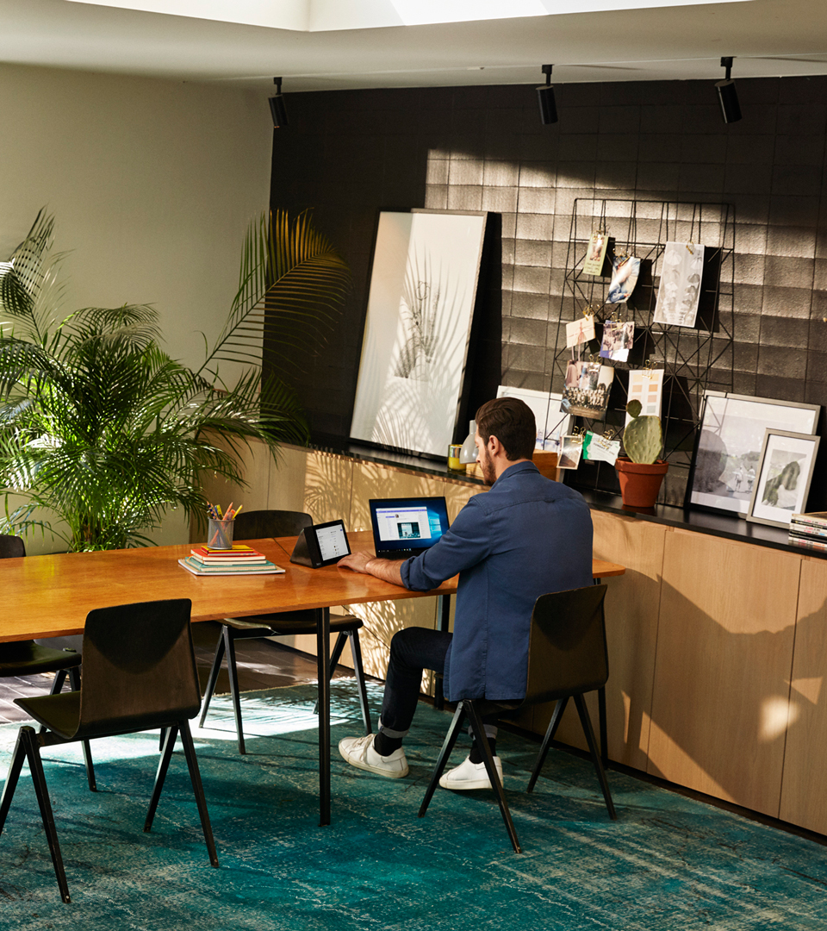
One Lenovo Mini Campaign
Link to Why Lenovo Pitch Deck
Link to Channel Lenovo 360 Sales Presentation
2022 Lenovo Internal. All rights reserved.

Slide 14

Remote Workplace Enablement Conversation Card
Fast Facts
According to a McKinsey study from December 2020-January 2021, only 10% of workforce will be in the office more then 80% of the time (note: pre-covid, 99% of workforce reported going into the office more then 80% of the time)
41% if businesses say external PC service reduces the cost of IT
7.5 total work hours saved, per device, using Lenovo configuration services
Elevator Pitch
Work Takes Place Everywhere
As remote working is here to stay, you need the processes to make it easier to support​ your people, wherever they are.​The old ways no longer work. Manual processes are slow, error-prone and often delay deployment. Your users need a more flexible approach, where they have the device then need, when they need it, and where they need​ it. Lenovo Remote Work Enablement Solution provides the services to get this done. This flexible workforce solution offers fast deployment with easy manageability throughout the full device lifecycle- All through a single, trusted vendor. Lenovo Remote Work Enablement solution empowers you to deliver better outcomes for your users, with improved UX and performance, while providing innovative, cost-efficient ways to manage your remote workforce.
Customer Type
Why Lenovo
Discovery Questions/Door Openers
Any business with users working remotely can benefit from this solution, whether their teams are hybrid or fully remote
Company IT Departments and Procurement: as remote work increases, the strain on IT departments increases. This solution decreases strain on IT departments through:
Use of PC provisioning instead of IT department imaging (ship directly from manufacturing site to user
Augment User Support
Exchange device models when incidents occur
Customized end-to-end lifecycle service support
Customer Experience Managers
Head of End User Services
Security
The Lenovo Remote Work Enablement Solution provides:
Easy Setup for Work→ Single, tied shipment to end user. Complementary Lenovo integration services – avoiding the need for a separate configuration center
Productivity and Manageability→ management of all end user deployments whether in the home or in the office (managed and secure from day 1). Integrated, standardized employee experience. Speedy productivity for end users
Flexibility & Mobility→ enablement of end user from any location. Integrated and seamless connectivity (local, data center, cloud)
Major Solution Features
Smart Hardware: Best-in-class computing to help your users succeed no matter the task, no matter the location (ThinkPads, ThinkBooks, ThinkShield)
Smart Software: Advanced software solutions that range from robust data protection to cloud-based services for secure recovery, migration, provisioning and registration of your devices (ThinkShield Suite, SentinelOne Breach Protection, Trusted Supply Chain, Trusted Device Setup)
Smart Services: Advanced software solutions that range from robust data protection to cloud-based services for secure recovery, migration, provisioning and registration of your devices (Premier Support, Warranty Services, As-a-Service Scalability, Configuration & Deployment)
Support and Protection: secure and protect your technology investment, while reducing operational costs and avoiding downtime (Premier Support, Accidental damage protection)
Key Differentiators
Applicable for Remote Workers
Faster onboarding for new employees
Comprehensive and flexible to meet customer needs
Optimal cloud enablement
What to listen for:
Workforce has become increasingly remote over the past few years
Desire to lessen overhead by downsizing companies’ physical footprint and real estate costs
Slow, manual processes hampering productivity and collaboration
Current processes are resulting in slow deployment (multiple touches before a new device is ready for an end user)
Increased strain on IT department
Discovery Questions:
What have you had to do differently since working remotely around your device?
Do you have an equipment plan for your remote workers?
Are you looking to move your employee device to a more self-service model?
Do your users experience challenges accessing their home network?
2022 Lenovo Internal. All rights reserved.

Slide 15

Remote Workplace Enablement Mini Campaign
Product Overview
Link to Modern Workplace Video (Internal Use Only)
Link to Remote Enablement Guide
Link to Remote Work Enablement Conversation Card
Link to Remote Work Enablement Channel PowerPoint (Internal Only)
Case studies
Link to Roma Tre University Case Study
Link to Fraser Health Authority Case Study
2022 Lenovo Internal. All rights reserved.

Slide 16

Common Questions From End User Customers:
I manage our backup environment across both physical servers and VMs, can I do this with Lenovo?
Lenovo offers solutions that allow an organization to manage a backup environment for both virtualized and physical servers. These solutions support all the major hypervisors and allow both block and granular backup capabilities.
I have gigantic backup and archive repositories that I’m worried about migrating over to a new solution?
Lenovo professional services provides support for helping architect and deploy your data center solutions. These teams along with our software technology partners’ teams provide assurance for a smooth transition to your new backup & recovery solution.
How do I reduce my costs associated with my backup and recovery environment?
Lenovo backup and recovery solutions utilize scalable and flexible storage configurations with ThinkSystem DE and DM-series storage arrays along with highly efficient backup software partners that manage both compression and deduplication processes to minimize storing duplicated data and thus reducing disk costs.
How can we ensure the solution will be easy to maintain and manage?
Lenovo partners with cutting edge technology software to provide a simple route to highly capable data backup & recovery environments. Our integration with NetApp’s OnTap storage systems and the aforementioned software allow simple and effective management both on-premise and in the cloud.
ISG Backup & Recovery Conversation Card
Elevator Pitch
You need Backup and Recovery from Lenovo. The enterprise-class Backup and Recovery solution leverages the best mix of industry-leading servers and software to provide intelligent, cost-effective data protection with flexible, cloud-based remote recovery.
This innovative, software-defined solution brings together the best features of Lenovo ThinkSystem servers, Quest® QoreStor® software, and Veeam Backup & Replication software to help you trim costs, reduce your storage footprint, and enjoy peace of mind with secure storage and recovery that can be accessed anytime, anywhere. Plus, the optional “pay as you grow” structure keeps pace with your goals, so you always have access to seamless data storage and protection at exactly the scale you need.
Customer Type
Why Lenovo
Discovery Questions/Door Openers
SMBs, mid-range to large enterprises
All sizes and verticals:
Financial services organizations both big and small must adhere to strict regulatory compliance mandates for data backup and archive.
Government and education organizations are targets for security threats; backup solutions can act as a shield from being held ransom.
Organizations with huge VM farms can be provided scalable and simple backup solutions with Lenovo ThinkSystem storage and best-of-breed software.
Increasingly stringent Industry-wide requirements for data availability
Critical for business continuity, financial requirements, and government (regulatory) requirements
Data Backup and Recovery solutions are intrinsic to any end-to-end data center solution
Needed to meet service level agreements (SLAs) and help mitigate the effects of security threats and effectively recovery from disasters
Reduce costs:
Costs associated with data downtime/ data availability
Greater efficiency with management and orchestration costs of data backup & recovery
Promote business agility
Deploy both workloads and data protection policies across multiple environments; from the on-premise data center to the hybrid and public cloud
Non-disruptive backup
Backup your critical workload data more efficiently and without disruption to the primary workload.
Recover your data at greater speed and specificity to ensure improved Recovery Time Objectives (RTO) and Recovery Point Objectives (RPO). Whether recovering entire VMs to individual emails, Lenovo helps you maintain business continuity.
Lenovo has heavily invested in world-class storage technology and partnered with key data backup and recovery software partners to provide cutting-edge solutions for the data management environment.
Lenovo’s proven track-record of customer satisfaction and reliability extends to our software solutions; maximizing organizational security, simplifying your IT environment, and reducing the costs associated with your backup and recovery workloads.
Lenovo provides data backup and recovery solutions that span any data center environment; fully on-premise, hybrid cloud, and public cloud capable. Our suite of software solutions and exceptional Lenovo Professional Services teams are able to architect any backup workload for any environment at any service level agreement.
How much time are you spending managing data protection and application availability
What projects could you focus on if managing your backup environment was more efficient?
Do you have a single way to ensure that business workloads and data is protected both on-premise and in the public cloud?
When was your last restore, how long did it take, and what was the business impact?
What infrastructure are you backing up; physical servers, VMs, cloud, a mix of everything
Do you need a highly scalable solution, how are you planning to scale your backup environment for growth?
What percentage of your data center is dedicated to your backup environment?
How do you test new software/ firmware patches before deploying them into your DC environment?
What to listen for:
Need to modernize due to exponential data growth, straining legacy backup & recovery infrastructure
Rising prominence of sophisticated cyber-security threats require more agile data backup capabilities
Increasing compliance and regulatory requirements necessitate sharpened data retention policies
Desire to utilize data in archives and repositories to drive business initiatives
2022 Lenovo Internal. All rights reserved.

Slide 17
Back up & recovery Mini Campaign
Link VEEAM playbook
Link Business Continuity, Simplified
Link Backup & Recovery Terminology
Link to Lenovo360 Backup & Recovery video
Link to Q2 slide
Link for Back up and Recovery Solutions Guide
Link to Backup and Recovery Conversation Card
Link to Back up and Recovery Channel PowerPoint
2022 Lenovo Internal. All rights reserved.

Slide 18

Complete Conference Room Conversation Card
Fast Facts
57% of all the U.S. workforce is working remotely at least part of the time
40.7 million American professionals say their jobs will become fully remote within the next five years
67% of businesses have already made more changes to long-term management practices during the pandemic than in a normal year
Elevator Pitch
Conference rooms can prove to be complex. Varying sizes, degrees of hardware, compatibility, and the element of hybrid work can make outfitting a conference room seem like a challenge. The Lenovo Complete Conference Room Solution provides everything a company could need to deploy, maintain, and manager their enterprise conferencing. This solution is a simple, flexible solution loaded with innovative technology to support a variety of platforms and room sizes. Designed to ensure the end user can walk in and click to get started.
Customer Type
Why Lenovo
Discovery Questions/Door Openers
Any business with users working remotely
Examples of Target Verticals include:
Automotive
Education
Energy + Oil & Gas
Healthcare
Entertainment
Finance
Manufacturing
Target Personas
Sell to Tech Experts (IT Directors, Managers, CTOs, CIOs)
Appeal to Support Teams (Facilities EVPs, VPs, or Directors)
Call on Key Stakeholders (ESG Compliance CEOs, COOs, & CFOs, Human Resources EVPs, VPs, or Directors)
Neatly packages everything to transform collaboration with solutions that can include:
Hardware- ThinkSmart Core Kit and around device accessories
Software- ThinkSmart Manager
Services- ThinkSmart Services
One payment as a service model priced per conference room
Latest technology compatible with conference room platforms
24x7 monitoring helps ensure conference room uptime
Proactive remediation for failures
Can help reduce risk by leveraging proven best practices
Increases IT flexibility while reducing capital expenses, and tech vulnerabilities
Offered white-glove service from a technology leader
Supports the team’s choice on UC Platform
Equal opportunity and quality for participants
Intuitive operation with AI-powered cameras and audio
What to listen for:
Growing concerns from IT departments surrounding security, migrating to the cloud, and managing multi-vendor environments.
Low bandwidth/low quality A/V on remote connections prevents effective participation​
Remote participants can’t hear or follow discussions among on-premises teams or see whiteboarding sessions​
On-premises people seated far from mics/cameras can’t participate effectively
Discovery Questions:
Is your company showing a strong hybrid/work-from-home trend, even post-pandemic​
Is there currently a need for more meeting room space?
Has the space you work in reduced in size or changed with transitions to remote work?
Are you noticing an increased reliance on video conferencing platforms (like Microsoft Teams or Zoom) and devices?
2022 Lenovo Internal. All rights reserved.

Slide 19
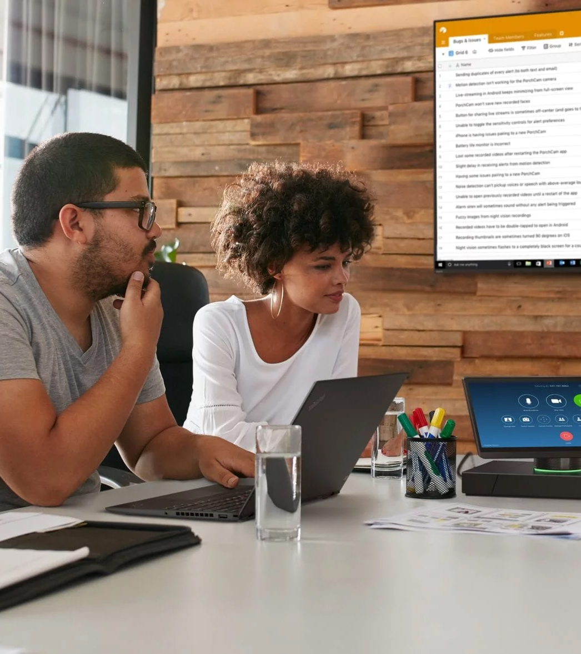
Complete Conference Room Mini Campaign
Link to One Pager- Lenovo 360 Solutions Packs Flyers Complete Conference pdf
Link to Complete Conference Room Conversation Card
Link to Complete Conference Room Channel PowerPoint (Internal Only)
2022 Lenovo Internal. All rights reserved.

Slide 20

Immersive Design and Education Conversation Card
Fast Facts
VR learners are:
4x faster to train than in the classroom
275% more confident to apply skills learned after training
3.75x more emotionally connected to content than classroom learners
4x more focused than their e-learning peers
Elevator Pitch
A complete solution for teaching with VR for K12 and HiEd, including a seamless combination of hardware, content, training, device management, and support. Easy, flexible, and complete.
Customer Type
Why Lenovo
Discovery Questions/Door Openers
Educators
Solution featuring Lenovo ThinkStation Workstations, Varjo VR-3 & XR-3 head mounted displays, Professional 3D softwares including Unity, Unreal Engine & OpenXR, and services including Lenovo LISS & warranty, and As-a-service services designed for higher ed, engineering schools, and design schools.
Healthcare
Solution featuring Lenovo ThinkStation Workstations, Varjo VR-3 & XR-3 head mounted displays, Professional 3D softwares including Imotions & Toltech, and services including Lenovo LISS & warranty, and As-a-service services designed for medical education centers, surgery training, and anatomy studies.
Automotive
Solution featuring Lenovo ThinkStation Workstations, Varjo VR-3 & XR-3 head mounted displays, Professional 3D softwares including Autodesk, Vred & ZeroLight, and services including Lenovo LISS & warranty, and As-a-service services designed for automotive designers, physical modeling replacement, and sales centers.
The only Educational VR solution designed with organizational-scale device and classroom management, enterprise-level security, and flexible content options.
Photorealistic, True-to-Life Mixed Reality
Industry’s Highest Resolution
The Widest-Ever Color Gamut
Depth Awareness - Powered by LiDAR for Pixel-Perfect Real-Time Occlusion & 3D World Reconstruction​
Industry’s Most Ergonomic Design
Easy to use interface to deploy content in bulk
Enterprise focused quality of hardware
What to listen for:
Virtual Reality
Immersive training/experience
Training challenges cost/travel restrictions?
Virtual collaboration when physically/logistically not possible
Discovery Questions:
What is your target/objective/use case with this technology?
How is experience with VR in your environment? What are the pain points?
What product being tested?
What is current process?
How do you manage devices? Deploy content?
How do you develop/create content?
Can you Scale your environment?
Do you have a budget for the project?
Is it on a roadmap or part of business plan?
2022 Lenovo Internal. All rights reserved.

Slide 21
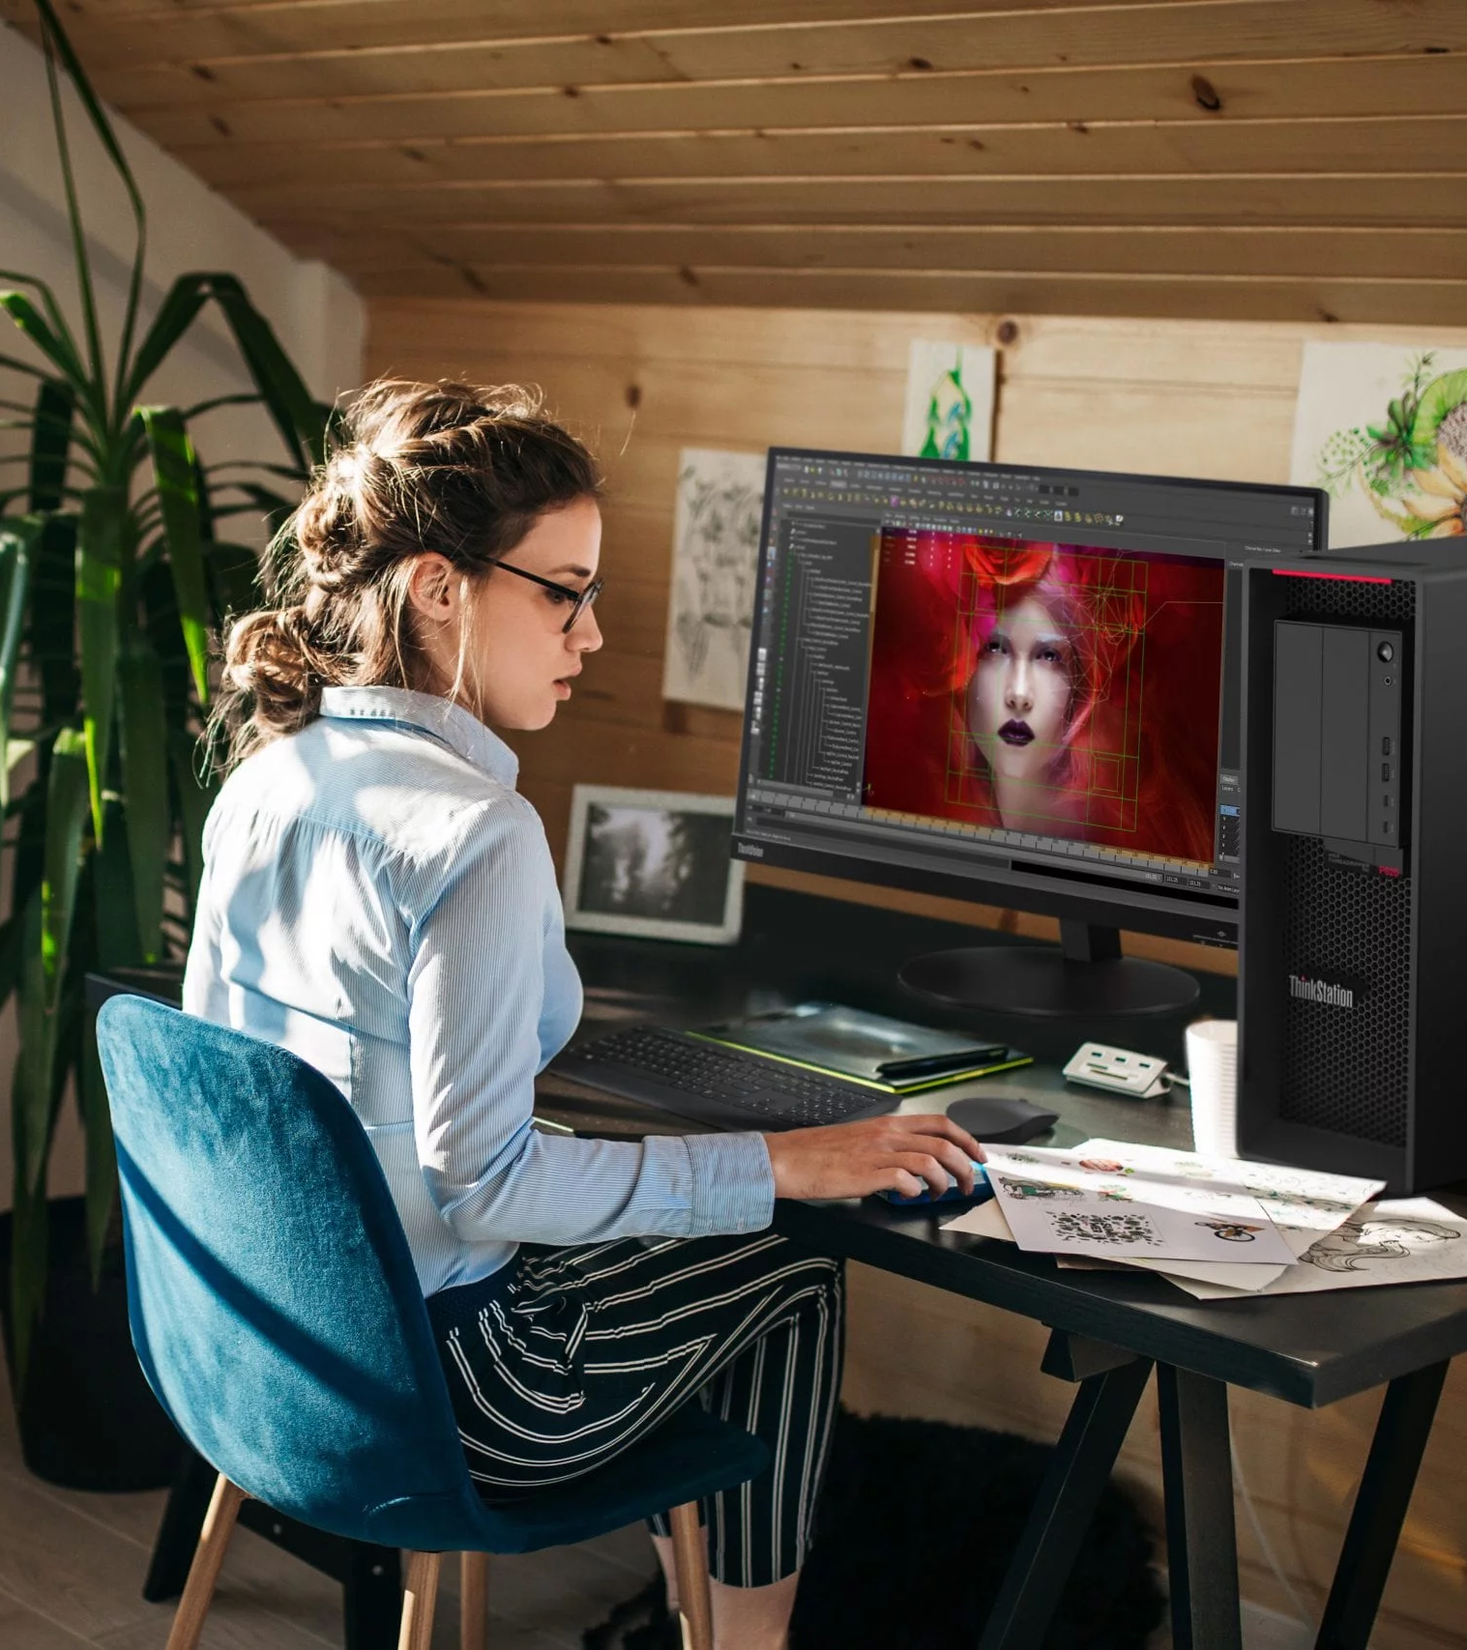
Immersive Design and Education Mini Campaign
Link to One Pager- Lenovo 360 Solutions Pack Flyer Immersive Education pdf
Link to Immersive Design and Education Conversation Card
Link to Immersive Design and Education Channel PowerPoint (Internal Only)
2022 Lenovo Internal. All rights reserved.

Slide 22

TruScale Conversation Card
Fast Facts
The global managed service market is expected to grow by 12.44% CAGR until 2027.
92% of IT leaders would consider adding new as-a-Service offerings in the next two years as a result of changing business models.
1 in 4 CIOs say they would replace most or all of their company's current technology, and they need the right model to do that with limited resources.
Elevator Pitch
Realize your vision in business, whether that’s greater productivity, improved employee experiences or a more sustainable future. Lenovo TruScale gives you easy access to scalable, everything-as-a-service solutions – in a pay-as-you- go model. From the pocket to the cloud, Lenovo TruScale works with you to design a flexible and empowering solution, leveraging technology from a proven global leader to evolve your business and free up your IT resource so they can focus on innovation. The vision is yours. Get there with Lenovo TruScale.
Customer Type
Why Lenovo
Discovery Questions/Door Openers
TruScale is made for business of every size, from SMB with 1-999 users to Enterprise customers with no upper limit on growth.
Decision Makers:
CEO/CIO
HEAD OF IT
CFO
Purchasing
Empower Customers to achieve their goals:
Easily access innovation, from the pocket to the cloud.
Reliable, managed services enable IT Teams to focus on long-term strategy.
Control how technology is deployed, managed & used
Unlock faster ROI without capital expenditure & reduce your customer's TCO
Enhance business agility & versatility:
Customize an XaaS package for individual customers, with unmatched flexibility.
Keep pace with customers' needs by easily scaling up or down service provision.
Enable customers to manage all Lenovo TruScale services through simple contracts.
Supplement with Value-add services to provide more effective, tailored solutions.
Join forces with a proven Technology Leader:
Simplify global services with models for financing, invoicing, contracting, & delivery.
Work with powerful, reliable, technology. Lenovo has supplied 6 of the top 10 hyperscalers.
With coverage in more than 100 markets, we can reliably support market expansion or streamline your customers' international organization.
What to listen for:
Virtual Reality
Immersive training/experience
Training challenges cost/travel restrictions?
Virtual collaboration when physically/logistically not possible
Discovery Questions:
Do you find it easy to predict how much computing resource you’ll need over the next quarter? What about the next year and the next three years? How do you respond to this challenge?
How do you keep up-to-date with the latest innovation? If you had easy access to cutting-edge technology, how would that benefit your business? Would it help to position your business more competitively?
How do you plan for scaling your infrastructure? Do you find that’s cost-effective and timely? Can you easily respond to unforeseen needs?
Is your IT resource flexible in terms of achieving operational and strategic goals? Do you often find that requirement exceeds resource, or vice versa? How much budget could you save by right-sizing your provisioning?
What’s your vision for transforming your IT landscape? Do you have a clear picture of the resource you’ll need to achieve this?
What do you think are the downsides of moving to a technology-as-a-service model?
2022 Lenovo Internal. All rights reserved.

Slide 23

TruScale Mini Campaign
Link to TruScale PDF battlecard
Link to “The Vision is Yours” Video
Link to Master TruScale offering PowerPoint
2022 Lenovo Internal. All rights reserved.

Slide 24

Premier Support Conversation Card
Fast Facts
91% of premier support customers indicate they would purchase again
88% of customers indicate they would recommend premiere support to a peer
67% of businesses report they lack the time to address PC issues adequately
Elevator Pitch
Advanced Engineers. End-to-End Case Management. Faster, First-time Resolution
As IT budgets contract, you need to reduce complexity and operational costs and find ways to increase efficiency from your in-house IT support teams, Lenovo Premier support can help by managing your routine support tasks, freeing up your IT staff to focus on strategic efforts that move the organization forward. We can boost your end users’ productivity and limit their downtime with direct access to elite Lenovo engineers who provide unscripted, advanced hardware and software support. Lenovo Technical Account Management teams also provide end-to-end case management for faster, hassle-free case resolution.
Customer Type
Why Lenovo
Discovery Questions/Door Openers
CIOs: need reliability, protection, and support for their Lenovo PCs. If something goes wrong, they need to be back up and running fast. Lenovo Premier Support provides VIP treatment with faster first-time resolutions, parts prioritization, onsite delivery, and access to Technical Account Managers.
IT Directors: don’t want their valuable help desk team members tied up on support calls. They can free up time for more strategic tasks by offloading 1st- and/or 2nd-level IT support to the Lenovo Premier Support team.
Help Desk Technicians: need the direct access to advanced engineers provided by Lenovo Premier Support. With less time wasted on standard support call queues, they can jump right into problem-solving mode and get employees back to work fast.
We understand that all workloads are not created equal, and we make the decision-making process simple, with services for every stage of your customers' journey and pre-defined scopes to meet requirements.
Hassle-free, advanced technical support available 24x7x365
Comprehensive hardware and original equipment manufacturer software support
Simplified end-to-end case management with a single point of contact
Proactive relationship and escalation management with Technical Account Managers
VIP service with labor and parts prioritization
Comprehensive suite of reporting to help identify trends and proactively address issues
Easy reference to Premier Support contact centers worldwide with optional asse tags
Customized dashboards for your Lenovo assets and warranty and service delivery information with the Lenovo Service Connect portal
What to listen for:
Facing growing complexity, increased maintenance costs, increased workload/resource constraints, multiple vendors, and increasing end-usear demands. Seeking VIP support, direct access & improved visibility, consistency, and commitment & accountability, spending too much time on employee support calls, do not have time to wait on parts and labor
Discovery Questions:
How are you supporting your Lenovo Data Center products? Where are you leveraging an IT service provider to help maintain complex environments?
Does your IT infrastructure support and enhance your core business strategy? How are you ensuring your IT staff has time to focus on innovation?
Do you value direct technician-to-technician access when contacting your service provider with a problem?
What percentage of your IT budget spend goes towards ongoing maintenance and support?
Is your IT team feeling stretched thin in this do-more-with-less world?
What applications/workloads will be residing on this equipment? What is the availability expectations of those applications/workloads?
For this equipment, walk me through your expectations of resources you would want available to you during and incident.
How might Lenovo’s multiple technical support contact methods (phone, chat, online portals, and other channels) benefit your business, giving you a peace of mind?
Walk me through how your maintenance window policy that allows you to apply patches, updates, and upgrades. What are your expectations from Lenovo to support you in that effort?
2022 Lenovo Internal. All rights reserved.

Slide 25
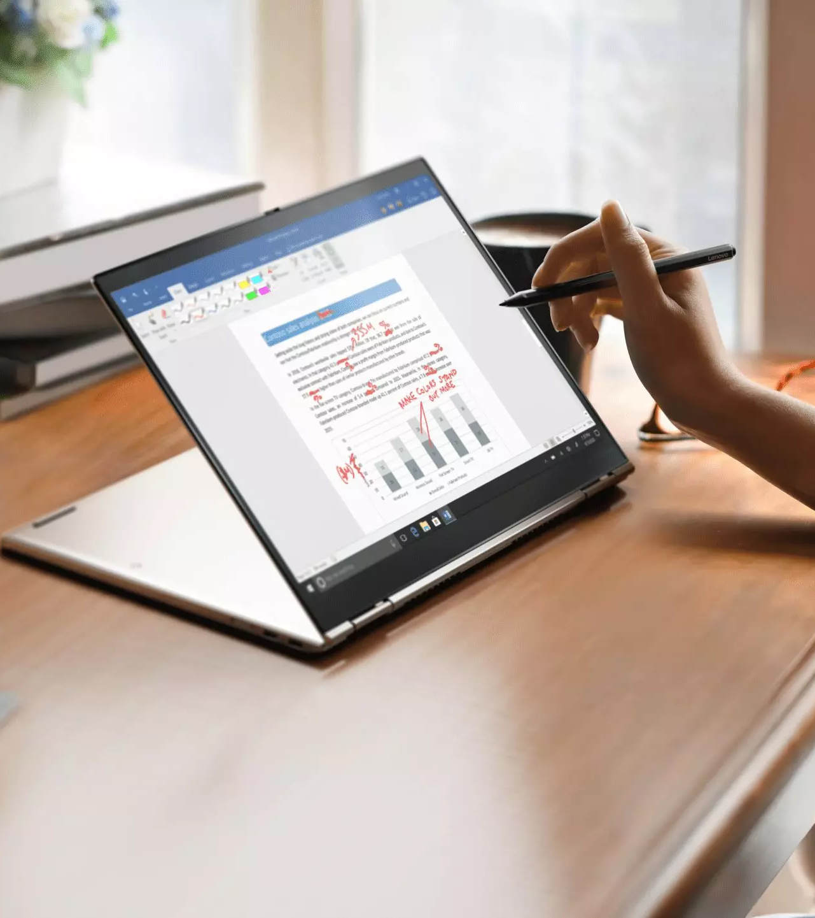
Services Conversation Card
Product Overview – brief blurb and video link
Link to Why Lenovo Premier Support Video
Link to Why Lenovo Services Pitch
Link to Lenovo Premier Support Brochure
Link to IDG Channel Conversation Cards (Internal Use Only)
Link to ISG Services Attach Partner Playbook (Internal Use Only)
Link to End-to-End Services Guide for Channel Sellers (Internal Partner Use Only)
Link to Premier Support Battlecard (Internal Use Only)
Case studies
Link to Customer Stories: Lenovo Data Center Services
2022 Lenovo Internal. All rights reserved.

