Slide 1

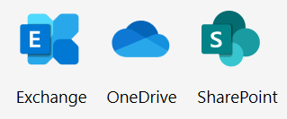


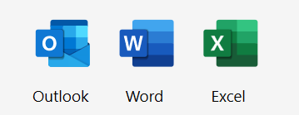
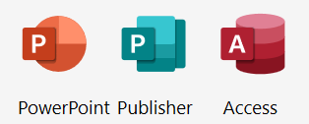




Upsell Guide for Partners
Microsoft 365 Exchange Online → Microsoft 365 Business Premium
IT Partners and Sellers: Use this document to understand the sales journey for Microsoft 365 Business Premium and guide your upsell conversations with customers. Do not share this document directly with customers.
Microsoft 365 Business Premium is a comprehensive solution for businesses with 1-300 employees. It includes everything Exchange Online offers, plus powerful office productivity tools and advanced security and device management in one solution. It contains the essential tools you need grow your business with peace of mind that your business information is protected.
Microsoft 365 Exchange Online
Cloud Services
Microsoft 365 Business Premium
Cloud Services
Bookings
Desktop Apps
(PC Only)
(PC Only)
Comprehensive Security
Microsoft Defender
Azure AD Premium P1
Azure Virtual Desktop
HOW TO UPSELL- START WITH DISCOVERY QUESTIONS
Do your employees need real time communication and collaboration as they work outside the office?
Are your employees able to seamlessly work and collaborate from multiple devices?
Did you know that approximately 1/3 of all cyberattacks are targeted at small businesses? (ref)
Have you had any recent security incidents like Phishing or Ransomware?
How do you protect against lost or stolen devices & passwords, especially for mobile/remote workers?
How do you help ensure confidential work and customer data is not accidently leaked ?
Do you have a process to secure data when an employee leaves your company?
Do you have a way to quickly identify attacks and mitigate risk and liability?
FOLLOW THE SALES JOURNEY BELOW
DISCOVER NEEDS
PITCH THE SOLUTION
HANDLE OBJECTIONS
MANAGE & DEPLOY
Identify customers in Cloud Ascent.
Use the Customer email for outreach
Use the Business Workshop tool to uncover needs.
Use Secure Score to help customers assess their risk posture.
Use these customer facing assets in discussions:
Microsoft 365 Business Premium video
BDM Pitch Deck
Licensing comparison
ITDM Pitch Deck
Cybersecurity Simplified one pagers.
Conduct an SMB Workshop with your customers.
For objection handling refer to the BP Upsell Deck.
Use customer ready Compete Leave behind and the Value Calculator tool to drive cost savings discussion with the customer.
Review the IT Checklist for securing work from anywhere.
Use the Step-by-step implementation guidance for securing work from anywhere using Microsoft 365 Business Premium.
For additional resources, go to: Microsoft 365 Business Premium Partner Playbook

Slide 2





Upsell Guide for Partners
Microsoft 365 Exchange Online (Plan 1) → Microsoft 365 Business Premium
Microsoft 365 Business Premium Additional Capabilities
Collaborate and create in real-time
Save, access, edit, and share files and photos wherever you are. File storage and sharing with 1 TB of OneDrive storage.
Connect from anywhere
Bring everyone together in one place to meet, chat, call, and collaborate. Host unlimited online meetings and video conferencing for up to 300 people with Microsoft Teams.
Secure devices
Control which devices and users can access business information with Intune Device Management. Apply security policies to protect data on any devices. Keep company data within approved apps on mobile devices. Remove business data from lost or stolen devices with Intune selective wipe.
Protect business data
Encrypt sensitive emails. Block sharing of sensitive information like credit card numbers with Azure Information Protection. Restrict copying and saving of business information. Enable unlimited cloud archiving.
Defend against cyberthreats
Activate Microsoft Defender for Office 365 to guard against unsafe attachments, suspicious links, phishing and ransomware with Safe Links. Detect malware with sandbox analysis of email attachments with Safe Attachments. Enable anti-phishing policies. Enable advanced multi-factor authentication.
Enable secure remote access and protect identity
Enable employees to securely access business apps, wherever they work. Help protect against lost or stolen passwords with advanced multi-factor authentication. Conditional Access helps provide the right access to the right people, while keeping hackers at bay.
Increase productivity and collaboration
Provide employees with enhanced Office features, helping them create content more easily, access and edit files while offline, and gain access to PC only applications such as Access and Publisher, all while maintaining a high level of security.
Streamline appointment scheduling and management
Help your staff stay on top of their schedules and avoid double-bookings. An easy to navigate webpage lets your customers find and book appointments around the clock.
Microsoft Defender for Business¹
Enterprise-grade endpoint protection with next generation AV, Endpoint Detection and Response, Threat and Vulnerability Management and Automatic Investigation and Remediation, that works across all devices and platforms - Windows, macOS, Android, and iOS
¹Microsoft Defender for Business is available in Microsoft 365 Business Premium and as a standalone SKU. Read the blog post to learn more.

Slide 3
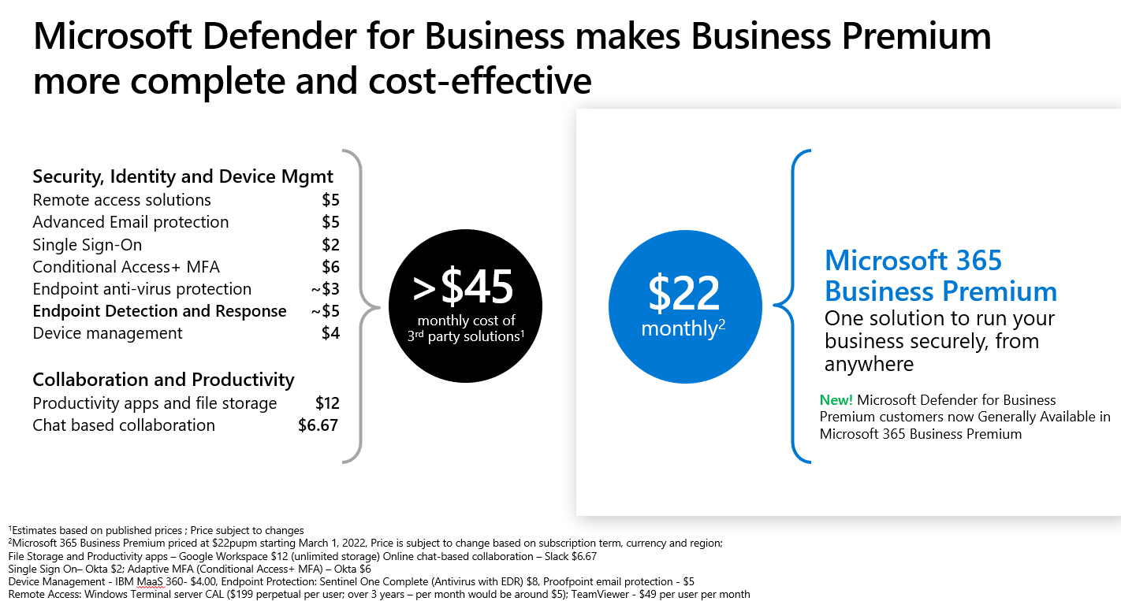
Upsell Guide for Partners
Microsoft 365 Exchange Online (Plan 1) → Microsoft 365 Business Premium
Customer Conversation talking points
Comprehensive and cost effective: A complete productivity and security solution, that’s easy to manage and deploy and cost effective vs. point solutions.
Simple activation: No need to deploy additional products; just activate protection capabilities in the same way as other Office features.
Streamlined: Designed for Office apps and Windows, so it protects without hogging system resources or requiring special add-ins.
Top rated security vendor. Gartner recently released Magic Quadrant reports across Endpoint Management, Access Management and more and Microsoft was a leader in these.
Top rated antivirus capabilities. Microsoft Defender AV is now ranked as a top AV product by tests such as AV Test, AV comparatives, SE labs are more.
Designed for a distributed environment. Microsoft 365 Business Premium provides a comprehensive solution for work from anywhere- with real time collaboration, online meetings, secure remote access and advanced cyberthreat protection to let you run your business from anywhere while helping safeguard your business data.

Slide 4
Reimagine productivity with
Microsoft 365 and Microsoft Teams
 |  |  | Microsoft 365 Exchange Online (Plan 1) $4.00 User/month (annual commitment | Microsoft 365 Exchange Online (Plan 1) $4.00 User/month⁴ (annual commitment | Microsoft 365 Exchange Online (Plan 1) $4.00 User/month (annual commitment | Microsoft 365 Exchange Online (Plan 2) $8.00 User/month⁴ (annual commitment | Microsoft 365 Business Basic $6.00 User/month⁴ (annual commitment) |  | Microsoft 365 Business Basic $5.00 User/month (annual commitment) | Microsoft 365 Business Standard $12.50 User/month⁴ (annual commitment) | Microsoft 365 Business Premium $22.00 User/month⁴ (annual commitment)
Teamwork and communication
Online meeting and video call hosting for up to 300 people with Microsoft Teams² |  |  |  |  |  |  |  |  |  |  | 
Bring together all your team’s chats, meetings, files, and apps with Microsoft Teams |  |  |  |  |  |  |  |  |  |  | 
Team sites to share information, content, and files throughout your internet using Microsoft SharePoint |  |  |  |  |  |  |  |  |  |  | 
Desktop, web and mobile versions of Office apps
Fully installed and always up-to-date versions of Microsoft Outlook, Word, Excel, PowerPoint, and OneNote (plus Access and Publisher for PC only) on up to 5 PCs or Macs¹ |  |  |  |  |  |  |  |  |  |  | 
Web versions of Word, Excel, PowerPoint, and OneNote (plus a web version of Outlook) |  |  |  |  |  |  |  |  |  |  | 
Always up-to-date versions of Word, Excel, PowerPoint, and OneNote (plus Outlook) for iOS and Android on up to 5 mobile devices and 5 tablets¹ |  |  |  |  |  |  |  |  |  |  | 
Real-time coauthoring so multiple users can work in the same document, simultaneously |  |  |  |  |  |  |  |  |  |  | 
Email and calendaring
Microsoft Exchange Online email with 50 GB mailbox |  |  |  |  |  |  |  |  |  |  | 
Microsoft Exchange Online email with 100 GB mailbox |  |  |  |  |  | 
Hosted Unified Messaging services that provide call answering
Use your own custom domain name (for example, yourname@yourcompany.com) |  |  |  |  |  |  |  |  |  |  | 
Manage calendars, share available meeting times, and schedule meetings |  |  |  |  |  |  |  |  |  |  | 
Exchange Online Archiving |  |  |  |  |  |  |  |  |  |  | 
File storage and sharing
1 TB of OneDrive storage for each user to access, and sync files on any device |  |  |  |  |  |  |  |  |  |  | 
eDiscovery and Audits
eDiscovery |  |  |  |  |  |  |  |  |  |  | 
Litigation Hold |  |  |  |  |  |  |  |  |  |  | 
Email Archiving |  |  |  |  |  |  |  |  |  |  | 
Information Protection
Azure Information Protection Plan 1 |  |  |  |  |  |  |  |  |  |  | 
Data Loss Prevention
Message Encryption |  |  |  |  |  |  |  |  |  |  | 
Data Loss Prevention |  |  |  |  |  |  |  |  |  |  | 
Cloud App Discovery |  |  |  |  |  |  |  |  |  |  | 
Email and Collaboration Security
Safe Links in email, chat |  |  |  |  |  |  |  |  |  |  | 
Safe Attachments for email |  |  |  |  |  |  |  |  |  |  | 
Anti-Phishing |  |  |  |  |  |  |  |  |  |  | 
Device Management
Windows device setup and management |  |  |  |  |  |  |  |  |  |  | 
Autopilot
Mobile Device Management |  |  |  |  |  |  |  |  |  |  | 
Mobile App Management |  |  |  |  |  |  |  |  |  |  | 
Identity and Access Management and Security
Conditional Access |  |  |  |  |  |  |  |  |  |  | 
Multi-Factor Authentication |  |  |  |  |  |  |  |  |  |  | 
Shared Computer Activation and AVD
Shared Computer Activation |  |  |  |  |  |  |  |  |  |  | 
Azure Virtual Desktop |  |  |  |  |  |  |  |  |  |  | Win10/11
Endpoint Security – NEW Microsoft Defender for Business³
Cross Platform Next Gen AV (Windows, MacOS, iOS, Android) |  |  |  |  |  |  |  |  |  |  | 
Endpoint Detection and Response, Automated Investigation and Remediation, Threat and Vulnerability Management |  |  |  |  |  |  |  |  |  |  | 
1. Compatible with Windows 10 or later. For complete requirements for PC and Mac see system requirements.
2. For HD calling, compatible HD hardware and broadband connection with at least 4 Mbps required.
3. Microsoft Defender for Business is available in Microsoft 365 Business Premium and as a standalone SKU. Read the blog post to learn more.
4. Price is subject to change based on subscription term, currency and region.
For the most current Microsoft 365 Business Premium SKU information,
please refer to Microsoft 365 Business Premium service description
© 2020 Microsoft Corporation. All rights reserved. This material is provided for informational purposes only. MICROSOFT MAKES NO WARRANTIES, EXPRESSED OR IMPLIED.

