Slide 1
Microsoft Dynamics 365 Business Central Pitch Deck Presentation Guidance
PARTNER & SELLER GUIDANCE ONLY
Disclosure | Customer ready
Objective | Provide an overview of Microsoft Dynamics 365 Business Central Explore customer priorities and pain points Advance to the next stage of the sales cycle
Audience | Owners, Business Decision Makers (BDMs), and Department Leads (Finance, Operations, and IT) of small and medium-sized businesses (SMBs), typically with 25-300 employees
Content Level | L100
Length | 30-60 minutes
Instructions | IMPORTANT: When presenting, ensure you are in the PowerPoint application on your desktop. Do not present from Teams or PowerPoint Online app in your browser, as the animations and formatting may not render as intended. A talk track has been provided which provides the overall narrative to share with customers. Slides should be adaptive to the specific audience situation – feel free to reorder slides, hide slides, etc. that you feel fit with your customer. Augment content with local or vertical specific customer stories. IMPORTANT: If you share these slides with a customer or partner, please share as PDF to reduce the file size and ensure the notes are not visible/accessible.
Deck owner | Tania Shepard
Version | June 2023
Notes:
The purpose of this presentation is to provide you with an example of how best to present this Level 100 deck to non-technical decision makers in small and medium-sized businesses. This external facing deck is intended to inform the audience on how Microsoft Dynamics 365 and Power Platform support customers’ digital transformation journey.
For your reference, every slide has comprehensive notes that you can review later. The notes are intended to guide you during various customer conversations, so you are empowered with accurate talking points as well as relevant statistics. Included in the deck are additional customer stories that you can leverage as evidence as well.
​
Without further ado, let’s go ahead and get started…

Slide 2
Adapt faster, work smarter, and perform better
Microsoft Dynamics 365 Business Central

Slide 3
Disruption is the new normal
Accelerated pace of change
New digital business models
Global market volatility
Hybrid work and the gig economy
Notes:
In the 2020’s, disruption is the new normal. Disruptions are reshaping business, requiring businesses to move at an even faster speed.
The only constant is change. What began as accelerating and converging technologies has become accelerating and converging markets.
The business model changes of the last decade are nowhere near the changes that are coming. Game changing innovation begins in the business model, not the product.
Coupled with this is the fact that market volatility is turning “business as usual” into “business UN-usual.” Since the global pandemic there simply is no steadfast norm.
SMB leaders are facing labor shortages, rising wage growth, multi-generational workforce challenges, along with a mindset shift, where people are fundamentally thinking differently about how, when, and where they work. People want transparency, accountability, and connection across their business.
If a company fails to innovate and adapt, they will be overtaken by more forward-thinking competitors. Now more than ever, leaders of small and midsized businesses (SMBs) need to ensure their people are enabled to deliver on customer expectations, no matter where they are or what comes next.

Slide 4
Is your business prepared for rapid change?
20%
73%
76%
20% of SMBs will cease operations by 2025 because they cannot pivot fast enough to digitize their operations to meet customer demands.¹
73% of employees want flexible hybrid work options to stay post-pandemic.²
76% of CFOs are dissatisfied with cross-functional collaboration to bridge the gap between operational and financial planning.³
¹ IDC ² Microsoft annual work trend index ³ Gartner AFP
Notes:
Traditional SMB financial management systems don’t allow for rapid change.
20% of SMBs will cease operations by 2025 because they cannot pivot fast enough to digitize their operations to meet customer demands.¹
73% of employees want flexible hybrid work options to stay post-pandemic.²
76% of CFOs are dissatisfied with cross-functional collaboration to bridge the gap between operational and financial planning.³

Slide 5
Traditional small business accounting systems inhibit growth and make it difficult to adapt to disruptions and rapid change.
Manual, inefficient and error-prone
Bog down employees, hindering their operational effectiveness
Prevents employees from focusing on strategic work
Leads to frustrated employees, low profit margins, higher employee turnover, and increased costs
Notes:
Traditional small business accounting systems inhibit growth and make it difficult to adapt to disruptions and rapid change.
They’re manual, inefficient and error-prone, and they bog down employees, hindering their operational effectiveness and preventing them from focusing on more strategic work that could help your business grow and expand. This often leads to frustrated employees, low profit margins, higher employee turnover, and increased costs.

Slide 6
Challenges some of our customers have faced
Needed a finance and customer engagement platform for its sales and accounting departments to accommodate rapid and anticipated business growth.
Wanted to run its business from anywhere and have all the advantages a cloud solution could bring.
Needed to find a unified ERP and CRM tool to tightly manage and track all aspects of its operations.
Notes:
Many businesses remain limited by systems that simply don’t allow for change.
Here are some specific challenges and needs that a few customers we’ve worked with were experiencing with their existing platforms.
Design Offices needed a finance and customer engagement platform for its sales and accounting departments to accommodate rapid and anticipated business growth.
CURRAX wanted to run its business from anywhere and have all the advantages a cloud solution could bring.
Call2Recycle needed to find a unified ERP and CRM tool to tightly manage and track all aspects of its operations.
We’ll revisit these businesses later to see how Business Central helped them meet these needs.

Slide 7
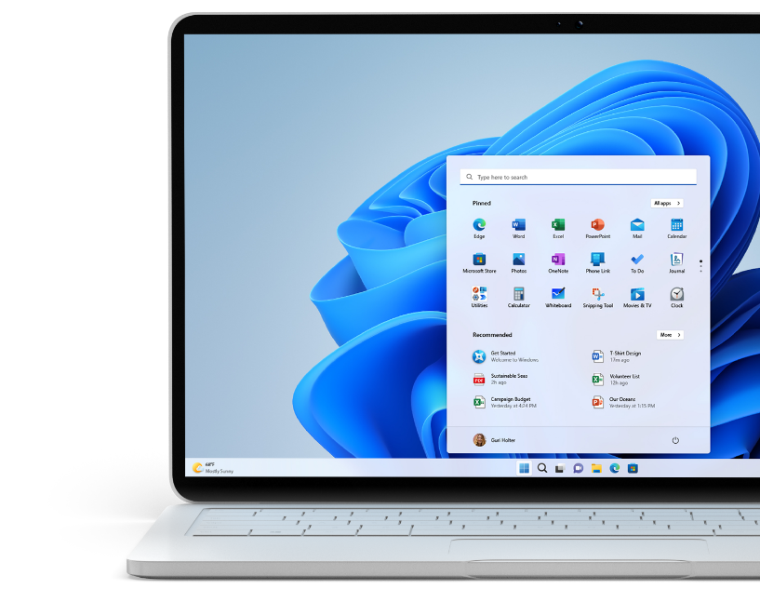
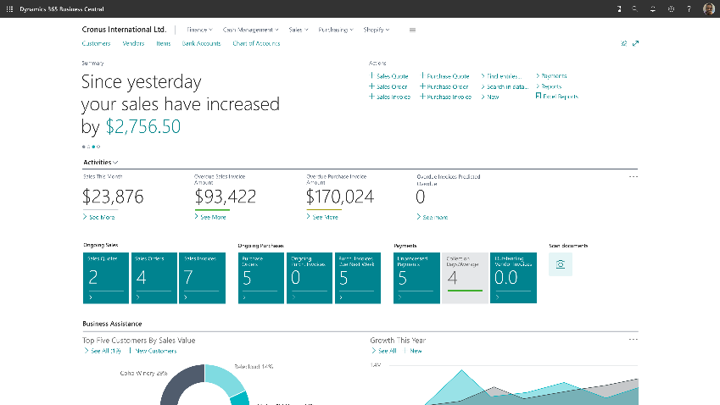
Microsoft Dynamics 365 Business Central
Notes:
Demo video

Slide 8
Dynamics 365 Business Central
Connects sales, service, finance, and operations teams in a single solution to help them adapt faster, work smarter, and deliver results.
Financial Management
Project Management
Sales Management
Operations Management
Reporting &
business insights
Service Management
Supply chain Management
Named “the Best ERP System” in 2023 by Forbes Advisor
Notes:
To help SMBs overcome these challenges and make their visions a reality, Microsoft offers Dynamics 365 Business Central, is a connected business management solution that enables you to adapt faster, work smarter, and perform better. Connected means you can bring together your finance, sales, services, and operations teams within a single, easy-to-use application to get the insights needed to drive your business forward and be prepared for what’s next.
Dynamics 365 Business Central was named the “Best ERP System” in 2023 by Forbes Advisor - Best ERP Systems Of 2023 – Forbes Advisor

Slide 9
Dynamics 365 Business Central Capabilities
Finance and Accounting
General Ledger
Unlimited Dimensions
Multiple currencies
Multiple companies
Budgets
Financial reporting
Consolidation
Intercompany postings
Statistical accounts
Cash flow forecast (AI)
Fixed assets
Cost accounting
Deferrals
Electronic payments/direct debits
Customer payment process
Late payment prediction (AI)
Bank account reconciliation
Bank account management
Check writing
Sales and marketing Contact management Campaign management Interaction and email logging Opportunity management Dynamics 365 Sales integration | Sales and delivery Sales invoicing Sales order management Sales line pricing and discounting Campaign pricing Sales invoice discounts | Purchasing and payables Purchase invoicing Purchase order management Purchase return order management Alternative order addresses Purchase invoice discounts
Inventory Inventory control Item categories and attributes Item tracking Multiple locations Location transfers | Supply planning and availability Supply planning Demand forecasting Sales and inventory forecasting (AI) Order promising Calendars | Project management Basic resources Capacity management Multiple costs Jobs Time sheets
Service management* Planning and dispatching Service contract management Service item management Service order management Service price management | Warehouse management Bin Tracking Inventory picks and put-aways Warehouse receipt Warehouse shipment | Manufacturing* Assembly management Standard cost worksheet Production bill of materials Basic capacity planning Machine centers Version management
*Available in Dynamics 365 Business Central Premium
Notes:
Here’s a list of Business Central capabilities. Note that Service Management and Manufacturing are only available in Dynamic 365 Business Central Premium. See full list of capabilities below.
https://dynamics.microsoft.com/en-us/business-central/pricing/
General
General Ledger
Dimensions
Multiple currencies
Budgets
Accounts schedules
Consolidation
Intercompany postings
Cash flow forecast
Fixed assets
Cost accounting
Deferrals
Bank account management
Electronic payments and direct debits
Customer payment process
Reconciliation of bank transactions
Bank account reconciliation
Check writing
XBLR
Sales and marketing
Contact management
Campaign management
Interaction and document management
Email logging
Opportunity management
Dynamics 365 Sales integration
Sales and delivery
Sales invoicing
Sales order management
Sales line pricing and discounting
Campaign pricing
Sales invoice discounts
Alternative shipping addresses
Sales return order management
Bulk invoicing from Microsoft bookings
Purchasing and payables
Purchase invoicing
Purchase order management
Purchase return order management
Alternative order addresses
Purchase invoice discounts
Purchase invoice discounts
Alternative vendors
Vendor catalog items
Inventory
Basic inventory
Item categories
Item attributes
Item tracking
Multiple locations
Location transfers
Shipping agents
Item charges
Item cross-references
Item substitutions
Item budgets
Analysis reports
Cycle counting
Supply planning and availability
Supply planning
Demand forecasting
Sales and inventory forecasting
Order promising
Calendars
Drop shipments
Order planning
Project management
Basic resources
Capacity management
Multiple costs
Jobs
Time sheets
Service management
Planning and dispatching
Service contract management
Service item management
Service order management
Service price management
Warehouse management
Bin
Bin setup
Inventory picks and put-aways
Warehouse receipt
Warehouse shipment
Picks and put-aways
Warehouse management systems
Manufacturing
Assembly management
Standard cost worksheet
Production bill of materials
Basic capacity planning
Machine centers
Version management
Production orders
Finite loading

Slide 10
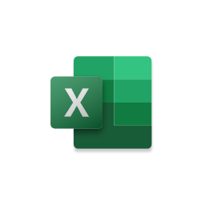
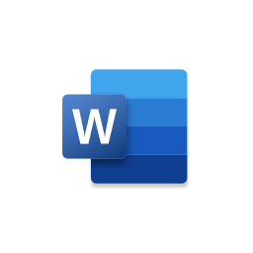
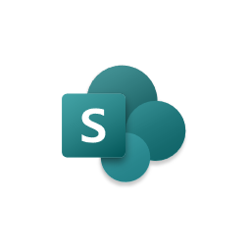
Dynamics 365 Business Central outcompetes with the only fully integrated stack, on the world’s most trusted and comprehensive cloud
Microsoft Dynamics 365 Business Central
Microsoft 365
Works seamlessly with the Microsoft applications you already use and know – Outlook, Teams, Excel and Power Platform
AI infused throughout the solution brings you continuous insights to speed decision making
A single system that works across international locations
Scalable and extensible to grow and adapt with your growing business
Developer Tools
Power Platform
Microsoft Azure
Identity, security, management, and compliance
Notes:
No other vendor offers the breadth of the Microsoft cloud, while continuing to be modular and extensible, so our customers can start with what they need today and adapt as they grow.
Also, Business Central runs on the Microsoft Azure cloud platform, which means you benefit from multi-layered, state-of-art security across physical datacenters, infrastructure, and operations, with security features like multi-factor authentication, data encryption, regulatory compliance, and more.
You also benefit from a team of more than 3,500 global cybersecurity experts that work together to help safeguard your business assets and data in Azure.

Slide 11
Business Central Differentiation: reliability, performance, and scale The best cloud platform for ERP
Performance and Scale
Security
Business Continuity and Disaster Recovery
Compliance
Notes:
Reliability, performance, security, compliance, and scale

Slide 12
Application Security in Business Central
Authentication
Users
Authentication
Authorization
Auditing
Data Encryption
Security Development Lifecycle
Authorization
License
Permissions
Database
Company
Object
Record
SQL database
Notes:
Business Central uses a layered approach to application security that includes authentication, authorization, and auditing, as well as data encryption and secure development practices.
Authentication
Before users can sign-in to the Business Central application, they must be authenticated as valid user in the system. Business Central On-Premises supports several authentication methods, such as Windows and Azure Active Directory. Business Central Online uses strictly Azure Active Directory (Azure AD).
Authorization
Once authenticated, authorization determines which areas a user can access, such as the pages and reports that they can open, and the permissions that they have on associated data.
Auditing
Business Central includes several auditing features that help you track information about who is signing in, what their permissions are, what data have they changed, and more.
Data Encryption
You can encrypt data on the Business Central server by generating new or importing existing encryption keys that you enable on the Business Central server instance that connects to the database.
Security Development Lifecycle
Microsoft's Security Development Lifecycle (SDL) is a software development process that helps developers build more secure software and address security compliance requirements while reducing development cost.
For more information, visit:
https://docs.microsoft.com/en-us/dynamics365/business-central/dev-itpro/security/security-application

Slide 13
Do more with less: Business Central
ROI
162%
With Dynamics 365 Business Central over three years¹
Savings
$44k
Third-party reporting spend reduction¹
Productivity
10%
Reduction in finance and operations hiring needs¹
Customer results
Call2Recycle saves $25K annually by reducing costs of previous system
CURRAX realized year-over-year growth of 12% in project handling
Payzone increased staff productivity by 40%
Dynamics 365 Business Central customers can enjoy new customer and migration offers
*Source: Results are over three years for a composite organization based on interviewed customers. The Total Economic Impact ™ of Microsoft Dynamics 365 Business Central, 2020

Slide 14
Dynamics 365 Business Central
Make your vision a reality with a connected business management solution that enables you to adapt faster, work smarter, and perform better
Adapt faster
Be prepared for disruption with the insights needed to pivot quickly, shift business models, and cultivate strategic plans.
Work smarter
Empower your people to confidently take action and get more done with AI-infused processes, automated workflows, and interoperability with Microsoft 365 + Teams.
Perform better
Enable better business performance with continuous process improvements and responsiveness across your entire business—not just financials.
Notes:
Here’s how Dynamics 365 Business Central helps you address the challenges of disruption by enabling you to adapt faster, work smarter, and perform better.
Adapt faster: Be prepared for disruption with the insights needed to pivot quickly, shift business models, and cultivate strategic plans.
Work smarter: Empower your people to confidently take action and get more done with AI-infused processes, automated workflows, and interoperability with Microsoft 365 + Teams.
Perform better: Enable better business performance with continuous process improvements and responsiveness across your entire business—not just financials.
Let’s take a look at each of these in more detail.

Slide 15
Adapt faster
Be prepared for disruption with the insights needed to pivot quickly, shift business models, and cultivate strategic plans.
Notes:
Adapt faster:
Be prepared for disruption with the insights needed to pivot quickly, shift business models, and cultivate strategic plans.
Innovate and adopt new business models faster with flexible deployment models, mobility, reliability, security, and adaptable Microsoft cloud solution that grows with your business.
A dynamic ecosystem creates adaptable business and operating models.
Deploy in the Microsoft cloud or on-premises
Easily tailored and extendable solution – over 2,000 apps on AppSource, while the Power Platform allows low code/no code customization
Can be used on any device, anywhere

Slide 16
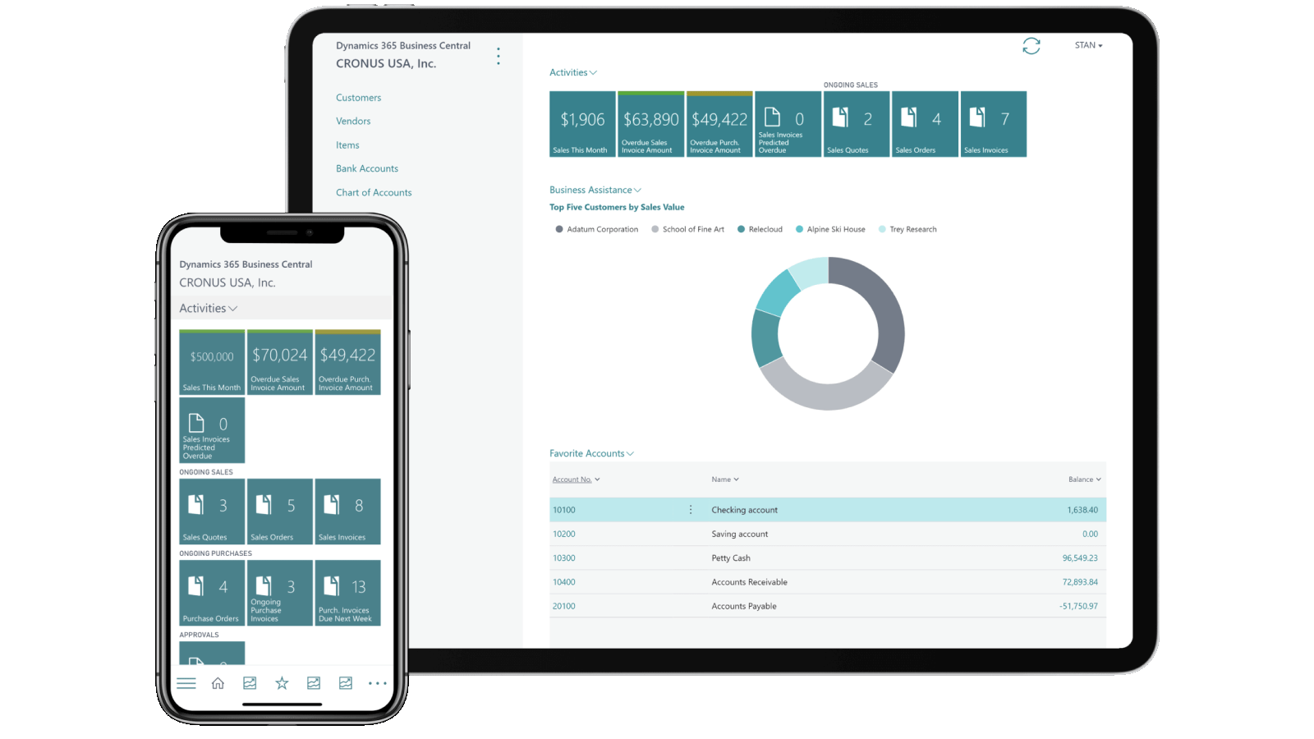
Take your business on the go
Work wherever your business takes you with full capabilities on desktop, tablet, or mobile, on premises or in the cloud, across Windows, Android and iOS devices.
Get a consistent experience across all your devices.
Notes:
Take your business on the go
Take your business on the go: work wherever your business takes you, with full capabilities on desktop, tablet, or mobile, on premises or in the cloud, across Windows, Android and iOS devices. Get a consistent experience across all your devices and secure single sign on to calendar, email, files, collaboration tools, and business processes.

Slide 17
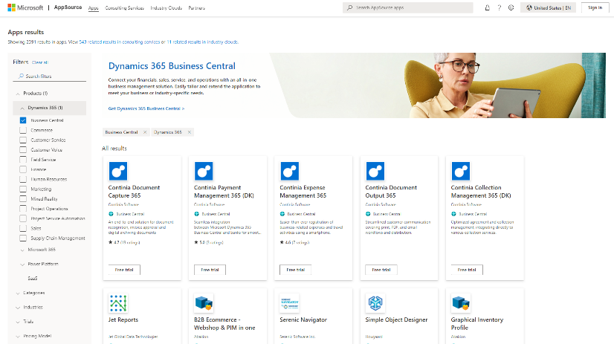
Industry-specific apps
Extend the solution to meet you unique vertical or business-specific requirements.
3,800+ apps on Microsoft AppSource designed for Business Central.
Notes:
Extend the solution with industry-specific apps built for Dynamics 365. Get purpose-driven extensions from Microsoft AppSource business applications marketplace with over 3,800 apps designed for Business Central to meet you unique vertical or business-specific requirements.

Slide 18
Onboarding framework for ease and speed Implementations are often measured in weeks, not years. Onboarding efforts include:
Customer interview
Teaching tips, tours, spotlights
Partner specific trial
Getting started checklist
Management API
Onboarding framework
https://aka.ms/ BConboarding
Configuration questionnaire
Configuration packages
Manual setup
Assisted setup wizards
Notes:
Awarded Fastest Implementation for Mid-Market Distribution ERP in 2023 by G2

Slide 19
“No other provider could offer us the potential to integrate our complete accounting department in just four months like Microsoft did.”
Florian Bauer: Project Manager, Digital
Design Offices
Notes:
Here’s a specific example of one of our customers, Design Offices, and how we helped them adapt faster.
As we mentioned earlier, Design Offices needed a finance and customer engagement platform for its sales and accounting departments to accommodate rapid and anticipated business growth. By embracing Microsoft Dynamics 365 Business Central, Design Offices has scaled up and optimized its sales and purchasing processes without having to operate an independent IT infrastructure.
Streamlining customer and employee experiences
Finance professionals at Design Offices use Dynamics 365 Business Central to optimize and digitize payment processes, while sales managers use Dynamics 365 Sales to track and qualify leads and manage contracts, especially those that may automatically recur.
Expanding the scope of the solution
Design Offices extended its Dynamics 365 environment to take advantage of Microsoft Power Platform and Microsoft Azure cloud resources, including Azure API Management and Azure Active Directory B2C. The company streamlines workflows using Power Automate, increases data visibility and delivers insights through Power BI, and empowers non-technical employees to quickly develop applications using Power Apps. It also uses Azure Logic Apps to build further integration into its workflows and optimize its operating models to help manage sales.
Uniting data, achieving flexibility, and unlocking new customer insights
By managing operations and sales processes on a single, centralized system, Design Offices now has the adaptable IT infrastructure it always dreamt of to proactively address ever-changing customer demands.
--
Design Offices adapts business processes to support rapid growth with Dynamics 365 Business Central
Quotes:
“No other provider could offer us the potential to integrate our complete accounting department in just four months like Microsoft did.” - Florian Bauer, Project Manager, Digital, Design Offices
“All of the data for our mobile Design Offices member app is collected in Dynamics 365, sent via custom APIs, and displayed in a customized native iOS and Android app. If we still had an on-premises system, we would never have had a chance to provide such an app.” - Florian Bauer, Project Manager, Digital, Design Offices
Link to story:
Design Offices optimizes business processes and supports rapid growth with Dynamics 365

Slide 20
Work Smarter
Empower your people to confidently take action and get more done with AI-infused processes, automated workflows, and interoperability with Microsoft 365 + Teams.
Notes:
Work smarter:
Empower your people to confidently take action and get more done with actionable insights, AI-infused processes, automated workflows, and interoperability to Microsoft 365, including Teams, Word, Excel, and Outlook.
Connectivity and data drive agile and productive experiences
Predict sales using historical data
Role-based workspaces and workflow guidance
Improved productivity with embedded Microsoft 365

Slide 21
Microsoft is fueling AI innovation
Decades of research & development
Committed to advancing Responsible AI
Secure from the start
Reliability & performance at scale for large AI models
Trusted by AI leaders like OpenAI
Runs on trust
Your data is your data
Notes:
We have invested in fueling AI innovation for years.
We’ve spent decades in research and development.
We’re committed to advancing the principles and practice of Responsible AI.
We’ve built security and trust into our platform and all our solutions right from the start.
We’ve created purpose-built AI infrastructure to deliver reliability and performance at scale, based on thousands of interconnected GPUs and Infiniband networking.
And as a result, we are trusted by AI leaders like OpenAI and many others. In fact, OpenAI builds and trains all of their AI models and experiences using the unique AI infrastructure of Microsoft Azure.
This innovation is exciting, but as AI is poised to transform our lives, we must collectively define new rules, norms, and practices for the use and impact of this technology.
The Microsoft Cloud runs on trust.
Trust has been a fundamental promise we have built into the Microsoft Cloud since the very beginning.
Data is the fuel that powers AI technology – and you need to trust what your technology partners are doing with your data.
----
There are three fundamental promises we make with the Microsoft Cloud:
First, your data is your data. It is not our data. It is your data. That means it is yours to own and control. Your data to choose how you want to leverage and monetize.
Second, your data is not used to train or enrich the foundation AI models used by others. You don’t have to worry about anyone other than your organization is benefiting from AI that is trained on your data. Only your organization benefits from your data and business processes.
And third, your data and AI models – in fact, your entire organization – are protected at every step by the most comprehensive enterprise compliance and security controls in the industry.
That is Microsoft’s commitment to you.

Slide 22
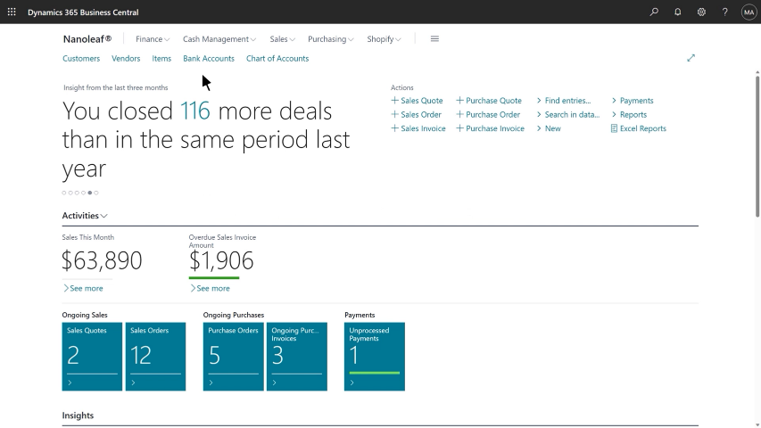
Copilot in Dynamics 365 Business Central
AI as a real-time collaborator that generates content, that sparks creativity, that saves time and drives sales.
Notes:
Demo video
Auto-generate compelling, creative product descriptions - Save time and drive sales with engaging marketing text tailored to your product and brand
Challenges
Producing and publishing product descriptions is resource- and time-intensive
Description copy is prone to erroneous product details
Creating unique, original text for similar products can be challenging
With Copilot in Dynamics 365 Business Central
Bring products to market faster with AI-generated product description suggestions
Create copy ideas in seconds based on selected product attributes, tone and format
Seamlessly publish to Shopify with just a few clicks

Slide 23
Improving the way business is done with AI in Business Central
Actionable insights that deliver business results
Improve customer service
Sales and inventory forecast extension
Anticipate business challenges
Late payment predictions
Enhance decision-making
Cash flow analysis
Notes:
Improve customer service with Sales and Inventory Forecasting
In a highly competitive business landscape, effective inventory management can be the key differentiator between a successful business and one that struggles to retain customers and remain profitable. Inventory management is a trade-off between customer service and managing your costs. While low inventory requires less working capital, inventory shortages can lead to missed sales. Using AI, the Sales and Inventory Forecast extension predicts future sales using historical data to help you avoid stockouts. Based on the forecast and inventory levels, the extension helps create replenishment requests to your vendors, helping you save time and improve inventory availability to keep your customers happy.
Anticipate business challenges with Late Payment Predictions
Effectively managing receivables is critical to the overall financial health of a business. The Late Payment Prediction extension can help you reduce outstanding receivables and fine-tune your collections strategy by predicting whether sales invoices will be paid on time. For example, if a payment is predicted to be late, you might decide to adjust the terms of payment or the payment method for the customer. By anticipating late payments and making adjustments, you can better manage and ultimately reduce overdue receivables.
Enhance decision-making with Cash Flow Analysis
Azure AI in Business Central helps you create a comprehensive cash flow forecast with Cash Flow Analysis, enhancing decision-making so you can stay in control of your cash flow. A company’s cash flow indicates its financial solvency and reveals whether the company can meet its financial obligations in a timely manner. To make sure that your company is solvent, a future-oriented planning instrument is necessary. With insights from AI, you can make proactive adjustments to ensure your company’s fiscal health, such as reducing credit when you have a cash surplus or borrowing to mitigate a cash deficit.

Slide 24
Work smarter using collaborative applications
Teams
Outlook
Excel
Windows
Dynamics 365 Business Central
Teams
Business data is available to everyone, everywhere
Easily communicate as part of any business process
Business applications are now multiplayer
Notes:
Collaborative applications like Dynamics 365 Business Central are transforming how people in organizations work together.
They empower people to be more collaborative, more productive, and more impactful by:
Making business data available to everybody, everywhere they interact in the digital space.
Facilitating easy communication as part of any business process—from within any business application, you can connect with the right people without switching applications or losing focus.
Enabling business applications to be multiplayer—allowing people to co-create Word docs, PowerPoint presentations, or Excel spreadsheets, collaborate on finance, sales, or service instances, or work on operations as a team.

Slide 25
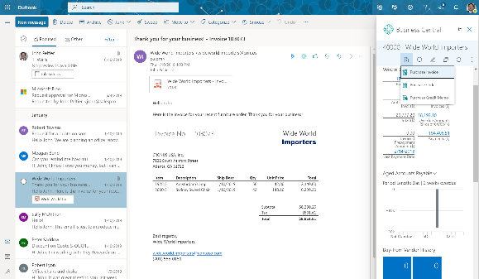
Dynamics 365 Business Central with Outlook
Go from quote to cash within the flow of work
Interact with customers and vendors directly from Outlook to accelerate transactions and business decisions
Promptly manage inquiries, service requests, or process payments to accelerate the sales cycle
Get insights into customer history, previous discounts, and more without leaving Outlook
Notes:
Go from quote to cash while checking your email in Outlook.
Interact with customers and vendors directly from Outlook to accelerate transactions and business decisions.
Promptly manage inquiries, service requests, or process payments to accelerate the sales cycle.
Get insights into customer history, previous discounts, and more without leaving Outlook.

Slide 26
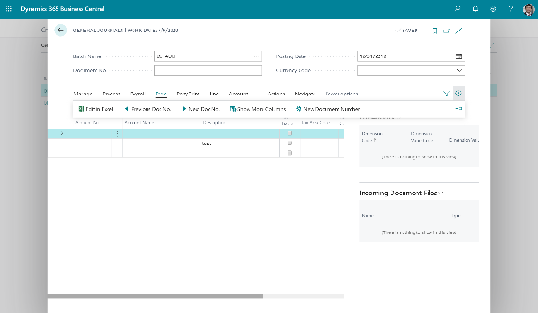
Dynamics 365 Business Central with Excel
Simplify daily tasks to free more time for strategy
Get up-to-date operational insights as Excel reports, and adapt quickly by customizing report layouts as Excel worksheets
Export data from Business Central to Excel for efficient data entry, then publish back to Business Central with business rule validation
Easily analyze transactions using familiar Excel functionality, then share with the team for review and co-authoring
Notes:
Simplify daily tasks, creating more time for strategy using Dynamics 365 Business Central with Excel.
Access Excel within Business Central to view data and create transactions such as general ledger journals.
Export data from Business Central to Excel for efficient data entry and accuracy and publish data back to Business Central.
Easily analyze transactions using familiar Excel functionality, add additional data, and publish.

Slide 27
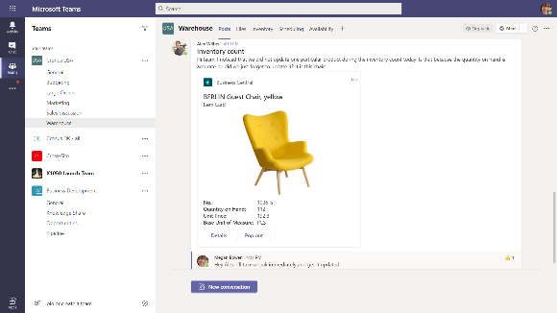
Dynamics 365 Business Central with Teams
Quickly share details so you can act faster
Make faster decisions by sharing Business Central data within Microsoft Teams conversations and tabs
Look up business contacts from Teams, along with insights, a history of interactions, and related records
Easily edit data and take action without switching apps
Notes:
Connect Microsoft Teams to your business data in Business Central so you can quickly share details across team members, look up contacts, and respond faster to inquiries.
Make faster decisions by sharing Business Central data within Microsoft Teams conversations and tabs. For example, paste a link to any Business Central record and it will expand into a compact card to share with coworkers. Pin a record or a curated list of records as a tab to focus your team on important datapoints.
.
Look up business contacts from Teams, along with insights, a history of interactions, and related records.
Easily edit data and take action without switching apps.

Slide 28
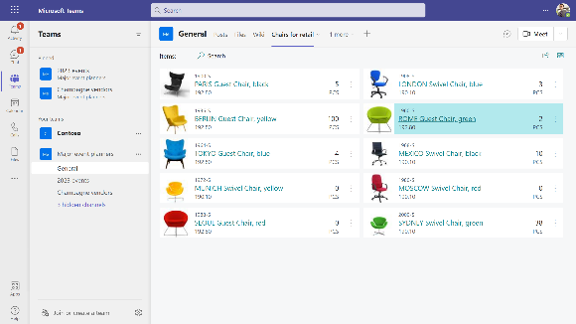
Access Business Central data with only a Microsoft 365 license at no additional cost
Access Business Central cards and tables that have been shared with you in Teams
Unlock data, improve collaboration, and enhance decision making without buying additional Business Central licenses
Read-only access is granted through your Microsoft 365 license as configured by your admin
Notes:
Access Business Central data with only a Microsoft 365 license at no additional cost
Access Business Central cards and tables that have been shared with you in Teams.
Unlock data, improve collaboration, and enhance decision making without purchasing additional Business Central licenses.
Read-only access is granted through your Microsoft 365 license as configured by your admin.

Slide 29
“The streamlining of all our processes allows our company leader to manage the whole organization from his tablet or smartphone.”
Jan Schmidt: Chief Digital Officer
CURRAX
Notes:
Here’s another of our customers, CURRAX. As we mentioned earlier, the CURRAX team wanted to run their business from anywhere.
Working smarter
To help them work smarter on the go, CURRAX colleagues use the Microsoft ecosystem and leverage Microsoft Teams and Dynamics 365 Business Central collectively to collaborate.
Performing better
In addition, the Microsoft 365 environment enables CURRAX’s subject matter experts to be able to focus on the core elements of their business.
Adapting faster
Business Central helped CURRAX adapt faster during the global pandemic. They had no operational issues due to the pandemic and were able to quickly adapted to the changing market environment. One manager was able to successfully work from the remote shores of Cameroon for several weeks. Working remotely was imperceptible to colleagues and clients.
Extending capabilities that enable end-to-end visibility
CURRAX can do its business anywhere. Now it wants to connect its ecosystem further and implement Dynamics 365 Customer Service to enable significant collaboration with key partners and customers. Turning ideas into action with Microsoft Power Platform, specifically Power Automate, is also on CURRAX’s agenda. Jan Schmidt sees many opportunities in automating approval processes and finding new ways to increase the quality of customer interactions.
--
Drive for digitization powered by Dynamics 365 Business Central keeps CURRAX fully focused on its winning ways
Quote:
“The streamlining of all our processes allows our company leader to manage the whole organization from his tablet or smartphone.” - Jan Schmidt, Chief Digital Officer, CURRAX
“With Dynamics 365 Business Central, we gain agility in a fast-moving world. Agility is the key to winning projects.” - Jan Schmidt, Chief Digital Officer, CURRAX
Link to story:
Drive for digitization powered by Dynamics 365 Business Central keeps company fully focused on its winning ways

Slide 30
Perform Better
Enable better business performance with continuous process improvements and responsiveness across your entire business—not just financials.
Notes:
Perform better:
Enable better business performance with continuous process improvements and responsiveness across your entire business—not just financials.
Enable high performance with guided workflows, governance, and real-time metrics that drive continuous process optimization, accelerates financial closes, and improves cycle times.
Continuous optimization and agility provide sustained profitability and cash flow
Faster reporting, cycle times, and financial closes
Real-time data visualization across departments
Built-in business intelligence and Power BI

Slide 31
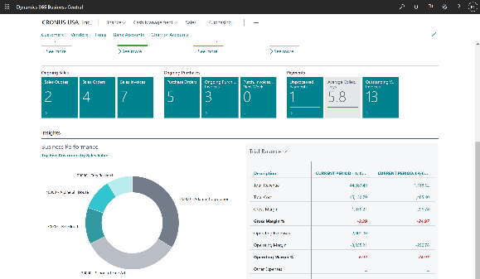
Increase financial visibility and performance
Take control of your financial data
Accelerate financial close, improve forecasting, and get real-time performance metrics while fostering compliance and security
Use built-in reports, Excel, or Microsoft Power BI and unlimited data dimensions to analyze trends and improve business planning.
Notes:
Accelerate financial close, improve forecasting, and get real-time performance metrics while fostering compliance and security across subsidiaries.
Take control of financial data
Better manage your cash flow, bank reconciliations, fixed assets, budgeting, and project costing while shortening cycle times with the late payment–prediction extension.
Accelerate financial closing and reporting
Easily support multiple currencies, exchange rates, consolidations, intercompany transactions, and localized tax regulations.
Maximize financial visibility
Use built-in reports, Excel, or Microsoft Power BI and unlimited data dimensions to get real-time cash flow, identify financial patterns, analyze trends, and improve business planning.
Better reporting for more profitable financial decisions
Connect reports, charts, and Power BI data from across accounting, sales, purchasing, and inventory teams to get accurate insights and make financial decisions with confidence.

Slide 32
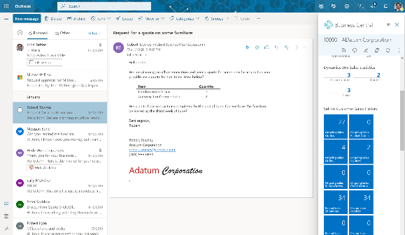
Boost sales and improve customer service
Build long-lasting relationships
Take better care of customers by managing the entire sales process from within Microsoft Outlook and deliver better outcomes with connected service operations
You can see information about customers, quotes, shipments and invoices without switching applications
Notes:
Take better care of customers by managing the entire sales process from within Microsoft Outlook and deliver better outcomes with connected service operations.
Prioritize leads based on revenue potential
Keep track of customer interactions and get guidance on the best upsell, cross-sell, and renewal opportunities throughout your sales cycle.
Offer flexible pricing and discounting
Create flexible pricing and discount structures for individual customers and groups of customers.
Deliver on promised customer outcomes
Track customer agreements to quickly access details about prices, discounts, delivery dates, product availability, and fulfillment status.
Ensure a smooth transition from sales to service
Automatically register shipped goods as service items and keep the required details in one place so both sales and service teams can respond quickly to inquiries.
Track customer returns and repairs
Offer full replacements or simple repairs, with parts and labor charges in one service order. Boost loyalty by providing spare equipment to customers awaiting service.
Live up to your service promises
Effectively assign personnel to work orders and get an overview of service tasks and workloads. Keep track of service agreements to deliver reliable service to your customers.

Slide 33
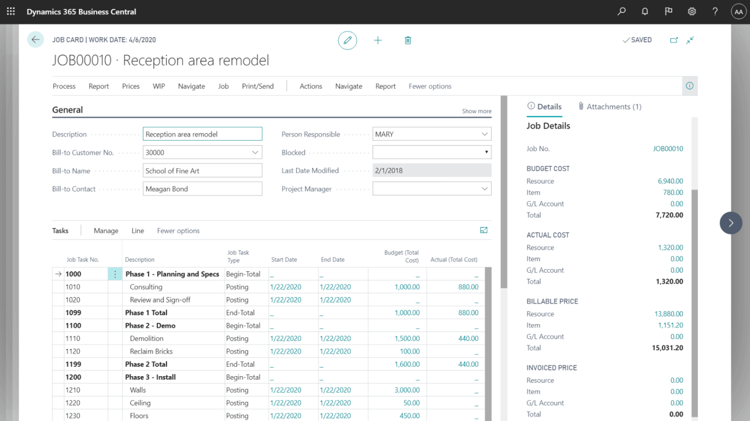
Finish projects on time and under budget
Successful projects start with proper planning
Ensure successful project execution and profitability with planning, resourcing, tracking, costing, billing, accounting, and real-time intelligence
Derive insights and get those insights into the hands of employees to support decision making in real-time
Notes:
Ensure successful project execution and profitability with planning, resourcing, tracking, costing, billing, accounting, and real-time intelligence.
Improve project costing and accounting
Better manage projects using timesheets and advanced job costing and reporting. Develop and modify detailed budgets to help ensure project profitability.
Optimize resource levels
Manage resource utilization by planning capacity and sales. Track customer invoicing against planned or actual costs on orders and quotes.
Drive profitability with project insights
Get real-time business intelligence on project status, profitability, and resource utilization metrics.

Slide 34
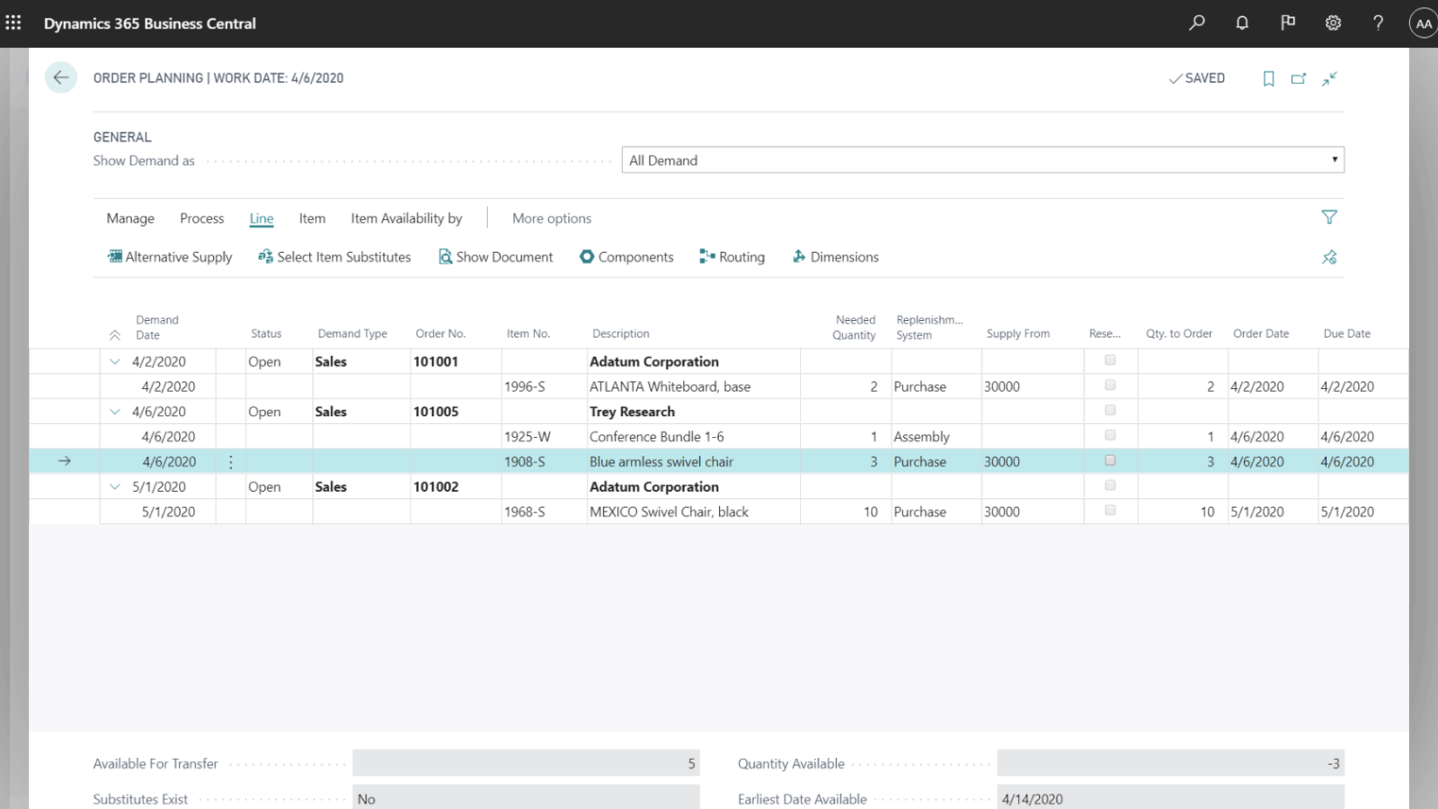
Optimize inventory and supply chain management
End-to-end visibility for better results
Deliver products on time and adapt to changing business models with visibility across purchasing, manufacturing, inventory, and warehouses
Move from manual forecasting and inventory management to AI based predictive forecasting to improve accuracy
Notes:
Deliver products on time and adapt to changing business models with visibility across purchasing, manufacturing, inventory, and warehouses.
Improve supplier engagement
Build better relationships with suppliers and convert the best offers to orders. Ensure compliance with policies, process, governance and approvals.
Get a holistic view of your inventory
Use the same costing method or different ones for inventory items, and easily move items between locations to control the quantity on hand using cycling counting.
Predict stock replenishment
Replenish inventory based on actuals, demand, and availability using built-in intelligence, sales forecasts, and expected stock-outs to automatically create purchase orders.

Slide 35
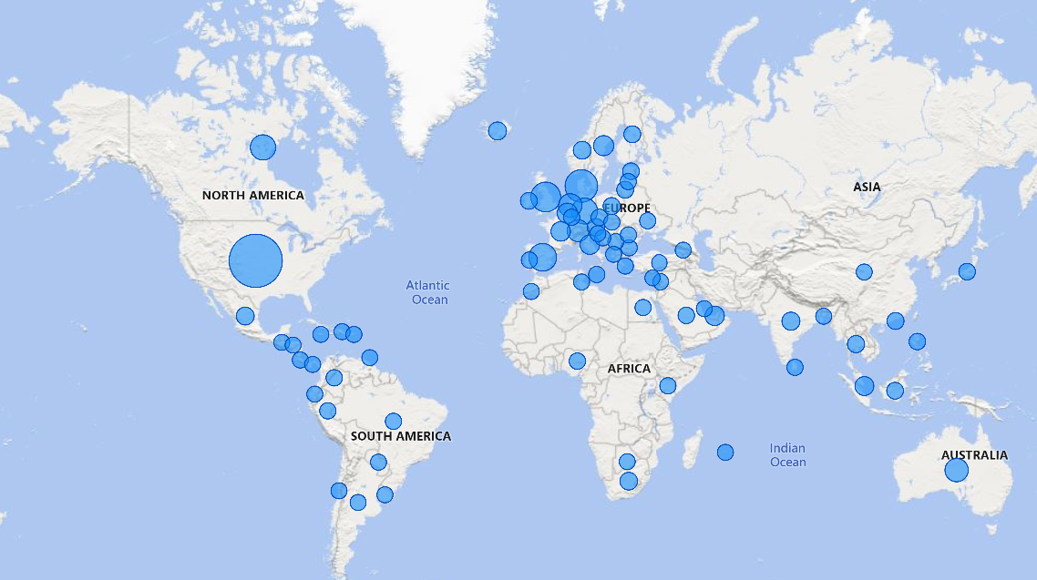
Expand into global markets
Be ready to grow
Support to scale business operations in over 130 countries and regions
Easily support multiple currencies, exchange rates, consolidations, intercompany transactions, and localized tax regulations
Visit https://aka.ms/BCcountries for current availability
Notes:
Expand into global markets
Support to scale business operations in over 130 countries.
Easily support multiple currencies, exchange rates, consolidations, intercompany transactions, and localized tax regulations.
Our global network of datacenters helps meet data residency and compliance requirements.
Business Central provides localization for over 130 countries and translation for over 30 languages.
This is extended by partners to even more countries and languages.
https://aka.ms/BCcountries

Slide 36
“With real-time information we immediately see trends with our revenue and customers, and we can act quickly if there is any kind of service disruption.”
Linda Gabor: Executive Vice President of External Relations
Call2Recycle
Notes:
Call2Recycle is the last of our customers that we mentioned at the beginning of the presentation.
As you’ll recall, they needed to find a unified ERP and CRM tool to tightly manage and track all aspects of their operations.
A comprehensive, connected solution
Call2Recycle researched combined ERP and customer relationship management (CRM) solutions. That search led to Microsoft Dynamics 365 Business Central, which is designed to provide small and midsize businesses with comprehensive capabilities and a lot of integration potential. To further boost its CRM capabilities, the organization adopted Dynamics 365 Sales to manage its end-to-end sales processes. The nonprofit also turned to Microsoft Power Platform to extend its Dynamics 365 environment. The organization uses Power BI to visualize data and gain advanced analytics, and it uses Power Automate and Power Apps to connect data sources and quickly build and automate workflows.
Streamlined operations, reduced costs
Call2Recycle improved efficiencies in many of its operations, such as invoicing and billing. For example, customer billing used to take several days to complete each month, but now the process has been automated. In addition to time savings, Call2Recycle also reduced costs. The organization also saves approximately $25,000 in annual fees, licenses, and hardware support that its previous systems required.
Real-time, self-service data
Call2Recycle’s data used to be siloed, but now it’s centralized and available in real time. That means data is democratized, and staff can respond more quickly to customer needs or operational hiccups. One reason that staff members now get data more easily is because they have more self-service options, which is especially important as the organization continues to grow and add more staff.
--
Call2Recycle increases organizational efficiency, powers more data-driven operations with Business Central
Quotes:
“With real-time information in Dynamics 365, we immediately see trends with our revenue and customers, and we can act quickly if there is any kind of service disruption.” - Linda Gabor, Executive Vice President of External Relations
“By automating processes in Business Central, we save 10 hours per month on invoicing, 8 hours on banking activities like vendor payment uploads, and 12 hours on processing vendor invoice approvals.” - David Ainsley: Director of IT, Call2Recycle
Link to story:
Call2Recycle increases organizational efficiency, powers more data-driven operations with Business Central

Slide 37
The Total Economic Impact™ of Business Central
ROI 162%
BENEFITS PV
$466K
NPV $288K
PAYBACK <1 year
“We were looking for an upgraded ERP solution capable enough for our complicated operations, in the cloud. Business Central is that solution. We have everything we need in one tool.“
Specialty manufacturing CEO
$231.5K
$147.0K
$44.8K
$42.7K
The Total Economic Impact™ of Microsoft Dynamics 365 Business Central
Notes:
Forrester’s analysis of five Microsoft customers found that Dynamics 365 Business Central enabled these organizations to bolster operational efficiency, avoid costs, and comfortably scale their deployments with growth while benefitting from the flexibility inherent in the cloud. An analysis based on a $15-million, 250-employee composite organization modeled after the five interviewees demonstrates benefits of $466K over three years versus costs of $178K, adding up to a net present value (NPV) of $288K and an ROI of 162%.
Quantified benefits included:
Avoidance of one full-time equivalent (FTE) and one part-time equivalent finance and operations hires. The functionality, visibility, and access improvements for finance and operations staff allowed the interviewed organizations to continue their growth trajectory without the need to hire additional staff, reducing the need to hire by an average of 10%.
Improved flow of operations by an average of 8%. Finance and operations professionals have better tools to execute their daily responsibilities, improving workflows throughout finance and operations. Staff use their reclaimed productivity to make other iterative improvements to operations.
Elimination of more than $44K of third-party reporting spend over three years. After migration to Business Central, organizations can leverage additional functionality and Microsoft tools such as Power BI and eliminate reliance on externally generated reports for a more granular visibility into their business.
Avoidance of more than $40K in costs pertaining to the previous solutions. Migrating from on-premises Microsoft and non-Microsoft ERP tools yields savings in the form of license fee and infrastructure reductions, as well as support personnel savings.
Unquantified benefits included:
Improved EX. On Dynamics 365 Business Central, employees are less burdened by some of the common frustrations around finance and operations exacerbated by a disparate set of ERP tools.
Integration with other Microsoft products. Interviewees cited integration with their other Microsoft solutions such as SharePoint and Power BI as additional boons to their Business Central migrations.
Increased confidence from real-time visibility. For the first time, for some organizations, decision makers could view key business data, reports, and metrics in real time. Beyond productivity, this real-time view into data fosters confidence in those who need to use it.
Quotes:
"We were looking for an upgraded ERP solution capable enough for our complicated operations, in the cloud. Business Central is that solution. We have everything we need in one tool." — CEO, specialty manufacturing
"The move to Business Central has been especially helpful during the pandemic, as our users can access key business functions remotely." —Controller, specialty manufacturing
Link to download:
The Total Economic Impact™ of Microsoft Dynamics 365 Business Central

Slide 38
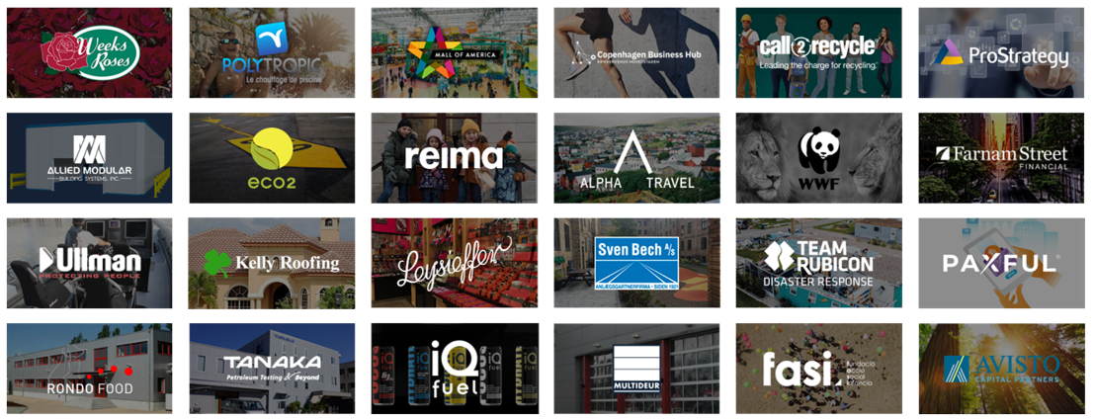
SMB customers growing with Business Central
Consumer goods
Manufacturing
Retail
Prof. services
Non-profit
Fin. services

Slide 39
Dynamics 365 Business Central
Make your vision a reality with a connected business management solution that enables you to adapt faster, work smarter, and perform better.

Slide 40
Get started with Dynamics 365 Business Central
Learn more → Read the Savvy SMB Leader’s ERP Buyers Guide
See how Microsoft can help address your finance needs → Take a guided tour
Try for free → Trial

Slide 41
Thank you

Slide 42
Appendix

Slide 43
Dynamics 365 Business Central – Video

Slide 44
Customers growing with Business Central
“No other provider could offer us the potential to integrate our complete accounting department in just four months like Microsoft did.”
– Florian Bauer, Project Manager, Digital
“The streamlining of all our processes allows our company leader to manage the whole organization from his tablet or smartphone.”
– Jan Schmidt, Chief Digital Officer
“With real-time information in Dynamics 365, we immediately see trends with our revenue and customers, and we can act quickly if there is any kind of service disruption.”
– Linda Gabor, Executive Vice President of External Relations
Notes:
Here’s what the three businesses we talked about earlier had to say about Business Central.
Design Offices: “No other provider could offer us the potential to integrate our complete accounting department in just four months like Microsoft did.” - Florian Bauer, Project Manager, Digital
CURRAX: “The streamlining of all our processes allows our company leader to manage the whole organization from his tablet or smartphone.” - Jan Schmidt, Chief Digital Officer
Call2Recycle: “With real-time information in Dynamics 365, we immediately see trends with our revenue and customers, and we can act quickly if there is any kind of service disruption.” - Linda Gabor, Executive Vice President of External Relations
We’ll take a look at their individual stories in more detail later.

Slide 45
Customer: Design Offices
Industry: Professional services
Size: 500+ employees
Country: United States
Products and services: Dynamics 365 Business Central Dynamics 365 Sales Microsoft Teams Power Apps Power Automate Power BI
Read full story here
“No other provider could offer us the potential to integrate our complete accounting department in just four months like Microsoft did.”
– Florian Bauer, Digital Officer, Design Offices
To support the company’s many types of accounts, its finance team manages billings, accounts payable, and accounts receivable for each customer—often a complex undertaking. Design Offices wanted to update its legacy infrastructure to streamline and automate processes, scale more elastically, and improve transparency.
By embracing Microsoft Dynamics 365 Business Central, Dynamics 365 Sales, Power Platform, Design Offices has scaled up and optimized its sales and purchasing processes without having to operate an independent IT infrastructure.
By managing operations and sales processes on a single, centralized system, Design Offices now has the adaptable IT infrastructure it always dreamt of to proactively address ever-changing customer demands. “In our on-premises environment, we had to check all our servers for capacity. In our Dynamics 365 cloud environment, we have the flexibility our company needs to handle continuous change”, says Florian.
Notes:
Here’s a specific example of one of our customers, Design Offices, and how we helped them adapt faster.
As we mentioned earlier, Design Offices needed a finance and customer engagement platform for its sales and accounting departments to accommodate rapid and anticipated business growth. By embracing Microsoft Dynamics 365 Business Central, Design Offices has scaled up and optimized its sales and purchasing processes without having to operate an independent IT infrastructure.
Streamlining customer and employee experiences
Finance professionals at Design Offices use Dynamics 365 Business Central to optimize and digitize payment processes, while sales managers use Dynamics 365 Sales to track and qualify leads and manage contracts, especially those that may automatically recur.
Expanding the scope of the solution
Design Offices extended its Dynamics 365 environment to take advantage of Microsoft Power Platform and Microsoft Azure cloud resources, including Azure API Management and Azure Active Directory B2C. The company streamlines workflows using Power Automate, increases data visibility and delivers insights through Power BI, and empowers non-technical employees to quickly develop applications using Power Apps. It also uses Azure Logic Apps to build further integration into its workflows and optimize its operating models to help manage sales.
Uniting data, achieving flexibility, and unlocking new customer insights
By managing operations and sales processes on a single, centralized system, Design Offices now has the adaptable IT infrastructure it always dreamt of to proactively address ever-changing customer demands.
--
Design Offices adapts business processes to support rapid growth with Dynamics 365 Business Central
Quotes:
“No other provider could offer us the potential to integrate our complete accounting department in just four months like Microsoft did.” - Florian Bauer, Project Manager, Digital, Design Offices
“All of the data for our mobile Design Offices member app is collected in Dynamics 365, sent via custom APIs, and displayed in a customized native iOS and Android app. If we still had an on-premises system, we would never have had a chance to provide such an app.” - Florian Bauer, Project Manager, Digital, Design Offices
Link to story:
Design Offices optimizes business processes and supports rapid growth with Dynamics 365

Slide 46
Customer: Call2Recycle
Industry: Nonprofit
Size: 1–49 employees
Country: United States
Products and services: Microsoft Dynamics 365 Microsoft Dynamics 365 Business Central Microsoft Dynamics 365 Sales Microsoft Power Platform Microsoft Power Apps Microsoft Power Automate Microsoft Power BI
Read full story here
“With real-time information in Dynamics 365, we immediately see trends with our revenue and customers, and we can act quickly if there’s any kind of service disruption.”
—Leo Raudys, Chief Executive Officer, Call2Recycle
Call2Recycle outgrew its highly customized ERP tools, and as the largest battery recycling program in the United States, it needed to tightly manage its operations and increase efficiency to better serve and grow its customer base.
The nonprofit replaced its disparate systems with Microsoft Dynamics 365 Business Central, as well as Dynamics 365 Sales to manage its end-to-end sales processes and Microsoft Power Platform.
With increased integration and automation, Call2Recycle boosted efficiencies across its organization, saving time on invoicing, banking processes, and more. It now has flexible, modern technology to track the life of its batteries and serve future customers.
Notes:
Call2Recycle is the last of our customers that we mentioned at the beginning of the presentation.
As you’ll recall, they needed to find a unified ERP and CRM tool to tightly manage and track all aspects of their operations.
A comprehensive, connected solution
Call2Recycle researched combined ERP and customer relationship management (CRM) solutions. That search led to Microsoft Dynamics 365 Business Central, which is designed to provide small and midsize businesses with comprehensive capabilities and a lot of integration potential. To further boost its CRM capabilities, the organization adopted Dynamics 365 Sales to manage its end-to-end sales processes. The nonprofit also turned to Microsoft Power Platform to extend its Dynamics 365 environment. The organization uses Power BI to visualize data and gain advanced analytics, and it uses Power Automate and Power Apps to connect data sources and quickly build and automate workflows.
Streamlined operations, reduced costs
Call2Recycle improved efficiencies in many of its operations, such as invoicing and billing. For example, customer billing used to take several days to complete each month, but now the process has been automated. In addition to time savings, Call2Recycle also reduced costs. The organization also saves approximately $25,000 in annual fees, licenses, and hardware support that its previous systems required.
Real-time, self-service data
Call2Recycle’s data used to be siloed, but now it’s centralized and available in real time. That means data is democratized, and staff can respond more quickly to customer needs or operational hiccups. One reason that staff members now get data more easily is because they have more self-service options, which is especially important as the organization continues to grow and add more staff.
--
Call2Recycle increases organizational efficiency, powers more data-driven operations with Business Central
Quotes:
“With real-time information in Dynamics 365, we immediately see trends with our revenue and customers, and we can act quickly if there is any kind of service disruption.” - Linda Gabor, Executive Vice President of External Relations
“By automating processes in Business Central, we save 10 hours per month on invoicing, 8 hours on banking activities like vendor payment uploads, and 12 hours on processing vendor invoice approvals.” - David Ainsley: Director of IT, Call2Recycle
Link to story:
Call2Recycle increases organizational efficiency, powers more data-driven operations with Business Central

Slide 47
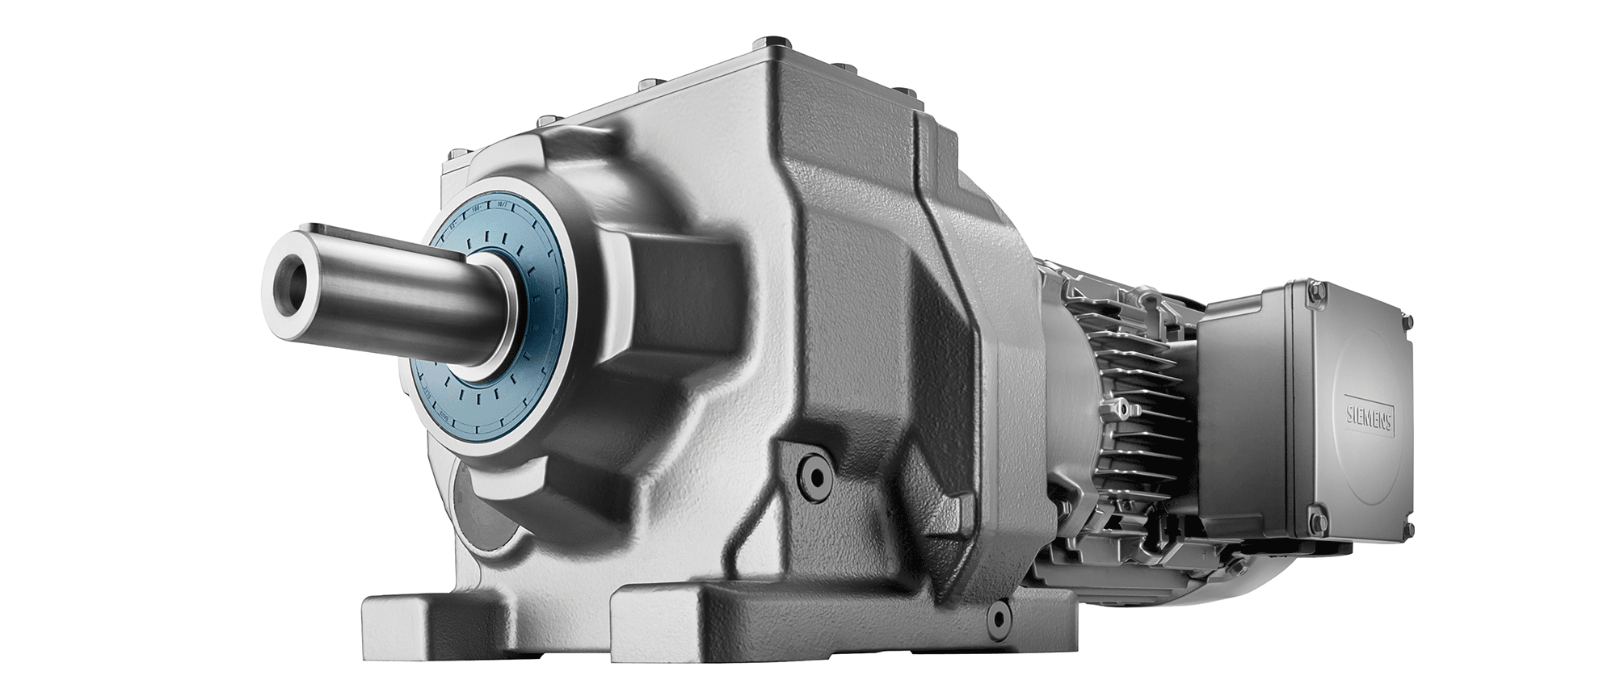
Customer: Currax
Industry: Professional services
Size: 1–49 employees
Country: Germany
Products and services: Dynamics 365 Business Central Dynamics 365 Customer Service Microsoft Teams Power Automate
Read full story here
“The streamlining of all our processes allows our company leader to manage the whole organization from his tablet or smartphone.”
—Jan Schmidt, Chief Digital Officer, Currax
Digitization drives CURRAX’s future. The Siemens and Flender partner, which is headquartered in Germany, wanted to stay on the forefront in streamlining its ability to run and grow the business.
The company implemented Dynamics 365 Business Central, enabling CURRAX’s subject matter experts to collaborate effectively and focus on the core elements of their business.
Amortized the cost of system in less than 6 months
Online sales project management enabled year-over-year growth of 12%
Significant cost savings, increased resource capacity, and top-notch remote collaboration
Notes:
Here’s another of our customers, CURRAX. As we mentioned earlier, the CURRAX team wanted to run their business from anywhere.
Working smarter
To help them work smarter on the go, CURRAX colleagues use the Microsoft ecosystem and leverage Microsoft Teams and Dynamics 365 Business Central collectively to collaborate.
Performing better
In addition, the Microsoft 365 environment enables CURRAX’s subject matter experts to be able to focus on the core elements of their business.
Adapting faster
Business Central helped CURRAX adapt faster during the global pandemic. They had no operational issues due to the pandemic and were able to quickly adapted to the changing market environment. One manager was able to successfully work from the remote shores of Cameroon for several weeks. Working remotely was imperceptible to colleagues and clients.
Extending capabilities that enable end-to-end visibility
CURRAX can do its business anywhere. Now it wants to connect its ecosystem further and implement Dynamics 365 Customer Service to enable significant collaboration with key partners and customers. Turning ideas into action with Microsoft Power Platform, specifically Power Automate, is also on CURRAX’s agenda. Jan Schmidt sees many opportunities in automating approval processes and finding new ways to increase the quality of customer interactions.
--
Drive for digitization powered by Dynamics 365 Business Central keeps CURRAX fully focused on its winning ways
Quote:
“The streamlining of all our processes allows our company leader to manage the whole organization from his tablet or smartphone.” - Jan Schmidt, Chief Digital Officer, CURRAX
“With Dynamics 365 Business Central, we gain agility in a fast-moving world. Agility is the key to winning projects.” - Jan Schmidt, Chief Digital Officer, CURRAX
Link to story:
Drive for digitization powered by Dynamics 365 Business Central keeps company fully focused on its winning ways

Slide 48
Business Central country availability
78%
Of the world Gross Domestic Product (GDP)
131
Countries
30
More countries planned for next release
Notes:
Country Availability: https://aka.ms/BCcountries

Slide 49
A truly extensible solution
Rapidly deploy and onboard
Harness data everywhere
Modular and purpose-built
Reshape and transform
Deploy solutions and onboard users in days or weeks, not months, to innovate and drive business outcomes in less time.
Connect to hundreds of data sources out-of-the-box, or easily create your own connectors, with seamless Office 365, Azure, LinkedIn, and third-party data sources.
Built using modular, purpose-built applications that integrate with your existing systems and software tools to extend capabilities of solutions you already use.
Work with a trusted Microsoft partner to accelerate success and get the most value from Dynamics 365.
Notes:
Business Central offers a truly extensible solution through the breadth of the Microsoft cloud, while continuing to be modular. Customers can start with what they need today and adapt as they grow.
Rapidly deploy and onboard. Deploy solutions and onboard users in days or weeks, not months, to innovate and drive business outcomes in less time.
Harness data everywhere. Connect to hundreds of data sources out-of-the-box, or easily create your own connectors, with seamless Office 365, Azure, LinkedIn, and third-party data sources.
Modular and purpose-built. While Dynamics 365 Business Central provides business management across financials, sales, service, projects, warehousing, supply chain, and manufacturing in a single solution. It is also built using the only business cloud platform to bridge ERP and CRM with modular, purpose-built applications that integrate with your existing systems and software tools to extend capabilities of solutions you already use. You can expand capabilities by also deploying Dynamics 365 Sales Professional, Customer Service Professional, and Power Apps.
Reshape and transform. Work with a trusted Microsoft partner—leaders in vertical innovation—to accelerate success and get the most value from Dynamics 365. 60K+ Cloud Solution Provider (CSP) Partners.

Slide 50
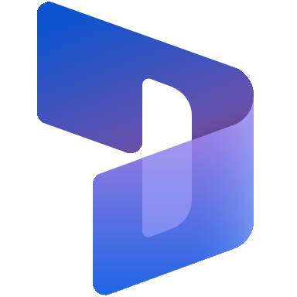
The blueprint for cross-organization impact
BUSINESS DATA & PROCESSES
PRODUCTIVITY & COLLABORATION
Dynamics 365
Teams
Microsoft 365
LOW CODE
INSIGHTS & ANALYTICS
Power Platform
Customer Insights
Power BI
1
Copilot
Data and AI/infrastructure
Identity, security, management, and compliance
Notes:
Let’s take a look under the hood at the elements that enable these capabilities.
Dynamics 365 connects data from across the company, processes for any business function, and intelligence to engage customers and optimize operations. These applications break down siloes so that everyone can work from one source of truth.
Dynamics 365 is supported by Microsoft Power Platform, a unified platform of low-code tools that anyone can customize to analyze data, build apps, automate processes, and create virtual agents.
We’ve also tightly integrated Microsoft 365—including Office applications and Microsoft Teams—with Dynamics 365. Everything is connected and accessible—customer and business records, documents, and colleagues. So one can easily and securely share business and customer records and documents with coworkers, collaborate on that information and sync your work back to the system of record---whether from Dynamics 365 or Teams or Outlook.
Finally, we have our insights and analytics capabilities—AI-powered insights derived from the volumes of data harnessed every hour of every day, surfaced when people need it from within Dynamics 365 or Teams.
We even connect with hundreds of other systems, platforms and databases---letting you get the most value from your investments.
By integrating AI-powered insights, automation, innovation and collaboration into your employees’ workflow, you can elevate customer experiences and operational excellence in every department. Everyone can help grow the organization with a shared purpose.

Slide 51
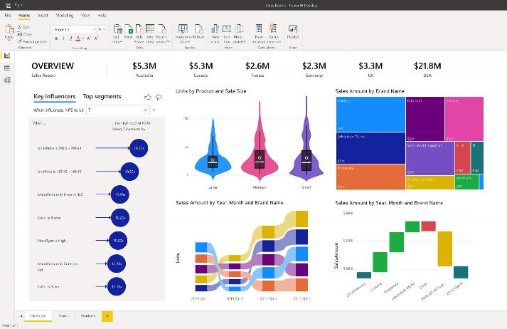
Microsoft Power Platform
Give everyone the ability to create solutions that accelerate business
Power BI
Analyze data
Make informed, confident business decisions by putting data-driven insights into everyone’s hands.
Power Apps
Automate processes
Boost business productivity to get more done by giving everyone the ability to automate organizational processes.
Power Automate
Build solutions
Turn ideas into organizational solutions by enabling everyone to build custom apps that solve business challenges.
Power Virtual Agents
Create virtual agents
Easily build chatbots to engage conversationally with your customers and employees— no coding required.
Notes:
The Power Platform enables business users to Analyze, Act, and Automate in ways that can make a big impact across the business.
[Analyze] Any business user, from the CEO to frontline workers, can make sense of data through interactive, real-time dashboards and unlock the insights needed to drive business forward
[Act]…which provides informed actions to create intelligent business processes via PowerApps without writing code
[Automate] and then leverage Flow to automate workflows between apps and services.

Slide 52
Customer Priorities
Key findings from 2023 Business Trends Survey
Empower employees
Collaborative Apps
AI and automation
Low-code tools
79%
64%
89%
77%
of employees think it’s important to include their buy-in when it comes to digital transformation initiatives
of employees say the lack of integration between tools and processes makes it difficult to collaborate across teams
with access to automation and AI-powered tools feel more fulfilled because they can spend time on work that truly matters
wish that they had more access to low code / no code tools that help them achieve their goals
“’Workers want more AI to get rid of their office busywork,’ says Microsoft survey”

Slide 53
Dynamics 365 Copilot
AI-powered assistance that helps business professionals
Generate ideas and content faster
Perform and automate task faster
Get insights and next best actions
All using natural language
Key differentiation:
GPT-powered Copilot for every job role
Copilot features natively built in Dynamics 365
Secure enterprise data – your data is your data
Powered by Azure OpenAI Service
Empowering impactful responsible AI practices
Notes:
At a high-level, you’ll see Copilot provide AI-powered assistance to help professionals in their daily workflow. It’s meant to augment workflows and help reduce the time spent on administrative tasks.
It can also help uncover insights and identify next best actions, leading to a more agile and proactive organization.

Slide 54
Roadmap
http://aka.ms/BCreleaseplan
Notes:
To learn more about what’s new and planned for Business Central visit our release plan http://aka.ms/BCreleaseplan
Because the page lists features that may not have released yet, delivery timelines may change and projected functionality may not be released.

Slide 55
A look into the future
World class user experience
Business Central will continue to be a user-friendly business application suite that is efficient, “video-game” fast, and powerful, yet simple to discover and quick to onboard.
Connected
Seamless integration with the world’s data—from banking, invoicing, commerce, shipping, and procurement—to IoT and sensor data, and large datasets like Census data, currencies, weather, taxes, traffic.
Predictive era
With connected data the user experience turns upside down; AI augments human intelligence to optimize processes, make predictions, delight customers, and revolutionize how businesses are run.

Slide 56
Why migrate to the cloud?
Always be on the latest version of the solution without costly upgrades
No more infrastructure management
Work seamlessly with other Microsoft products
Enhanced Microsoft cloud security
Improve privacy, reliability, and scalability
Work from anywhere, on any device
Access predictive analytics, AI, and data visualizations
Be ready for the future with the latest AI and product innovations

Slide 57
Align to industry priority scenarios

Slide 58
Pharma and life sciences shifting organizational priorities
Empower health consumers
Accelerate scientific innovation
Enhance workforce experience
Build operational agility
Notes:
Slide title: The COVID-19 pandemic was a catalyst for change and shifting organizational priorities​
​
The pandemic put the healthcare industry through a perfect storm—significant disruptions in terms of delivery of care, information management, member engagement, and more. The pandemic also accelerated digital trends that were already growing, and healthcare companies rose to the challenge by capitalizing on those trends. ​Pharmaceutical and life sciences organizations are working hard to keep employees safe and support an increase in remote workers; minimize any operational disruption to keep services running smoothly for members; manage risk, manage cost to meet demand, and help those who need assistance the most.
Here are some of the biggest trends in healthcare today, particularly for ​pharmaceutical and life sciences organizations like yourself:
Empowering and protecting health consumers. Engage directly and securely with health citizens, to drive market efficiency and reduce costs.​ Health citizens expect more, and when they are more informed about their healthcare—they have convenient access to their personal health information, receive evidence-based guidance and personalized support - they can be a valuable source of data to aid improvements to clinical trial processes. ​​
Accelerate scientific innovation. Modernize discovery, R&D, and improve clinical trial management. Innovation is key in Healthcare – but it takes massive computing resources to search through chemical and biological databases looking for new drug candidates. Unless researchers have access to either a state-of-the-art corporate data center or one of the world’s few supercomputers, there’s just too much data to analyze efficiently. The identification of compounds that will cause a desired biological effect requires a huge investment in technical infrastructure.​ When you can give R&D, operations, and administration the ability to spend more time with pts by cutting through the clutter of their fragmented systems, they can communicate and collaborate much more effectively—and that’s when great things happen inside and outside your organization.
Enhance workforce experience. Equip your workforce with skills and tools needed to streamline processes and remove barriers to increased collaboration.
Build trust and operational agility. Pharma and Life sciences organizations deal with increased global regulatory scrutiny and manufacturing in this space is no different—it’s under massive transformation. Use secure actionable insights to transform operations, increase productivity and reduce time-to-market.​
By making the most of these trends, pharma and Life sciences organizations have responded and adapted to the pandemic. They’re recovering, and though some may have initially adopted digital technology out of necessity, they’re now recognizing its benefits. They’re seeing how it can help them become more adaptive, develop new models and ways of working, and increase efficiencies.
<click>

Slide 59
Healthcare payor shifting organizational priorities
Trusted member experiences
Empower care management
Protect health information
Reduce cost of care
Notes:
Slide title: The COVID-19 pandemic was a catalyst for change and shifting organizational priorities​
​
The pandemic put the healthcare industry through a perfect storm—significant disruptions in terms of delivery of care, information management, member engagement, and more. The pandemic also accelerated digital trends that were already growing, and healthcare companies rose to the challenge by capitalizing on those trends. ​Health Payor firms are working hard to keep employees safe and support an increase in remote workers; minimize any operational disruption to keep services running smoothly for members; manage risk, manage cost to meet demand, and help those who need assistance the most.
Here are some of the biggest trends in healthcare today, particularly for payor firms like yourself:
Deliver trusted member experiences: Provide multiple, modern channels for members to interact with health organizations in their network and efficiently manage high volume interactions, while safeguarding member and organizational data. You may want to engage through an online portal or health coaching. With online scheduling and digital knowledge repositories, you can reduce the burden on your service teams.
Enhance care management capabilities: Collaborate more effectively across departments, providers, and other stakeholders to create and manage personalized care plans for Members. Share knowledge more easily and securely to better monitor members' conditions and accelerate decision-making. Boost satisfaction for your staff and improve their effectiveness through centralized data storage and easy, secure sharing of insights.
Protect health information: Help protect your organization from cyberattacks using products and services designed and delivered with security in mind. Protect sensitive health data to support privacy and effective security end-to-end
And Reducing cost of care through, Use data insights to operationalize new models of care, predict future health trends, reduce risk and improve population health.
By making the most of these trends, payor firms have responded and adapted to the pandemic. They’re recovering, and though some may have initially adopted digital technology out of necessity, they’re now recognizing its benefits. They’re seeing how it can help them become more adaptive, develop new models and ways of working, and increase efficiencies.
<click>

Slide 60
Transportation shifting organizational priorities
Changing employee and customer needs demand digital transformation in transportation.
50%
79%
50 percent of transportation and logistics organizations say lack of digital culture and training is their biggest challenge.¹
79 percent of consumers only consider transportation brands that understand and care about “me” before making a purchase decision.²
¹ PwC. “The future of the logistics industry.” 2016
² DXC.technology. “Five keys to improved customer loyalty in travel and transportation.” January 25, 2018

Slide 61
Professional Services priorities
Revenue forecast
Engage loyalty
Improving sales
Anticipate clients' needs
20%
85%
28%
81%
Professional services revenues will grow at 7.9% CAGR in 2021 as companies rearrange their operations and recover from Covid-19. 2020 revenues delivered a 0.1% growth mainly due to the pandemic.¹
85 percent of customers will continue to do business with a company that demonstrates transparency and continuity during a crisis.²
Respondents ranked “Improving sales processes” as the top priority (28 percent), followed by visibility, resource allocation, accuracy and actionability.³
81 percent of those working in business development in professional services have had to adapt quickly to new ways of selling—and 91 percent say current economic conditions make it important to anticipate clients' needs.⁴
Sources: ¹ Research and Markets (January 2021), ² Deloitte (June 2020), ³ Alithya (July 2020), ⁴ Business Insider (October 2020)
Notes:
PITCH:
Let’s review with some data points the primary forces that continue to drive organizations to transform their business.
HINT:
Put special emphasis on those data points that apply the most to your customer’s current situation
EXTRA INFORMATION:
Revenue forecast (January 2020)
Covid-19 meant the professional services market hardly grew during 2020. Customers struggled to continue operations and put any further expense on hold. 2021 is expected to be a bright year as customers try to rearrange operations to adapt to the new normality. CAGR for 2021 is expected to be 7.9% after a 0.1% growth the previous year.
https://www.globenewswire.com/news-release/2021/01/27/2164917/0/en/Insights-on-the-Professional-Services-Global-Market-to-2030-Identify-Growth-Segments-for-Investment.html
https://www.businesswire.com/news/home/20200831005600/en/Global-Professional-Services-Market-Report-2020-to-2030---COVID-19-Impact-and-Recovery---ResearchAndMarkets.com
2) Engage loyalty (June 2020)
Designate employees to engage customers and key stakeholders regularly. This is vital, as 85% of customers will continue to do business with a company that demonstrates transparency and continuity during a crisi
https://www2.deloitte.com/content/dam/Deloitte/gh/Documents/human-capital/gh-remote-work-the-new-normal.pdf
3) Improving sales processes as a priority (July 2020)
Sales pipeline, a business factor extremely important to organizations. Do you struggle personally with it? Could your professional services organization benefit from improved pipeline management or is everything tiptop? If you are struggling, what may be interesting to know is if you’re not alone and in what areas are others seeing issue. This survey report shows the results of the priorities its respondents are facing. Let’s breakdown what results showed and how to navigate them.
The results of this survey report showed respondents ranked improving sales processes as the top priority, followed by visibility, resource allocation, accuracy, and actionability. Getting better visibility would help sales reps drive efficiency through the sales funnel and better identify opportunities to grow both prospective and current relationships.
https://www.alithya.com/en/insights/2020-professional-services-industry-trends-sales-pipeline-priorities
4) Anticipate clients' needs (October 2020)
The survey found that 81% of those working in business development in Professional Services have had to adapt quickly to new ways of selling — and 91% of business development professionals say current economic conditions make it important to anticipate clients' needs.
https://www.businessinsider.com/sc/learn-from-salesforce-insights-about-business-strategies-during-covid-19-2020-10\

Slide 62
Telecommunications priorities
More remote workers
Disparate systems, less standardization, lower visibility, greater need for information sharing
Streamlined workforces
Higher workloads, capacity constraints, time-starved employees
Higher customer demands
Greater urgency, higher expectations, and decreased satisfaction

Slide 63
Nonprofit sector trends
Financial hardship
Growing funding needs
Latent funds
Event limitations
5.3%
31%
33%
73%
The number of donors dropped by 5.3% while donations over $1,000 have dropped by 7.4%. First-year donor retention has reduced by 3 percentual points, reducing the total amount of funds raised. Grants based on services provided have also decreased.
Covid-19 has increased the demand for services by 31%, anticipating for later in 2020.
In order to serve struggling populations more money needs to be raised while fundraising costs are reduced.
$6-$10 billion in matching gift funds go unclaimed every year as donors are not aware of the matching corporate donation.
1 in 3 donors say they’d give a larger gift if they had known.
By April 2020, 73% of nonprofits had cancelled fundraising events, losing $644 M in the US alone. Most organizations are now redesigning their fundraising strategies.
Source: AFP, Nonprofit Finance Fund, Doublethedonation & CSRwire
Notes:
HINT:
Put special emphasis on the data points that apply the most to your funder’s current situation.
PITCH
We have observed the following 4 trends linked to fundraising as a result of Covid-19.
Financial hardship
The number of donors, the amounts and the retention has reduced as a result of Covid-19. Retail sales have also declined due to lockdowns and organizations that receive grants based on provided services are seeing their funds reduced. Many organizations are struggling to provide services in a time of increased need.
Growing funding needs
Demand for services has increased by 31% while funds have been reduced making the need of fundraising more urgent than ever.
(source: https://nff.org/covid-19-survey-results#Demand)
Matching gift fundraising
Many NFP have programs agreed with big corporations to match their employees’ donations. However, donors are unaware or do not follow the process to release the gift, leaving the NFP significantly short of money. It is estimated the amount of money left on the table may be up to $10bn in the US alone.
(source: https://doublethedonation.com/tips/matching-grant-resources/nonprofit-fundraising-statistics/)
Event limitations
Lockdowns have brought to a stop the most frequent fundraising activity: events. Rather than losing all that revenue, many organizations are rethinking events and how they reach their donors.
(source: https://www.csrwire.com/press_releases/44446-Survey-73-of-Nonprofits-Have-Already-Canceled-Fundraising-Events-Due-to-Coronavirus-Losing-644-Million?tracking_source=rss)

Slide 64
Microsoft perspective for enabling fundraising
Connect with your donors, knowing exactly who they are and how to engage with them, to accelerate donations.
Know your constituents
Understand your donors
Ease the giving experience
Optimize fundraising and marketing processes
⬅
Create experiences, unlock new opportunities with data & predictive AI
Gather and maximize the use of donor data with the Nonprofit Common Data Model.
Run fundraising campaigns and events with fully integrated solutions, to raise funds easily.
Automate processes and optimize activities, to reduce fundraising costs.
64
Notes:
PITCH
SO WHAT IS THE RESPONSE?
One thing is clear – the world is changing and NFP organizations need to rethink how they raise their funds, attracting new donors and constituents. But not only attracting them is necessary. In a world with so many needs and with limited attention spans, it is critical to understand your donors, using data to drive that knowledge and empower them to act. It is also critical to ease the giving experience: if you can reach new constituents but they will not purchase/donate, you won’t be able to provide services to your community and finally, processes for fundraising need to be automated and optimized to drive the best ROI per dollar spend.
HINT:
Allow some time for the audience to read through and share some thoughts.
Sources:
https://ledgeviewpartners.com/blog/5-ways-nonprofits-benefit-from-dynamics-365/
https://www.soapboxengage.com/blog/1878-microsoft-dynamics-for-nonprofits
https://nfp365.com/nfp-365-enterprise/

Slide 65
Public Finance shifting organizational priorities
Fiscal compliance & tax collection
Economic development
Responsible spending
Security and compliance
Notes:
Slide title: The COVID-19 pandemic was a catalyst for change and shifting business priorities
The pandemic put the Government industry through a perfect storm—significant disruptions in terms of business continuity, operational visibility, remote work, employee safety, and more. The pandemic also accelerated digital trends that were already growing, especially for governments working quickly to protect their employees and citizens.
Here, you can see four of the biggest trends in Government today.
Fiscal compliance & tax collection: Promote accountability and compliance through digitally comprehensive tax services governed by customs, taxation, license and permitting processes.
Economic development: Enable government agencies to safeguard and efficiently administer economic stimulus to eligible recipients based on outcome-driven decisions.
Responsible spending: Effectively govern public budgets and spending from allocation to distribution and evaluation of impact. Promote data transparency and accountability through the responsible use of artificial intelligence, machine learning, data visualization, low code automation and secure communication tools.
Security and compliance: Enable anti-corruption efforts through sustainable technological innovation and prevent waste, abuse & fraud of public fund
Meet your mission to reignite economic growth by engaging with the community, modernizing the workplace with innovative tools, and enhancing government services.
How have your organizational priorities changed?

Slide 66
As a result, governments are looking for a new approach to ensure future stability and resiliency
80%
of governments report that investment in digital technology has increased since the start of the pandemic, with more budget available for digital transformation initiatives than before COVID-19¹
The pandemic validated cloud’s value proposition. The ability to use on-demand, scalable cloud models to achieve cost efficiency and business continuity is providing the impetus for organizations to rapidly accelerate their digital business transformation plans. The increased use of public cloud services has reinforced cloud adoption to be the ‘new normal’ now more than ever.
— Sid Nag Research Vice President, Gartner
Notes:
Slide title: As a result, governments are looking for a new approach to ensure future stability and resiliency
What we are hearing is that governments and public finance organizations are prioritizing cloud services to drive digital transformation because of the ability to speed up deployment, lower complexity and manage upfront investment. Moving to the cloud is the only way to transform the entire organization and manage the vast amounts of data that come with embedding digital technology into a business.
<click>
¹ Source: The Economist Intelligence Unit, “The transformation imperative: Government,” 2021 (https://transformationimperative.economist.com/government/)
What is on your mind?

Slide 67
Data-driven transformations yield significant benefits
54%
increase in
revenue performance
44%
faster time
to market
62%
improvement in
customer satisfaction
54%
increased
profit results
Source: https://hbr.org/webinar/2020/05/how-to-lead-a-data-driven-digital-transformation
67
Notes:
Benefits of DT
Data-driven digital transformation can ignite growth by:
Producing insights that help create innovative new products
Leading to entirely new business models
Crafting new pricing models
Improving the customer experience
Driving strategic differentiation and revenue growth
Source - https://hbr.org/webinar/2020/05/how-to-lead-a-data-driven-digital-transformation
Let’s look at how data is powering this digital transformation

Slide 68
Retailer shifting organizational priorities
Empower your employees
Know your customer
Build resilient supply chains
Reimagine retail
Notes:
Slide title: The COVID-19 pandemic was a catalyst for change and shifting organizational priorities​
​
The pandemic put the retail industry through a perfect storm—significant disruptions in terms of business continuity, operational visibility, supply chains, customer engagement, and more. The pandemic also accelerated digital trends that were already growing, and retailers rose to the challenge by capitalizing on those trends. ​
Here are some of the biggest trends in retail today:
Know your customer: How do you use data to know more? That consumer behavioral understanding is what retail is all about. And how do you take what you have always done very well to the next level? Unify and enrich data across the shopper journey to discover better customer insights that enable more personalized shopping experiences.
Empower employees: Enable associate impact by connecting your workforce, digitizing processes, and accelerating onboarding in a safe and secure environment. Employees are your most valuable brand ambassadors but often they are the last to be reached by technology. In an environment where 80% of retail employees are firstline workers (HBR report), it is beneficial to ensure that they have access to the right insights and data at their fingertips. Thereby empowering them to make a difference within the organization.​
Build resilient supply chains: Create an agile and responsive supply chain by connecting data across your ecosystem to enhance visibility, speed to customer, and time to value.
Reimagine retail: When you know your customers, when you empower your employees, when you can deliver a resilient supply chain, you can start to reimagine retail. This industry is under massive transformation and 2020 was just a taste of that. Transform your operating model to respond in real time to customers’ evolving needs using data and new technology to engage shoppers and create new revenue streams.
By making the most of these trends, retailers have responded and adapted to the pandemic. They’re recovering, and though some may have initially adopted digital technology out of necessity, they’re now recognizing its benefits. They’re seeing how it can help adapt business processes, develop new models and ways of working, and increase efficiencies.
<click>

Slide 69
Manufacturing shifting organizational priorities
Customer engagement
Workforce transformation
Agile factories
Resilient supply chains
Security and compliance
Notes:
Slide title: The COVID-19 pandemic was a catalyst for change and shifting business priorities
The pandemic put the manufacturing industry through a perfect storm—significant disruptions in terms of business continuity, operational visibility, remote work, employee safety, and more. The pandemic also accelerated digital trends that were already growing, and manufacturers rose to the challenge by capitalizing on those trends.
Here, you can see five of the biggest trends in manufacturing today.
Customer engagement: Customers are leveraging digital engagement channels more than ever, requiring personalized customer journeys and differentiated experiences across marketing, sales, and service channels. Service agents, technicians, and virtual assistants need to be able to engage remotely and digitally across all these channels.
Workforce transformation: The frontline needs retooling and reskilling for an increasingly digital and remote industry, and to be equipped with the skills and tools for the next normal of digital manufacturing. The increase in remote operations has increased the need for digital technology to connect workers and provide a safer work environment.
Agile factories: Factories are forging ahead with new technology and smart manufacturing, using IT, OT, and industrial IoT to connect factory assets, detect anomalies, and complete predictive maintenance, increasing production efficiency and lowering costs. And they’re looking to automate those systems with advanced AI-powered automation, reducing downtime without the need to hire on data scientists.
Resilient supply chains: Connecting your workforce and giving your factories digital agility provide a great foundation for an efficient supply chain. You can build on that foundation with tools that provide deep control, visibility, and planning capabilities to improve service resilience and profitability.
Security and compliance: Manufacturers are looking to secure their investments with new levels of asset and workforce productivity while streamlining and improving security for IT, OT, and industrial IoT across the manufacturing value chain
By making the most of these trends, businesses have responded and adapted to the pandemic. They’re recovering, and though some may have initially adopted digital technology out of necessity, they’re now recognizing its benefits. They’re seeing how it can help adapt business processes, develop new models and ways of working, and increase efficiencies.
How have your organizational priorities changed?

Slide 70
Digital trends are changing manufacturing
Enhance the customer experience
Innovate faster
Create service-based business models
71% of B2B companies are at risk of losing customers by not being fully engaged
80% of manufacturers expect that improved factory connectivity will help them to increase output levels
83% of manufacturers said that selling products as services would increase profits
Notes:
Digital transformation is changing the entire manufacturing industry. Competitive edge is no longer based on product offerings alone. Now, manufacturing is about the best and most profitable business models.
The decreasing cost of IoT sensors, the increase in mobile devices, the scale of cloud-based platforms, and advances in traditional analytics as well as machine learning and artificial intelligence have created a tempest that is engulfing, changing, and opening almost every industry.
In manufacturing it’s no different. Customers are more knowledgeable, want more responsive experiences in purchasing and using products, and have more choices than ever before.
That’s creating a confluence of trends, some surprising, and some not so surprising:
71% of B2B companies lose customers due to a lack of deep engagement
80% of manufacturers expect that improved factory connectivity will help them to increase output
83% of manufacturers see a profit boost from selling services in addition to products
T: This sea change in manufacturing means that…
<click>
Stat sources:
Gallup poll: http://linkis.com/www.gallup.com/busin/M4Mmc
http://www.columbusglobal.com/en-gb/insights/blogs/2017/02/the-annual-manufacturing-report-2017-key-statistics/

