Slide 1
The Power Apps for Partner Story
Why Low-code/No-code?
  Customers are modernizing to the cloud
  The modern app development opportunity will continue to grow
  The great developer shortage
Why Power Apps?
  Microsoft Power Platform momentum
  App development is a critical part of modernization
  This is the time for partners to grow their offers with Power Apps
What is Power Apps?
  Why Power Apps? Why now?
  Microsoft’s low-code app development platform
  Enabling digital transformation across the organization
  Make it easier to unlock data silos with cloud and on-premises connectivity
  Low-code backend with Microsoft Dataflex Pro
  Build on a platform or standalone apps
  A platform for all makers
Build a profitable Power Apps practice
  3 ways Power Apps enables you to build a profitable practice
    Efficient application modernization & development
    New and unique service offers
    Ongoing revenue streams
Partner Case Studies
Why Microsoft?
  MSFT should be your 1st low-code platform of choice
Get started

Slide 2
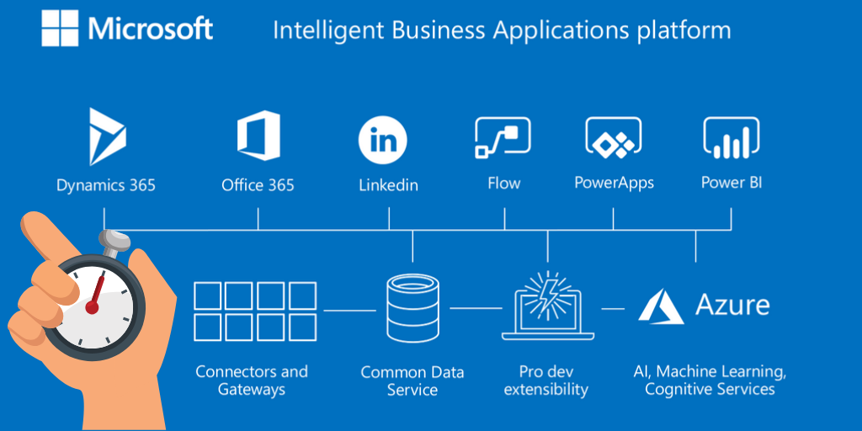
Grow your practice with
Microsoft Power Apps

Slide 3
Customers are motivated to modernize to the cloud
Reduce costs
Improve performance
Increase agility
Accelerate innovation
Aging datacenters
Urgent capacity needs
Software end of support
Security and governance risk
Inefficient scalability
One technology stack
Manual processes
Increasing competition
By 2022, cloud shift spending across enterprise IT markets will increase 28%, up from 19% in 2018. – Gartner
Notes:
Why should a Partner care about Power Apps?
Customers are modernizing to the cloud
There are quite a few customer triggers for modernization, but it essentially comes down to two increasingly important customer priorities: retiring aging datacenters and other infrastructure for more agile platforms and accelerating innovation. This last point have become increasingly urgent as more and more customers are moving to the cloud. Those are that are slow to transition from legacy apps and infrastructure are quickly being left behind.
https://www.gartner.com/smarterwithgartner/modernize-it-infrastructure-in-a-hybrid-world/

Slide 4
The modern app development opportunity will continue to grow
500 million new apps will be built in the next 5 years – more than all apps built in the last 40 years!¹
5x faster demand for mobile apps than IT can deliver.
65% of organizations report an app development backlog.
37% of organizations are still using paper to manage critical business processes.
20% annual growth projected for application modernization - to USD 16.67 Billion by 2022.
Forrester, Q1 Digital Process Automation Survey (for process improvement efforts 2 years from now); Dresner Advisory Services, The State of Business Intelligence, 2018 (critical responses only); Gartner, How to Deliver Enterprise Mobile Apps Faster – 2017​
1 IDC FutureScape: Worldwide IT Industry 2020 Predictions. Doc # US 45599219, October 2019
© Microsoft Corporation Power Apps
Notes:
Why should a Partner care about Power Apps?
Significant modern app development opportunity

Slide 5
The great developer shortage creates a challenge for app development
Low-code app development helps to close the gap
There are not enough developers in the world to meet app development demand
  Demand for mobile apps is growing 5x faster than IT can deliver²
  86% of organizations struggle to find technical talent to build applications
Low-code app development closes that gap
  65% of enterprise app development will be low-code by 2024⁴
  Power Apps enables developers to do more with less and empowers citizen developers to build simple apps
More than
1 Million
Sources: BLS, NSF, NCES, IDC, Gartner, LinkedIn, C+AI Corp Strat
2 Gartner, How to Deliver Enterprise Mobile Apps Faster – 2017
3 Indeed.com Survey
4 Gartner Magic Quadrant for Enterprise Low – Code Application Platforms – Aug 2019
Notes:
Demand for LoB apps and automation
500 million new apps will be built in the next 5 years – more than all apps built in the last 40 years!¹
Demand for mobile apps is growing 5x faster than IT departments can deliver ²
86% of organizations struggle to find technical talent³
65% of enterprise application development will be in the low-code category by 2024⁴
Over 85% of organizations struggle to analyze unstructured data⁵
How to help fill the app gap?
Business users have strong need for simple, low-code apps that wouldn’t be addressed by professional developers.
Power Apps can fill this gap by enabling developers to do more with less and creating a new workforce with citizen developers
1 Satya Nadella, Microsoft FY19 Q4 earnings call – Jul 2019
2 Gartner, How to Deliver Enterprise Mobile Apps Faster – 2017
3 Indeed.com Survey
4 Gartner Magic Quadrant for Enterprise Low – Code Application Platforms – Aug 2019
5 IDG: Big Data Survey 2017

Slide 6
Microsoft Power Platform momentum
86%
    of Fortune 500 companies using Power Apps
>700%
    Power Apps growth in production apps in the last year
>300%
    Power Apps growth in monthly active users in the last year
>3M
    Monthly active developers on the Power Platform
>25B ​
    Power Automate steps run each day​
>25M
    Data models hosted in the Power BI service
97%
    of Fortune 500 companies using Power BI

Slide 7
App development is a critical part of modernization
Expanding app development services unlocks value and expands revenue
REHOST
REFACTOR
REARCHITECT
RE/BUILD
Redeploy apps/infrastructure
as-is to cloud
Minimally alter to take better advantage of cloud
Materially alter/decompose application to services
New code written with cloud-native approach
Reduce costs
Lower Capex.
Free up datacenter space
Quick cloud ROI
Improve performance.
Faster, smaller updates
Greater cloud efficiency
Improved security and compliance
Increase agility
App scalability
Easier adoption of new cloud capabilities/technologies
Mix technology stacks
Accelerate innovation
Build apps more efficiently
Automate processes
Multi-channel access
Reduce operational cost
Benefits
Core
technologies
IaaS
LCAP¹ (PaaS) - Power Apps
LCAP¹ (PaaS) - Power Apps
LCAP¹ (PaaS) - Power Apps
© Microsoft Corporation Power Apps
1 Low-Code Application Platform
Notes:
Why should a Partner care about Power Apps?
App development is a critical part of modernization
There are multiple strategies for modernization based on a customer needs and priorities but they essentially come down to four paths.
The more of these paths you can support, the more modernization benefits you can deliver to your customers.
Rehost
Also known as a lift and shift migration, a rehost effort moves a current state asset to the chosen cloud provider, with minimal change to overall architecture.
Refactor
Platform as a service (PaaS) options can reduce the operational costs that are associated with many applications. It's a good idea to slightly refactor an application to fit a PaaS-based model.
"Refactor" also refers to the application development process of refactoring code to enable an application to deliver on new business opportunities.
Rearchitect
Some aging applications aren't compatible with cloud providers because of the architectural decisions that were made when the application was built. In these cases, the application might need to be rearchitected before transformation. In other cases, applications that are cloud-compatible, but not cloud-native, might create cost efficiencies and operational efficiencies by rearchitecting the solution into a cloud-native application.
Rebuild
In some scenarios, the delta that must be overcome to carry an application forward can be too large to justify further investment. This is especially true for applications that previously met the needs of a business but are now unsupported or misaligned with the current business processes. In this case, a new code base is created to align with a cloud-native approach.

Slide 8

This is the time for partners to grow their offers with Power Apps
Customers are quickly modernizing to the cloud.
App development is a critical part of modernization.
Significant modern app development opportunity.
The great developer shortage.
Stay competitive, relevant, and ahead in a quickly modernizing market, using a low-code/no-code platform as part of your practice.
© Microsoft Corporation Power Apps

Slide 9
Microsoft Power Apps
Low-code efficiency, “no cliffs” extensibility

Slide 10





Why Power Apps, why now?
Ready for remote work
World-class data platform
Trusted by IT departments
“No cliffs” pro extensibility
Intelligence built in
The most complete low-code platform

Slide 11

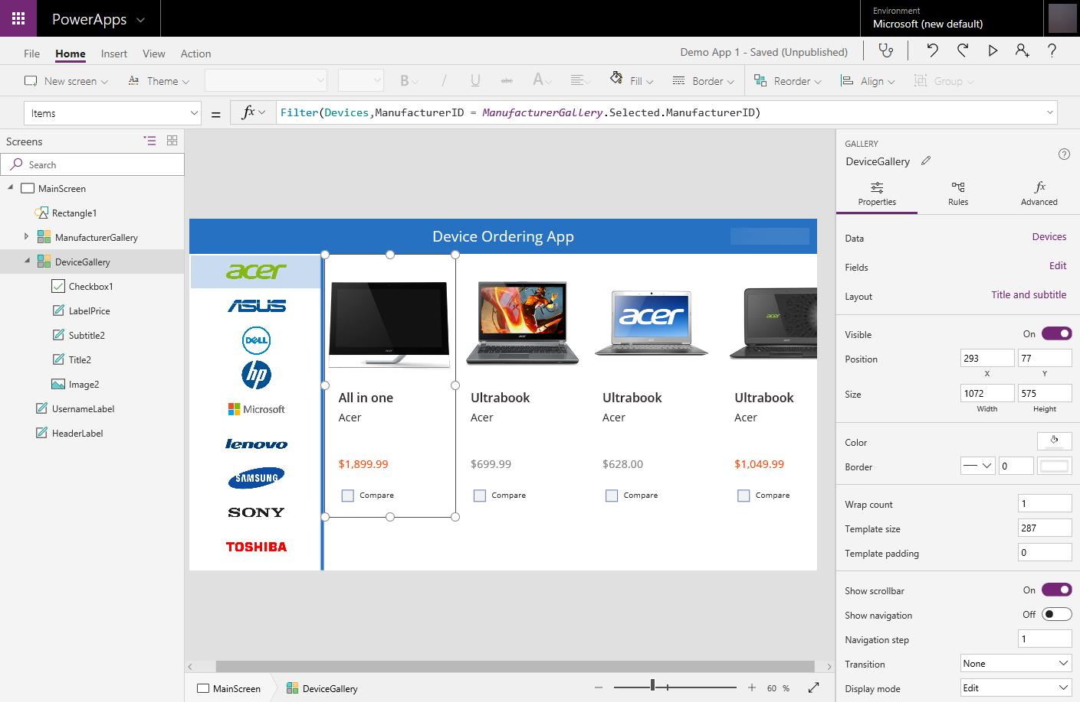

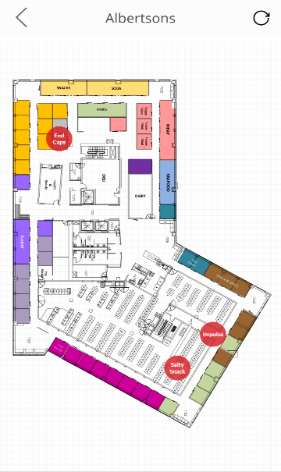
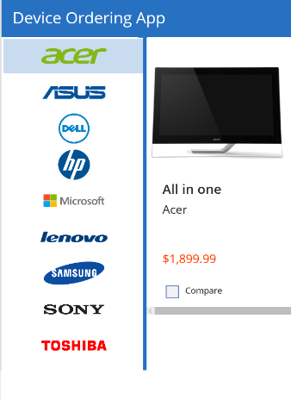
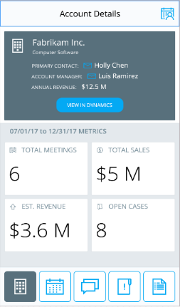
Microsoft’s low-code app development platform
A more efficient way to build modern apps with advanced functionality
Platform as a Service for both SIs and ISVs
Faster, simpler, but full-featured for complex solutions
Uses pre-built components to accelerate app development
Powerful and capable – same native platform for Microsoft Dynamics 365 applications
Deploy one build across web, tablet and mobile
Easily add AI with built-in cognitive service
© Microsoft Corporation Power Apps
Notes:
Platform as a Service for both SIs and ISVs for building business applications
Faster, simpler, more efficient than coding an app from the ground up, but full-featured for complex business needs
Uses pre-built templates, logic, rules, and entities to enable solutions to be built with low coding or no coding
Incredibly powerful and capability of handling any level of complexity – the same platform on which Dynamics 365 apps are built
Deploy one build across web, tablet and mobile
Add AI and intelligence with ease through
built-in cognitive services.

Slide 12


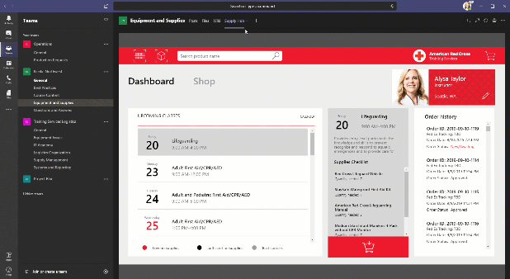
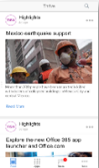

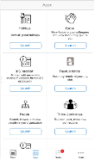
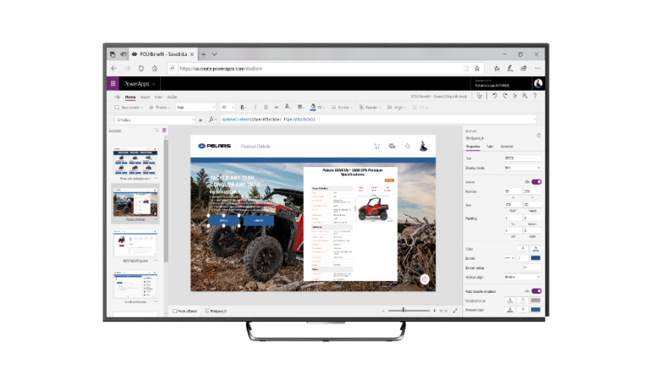

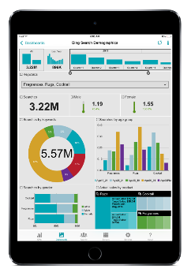
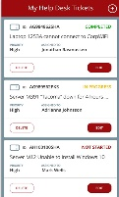

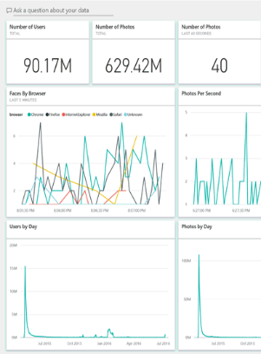
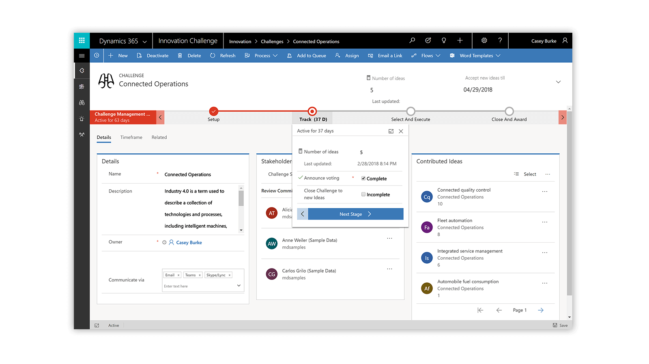

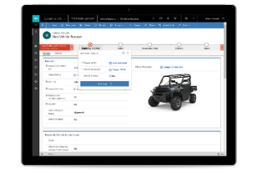

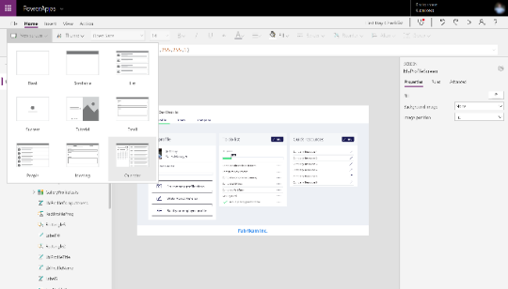
Accelerating digital transformation for simple and complex app development scenarios
EXTEND Office 365 and Dynamics 365
CONNECT legacy
& third-party apps
BUILD departmental solutions
BUILD mission-critical
end-to-end solutions
Power Apps
SELF-SERVICE for users to turn ideas into apps

Slide 13
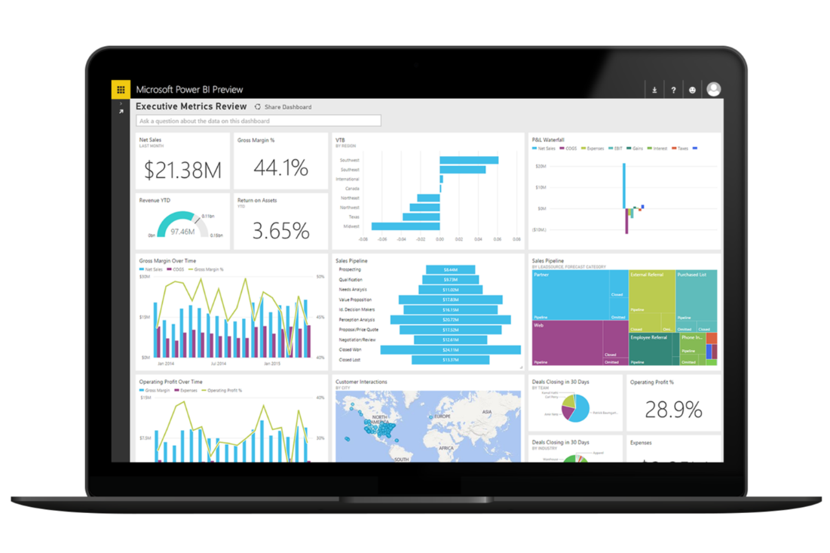
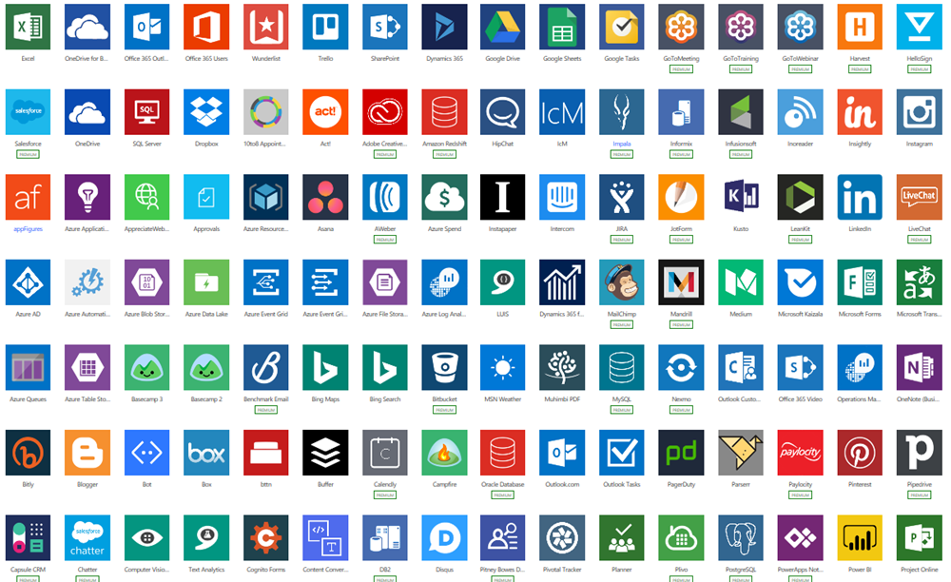
Make it easier to unlock data silos with cloud and on-premises connectivity
Built-in connectivity to 350+ cloud services, content services, databases, APIs, etc.
Seamless hybrid connectivity to on-premises systems via the on-premises data gateway.
Develop and register custom connectors as a building block for citizen developers.
Break down data silos by using multiple data sources in a single application.
Easily integrate any Azure services, like Azure Functions, Azure Kubernetes Service, Azure SQL, or Cosmos DB

Slide 14
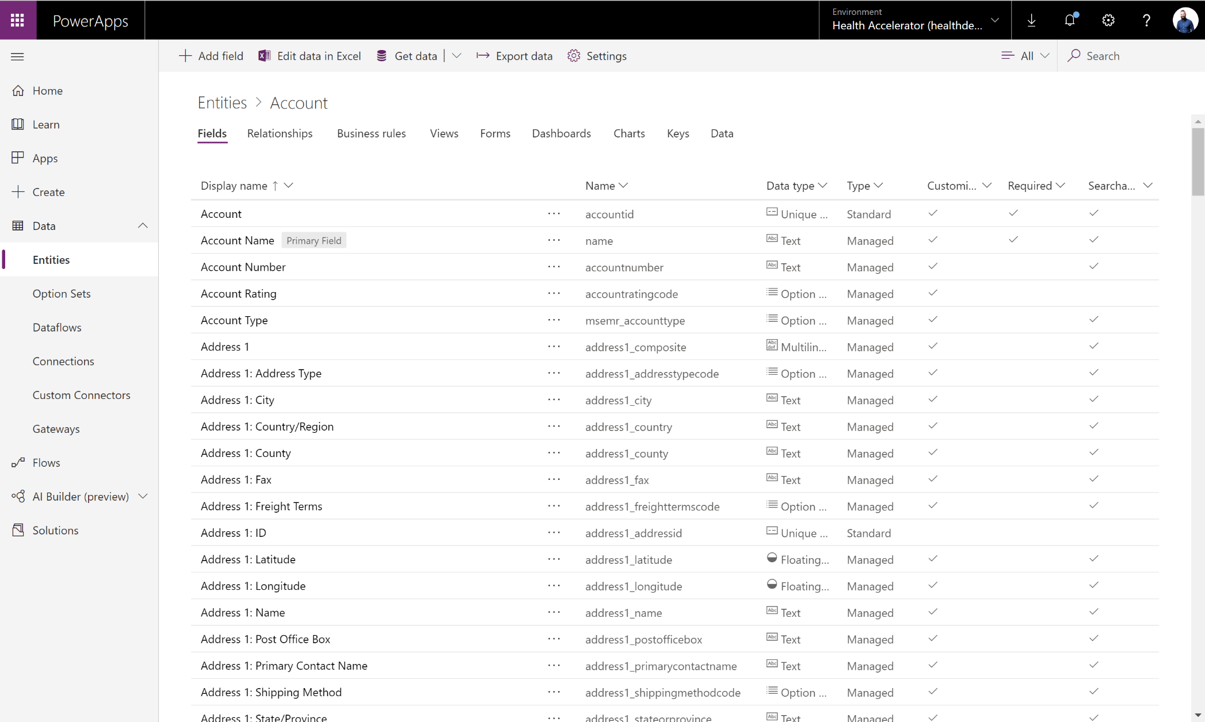
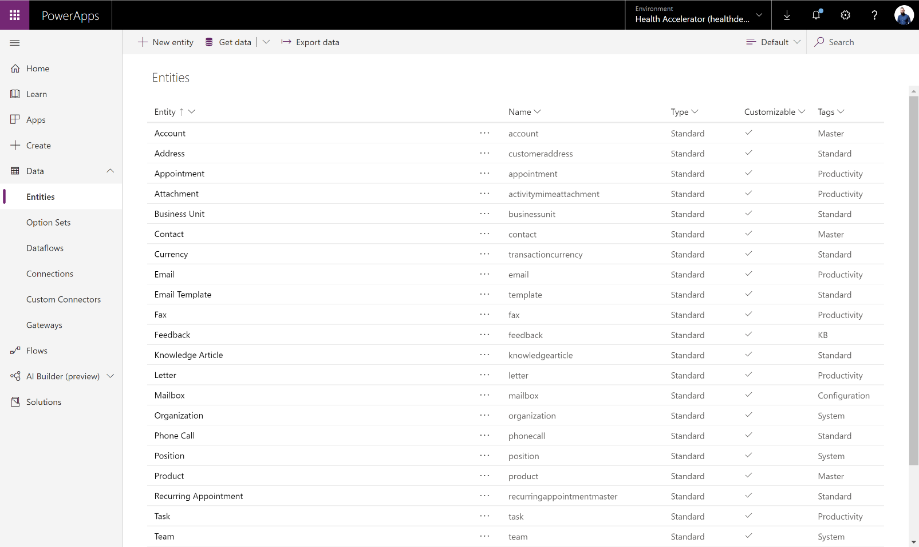
Low-code backend with Microsoft Dataflex Pro
Jumpstart apps using an extensible data model
with business logic, pre-built templates, security and integration built in.
Enable AI through built-in cognitive services
powered by AI Builder and Azure.
Microsoft Dataflex Pro uses the Common Data Model (CDM) which provides common entity definitions across different solutions
Support all your data: relational data, file and
blob storage, logs and search indexing.
Effortless Dynamics 365, Office 365
and Azure integration as well as powerful
integration capabilities.

Slide 15





Build on a platform or standalone apps
Spans Office 365, Dynamics 365, and standalone applications
Extend Microsoft apps
Build standalone apps
Build standalone apps
Build on Power Apps
Build on Power Apps and Azure
Office 365
Power BI
Business analytics
Power Apps
Application development
Power Automate
Process automation
Power Virtual Agents
Intelligent virtual agents
Connect other data sources using Data Connectors
3rd party
On-prem
Other cloud sources
Dataflex Pro
Notes:
One low-code platform that spans Office 365, Dynamics 365, Azure and standalone applications.

Slide 16
A platform for all app makers
From citizen developer to pro developer
Citizen Developers
IT Professionals
Pro Developers
SIMPLE
COMPLEX
Low-Code Capabilities
Self-service capabilities for users to take their own ideas on how to optimize or automate their work in the form of a Power Apps app
Unlocks app development backlog – Individual or Team Productivity apps that would otherwise never get built
Advanced Capabilities
High productivity app development – reduce time to develop and deploy
Powerful tools for existing apps customization and legacy app modernization – Use code to unblock complex requirements
“No limits” extensibility – build complex, customized applications
Add powerful BI, AI and chatbot functionality
Extend Dynamics 365, Office 365 and Azure solutions
Use pre-built templates and entities with pro developer business logic and rules
Standard dev tools – Visual Studio, VS Code, Azure DevOps
Enterprise-grade governance and world-class app lifecycle management
Notes:
Citizen Dev Capabilities
Empowers any user to build simple apps in a matter of hours with its predefined templates and low-code, no-code functionalities
Automate processes and modernize tasks normally done in Excel or on paper
Enrich Power Apps solutions with Power Automate, Power Virtual Agents, AI Builder, Power BI
Professional Dev Capabilities
“No limits” extensibility
Build complex, customized applications
Leverage components for future customers needing similar solutions
Add powerful BI, AI and chatbot functionality
Extend Dynamics 365, Office 365 and Azure solutions
Use pre-built templates and entities with the same business logic and rules that pro developers need, but without having to build from scratch
Use standard dev tools with Power Apps, like Visual Studio, VS Code, and Azure DevOps
Enterprise-grade governance and world-class app lifecycle management

Slide 17

3 ways Power Apps enables you to build a profitable practice
Expand your addressable market and create new revenue streams
1
Efficient application modernization & development
New and unique service offers
Ongoing revenue streams
2
3

Slide 18
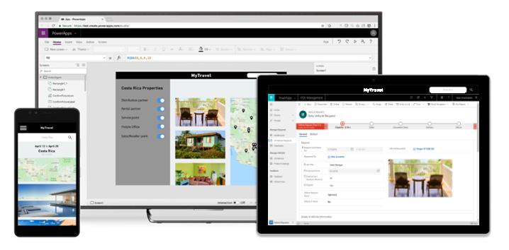
Efficient application modernization & development
Improve profitability with more efficient, lower-cost app development services
1
Deliver more with less
Why | How
Boost output through increased efficiency | Build complex apps in less time with fewer resources Pre-built templates, drag-and-drop simplicity, and quick deployment Advanced logic and rules built in
One platform for your customer’s needs | Power Apps makes it easier for your professional developers to Build complex mission critical apps Add advanced functionality to existing apps Modernize legacy apps and business processes Extend 1st and 3rd-party apps Drive larger Dynamics 365 and Power Platform projects
Meet your customer on their platform | Build your customer’s apps for multiple platforms Web Windows iOS Android
New app development opportunities with your existing workforce | Your business consultants lay the groundwork for app development Professional developers focus on what adds value to the customer and accelerate app development with powerful tools
2
3
© Microsoft Corporation Power Apps
Notes:
Boost output through increased efficiency
Build complex apps in less time with fewer resources
Pre-built templates, drag-and-drop simplicity, and quick deployment
Advanced logic and rules built in
One platform for your customer’s needs
Power Apps makes it easier for your professional developers to
Build complex mission critical apps
Add advanced functionality to existing apps
Modernize legacy apps and business processes
Extend 1st and 3rd-party apps
Help drive larger projects for your D365 and Power Platform business
Meet your customer on their platform
Build your customer’s apps on multiple platforms
Web
Windows
iOS
Android
New app development opportunities with your existing workforce
Turn your own business consultants into Citizen Developers with low-code, no-code functionalities
Build simple apps in a matter of hours
Modernize and automate business process that would normally never receive app development investments

Slide 19

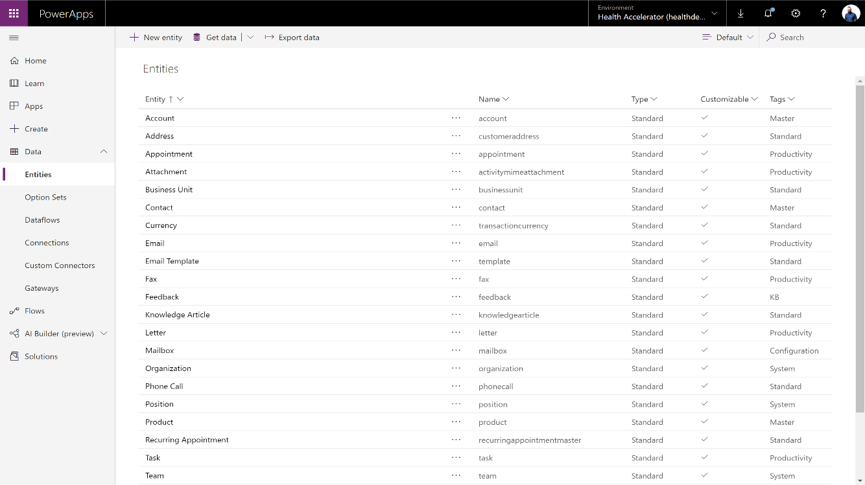
Efficient application modernization & development
Improve profitability with more efficient, lower-cost app development services
1
Unlock data siloes for more powerful apps
Why | How
Build more powerful apps with the ability to unlock and connect all your customer’s data | Easily bring all data together using Microsoft Dataflex Pro Remove barriers to data sources to build apps that easily interoperate across multiple systems Offer advanced solutions by enabling AI through built-in cognitive services Microsoft Dataflex Pro makes it easier to build business applications by storing your data, model processes, and business logic
Customer not using Dynamics 365? No problem | Use 350+ third-party app connectors to easily connect and share data with your customer’s existing systems Provide versatile, compatible solutions that can build on, extend, or modernize nearly any of your customer’s systems
Provide modernization for both your on-prem and cloud customers | On-Premises Data Gateway provides seamless hybrid connectivity, whether your customer still uses on-prem services or is in the process of moving to the cloud
2
3
© Microsoft Corporation Power Apps
Notes:
Bring all your customer’s data into one place
Make it easier to bring data together using the Microsoft Dataflex Pro
Microsoft Dataflex Pro is a compliant, scalable data service stores your data, model process, and business logic, so it’s fully integrated with Power Apps
Advanced logic and rules built in
Customer not using Dynamics 365? No problem
Integrate with third-party apps using over 350 connectors
Easily connect and share data with your customer’s existing systems such as SAP, ServiceNow, Salesforce, etc
Provide modernization for both on-prem and cloud customers
Provide seamless hybrid connectivity to on-premises systems via the On-Premises Data Gateway

Slide 20
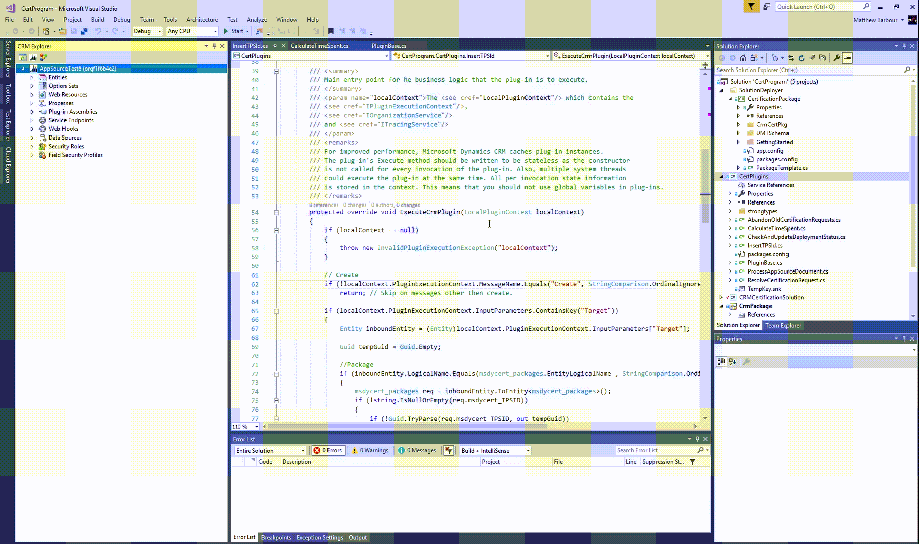
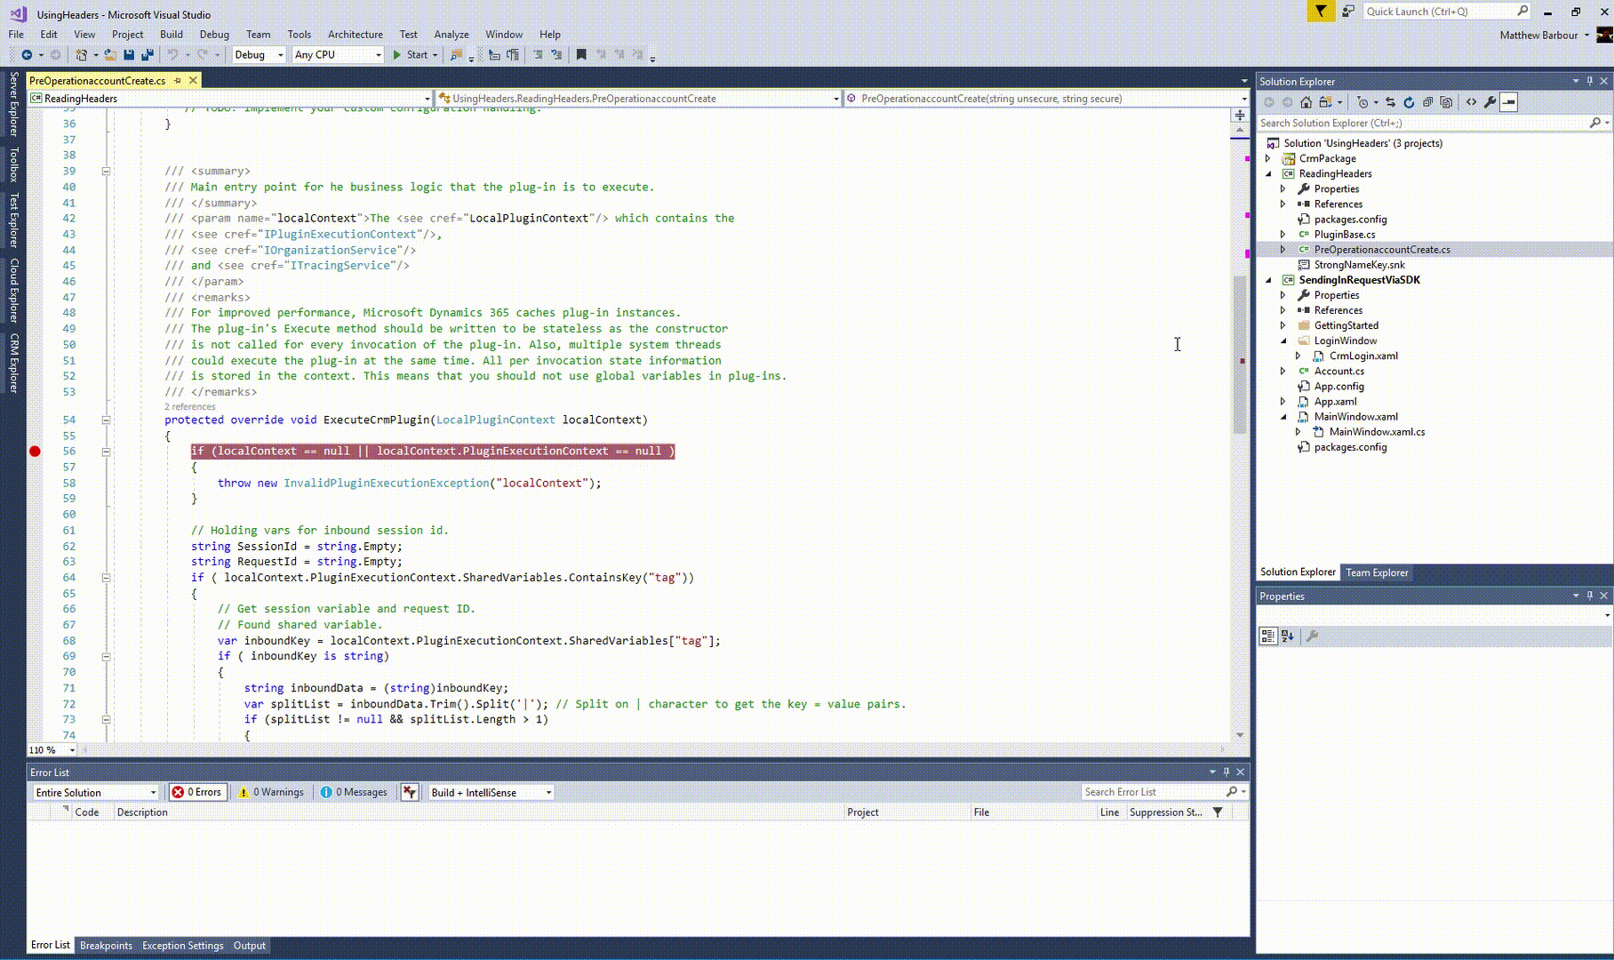
Efficient application modernization & development
Improve profitability with more efficient, lower-cost app development services
1
Give your pro developers the ability to build apps without limits
Why | How
Expansive customization capabilities for your pro developers | Build components for fully customized UX using command line interface and Visual Studio plugins Custom connectors to extend functionality and call APIs, services, and systems
Don’t have to sacrifice powerful control and efficient automation | Make global changes and define custom properties across apps, while supporting DevOps and Azure ALM methodologies Use Power Apps build tools to eliminate need for manually downloading custom tooling and scripts
2
3
© Microsoft Corporation Power Apps
Notes:
Expansive customization capabilities for your pro developers
Use Power Apps command line interface and Visual Studio plugins to build components for fully customized user experiences
Create custom connectors to extend functionality and call APIs, services, and systems that aren't available as pre-built connectors
Powerful control and efficient automation
Make global changes and define custom properties across apps, while supporting DevOps principles and Azure ALM methodologies.
Use Power Apps build tools - a collection of Power Apps specific Azure DevOps build tasks – to eliminate the need to manually download custom tooling and scripts.

Slide 21

New and unique service offers
Enhance your value to IT and business customers with differentiated service offers
1
Enable citizen developers and uncover new app development needs
Why | How
Expand your markets by demonstrating the value of low-code platforms | Empower innovation for people closest to the business by educating new makers and fostering best practices Build a low-code platform community that can advocate for the value of your Power Apps business and facilitate envisioning engagements to accelerate digital transformation Elevate your consulting role with the customer by supporting your customer’s citizen developers on more complex, strategic challenges
Play a closer, more effective consulting role with customers | Use citizen development to build closer relationship to business managers and better align to business goals Expand customer relationships – leverage business consultant citizen developers to help business managers quickly optimize business processes for digitization and build as simple Power Apps Generate more momentum with your customers by empowering innovation from the ground up, rather than just the top down
2
3
© Microsoft Corporation Power Apps
Notes:
Play a closer, more effective consulting role with customers
Expand customer relationships by helping business managers quickly modernize both complex and simple business processes, opening new markets needing app development investment
Leverage business consultant citizen developers to optimize business processes for digitization
Use citizen development to build closer relationship to business managers and better align to business goals
Expand your markets by demonstrating the value of low-code platforms
Develop courses and workshops to train your customer’s citizen developers
Build a low-code platform community among your business user customers who understand and advocate for the value of your Power Apps business
Elevate your consulting role with the customer by supporting these citizen developers with solutions for more complex, strategic challenges and extending the customer’s existing systems

Slide 22
New and unique service offers
Enhance your value to IT and business customers with differentiated service offers
1
Provide governance, security and support services.
Why | How
Customers will need your help to build a governance model that support hundreds or thousands of apps going viral | Adoption and change management planning and execution Provide best practices and structure through governance process for your customer’s development and release cycles Protect customers against risk of “shadow IT” when different business units create their own apps and data silos Provide critical security and support services for your customer’s growing platform
Package and sell Power Apps Center of Excellence | Combine these services (administration and governance, support and operations, training and evangelism) to develop complete Centers of Excellence (CoE) Offer ongoing CoE as a Service to support app growth and adoption, and your customer’s constantly evolving governance, security, and support needs Help your customers realize the full potential of an effective app development practice Package your CoE best practices as a repeatable solution
Training
Support
2
Governance
3
© Microsoft Corporation Power Apps

Slide 23
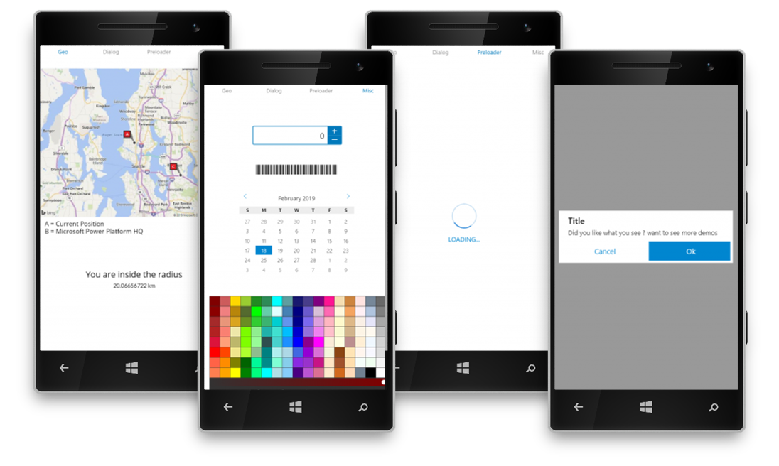
Ongoing revenue streams
Expand revenue streams with repeatable IP
1
Develop pre-built solutions and accelerate delivery cycles
Power App Components
Why | How
Establish ongoing customer relationships that increase ROI for your customer | Land initial solution with a customer and establish Power Apps, then easily expand by building on their initial investment with more apps and ongoing services The more your customer builds with Power Apps, the greater their ROI and the more opportunities for Partners to engage
Increase your ROI and accelerate time to market | Re-use your solution components to address other similar customer scenarios and business processes Customize components for specific business and industry scenarios Shorten your GTM timeline and focus on adding strategic value to the customer
Provide the increased speed and agility that the market is demanding | Use repeatable IP to meet growing demand for faster app development
Profit again from what you’ve already built | License repeatable and proven IP components and publish on AppSource for ongoing revenue opportunities
Data model | Connectors | Business logic | Rules
Re-Use and Customize
2
3
© Microsoft Corporation Power Apps
Notes:
Extend ROI and go to market faster
Re-use what you’ve already invested in and built (data model, connectors, entities, business logic and rules to create off-the-shelf solutions) to address common business process scenarios
Customize components for specific business and industry scenarios
Shorten your GTM timeline by reusing common components so you can focus on adding strategic value to the customer
Provide the increased speed and agility that the market is demanding
Use repeatable IP to meet customers’ growing demand for faster development and iteration of business apps
Profit again from what you’ve already built
License repeatable and proven IP components and publish on AppSource for ongoing revenue opportunities

Slide 24

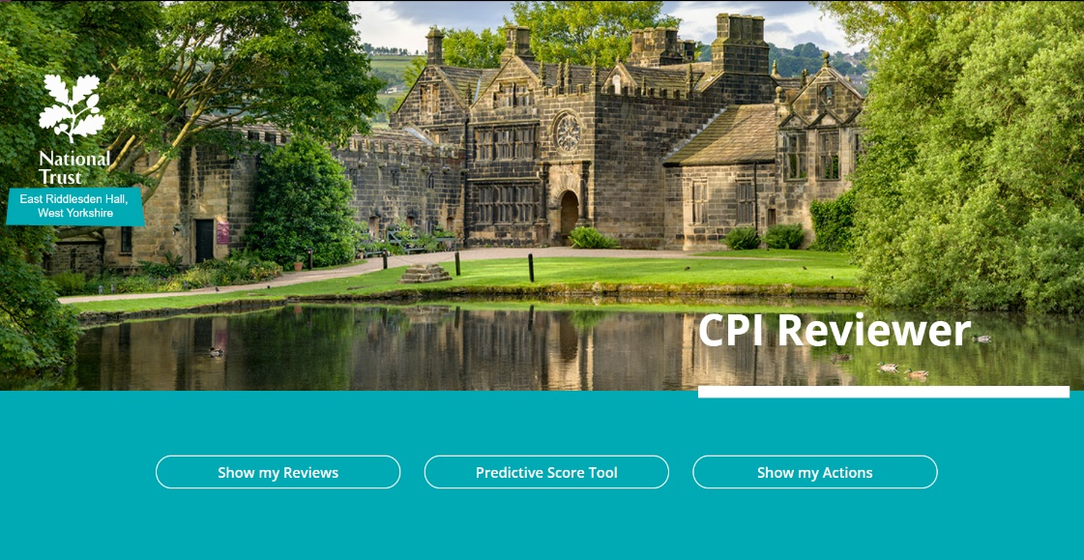
Power Apps opens doors for DXC Technology
Small apps drive big projects and new service revenue
Partner:
COMPANY PROFILE
DXC Microsoft Business Applications is a division of DXC Technology - the world’s leading, independent IT services company with over 138,000 employees and over 6,000 global customers.
CHALLENGE
The division worked with customers on business app planning and architecture but would have to hand off development to partners.
WHY POWER APPS
All business app development is now handled in-house.
Junior developers can build with senior architects acting as a technical design authority to help scale apps.
Support services and training account for 20% of revenue – a number expected to grow dramatically as their citizen developer base expands.
80% of all business application projects now involve the Power Platform.
Power Apps projects are helping drive larger Dynamics 365 implementations and Power BI data warehousing projects.
UK National Trust property managers use this customer app to monitor the KPIs for their properties stored in SQL Azure, identify trends using Power BI, and manage actions to improve the state of the properties—all from a single app. See customer story.
© Microsoft Corporation Power Apps
Notes:
PARTNER QUOTE:
We like to train customers to build their own apps on the platform. Once an app goes live, the citizen developers who created the app don’t always have the time or expertise to maintain, update and support it. That’s where we come in to help. We not only support the apps with an SLA but help build out advanced functionality through the Power Platform. - Paul Saxton
CTO - UK & Ireland, Microsoft Business Applications
SHOWCASE APP:
National Trust is a 120-year-old conservation charity that protects and preserves property, land, and historical sites across the UK. The sites that National Trust oversees, rich in both aesthetic appeal and cultural significance, total 250,000 hectares of land.
Effectively managing and safeguarding these properties required a solution that could revolutionize the data collection, storage, and the visualization process for the trust’s preservation efforts. Leveraging a new line-of-business solution built on Microsoft PowerApps and developed by eBECS—2016 Microsoft Partner of the Year for the UK—National Trust revamped the way it tracks the progress and measures the success of preservation efforts.
This new, easy-to-use solution increases visibility into property status, offers more efficiency, and improves cost effectiveness—high priorities for a charity.
The app incorporates CPI templates and framework, Power BI integration for data visualization and interrogation, Azure SQL interoperability, and National Trust’s branding guidelines for look and feel.

Slide 25


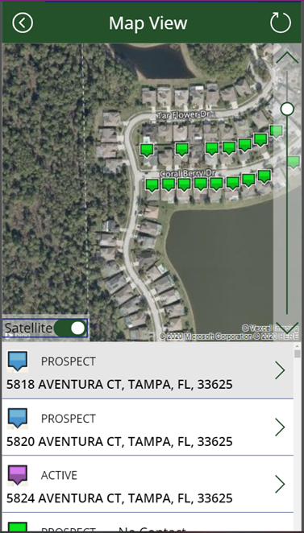
PK delivers custom apps four times faster
Meets new demand for fast track applications
Partner:
COMPANY PROFILE
PK is a 3,500-employee, experience engineering consultancy offering custom application development and business intelligence solutions.
WHY THEY CHOOSE POWER APPS
Customers were asking for faster development of applications which their internal, less technical teams could maintain and update.
ADVANTAGES
Applications can be delivered up to 4 times faster with 75% less developer resources vs custom coding.
Deep integration with the Azure platform makes it easy to integrate with Active Directory authentication and DB resources.
Accelerated time to value has opened up new opportunities for more ‘fast track’ applications, especially sales and marketing solutions.
Makes it easier to deliver POCs for more complex apps.
TruGreen mobile app provides employees a personalized sales route with integration to Bing Maps, AAD auth and DB and integration to a sales channel application. One developer completed the app in just 2 weeks using Power Apps.
© Microsoft Corporation Power Apps
Notes:
SHOWCASE APP
TruGreen, the largest lawn care company in the US, was in need of a new tool to support their door to door sales team.
TruGreen mobile application maps customer prospecting data to a specific sales routes with integration to Bing Maps and secure access to an Azure customer database.
A custom-coded version of the app would have required 4 developers up to four months to deliver. Power Apps enabled one developer to complete the project in 2 weeks.

Slide 26
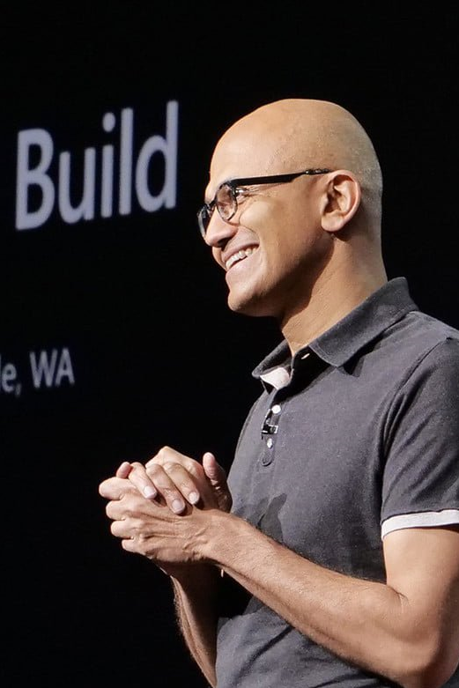

“Microsoft 365, Dynamics 365, and the Power Platform, on top of what we’re doing with Azure, is the core of what we
are doing as a company.”
--Satya Nadella
© Microsoft Corporation Power Apps

Slide 27
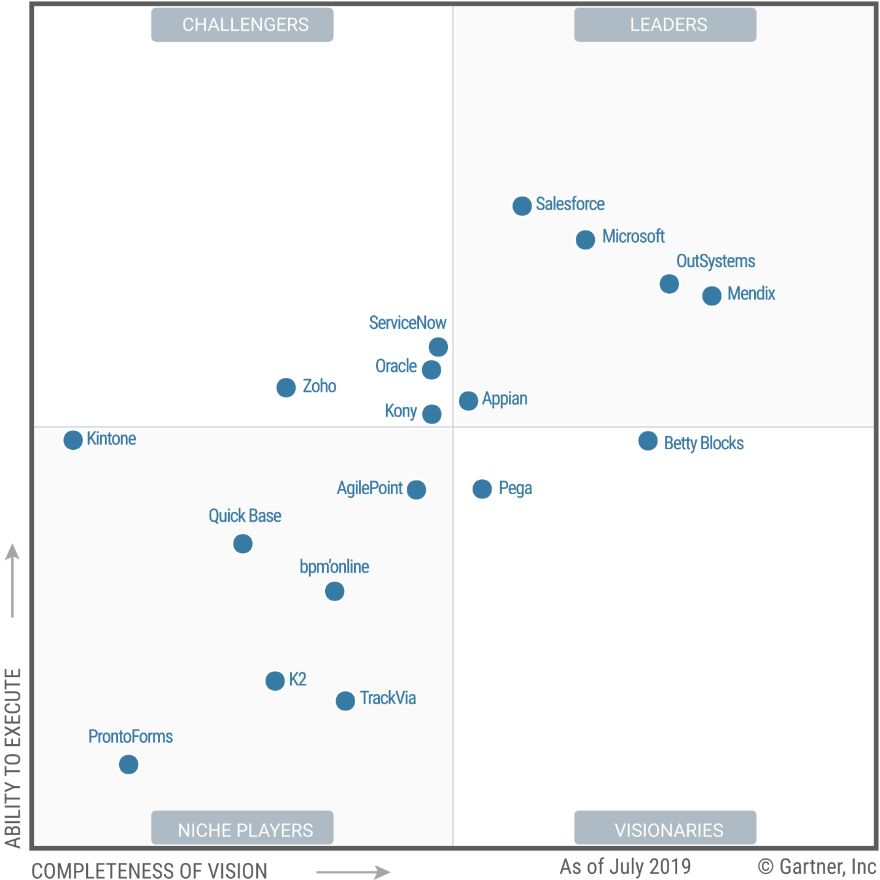

August 2019
A leader in enterprise low-code application platforms.*
*Gartner “Magic Quadrant for Enterprise Low-Code Application Platforms,” by Paul Vincent, Kimihiko Iijima, Mark Driver, Jason Wong, Yefim Natis, 08 August 2019.
The graphics at right were published by Gartner, Inc. as part of a larger research document and should be evaluated in the context of the entire document. The Gartner document is available upon request from Microsoft. Gartner does not endorse any vendor, product or service depicted in its research publications, and does not advise technology users to select only those vendors with the highest ratings or other designation. Gartner research publications consist of the opinions of Gartner's research organization and should not be construed as statements of fact. Gartner disclaims all warranties, expressed or implied, with respect to this research, including any warranties of merchantability or fitness for a particular purpose. GARTNER is a registered trademark and service mark of Gartner, Inc. and/or its affiliates in the U.S. and internationally and is used herein with permission. All rights reserved.

Slide 28
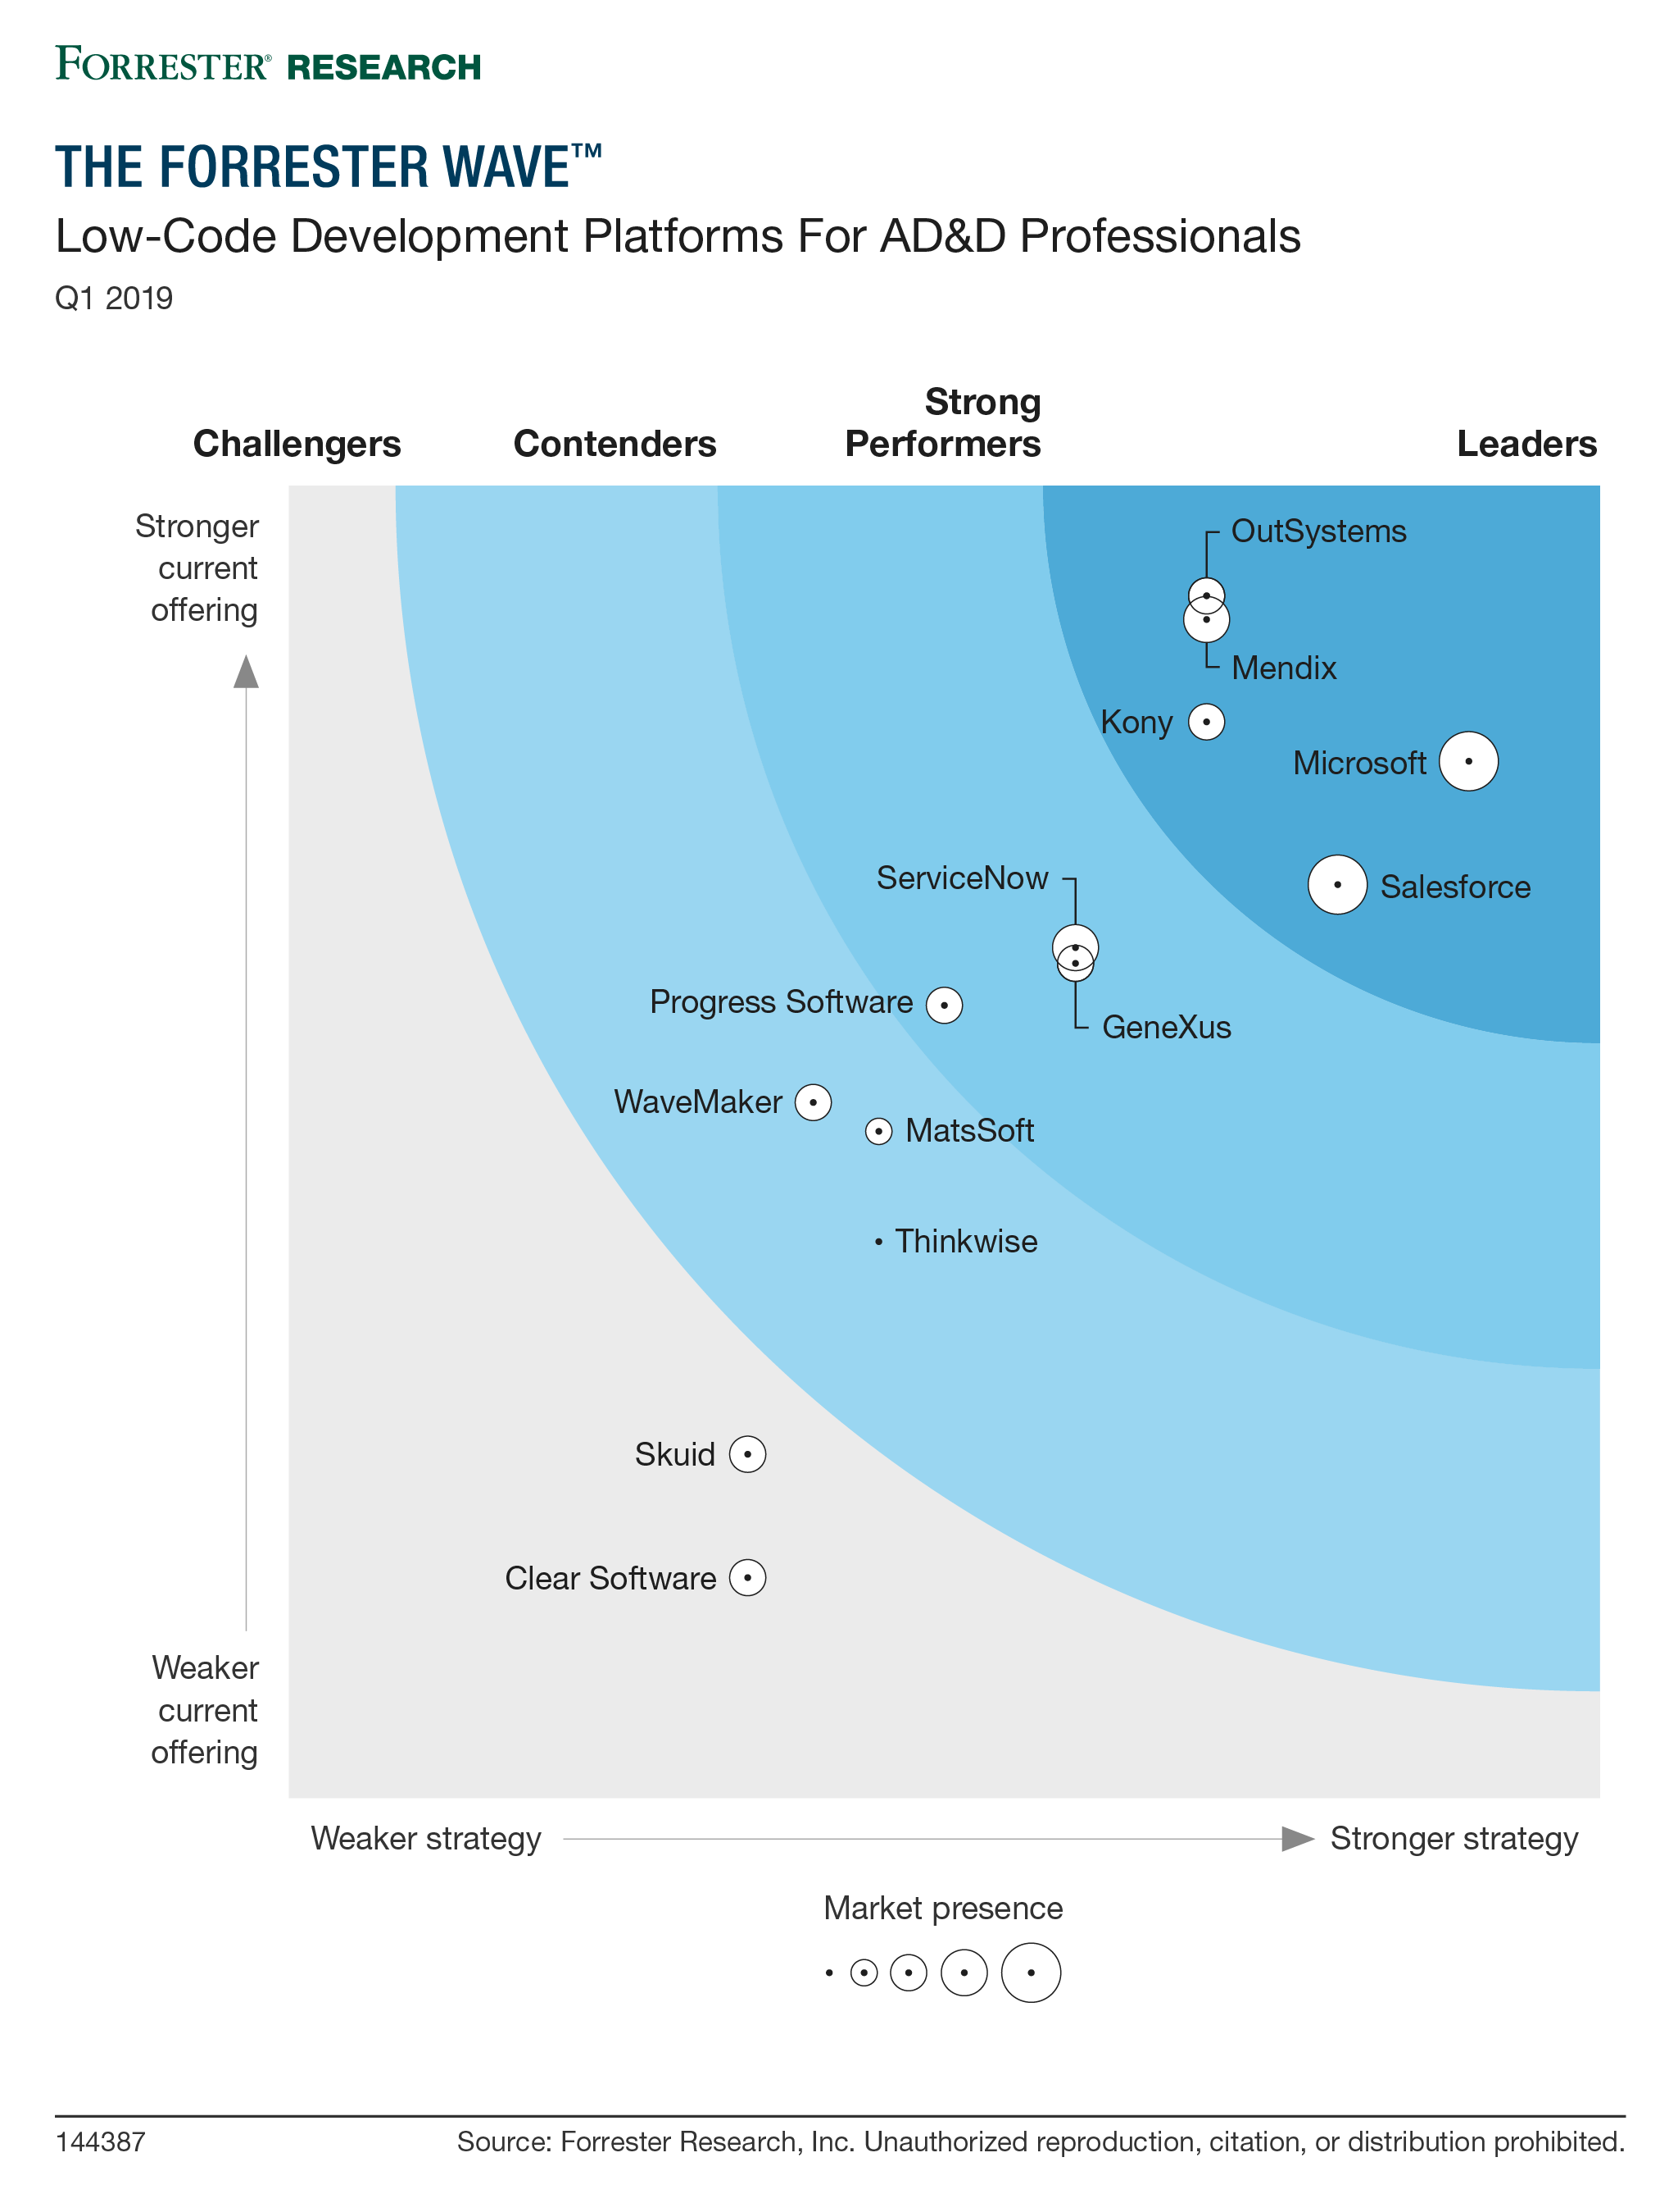
Forrester,
Q1 2019
A leader in low-code development
platforms for application development
and delivery professionals.
https://reprints.forrester.com/#/assets/2/108/RES144387/reports

Slide 29

Get started
Learn more about Power Apps
Access online learning for your consultants and professional developers.
Showcase your services and solutions
Post your Power Apps services and showcase your apps on AppSource Marketplace.
Go to market with Microsoft
Access resources, programs and offers to generate demand and grow your business
© Microsoft Corporation Power Apps

Slide 30
Thank you

