Slide 1


Solution Partners for Business Applications in the Nonprofit Sector
Henrik Krogh Andersen
SMB Sales
Bryan Allen
Territory Channel Manager
Notes:
Hello & welcome – I am honored to be here and to share with you how to leverage your skills as a Solution Partner for Business Applications to make a positive impact for people and the planet.
Today, my co-presenter, Henrik Andersen and I would like to spend a couple of minutes to share our approach to align with the Microsoft Cloud Partner Program to drive social impact locally and globally.

Slide 2



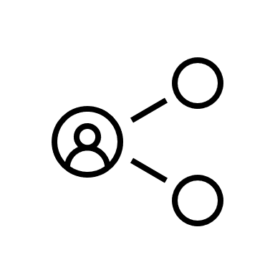
Onboard to the nonprofit sector
Discover nonprofits
Align your skills
Target your audience
Connect with peers
Step 1
Step 2
Step 3
Step 4
Gain insight to nonprofits who are need technology to support them in addressing our world's most challenging issues.
Leverage your existing skill set to reach your nonprofit customers in need of your services to deliver on their mission.
Access customizable campaigns, targeted offers and more to reach your local and global nonprofit organizations.
Join a community of partners servicing the nonprofits to share best practices and get latest news.
Notes:
Before we get started, this video is the second step in your partner journey to onboard to the nonprofit sector.
If you haven’t already, I recommend you watch “Introduction to Nonprofit for Partners” to get an overview of the sector, specifically:
Why Microsoft cares about nonprofits
Your potential opportunity if you add this sector to your portfolio, AND
How you can quickly get up and running simply leveraging your existing skills set + our nonprofit offers (grants+discounts).
Today, however, we will align your skills to reach a new audience.

Slide 3



Leverage your skills to impact the world
Agenda
Industry alignment to the Microsoft Cloud Partner Program
Understand how to expand your business using the skills you have today.
Business Applications in the Nonprofit Sector
Discover how trusted and skilled partners can provide nonprofit organizations with modern work solutions
Grow your business
Access tailored resources to your solution designation to grow your business in nonprofit sector
Notes:
Today, we are discussing how you should leverage your cloud skills to service nonprofits both small and large
We will clarify the role of industry in Microsoft Cloud Partner Program
Key nonprofit customer scenarios around Business Applications in the Nonprofit Sector
Show you how to grow your business with exclusive offers, customizable campaigns, and resources

Slide 4



Why add the nonprofit sector to your portfolio?
1
2
3
Grow your business with one of the largest sectors in the world
Improve employee satisfaction, retention and brand loyalty
New revenue streams leveraging existing skills & offers
Notes:
Why should you focus on the nonprofit sector? As we discussed in our partner introduction to the nonprofit sector,
There are 3 strategic reasons to add nonprofit to your portfolio
1. First, you can grow your business within one of the largest sectors in the world
2. Second, you can drive employee satisfaction, retention and overall brand loyalty
3. And third, you can gain incremental revenue streams leveraging your existing skills, solutions, and offers
Let’s take a further look at each of these opportunities.

Slide 5
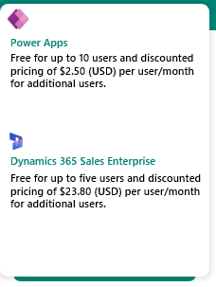
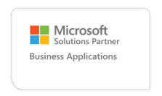
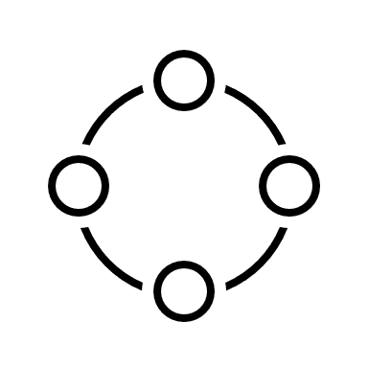
The perfect equation for business applications success
Optimize our business operations
Your skills and solutions
Our technology and offers
Sector Impact
Notes:
Together, we have the perfect equation for success.
Taking your skills & solutions, plus our technology and offers means we can create quality nonprofit solutions and help transform the sector

Slide 6

Microsoft Cloud Partner Program + Nonprofit Sector
The new solution designations enable you to showcase your skill to prospective nonprofits.
Nonprofit customers will count toward your partner capability score (coming soon).
Industry designations will be available in the future.
Notes:
When you earn your solution designation with Microsoft Cloud Partner Program, you can showcase your expertise to prospective new clients – including nonprofit organizations.
In October 2022, the Microsoft Cloud Partner program launched with new solution partner designations and specializations to showcase your skills to customers.
At the time of the program launch, nonprofit customers did not count toward your partner capability score for earning the new solution partner designations and specializations
We are currently working on changes to ensure partners will be credited with the work they are doing for nonprofit customers to earn their solution designations.
Additionally, the Microsoft Cloud Partner Program is working on industry designations anchored on the Microsoft Industry Clouds to help partners further differentiate their organization’s capabilities and marketplace offers.
We will provide an update in our Tech for social impact digital community once we have more information on timing and details.
So much exciting change coming down the pipeline. Don’t wait to get skilled up and target this exciting sector.
Now, I will pass it over to Henrik to talk more about Business Applications in the Nonprofit Sector.

Slide 7
Business Applications
Industry cloud specialized components Partner ecosystem
Microsoft Dynamics 365
Microsoft Dynamics 365
Microsoft 365
LinkedIn
Microsoft Power Platform
Microsoft Power Platform
GitHub
Microsoft Azure
Identity, security, management, and compliance
Notes:
Thank you Bryan!
I will spend a few minutes walking you through the Dynamics 365 platform and talk about how this can help your Non-profit customers do more with less.
Dynamics 365 business applications is a set of connected applications designed to transform and enable your core organizational activities, whether it’s engaging with donors and volunteers, connecting with employees, or managing finances. Not only does Dynamics 365 combine CRM and ERP capabilities, but it also integrates your data, business logic, and processes.
It’s built on Microsoft Azure, offering both a trusted platform and a broad ecosystem of services.
It’s natively integrated with productivity apps in Microsoft 365 – helping your staff to be more productive and achieve more.

Slide 8


Business Applications
Intelligent cloud applications that unify constituent and fundraising management, program delivery, and finance and operations to maximize program outcomes and impact.
Notes:
Dynamics 365 helps nonprofits optimize core business processes. To highlight just a few areas where our customers get benefit from the Dynamics 365 Platform I would like to point out
What can you do with Dynamics 365?
Donor and Volunteer management: where you are able to personalized interactions with the customer relationship management (CRM) capabilities.
Staff productivity: The seamless integration with the Office365 productivity suite with tools like Outlook, Excel, and Power BI. , helps staff to be more productive and efficient in their daily work.
Align donor resources and volunteer skills to connect beneficiaries with the services and information they need the most.
Streamline your organizational operations in the field and in the office, reducing costs with D365 ERP capabilities.
Use artificial intelligence to deliver actionable insights that proactively guide staff to optimal impact.
Easily tailor, extend, connect, and build applications with little-to-no code so you can meet your specific organizational needs.

Slide 9
CRM and ERP
Meg: Since you have MC4N as a separate section, I’m updating this section as “horizontal” BizApps. Next several slides are the latest versions from corp EBC deck so will require agency cleanup to match this deck’s color scheme.
CRM
ERP
Notes:
Traditional CRM and ERP software are an outdated model—expensive to implement, disconnected, and difficult to adapt.

Slide 10
CRM and ERP
Sales
Marketing
E-commerce
Finance & Accounting
Operations
Customer Service
Field Technicians
Physical stores
Human Resources
Supply Chain
Notes:
We’ve transcended traditional ERP and CRM software with a set of purpose-built, modular solutions for every line of business, from the front office to the back office, supply chain to storefront.
These solutions are modular, seamlessly connected together across your departments
From those focused on customer engagement—like sales, marketing, and service
Your physical and online storefronts
And connected operations—from finance and accounting to HR and your supply chain and distribution channels

Slide 11
CRM and ERP
Improve lead quality
Ensure revenue reporting ties to nonprofit requirements and regulations
Personalize marketing campaigns
E-commerce
Sales
E-commerce
Sales
Customer Service
Customer Service
Operations
Operations
Supply Chain
Supply Chain
Identify constituent behavior
Optimize inventory & logistics
Human Resources
Physical stores
Human Resources
Marketing
Physical stores
Marketing
Field Technicians
Field Technicians
Finance & Accounting
Finance & Accounting
Provide predictive service
Predict cash flow
Data
+ Intelligence
+ Security
Maintain control over your finances while building and growing relationships with constituents so that you can achieve your mission
Notes:
Using this wealth of data, Dynamics 365 leverages AI-assisted guidance and predictive analytics to surface insights you and your teams can use to guide the next best action across your organization, every day.
Everyone can have access to insights that surface in context with the task at hand—from customer engagement insights to create more engaging, relevant experiences….to up-to-the-moment insights into the factory line and supply chain, helping streamline operations and avoid disruptions.
And with Dynamic 365’s world-class security and compliance, you can rest assured that your business and customer data is protected and secured. In fact, we are leader in five Gartner Magic Quadrants for security—delivering world-class identity protection, role-based access, encryption; and auditing and logging.
Transition to customer story: This focus on insights is helping digitally transform the way business innovates, creates impact and adapts to new opportunities

Slide 12







A single platform that nonprofits can grow with over time
Data
+ Intelligence + Security
Constituent Engagement
Connected Operations
Sales
Marketing
Customer
Service
Field
Service
Commerce
Human Resources
Business Central
Finance
Product Visualize
Customer Insights
Virtual Agent for Customer Service
Remote Assist
Supply Chain Management
Connected
Store
Fraud
Protection
Project Operations
Customer Voice
Guides
IOM
Microsoft Power Platform
Power BI
Power Automate
Power Apps
Power Apps
Notes:
Dynamics 365 is the truly the only portfolio of intelligent business applications that helps organizations reach their limitless potential.
All of these solutions snap together seamlessly, unifying customer and business data, relationships and workflows on a single cohesive business cloud that integrates with your existing systems and software tools to extend capabilities of solutions you already use—all fully customizable to align with organizational processes in place.
Here you see several “finished” apps to manage Constituent Engagement as you “reach out” to your nonprofit stakeholders, as well as “Connected Operations” to manage your back office requirements around accounting, HR and supply chain.
And you can use Power Platform to create new low code no code apps to automate processes unique to your nonprofit.
This holistic system enables you to optimize operations, empower cross-functional innovation, and better engage constituents—all the elements of a more resilient and adaptive organization.
And since its all on the Microsoft cloud, you can deploy solutions and onboard users in days or weeks, not months, to innovate and drive business outcomes in less time. Dynamics 365 integrates with your existing systems and software tools.

Slide 13
CRM and ERP
Improve lead quality
Ensure revenue reporting ties to nonprofit requirements and regulations
Personalize marketing campaigns
E-commerce
Sales
E-commerce
Sales
Customer Service
Customer Service
Operations
Operations
Supply Chain
Supply Chain
Identify constituent behavior
Optimize inventory & logistics
Human Resources
Physical stores
Human Resources
Marketing
Physical stores
Marketing
Field Technicians
Field Technicians
Finance & Accounting
Finance & Accounting
Provide predictive service
Predict cash flow
Data
+ Intelligence
+ Security
Maintain control over your finances while building and growing relationships with constituents so that you can achieve your mission
Notes:
Using this wealth of data, Dynamics 365 leverages AI-assisted guidance and predictive analytics to surface insights you and your teams can use to guide the next best action across your organization, every day.
Everyone can have access to insights that surface in context with the task at hand—from customer engagement insights to create more engaging, relevant experiences….to up-to-the-moment insights into the factory line and supply chain, helping streamline operations and avoid disruptions.
And with Dynamic 365’s world-class security and compliance, you can rest assured that your business and customer data is protected and secured. In fact, we are leader in five Gartner Magic Quadrants for security—delivering world-class identity protection, role-based access, encryption; and auditing and logging.
Transition to customer story: This focus on insights is helping digitally transform the way business innovates, creates impact and adapts to new opportunities

Slide 14
A single platform that nonprofits can grow with over time
Data
+ Intelligence + Security
Constituent Engagement
Connected Operations
Sales
Marketing
Customer
Service
Field
Service
Commerce
Human Resources
Business Central
Finance
Product Visualize
Customer Insights
Virtual Agent for Customer Service
Remote Assist
Supply Chain Management
Connected
Store
Fraud
Protection
Project Operations
Customer Voice
Guides
IOM
Microsoft Power Platform
Power BI
Power Automate
Power Apps
Power Apps
Notes:
Dynamics 365 is the truly the only portfolio of intelligent business applications that helps organizations reach their limitless potential.
All of these solutions snap together seamlessly, unifying customer and business data, relationships and workflows on a single cohesive business cloud that integrates with your existing systems and software tools to extend capabilities of solutions you already use—all fully customizable to align with organizational processes in place.
Here you see several “finished” apps to manage Constituent Engagement as you “reach out” to your nonprofit stakeholders, as well as “Connected Operations” to manage your back office requirements around accounting, HR and supply chain.
And you can use Power Platform to create new low code no code apps to automate processes unique to your nonprofit.
This holistic system enables you to optimize operations, empower cross-functional innovation, and better engage constituents—all the elements of a more resilient and adaptive organization.
And since its all on the Microsoft cloud, you can deploy solutions and onboard users in days or weeks, not months, to innovate and drive business outcomes in less time. Dynamics 365 integrates with your existing systems and software tools.

Slide 15

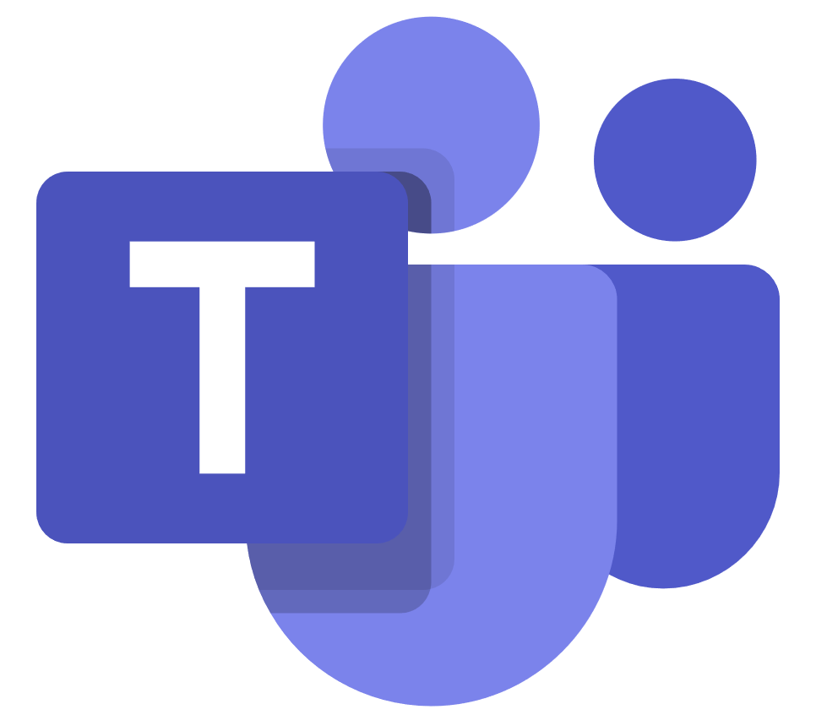
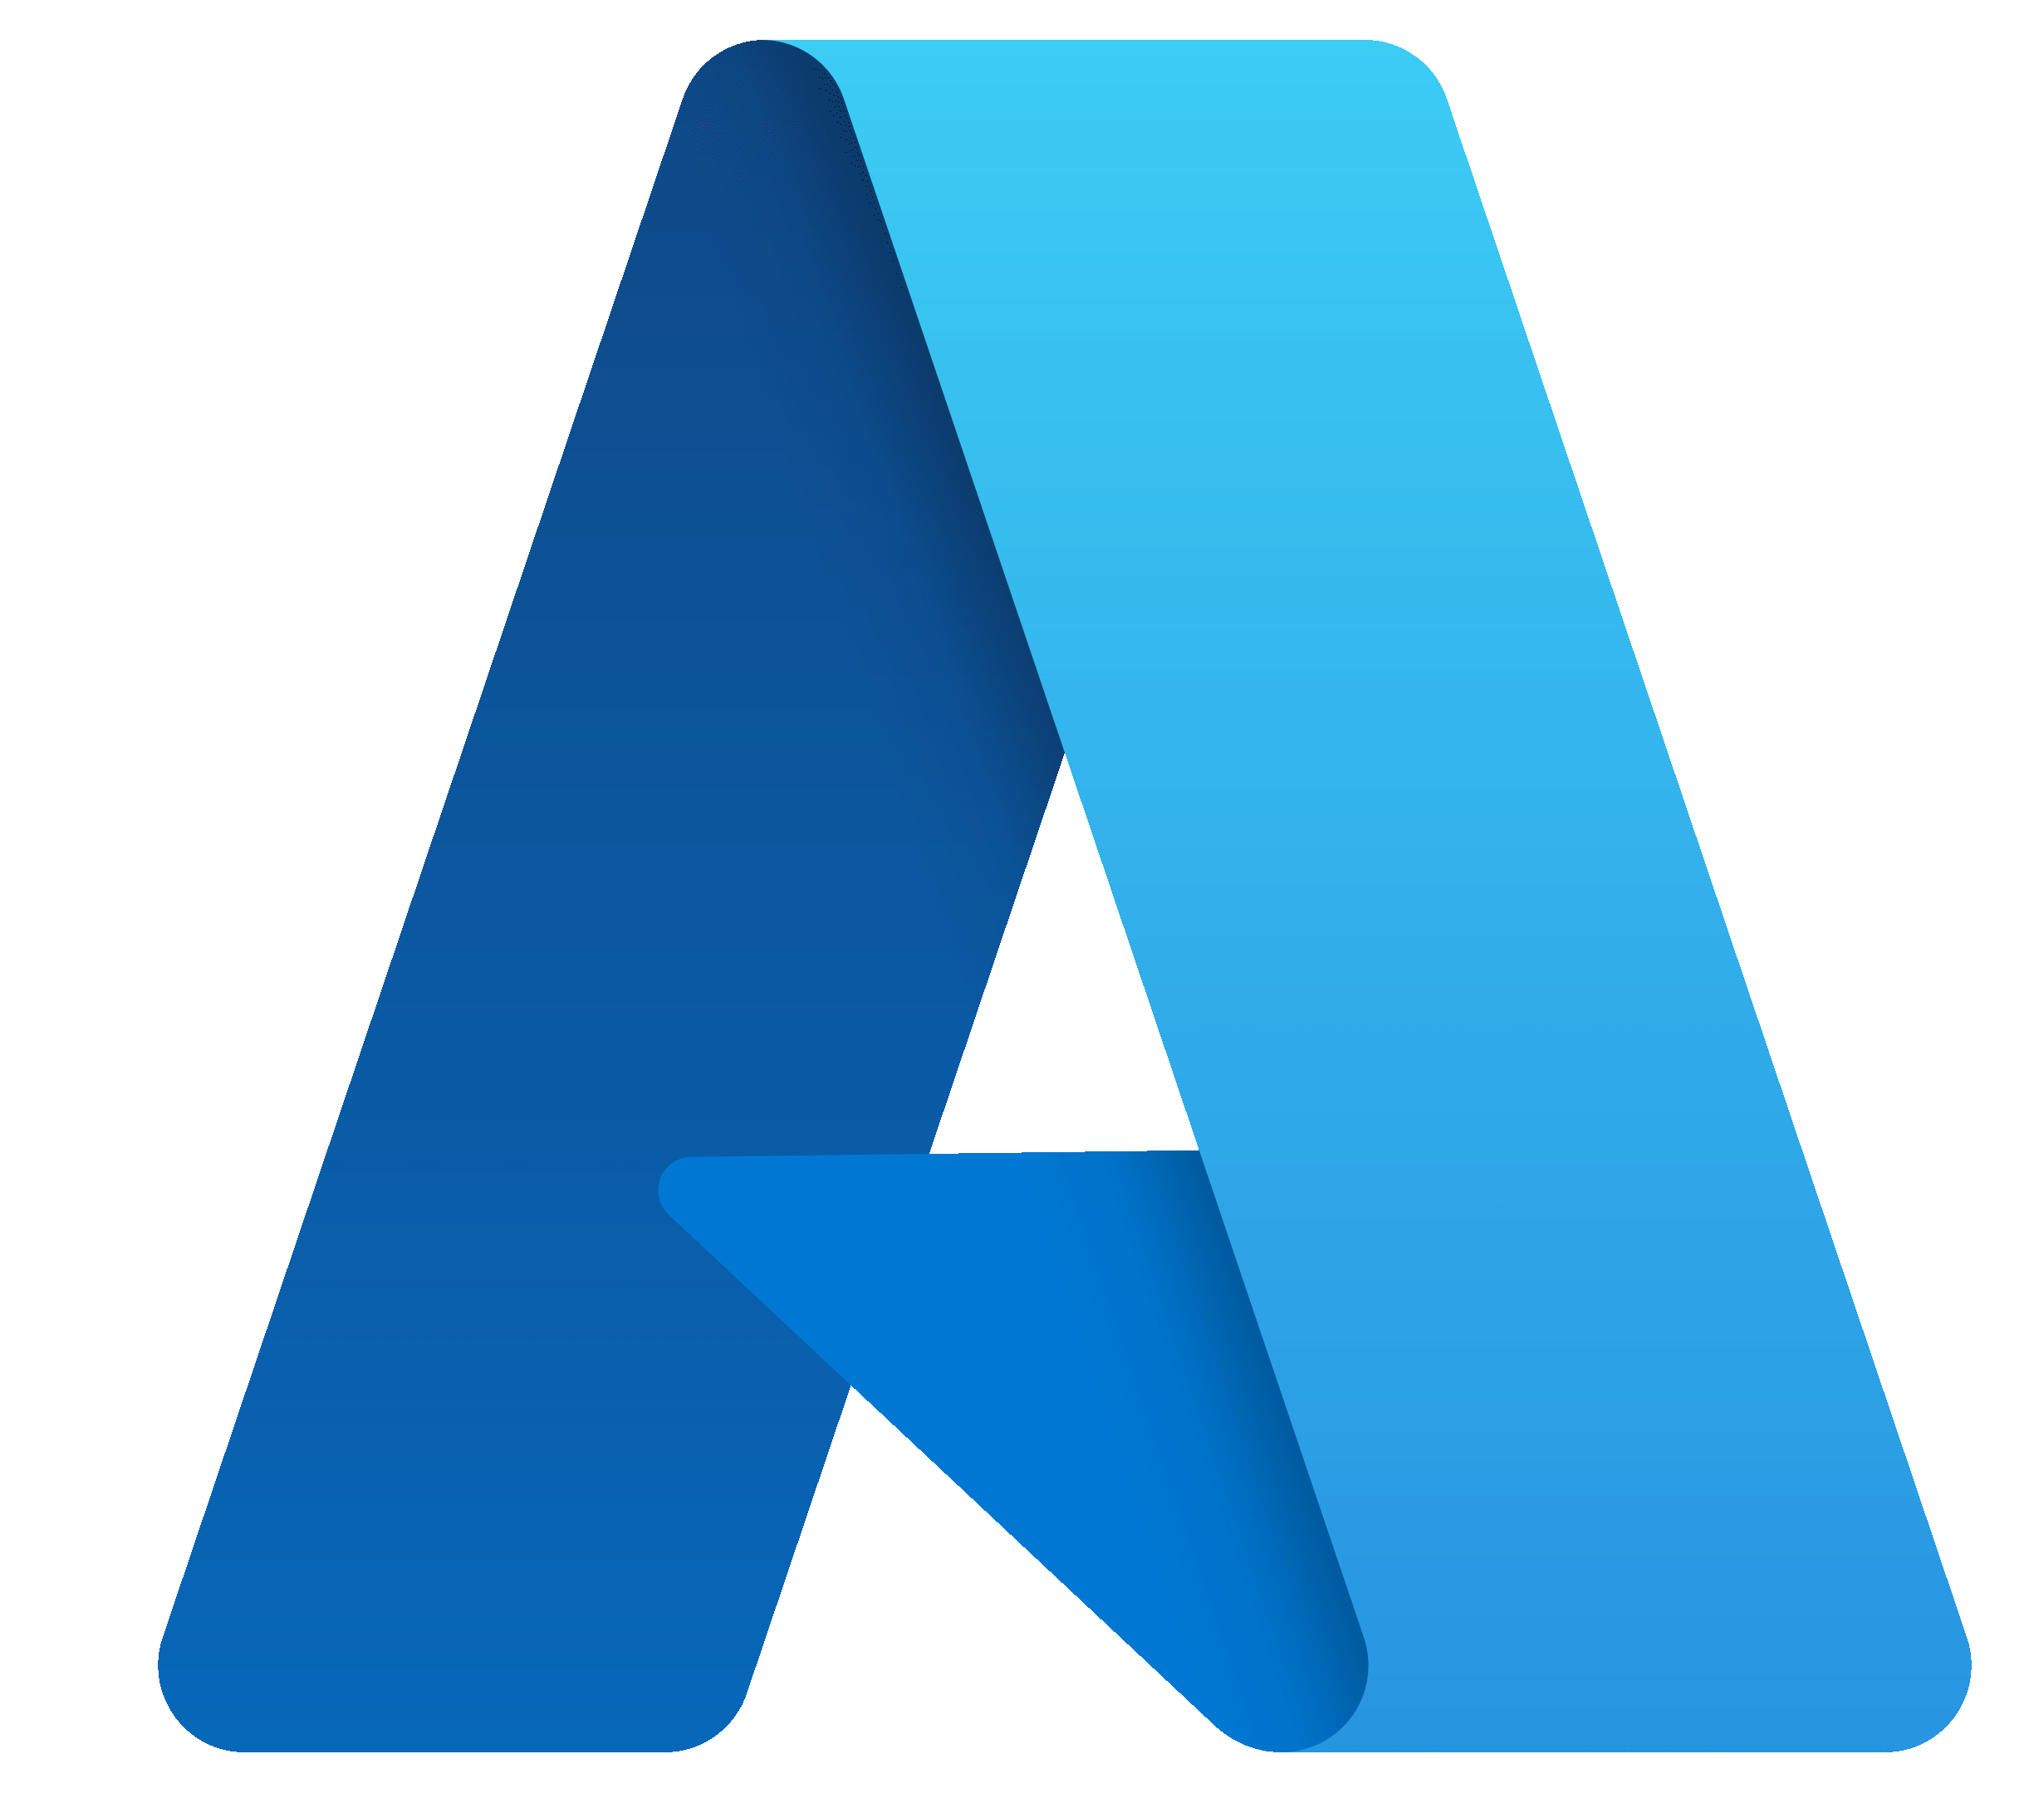
Microsoft Cloud for Nonprofit solutions
Know your donors and supporters
Deliver effective programming
Accelerate mission outcomes
Fundraising and Engagement
LinkedIn Sales Navigator
Constituent Marketing Journeys
Volunteer Management
Volunteer Engagement
Volunteer Center
Manage Volunteers
Microsoft Community Training
Program Impact Dashboard
Dynamics
Sales
LinkedIn
Navigator
Dynamics Marketing
Power Apps
Power Portal
SharePoint
Teams
Azure
Power BI Pro
Azure App Services
Azure
Dynamics 365
Power Apps
Modern Work
Azure
Power BI
Nonprofit Common Data Model
Notes:
As shown earlier, several of the Cloud for Nonprofit solutions are built on top of the Business Applications platform.
(One sliders for each in back of deck).

Slide 16


Microsoft Business Applications…
Operations
Service
Commerce
Sales
Human Resources
Marketing
Finance
Insights Apps
Power Platform
Notes:
Microsoft Dynamics 365 is a world leading Business Management Cloud. Dynamics 365 and Power Platform form the basis of a comprehensive set of connected, intelligent business applications to help automate processes across all of your departments or lines of business.

Slide 17


… transformed for the nonprofit sector
Service
Volunteer Management and Engagement (Power Apps)
Fundraising and Engagement (Sales)
Program Delivery
Operations
Constituents & Fundraising
Constituent Marketing Journeys (Marketing)
Commerce
Insights & Impact
Financials
Power BI
Human Resources
Insights Apps
Finance
Common Data Model for Nonprofits, Common Data Service and Dynamics 365 Accelerator
Notes:
We recognize the need for nonprofit capabilities and sector-specific solutions to support the unique processes for nonprofit organizations. Therefore we have translated the comprehensive D365 platform to fit into the world of the Non-Profit sector. This means that we are now offering a set of applications tailormade to help Non-Profits to achieve more, ranging from Fundraising and Engagement, Volunteer management, Business processes and tools for analysing business outcomes.
To learn more about the Cloud for non-profit and the Common Data Model, I will encourage you to view the dedicated section on the partner onboarding journey.

Slide 18


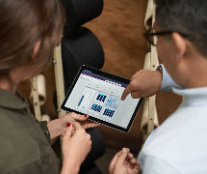


Business Applications
Fundraising and Engagement
Modernize donor and constituent engagement to increase mission impact
Attract, retain, and grow donors through personalized engagement
Drive fundraising efficiency and reduce costs w/ automated processes
Get accurate, real-time view of fundraising, programs and financial outcomes
Align all nonprofit systems and applications on a purpose-built nonprofit platform
Built on Dynamics 365 Sales and part of Microsoft Cloud for Nonprofit
Notes:
To highlight 3 unique areas, Firstly I want to give a brief overview of the Fundraising and Engagement capabilities
Technology can help you nurture constituent relationships as well as support you in the ever-important area of Fundraising.
The platform help non-profits to earn donors and volunteers for life with customer relationship management (CRM) capabilities. It enables organizations to take contextual information into every conversation and enable personalized interactions through a 360-degree view of donor and volunteer engagements.

Slide 19



Business Applications
Volunteer Solutions
Volunteer Management: A Power App that enables nonprofit volunteer managers to manage day to day processes to more effectively recruit, onboard, and retain larger pools of volunteers
Volunteer Engagement: One-stop shop for volunteers to easily engage and support the nonprofit’s mission. The portal experience interfaces with the nonprofit’s external-facing website
Built on Power Platform and part of Microsoft Cloud for Nonprofit
Notes:
From program design to delivery of services, program execution is the center of our entire model.

Slide 20






Business Applications
Financials
Monitor performance in real time
Simplify financial operations, with invoice automations, budget planning, expense management
Data reliability to help small nonprofits build trust with funders
Intelligent and predictive insights
Customizable tools and mobile apps
Dynamics 365 Finance or Business Central (depending on requirements)
Notes:
Second area I want highlight is the Financial Management capabilities
Under tremendous scrutiny, nonprofits must be efficient in their operations, effective in their delivery, and compliant with their donor requirements.
Automate and modernize your financial operations for nonprofits of all sizes with Business Central for smaller, less complex organizations or Dynamics 365 Finance for larger ones. Monitor performance in real time, predict future outcomes, and make data-driven decisions to drive greater impact.
It provides tools like vendor invoice automations, vendor collaborations, quote to cash, budget planning, budget control, expense management, and recurring invoices.
It derives true business value through the optimization of accurate and timely reporting, as well as intelligent and predictive insights.

Slide 21





Business Applications
Microsoft Power Platform
Build no-code and low-code customer applications
Analyze data using Power BI
Power Apps like Nonprofit Operations Toolkit can leverage all cloud solutions
Automate workflows using Power Automate
Build intelligent bots using Power Virtual Agents
Notes:
Lastly, I want to point attention to the Microsoft Power Platform
The Power Platform is a low-code platform that spans Office 365, Dynamics 365, Azure, and standalone applications. Underpinning our business applications suite, nonprofits can eliminate pen and paper processes and easily use their creativity to automate any unique process desired to drive efficiencies across the business.
It helps you modernize business processes, automate routine tasks and gives the organization an opportunity to tailor apps for specific individual purposes.

Slide 22
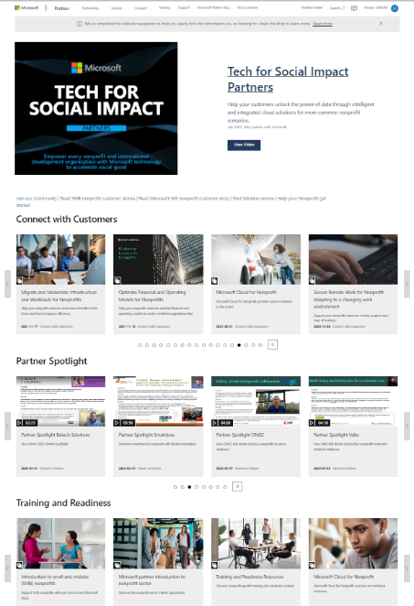
Tailored resources to help you succeed
Connect with customers with customizable campaigns
View partner spotlight stories to hear best practices
Sharpen your skills with training and readiness
Access to community updates for latest news and updates
Build and implement solutions for nonprofits with Microsoft
Notes:
With that we concluded a short overview of the business opportunity for partners to leverage their existing skills within Dynamics 365, whether that is on the CRM side or ERP side of the business.
The opportunity is massive and we have a great solution fit to serve even more Non-Profit organization in their journey to Digital Transformation.

Slide 23
Onboard to the nonprofit sector
Discover nonprofits
Align your skills
Target your audience
Connect with peers
Step 1
Step 2
Step 3
Step 4
Gain insight to nonprofits who are need technology to support them in addressing our world's most challenging issues.
Leverage your existing skill set to reach your nonprofit customers in need of your services to deliver on their mission.
Access customizable campaigns, targeted offers and more to reach your local and global nonprofit organizations.
Join a community of partners servicing the nonprofits to share best practices and get latest news.
Notes:
This concludes the second step in your nonprofit sector onboarding journey.
Today, we covered how you should leverage the skills in Dynamics 365 to service nonprofits both small and large
Take the next step. Target your audience. In step 3, learn how to Digital Marketing OnDemand to target nonprofits with your expertise. Visit our website to select the campaign that right for you.
Thank you for your time today!

Slide 24

Thank you
© Copyright Microsoft Corporation. All rights reserved.
Notes:
On behalf of the Microsoft Tech for Social Impact team, I want to thank you for listening and in. We are excited about this opportunity and we are ready to support you in the journey of becoming a partner serving the Non Profit sector.

