Slide 1
Accelerate Innovation with Low Code
Solution Play Partner Guide
Notes:
Click to Add Notes

Slide 2
Welcome!
This deck introduces the FY24 Solution Play Accelerate Innovation with Low Code and covers the following topics:
Customer and market trends that make this play relevant
What Solution Plays are and why they matter
How to navigate the customer scenarios
Target personas and how to approach them
Partner and customer stories
Resources to help accelerate your go to market (GTM)
Note: This deck was designed to be used internally by partners to skill up and align their teams to the Microsoft Solution Play. These slides are not intended to be presented to customers.

Slide 3




Your customers need help navigating the demand for digital transformation
Surge in demand for apps
750 million
new apps need to be built by 2025
Serious developer shortage
4 million
developer shortfall to meet the projected number of apps
Businesses want to automate
50%
of digital work can be automated with current tech
Hiring dev talent is hard
86%
of companies struggle to hire tech talent
Sources: DORA, Black Duck, ISC, IDC, Forrester, AppAnnie, Microsoft, IDG: Big Data Survey, McKinsey, Quantifying the Worldwide Shortage of Full-Time Developers (idc.com)

Slide 4
An unparalleled opportunity with Power Platform
No. 1 adopted low-code platform²
33 M monthly active Power Platform users³
36,000 organizations already using AI-powered capabilities in Power Platform⁴
140% ROI with Power Platform premium capabilities⁵
$18.5 B
low-code TAM¹
21% CAGR¹
1. Gartner Research Commissioned by Microsoft, 2023
2. The Forrester Wave™: Low-Code Development Platforms For Professional Developers, Q2 2023
3. FY23 Q3 Earnings Release link
4. Microsoft Internal data
5. A Forrester TEI Study Commissioned By Microsoft, August 2022

Slide 5
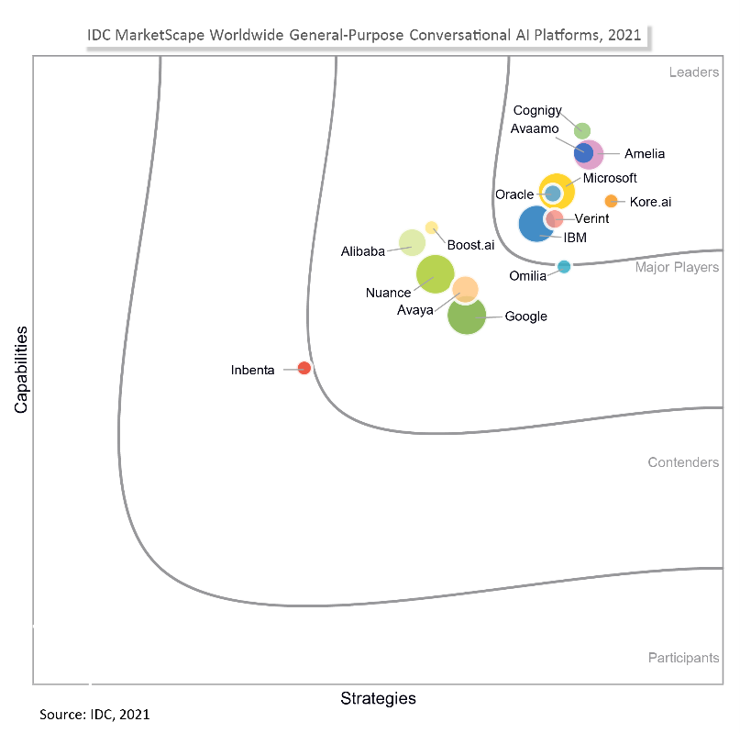
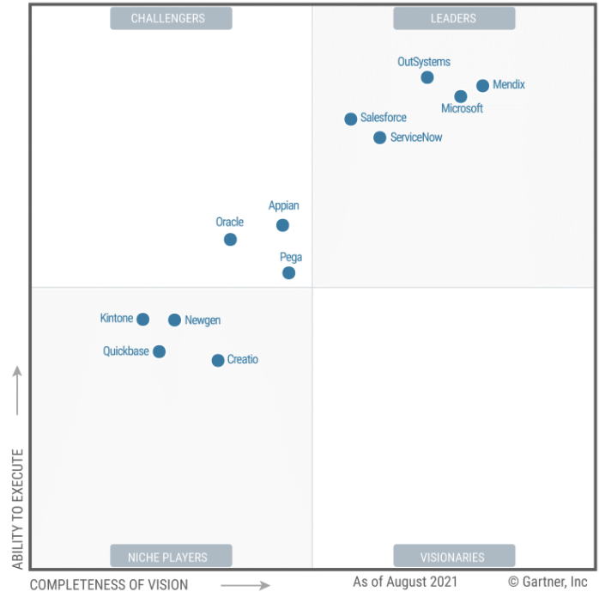
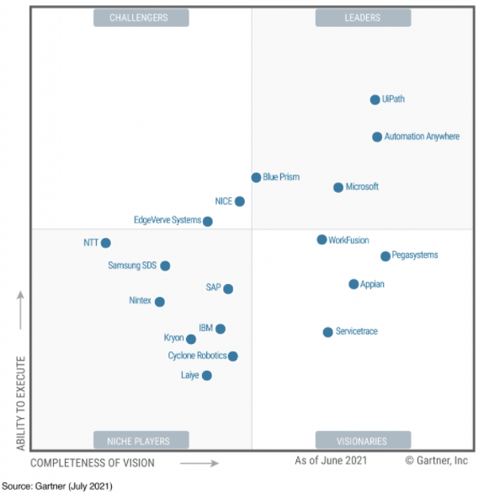
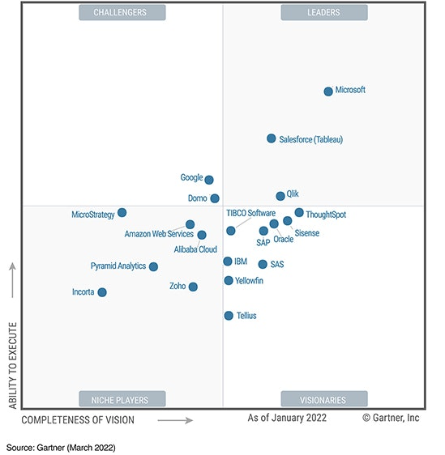
Microsoft is a leader and a trusted brand
Platform
Automation
Conversational AI
BI & Analytics
Leader | Gartner Low Code Applications Platform, 2022
Leader | Forrester Wave Low-Code Development Platforms for Professional Developers, 2021
Leader | Gartner Robotic Process Automation Attended & Unattended, 2022
Leader | Forrester Wave Robotic Process Automation, 2022
Leader | Forrester Wave Digital Process Automation , 2022
Leader | IDC MarketScape Worldwide General-Purpose Conversational AI & Bots, 2022
Leader | IDC MarketScape Conversational AI Software Platforms for Customer Service, 2021
Top Vendor | Gartner Analytics & Business Intelligence Platforms, 2022
Leader | Forrester Wave Augmented BI Platforms, 2021

Slide 6
Bring AI into every conversation
Align the company’s revenue strategy across Marketing, Sales, and Customer Success
Elevate the customer experience
Discover new ways to generate leads
Define the company value proposition
Outline the GTM strategy
Expanding into new markets
Seller recruitment, coaching, and retention
Choosing and deploying CRM and associated sales tools
Enhancing ability to forecast
Driving more opportunities into the pipeline
Align the company’s revenue strategy across Marketing, Sales, and Customer Success
Elevate the customer experience
Discover new ways to generate leads
Define the company value proposition
Outline the GTM strategy
Expanding into new markets
Seller recruitment, coaching, and retention
Choosing and deploying CRM and associated sales tools
Enhancing ability to forecast
Driving more opportunities into the pipeline
Driving outcomes for Power Platform customers using Copilot
The differentiated AI value from Microsoft
​Copilot in Power Platform is further democratizing development and enabling even more people to create innovative solutions through natural language. Now, if you can imagine your solution, you can simply describe it in everyday language and Copilot can create it for you through an intuitive and intelligent low-code experience. Copilot accelerates development for citizen and professional developers alike.
Amplify human ingenuity with a copilot for everyone
Realize exponential value with the leading AI platform
For developers
​Copilot in Power Platform
Generative AI templates
AI-assisted data integration
For users
​AI-generated analytics
Generative answers
Generative actions
Innovate confidently with a responsible AI partner
Learn more and access partner resources: aka.ms/BACopilot

Slide 7
Why Solution Plays and customer scenarios matter
FY24 Solution Plays
Accelerate Innovation
with Low Code
Accelerate Revenue Generation
Scale Business Operations
Optimize Finance and Supply Chain
Modernize Service
Every year, Microsoft develops Solution Plays that describe how market trends and current business needs have influenced our customers’ perceptions of the different business categories. These solution plays reflect the most relevant customer challenges and concerns to help sellers and partners connect with key business personas about what is top of mind for them.
Solution Plays are how the Microsoft Field go-to-market, and we provide the same guidance and resources to our partners to ensure strong co-sell motions and alignment in customers in achieving their desired business outcomes.
Solution Play
Every Solution Play has a set of customer scenarios which are a double-click into customers’ specific pain points and provide a solution with the right set of technical capabilities.
Customer scenarios allow sellers to meet the customer where they are and have a deeper, guided conversation with the key buying personas to solve a specific business problem within a broader line of business (LoB).
Customer scenario
Products deliver capabilities to enable a specific business outcome of the customer defined within each of the customer scenarios. While we lead with customer scenarios, we also provide product specific pitch decks and demos to provide depth into capabilities.
Product

Slide 8
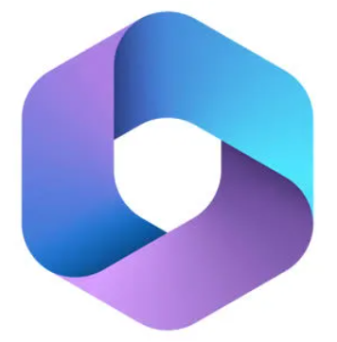
Meet the Low-Code Solution Play
Solution Play
Customer scenarios
Accelerate Innovation with Low Code
Scale innovation with low code ​
Accelerate innovation with the world’s most complete set of integrated, low-code development tools Power Platform is a highly secure platform, running on the global, hyper-scale, enterprise-grade Microsoft Cloud, which provides a comprehensive offering that spans capabilities from application development, automation, chat bots, and conversational agents to secure business websites. In addition, various audiences across the business realize value–from pro developers to IT admins, to business decision makers and end users.
Accelerate development and drive productivity
Optimize with hyperautomation
Infuse every interaction with AI using Copilot—built into the Power Platform

Slide 9
Get to know the key customer scenarios Align your go-to-market with Microsoft sellers and identify the priority patterns of value based on the customer scenario selected.
Align the company’s revenue strategy across Marketing, Sales, and Customer Success
Elevate the customer experience
Discover new ways to generate leads
Define the company value proposition
Outline the GTM strategy
Expanding into new markets
Seller recruitment, coaching, and retention
Choosing and deploying CRM and associated sales tools
Enhancing ability to forecast
Driving more opportunities into the pipeline
Primary customer scenario - Scale innovation with low code
​Under current economic pressures, organizations are being squeezed at all levels–struggling to address app backlogs, facing shrinking budgets, and lack of technical capacity. Low code enables your customers to modernize at speed, multiply their pro dev capacity, save costs, and get more value by customizing and extending their LoB solutions.
Land company-wide low-code adoption focused on the full value of the Power Platform. Focus on the CIO/ITDM persona as a key sponsor and utilize the 6 patterns of values (next slide) to identify key customer needs. Prioritize 2-3 patterns based on unique customer signals to provide a focused approach to initial value realization.
Targeted customer scenarios In cases where a customer is not ready to embark on organization-wide adoption, focus on a specific customer scenario for initial low-code success
Align the company’s revenue strategy across Marketing, Sales, and Customer Success
Elevate the customer experience
Discover new ways to generate leads
Define the company value proposition
Outline the GTM strategy
Expanding into new markets
Seller recruitment, coaching, and retention
Choosing and deploying CRM and associated sales tools
Enhancing ability to forecast
Driving more opportunities into the pipeline
Align the company’s revenue strategy across Marketing, Sales, and Customer Success
Elevate the customer experience
Discover new ways to generate leads
Define the company value proposition
Outline the GTM strategy
Expanding into new markets
Seller recruitment, coaching, and retention
Choosing and deploying CRM and associated sales tools
Enhancing ability to forecast
Driving more opportunities into the pipeline
Accelerate development and drive productivity ​
​Land value of low-code application development with both the business decision marker and technical decision maker audiences by focusing on business value – time and cost savings, employee productivity, pro dev productivity, department value.
Optimize with hyperautomation​
​Deliver a comprehensive, connected, and intelligent automation solution that enables everyone to engage in hyperautomation. Modernize business processes, optimize costs, and do more with existing systems while replacing expensive, legacy solutions with one integrated solution for automation.

Slide 10

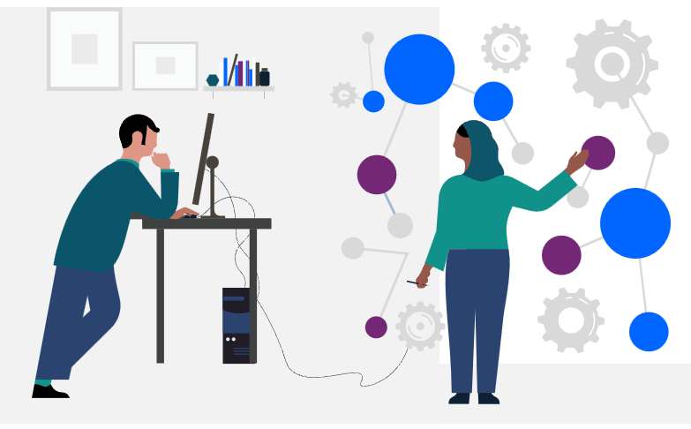
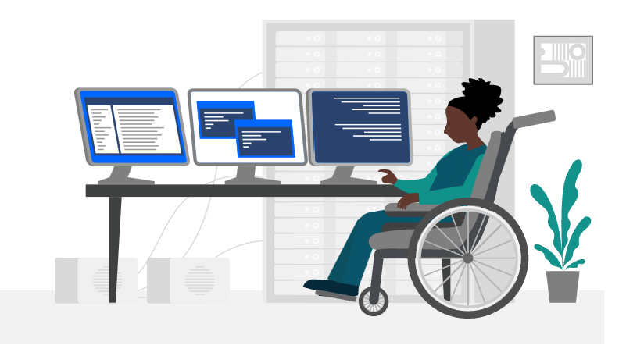
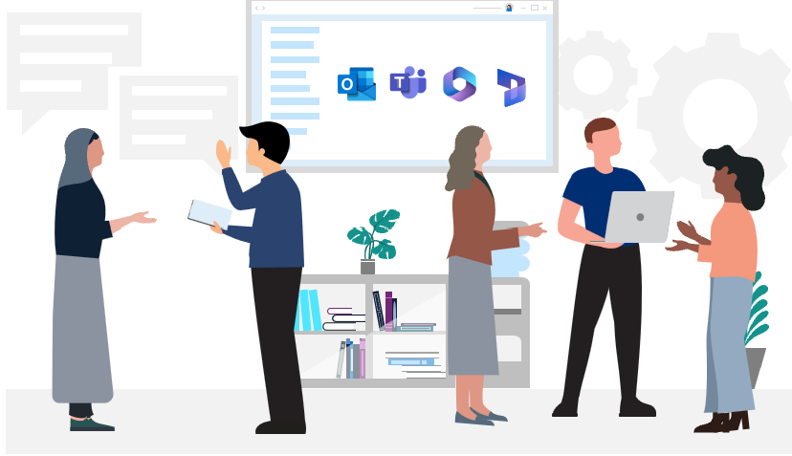
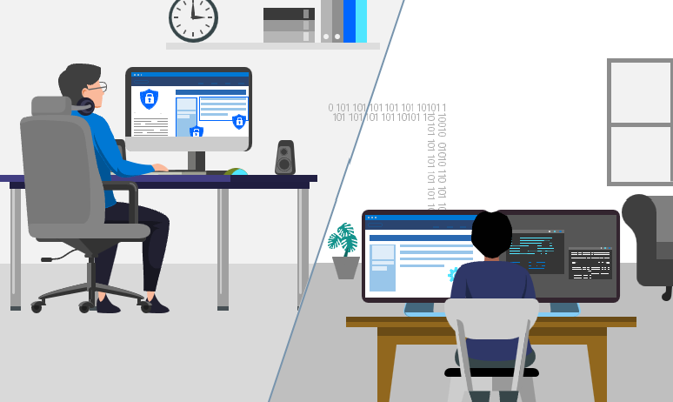
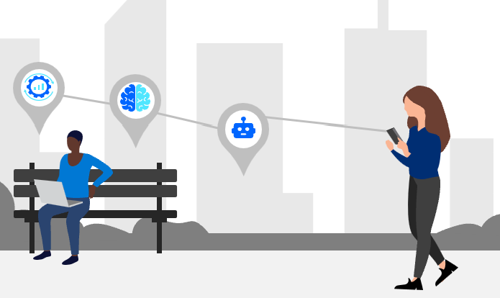
Use patterns of value to identify priority outcomes The six most common patterns of value provide a good starting point for finding opportunities with customers.
1
Application modernization
Update, rearchitect, rebuild, and create new applications faster and at scale to reduce your backlog.
2
Extend LoB Systems
Simplify user experience and connect processes by extending core systems (e.g. SAP, Oracle, Salesforce.com)
3
Accelerate professional developer
Reduce the time and effort needed to build new solutions and unlock faster time to value for everyone.
4
Enhance employee experiences
Integrate with Microsoft 365 to surface data where it’s needed and modernize processes for a better experience.
5
Empower departments
Empower business users to solve challenges while giving IT complete visibility and control into what’s being created.
6
Optimize with hyperautomation
End-to-end automation to modernize and streamline processes and integrate systems.
Deep dive into each pattern

Slide 11
Customer scenario deep dive: Scale innovation with low code ​
Equip all users from citizen developers to pro devs to work together to build better solutions faster and drive innovation.
Discovery questions Are your teams able to stay productive and efficient with your existing tools? How has your organization prepared to adapt to the hybrid workplace model? How many manual processes would you automate today if you had the time and staff?
Help admins and organizations secure, manage, monitor, and view their data according to their specific needs.
Discovery questions How do you ensure the security of your data and governance of your tools? How easy is it for your organizations to scale analytics capabilities while not disrupting end-user productivity? How many kinds of reporting tools and data storage systems do you use?
Integrate built-in governance, monitoring, and reporting in one centralized admin experience.
Discovery questions How easy is it for you to give your trusted ecosystem members, like suppliers and partners, secure access to relevant reporting to both party’s work from the same information? How easy is it for you to provide reporting in the places your users spend the most time like a mobile view for execs or sales professionals on the go, within the context of a collaboration tool, or within the applications or websites they use every day?
Utilize a single-structured platform for core business process data so organizations can rapidly adapt to and solve business challenge.
Discovery questions How consolidated is your data estate? What level of confidence do you have that today’s reporting is accurate and that everyone is working from a single source of truth?

Slide 12
Customer scenario deep dive: Accelerate development and drive productivity ​
Adapt, save money, and differentiate services by building scalable and connected mission critical solutions that solve your greatest business challenges.
Discovery questions How easy is it for non-technical citizen developers to create custom applications? How has your organization prepared to adapt to the hybrid workplace model? How do you integrate legacy systems into your custom applications? How long does it take you to develop an enterprise ready scalable solution?
Drive innovation across the organization while maintaining governance, security, and quality standards.
Discovery questions How do you ensure the security of your data and the governance of your tools? How do you ensure your custom applications are protected and only accessible to trusted parties? When all your lines of business are running simultaneously, how do you monitor all your applications at once?
Enable citizen developers to work directly with pro developers for even more advanced solutions.
Discovery questions How easily can you embed and connect to other services from your custom applications? How easily can you embed features such as mixed reality, chatbots and geo-sensitive interactive maps into your applications? What tools can your teams use to deploy solutions fast?
Refresh your existing pages with endless customizations or quickly create new ones using built-in, easy-to-use components.
Discovery questions Are you able to build and design pages specific to your brand and use them as templates for future pages? Does your website meet global and language accessibility standards? How do you visualize your data to derive insights? What pro-dev or advanced capabilities do you desire in your business website builder?

Slide 13
Customer scenario deep dive: Optimize with hyperautomation​
Create more time for your teams to focus on strategic work and streamline processes across modern and legacy systems.
Discovery questions How many manual processes would you automate today if you had the time and staff? Are you making the most of the tools you use by using RPA? Do you understand which of your processes are causing bottlenecks? If so, do you know how to fix them?
Empower everyone in your organization to create, test, and publish bots faster than before.
Discovery questions How much time do your employees spend answering questions that are already available on internal and external-facing websites? What level of confidence do you have that customers and employees are receiving consistent messaging from your company? Do you have manual processes that could be automated through conversations?
Efficiently scale automation and give IT controls they need to drive a secure and compliant organization.
Discovery questions Do your professional developers have the tools they need to drive automation across the company? How do you ensure the security of your data and the governance of your tools? Are you able to scale automation in a secure and compliant way? Are you able to access external data to create and manage customer connectors?
Build a culture of automation and digital transformation with the full Power Platform solution.
Discovery questions Are you familiar with the full spectrum of end-to-end automation solutions available across Microsoft ecosystem? Would you automate more if it would happen seamlessly within your existing ALM and SDLC processes? Have you infused everything from RPA, DPA, Process Mining and AI into your automation processes?

Slide 14

Get familiar with the decision makers
Chief Information Officer
More than ever before, CIOs today are involved in areas outside their traditional technology purview and are increasingly connecting cross-functionally with stakeholders driving innovation initiatives across the organization. CIOs and IT leaders are a critical sponsor in supporting low code vision and supporting organization wide adoption and an important stakeholder in developing COEs and governance models.
IT decision makers: ITDMs determine what applications and governance processes citizen developers and professional developers use and follow. They also ensure security and governance standards are upheld. ITDMs are closely concerned with integration and technical specs.
Application modernization
Extend LoB systems
Accelerate professional developer
Enhance employee experiences
Empower departments
Optimize with hyperautomation
Key personas:
LoB business decision makers
Citizen developers
Key personas:
LoB business decision makers
Citizen developers
Key personas:
Pro developers
Key personas:
LoB business decision makers
Citizen developers
Key personas:
Pro developers
Key personas:
LoB business decision makers
Citizen developers
Professional developer: Professional developers see value in low code to get work done faster. Low code doesn’t replace their full-stack technical skills, but with a low-code app platform, professional developers can accelerate foundational development and repetitive tasks, so they can focus on custom components, new innovations, and testing cycles.
LoB decision makers: Line of Business decision makers are looking for ways to optimize processes and reduce costs within their department (whether they lead for sales, finance, operations, etc.). They look to low code to enhance and customize their current systems to provide better employee experiences and streamline processes.
Citizen developer: Citizen developers are go-getters who seek out faster, better ways to get work done. Though development is not part of their job, they see it as an opportunity to improve processes or showcase their value at work. Citizen developers will often teach themselves how to develop apps, automations, and bots and prefer solutions they can learn quickly.

Slide 15
Discover low-code opportunities in key industries
Public sector/government
How do you respond to citizens’ needs today?
How do citizens alert you about an issue?
How do government employees keep track of things like social work cases or work orders?
Finance
How are you balancing compliance with accelerating sales of financial services?
What systems do you use to track loan applications or insurance claims?
How do you empower customers to self-serve, i.e., online banking?
Healthcare
How does your patient intake process work? What would you like to be digital?
How do healthcare staff handle shift management?
How do you track the status of patients today? What other details would you like to know?
Energy
What is your process for logging safety inspections?
How do you track equipment and machinery servicing?
How do users register for services, pay bills, and submit requests?
Retail
How do you connect your checkout functionality with your frontend UI?
How do you track order fulfillment?
What’s your vision for product recommendations?
Manufacturing
How do you identify supply chain roadblocks today?
Which factory operations rely on paper and what would you like to digitize?
How have you implemented predictive maintenance?
Find industry specific decks: Power Apps | Power Automate | Power Virtual Agents | Power Pages

Slide 16



Smart Consulting speeds up vendor registration for a retailer more than 85%
Via, a Brazilian retailer of household goods and electronics, needed to accelerate and simplify its supplier registration process.
Smart Consulting used Power Apps and Power Pages to create a new portal for suppliers to register. It built workflows with Power Automate that integrated the app with external web sites and the internal ERP system to automate vendor validation and registration processes.
As a result of the new solution, the 17-step process was reduced to five steps; the 40-day registration timeline shrank to five days; and supplier approvals increased from 50 to 96 percent.
Case study link

Slide 17



Hexaware helps Yorkshire Water drive rapid IT transformation
Yorkshire Water, a water supply and treatment utility in the UK, was looking to up-level their project management tools and streamline their processes.
Hexaware used Power App and Power Automate to develop a solution that automated processes such as demand intake, project approvals, and weekly project status tracking.
The solution was quickly adopted by employees and led to a 55 percent improvement in process efficiency.
Case study link

Slide 18



DigPacks helps NHS Trust reduce referral processing time 90%
The Berkshire Healthcare NHS Foundation Trust offers a wide range of services to local residents that get referred in from different providers and centers. Manually processing patient referrals consisted of highly complex business rules with 38 separate possible referral pathways that took the team about 20 minutes per referral.
Berkshire worked with DigPacks to digitize every step of the process and use a robot to take each action. By using Power Automate Desktop, the team was able to reduce the average referral process to two minutes and 20 seconds.
With hundreds of referrals submitted each week, this saves Berkshire Healthcare an average of 226 days of work annually.
Case study link

Slide 19



Acuvate launches HR bot in two weeks to better serve employees
Neptune Energy, an independent energy company with over 1,500 employees worldwide, was looking for an employee assistant that could help employees find and navigate HR information.
Acuvate used Power Virtual Agents and Power Automate integrated with Teams to launch the HR Handbook Bot in two weeks. This bot searches for relevant information across more than 100 topics to give employees quick responses to their HR questions.
As a result, Neptune saw an increase in operational efficiency of HR staff, reduced time to find information on employee benefits, and improved employee experience.
Case study link

Slide 20
Accelerate your customer’s sales cycle Resources aligned to the Microsoft Customer Engagement Methodology (MCEM) connect co-sell efforts with the Microsoft Field
Listen & consult
Inspire & design
Empower & achieve
Realize value
Manage & optimize
Description
Content | Solution Play Pitch Decks & Demos Thru Partner Marketing Campaigns ^{New} | Customer Scenario Decks ^{Updated} Patterns of Value ^{New} Adoption Assessment ^{New} | Customer Scenario Demos | Power Platform Adoption Resources
Programs & tools |  | Partner Pre-Sales Activities ^{Updated} | Partner Pre-Sales Activities ^{Updated} Power Apps Developer Plan | Partner Post-Sales Activities ^{Updated} | Partner Post-Sales Activities ^{Updated} In-A-Day Workshops
Incentives |  |  | OSA Incentive CSP Incentive |  | MCI Incentive
Listen to the customer, qualify their business problem.
Define solution value and create a customer success plan.
Develop the business and technical solution elements and shape the deal.
Implement the solution and action change management and value realization.
Achieve solution health and realize business value. Look for further opportunities.

Slide 21
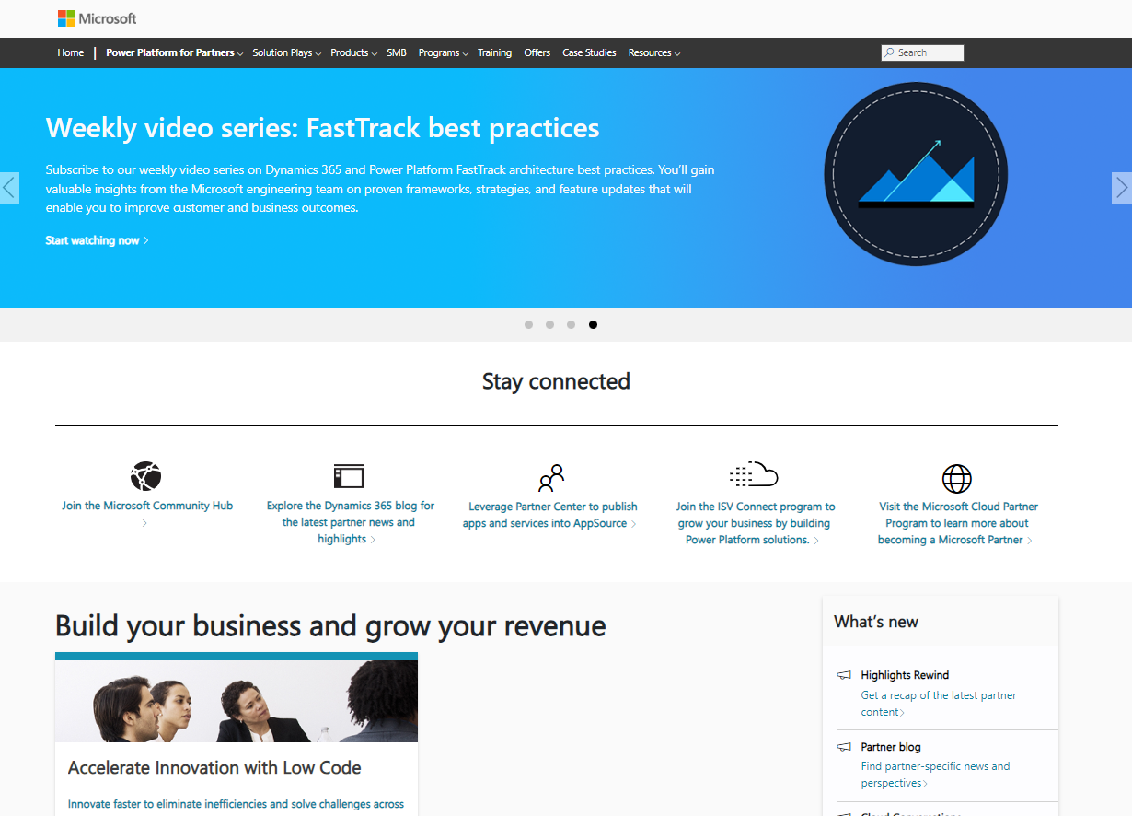
Access GTM resources specific to this Solution Play
Partner Hub: Your one-stop shop
Visit the Power Platform Partner Hub to access go-to-market resources such as:
Solution Play narrative deck
Customer scenario customer-ready pitch decks
Demos & click-through experiences
Partner evidence stories
Customer-ready videos
Whitepapers and research

Slide 22
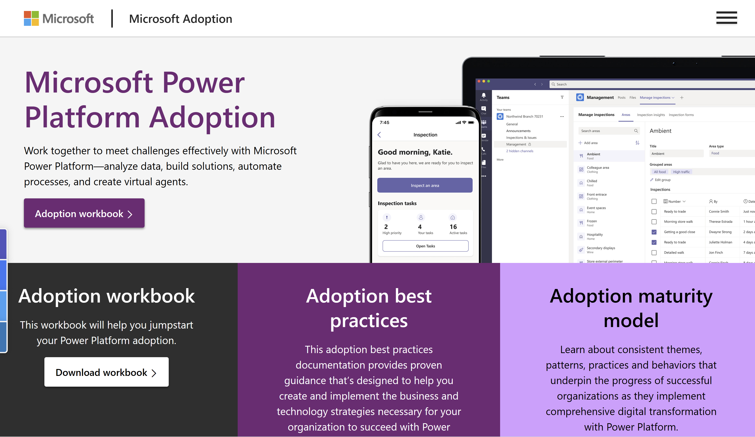
Drive usage and adoption
Advancing adoption and cultivating a low-code culture is about more than implementing technology features. Technology can assist an organization in making the greatest impact, but a healthy low-code culture involves many considerations across the spectrum of people, processes, and technology.
Envision
Get started
Project team
Executive sponsorship
Adoption strategy and vision
Onboard
Champions
Community
Rewards and recognition
Scale
Center of Excellence (CoE)
Adoption maturity
Operational plan
Success tracking
Change management
Activity calendar
Success criteria
Change management plan
Readiness
Training strategy
Communication plan
Awareness
Ongoing support
Microsoft Power Platform Adoption Resources

Slide 23
Plan your next step in the partner journey
Partner Hub
Build
Start building the business
Grow
Go to market with Microsoft
Accelerate
Specialize and differentiate
Stages
Register as a Microsoft Partner
Join the Microsoft Cloud Partner Program
Make Partner Center your portal
Define your business plan
Explore Low Code Partner Playbook
Review Partner Opportunity Deck
Staff core team
Explore MS Learn on-demand learning paths
Attend Cloud Weeks training events
Sign up for Weekly Tech Talks
Achieve initial Certifications
Complete initial wins, recognize your impact
Register deals with Partner Admin Link (PAL)
Sell licenses as a CSP
Publish on AppSource, become Co-Sell ready
Define your offering and publish on AppSource
Review requirements to publish Consulting Offers
Explore Co-Sell Ready
Leverage Solution Play resources
Solution Play Pitch decks & Demos
Thru-Partner marketing campaign
Power Automate
Grow your team
Skill your sales team with Catalyst
Increase # of Certifications, explore expert and developer skilling
In-A-Day Program
Eligible partners can provide hands-on, partner-led workshops with demand gen supported by Microsoft.
Achieve solution designation
After meeting the requirements of performance & skilling, unlock new benefits and recognition
Nominate for partner activities & incentives
Once eligible, explore pre-sales and post-sales activities funding and Microsoft Commercial incentives such as OSA.
Achieve low code specialization
After meeting the requirements of performance, skilling & AppSource, unlock new benefits and recognition
Low Code App Development Specialization
Intelligent Automation Specialization
Become FastTrack ready & recognize your skilled architects
Learn more about FastTrack
Explore FastTrack Recognized Solution Architect
Nominate for success stories
Nominate for Partner Success Stories
Nominate for POTYA annual awards
Key activities & resources
You are here
Get connected: Bookmark Partner Hub | Review the Partner Hub Blog | Join the Microsoft Partner Community

Slide 24
Unlocking the low-code patterns of value
Notes:
Click to Add Notes

Slide 25
Get to know the low-code patterns of value Align your go-to-market to address these patterns and differentiate with expertise in specific patterns
1
Application modernization
Update, rearchitect, rebuild, and create new applications faster and at scale to reduce your backlog.
2
Extend LoB Systems
Simplify user experience and connect processes by extending core systems (e.g. SAP, Oracle, Salesforce.com)
3
Accelerate professional developer
Reduce the time and effort needed to build new solutions and unlock faster time to value for everyone.
4
Enhance employee experiences
Integrate with Microsoft 365 to surface data where it’s needed and modernize processes for a better experience.
5
Empower departments
Empower business users to solve challenges while giving IT complete visibility and control into what’s being created.
6
Optimize with hyperautomation
End-to-end automation to modernize and streamline processes and integrate systems.
Deep dive into each pattern

Slide 26
Application modernization Build and update solutions at scale
1
Application modernization
z
Develop solutions at scale. Free up limited pro dev resources and enable them to work faster on mission critical solutions.
Build solutions where you work. Adapt and save money with scalable solutions that solve your greatest business challenges.
Create secure external websites. Refresh your existing websites or quickly launch new ones at scale using built-in, easy to use components.
87% of CIOs and IT pros say low code is very useful in helping their organizations modernize legacy applications.¹
Sources: Low-code signals 2023 - Microsoft Power Platform Blog

Slide 27





Application building and modernization
1
Application modernization
Retire
Retire it, right-size, eliminate environments
~10%
Replace
Use or convert to a SaaS solution
~15%
Accelerated with
Power Platform
Rebuild
Convert to Azure PaaS solution
Refactor
Optimize with platform capabilities (IaaS and PaaS)
~60%
Rehost
No change, migrate to IaaS
Remain on-premises
Remain
15%

Slide 28
Extend LoB systems Improve and extend your core systems
2
Extend LOB systems
z
Improve processes and user experience across your company’s core systems like SAP, Oracle, and Salesforce.
Extend your core systems with apps, flows, external websites, chatbots, and dashboards to fill gaps and deliver flexibility.
Get more out of your existing investments with a modern solution that keeps the user experience seamless and extends the life of your core systems.
% of CIOs and IT pros surveyed say low code is effective in increasing efficiency.¹
Sources: Low-code signals 2023 - Microsoft Power Platform Blog

Slide 29



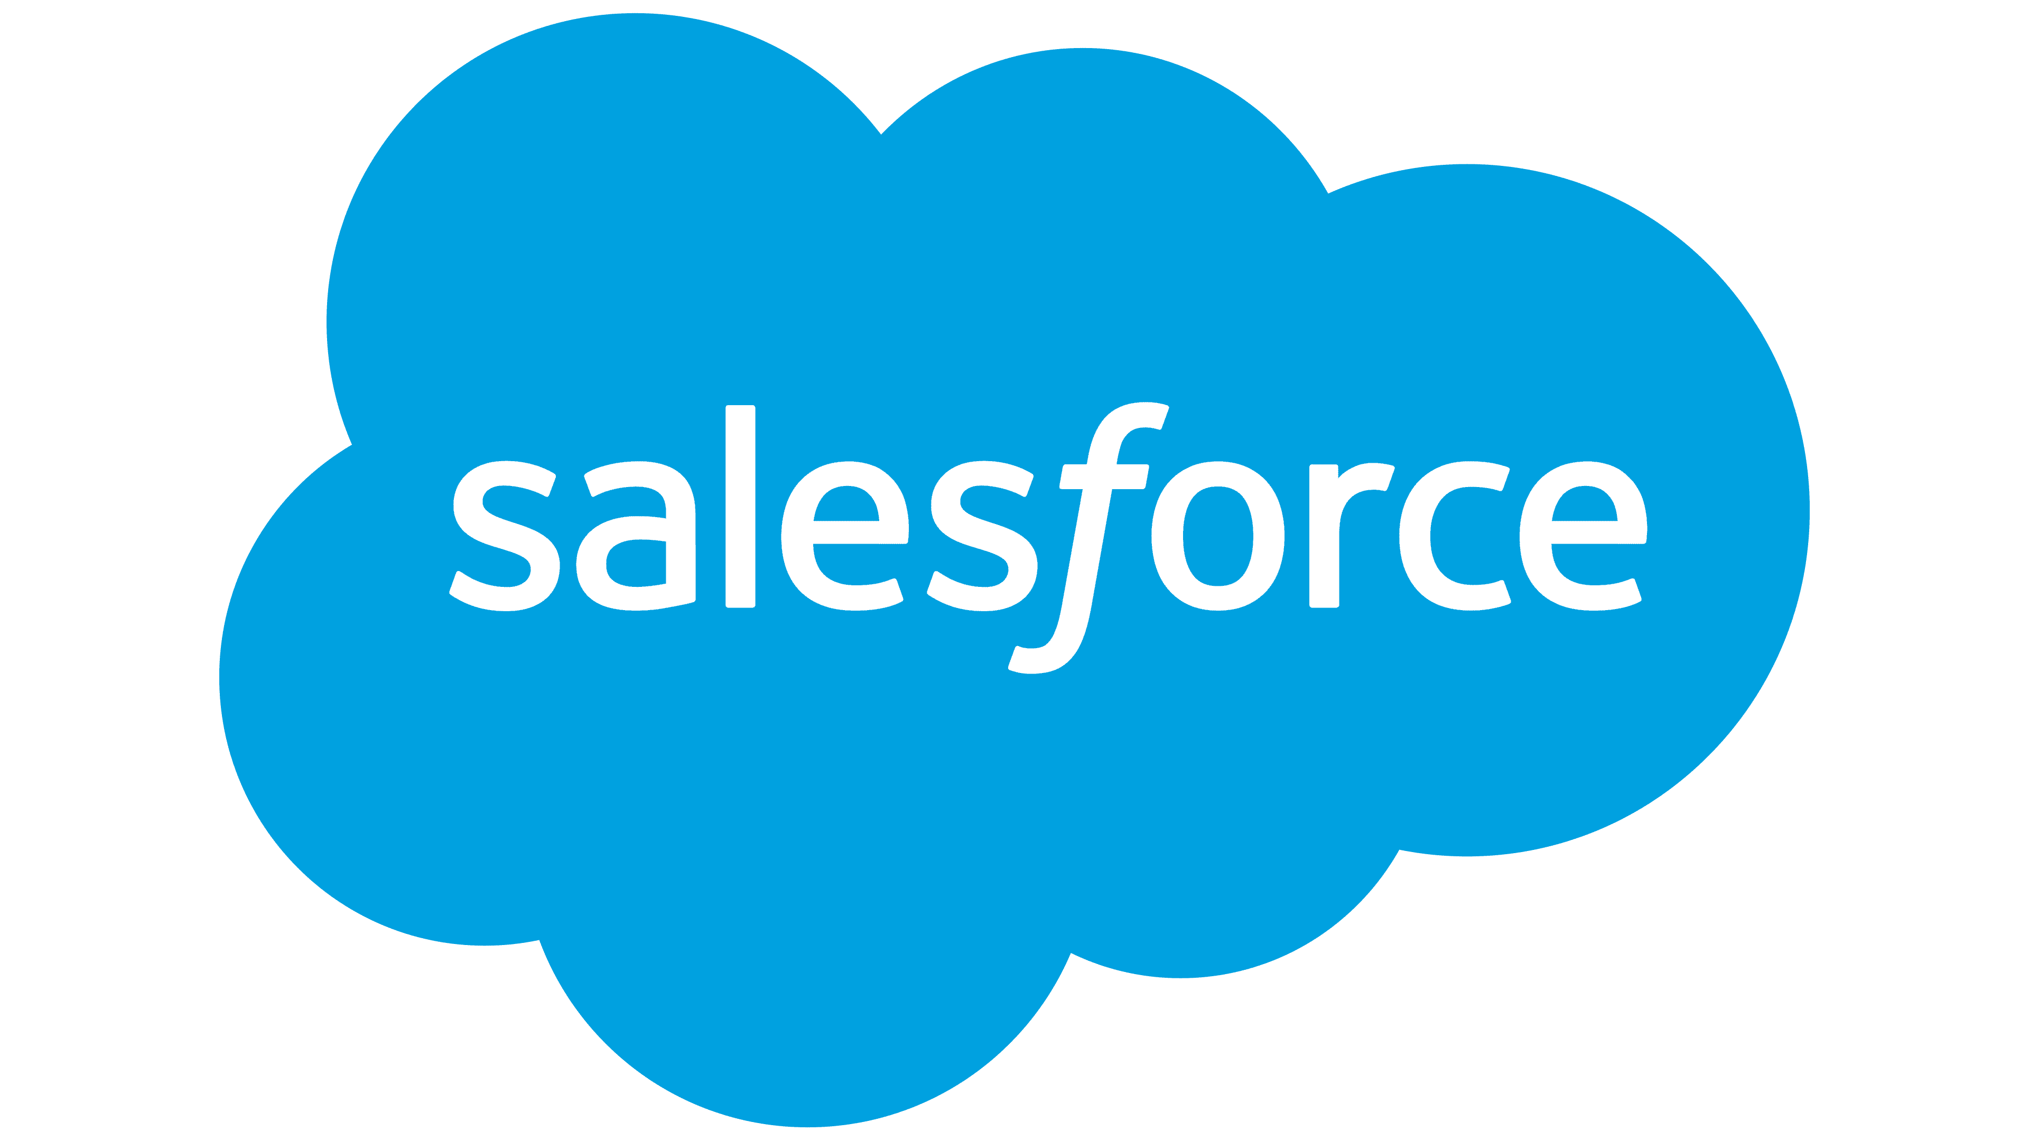






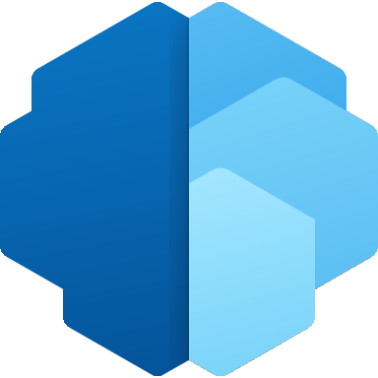


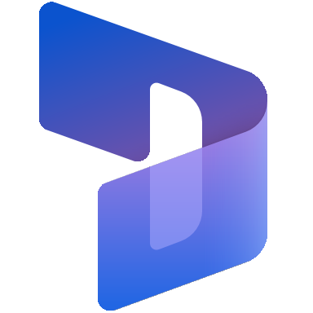
Agility for core business systems
2
Extend LOB systems
Power Platform
Core systems
Build, connect, and extend
Power Apps
Power Automate
SAP
Salesforce
Data connectors
Dataverse
Power Virtual Agents
Power Pages
Workday
Oracle
AI Builder
Power Fx
Power BI
Dynamics 365

Slide 30
Extend LoB systems with Power Platform
2
Extend LoB systems
Build low-code apps, workflows, external websites, chatbots, and dashboards to deliver simple, modern, and powerful experiences across your data and processes on any device.
Automate processes that span your key line of business systems without the need for complex code using digital and robotic process automation.
Empower users wherever they work by surfacing apps and processes in the productivity tools they use every day, such as Teams and Outlook.
Safeguard mission critical data that supports your core processes with strict security and governance tools.

Slide 31
Accelerate professional developer Build complex solutions faster with low code
3
Accelerate professional developer
z
Reduce time and effort needed to create new solutions with low code to accelerate development and enable faster time to value.
Extend and integrate your solution with professional developer tools to create complex solutions quickly and easily.
Maintain governance and control at scale with built in administration and security tools that work across all your solutions.
Power Platform and Azure helped reduce costs by 24% due to increased developer efficiency, increased DevOps efficiency, and reduced spending on third-party solutions.¹
Sources: Microsoft Power Platform and Azure for Corporate IT TEI

Slide 32

















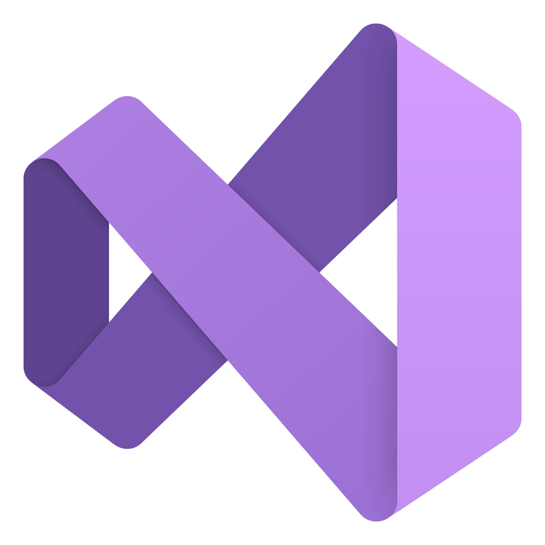
Integrated experience
3
Accelerate professional developer
Power Platform
Every developer (low code)
Power Apps
Power Automate
Power Virtual Agents
Power Pages
Power BI
Azure
Dev Ops
GitHub
Services
Analysis Services
API Management
Azure Functions
Kubernetes Service
Logic Apps
Cognitive Services
Pro developer (code first)
Data services
Data Services
Microsoft Graph
Dataverse
Azure Synapse Analytics
Cosmos DB
VS Code
Visual Studio

Slide 33
Enhance employee experiences Boost employee engagement and productivity
4
Enhance employee experiences
z
Connect your internal and external data sources and give employees information they need to decide & act fast.
Improve communication, focus, and collaboration with apps, workflows, and bots available in the flow of work through Teams and M365.
Simplify work with applications and automations that streamline activities and experiences both in the office and on the front line.
The use of no-code or low-code platforms or apps is shown to have led to an 83% positive impact on work satisfaction.¹
Sources: Low-Code Trend Report 2022 - Microsoft Power Platform Blog

Slide 34
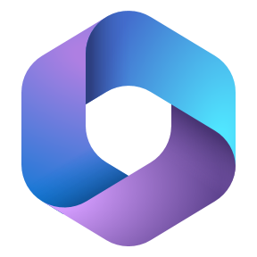
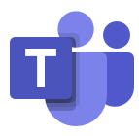


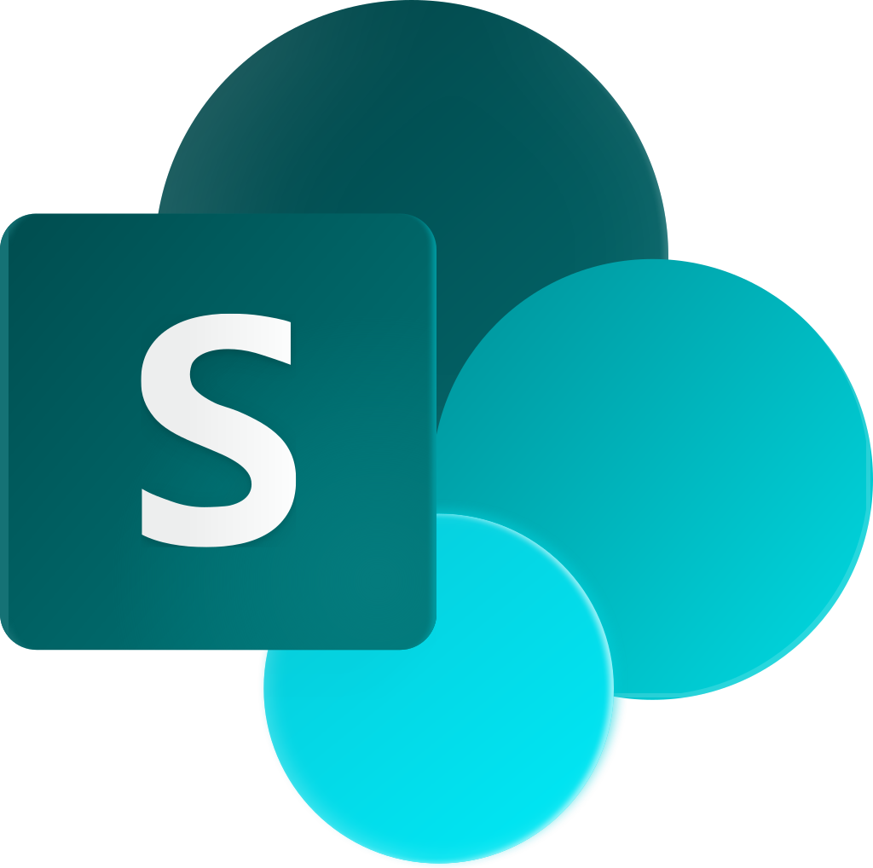

Integrate with productivity tools
4
Enhance employee experiences
Power Platform
Connect, extend and integrate with productivity tools
Power Apps
Power Automate
Microsoft 365
Dynamics 365
Microsoft Teams
Dataverse
Power Virtual Agents
Power Pages
Outlook
OneDrive
SharePoint
Forms
Power BI
Data connectors

Slide 35
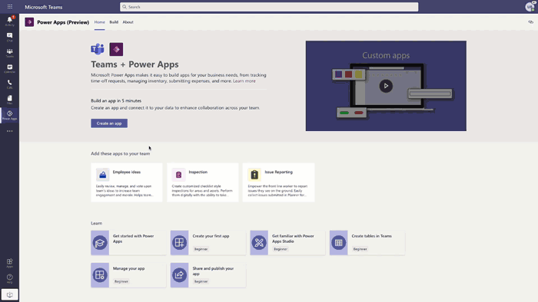
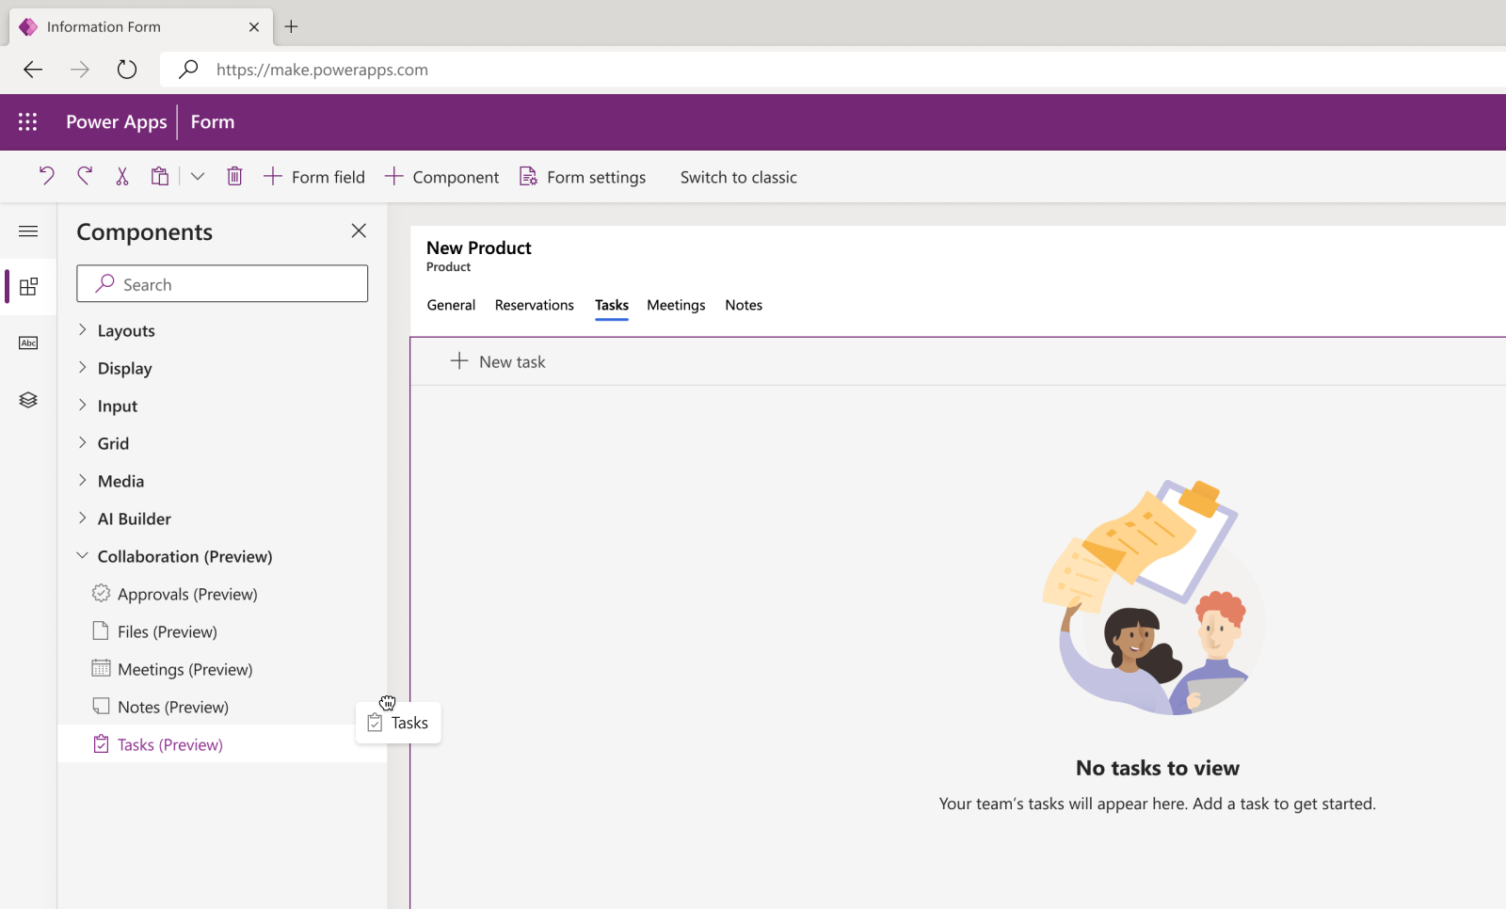
Power Platform + Teams
4
Enhance employee experiences
Align the company’s revenue strategy across Marketing, Sales, and Customer Success
Elevate the customer experience
Discover new ways to generate leads
Define the company value proposition
Outline the GTM strategy
Expanding into new markets
Seller recruitment, coaching, and retention
Choosing and deploying CRM and associated sales tools
Enhancing ability to forecast
Driving more opportunities into the pipeline
​Keep the focus in the flow of work with app deployment through Teams
Enable collaboration between business and technical users, decreasing costs and time to delivery
Use adaptive cards and link unfurling to take simple action directly in chat
Start with pre-built solutions to common scenarios with out of the box templates

Slide 36
Empower departments Empower departments to solve business challenges
5
Empower departments
z
Accelerate developers and empower business users to develop solutions faster and at scale with safeguards in place.
Build solutions with less effort with next generation AI copilot to quickly go from idea to solutions with natural language.
Keep IT in full control and reduce the risk of shadow IT with centralized administration and governance.
More than 80% of users and potential users of low-code or no-code platforms report that they would be more willing to work for a company that invests in their technical upskilling.¹
Sources: Low-Code Trend Report 2022 - Microsoft Power Platform Blog

Slide 37


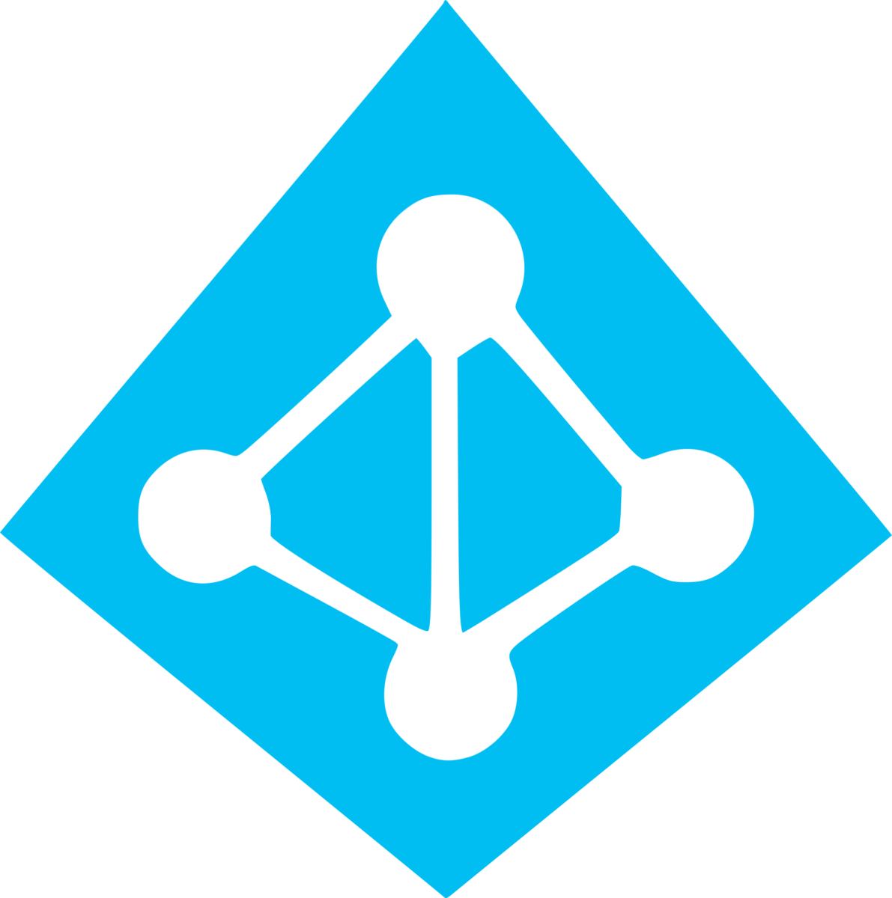
Enable all makers
5
Empower departments
Power Platform
Power Apps
Power Automate
Power Virtual Agents
Power Pages
Power BI
Empower Business Users
Dataverse
Data Connectors
Power Fx
Microsoft Teams
Copilot
Robust Control
Data Services
Power Platform Admin Center
Managed Environments
Azure Active Directory

Slide 38
Optimize with hyperautomation Solve business challenges faster
6
Optimize with hyperautomation
z
End-to-end automation and process modernization with RPA, DPA, embedded AI, chatbots, and process mining.
Build a culture of automation and digital transformation with the full Power Platform solution.
Efficiently scale automation and give IT controls they need to drive a secure and compliant organization.
By 2025, 60% of organizations will capitalize on disruption with an enterprise- and
ecosystem-wide approach to automation, leveraging model-based enterprise concepts,
COEs, and low/no-code platforms.
Sources: IDC FutureScape Webcast: Worldwide Digital Transformation 2022 Predictions

Slide 39
Let’s get started
Notes:
Click to Add Notes

