Slide 1
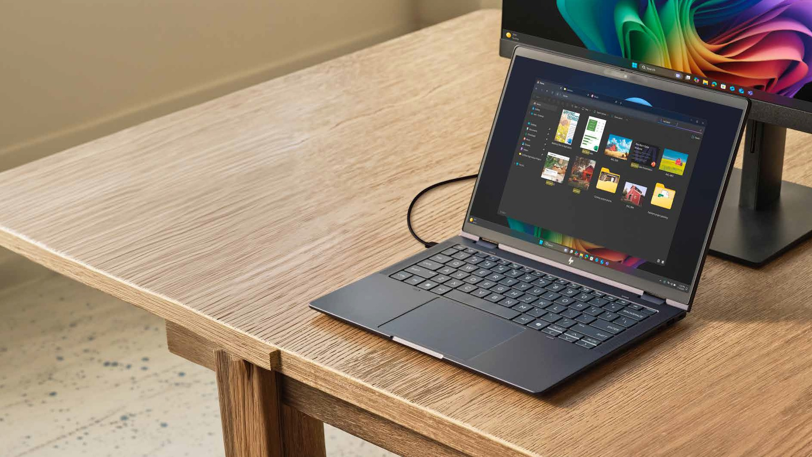
Introducing the Copilot+ PC.
A new class of device, designed for AI acceleration, all-day performance and enterprise-grade security.
Our goal is to help you deliver value from day one with Copilot+ PCs, not months into the rollout. This presentation covers three ways to kickstart this initiative:
Top features to try with Copilot+ PCs.
Role-based examples of how colleagues already work with Copilot+ PCs.
Details on where to go next for additional resources and support.
The best part? Every feature mentioned is already built into the device. No downloads, installs,
or setup wizards required.

Slide 2
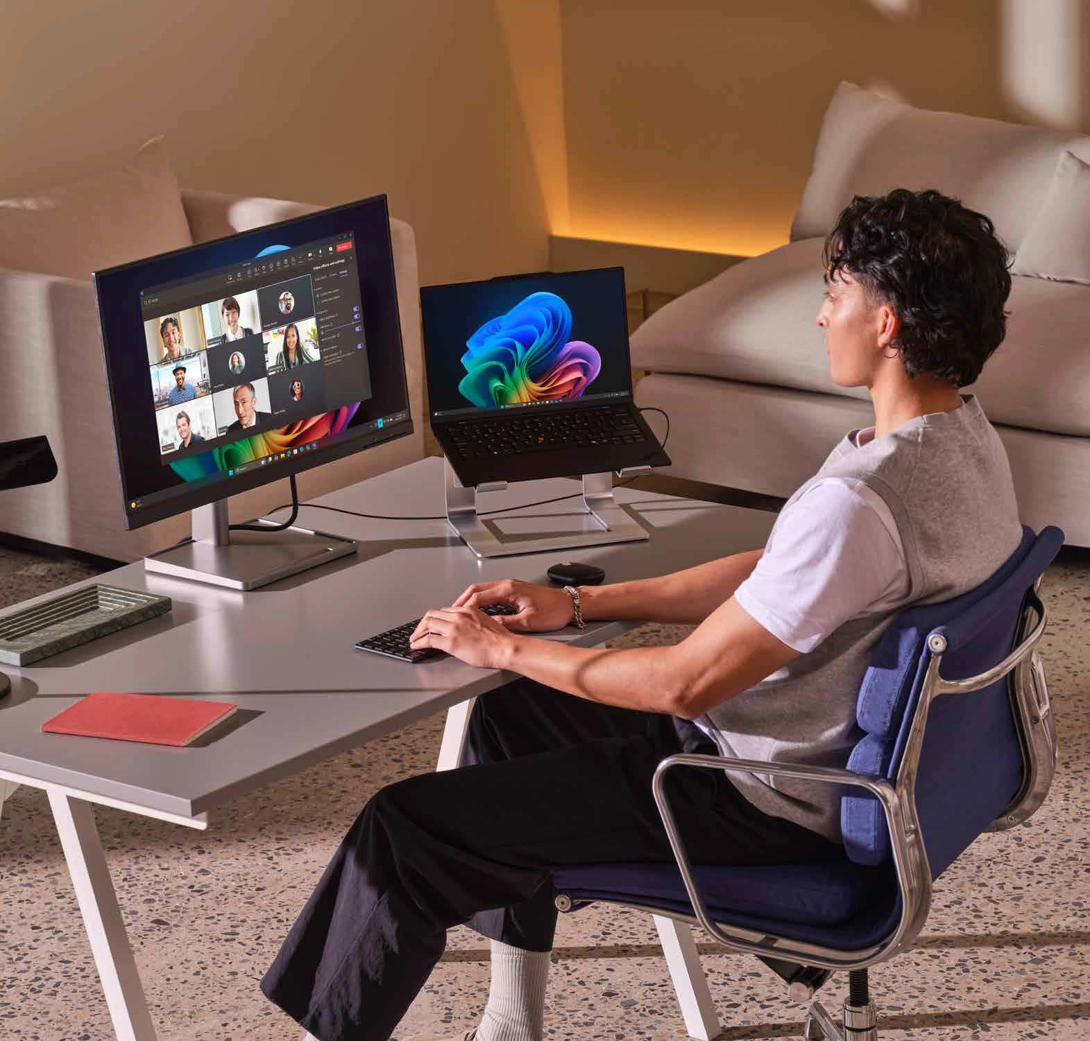









The challenge:
Creating a starting point.
Copilot+ PC features are built-in and instantly available. No installations, setup wizards or downloads stand between you and your Copilot benefits.
The biggest barrier is knowing what to try first and how it applies to each person’s role.
Ask yourself:
How do I want Copilot+ PCs to help me in my daily work?
What task(s) do I perform regularly that could be done faster with Copilot+ PCs?
What guidance (or permission) do I need to use Copilot+ PCs in my daily work?

Slide 3
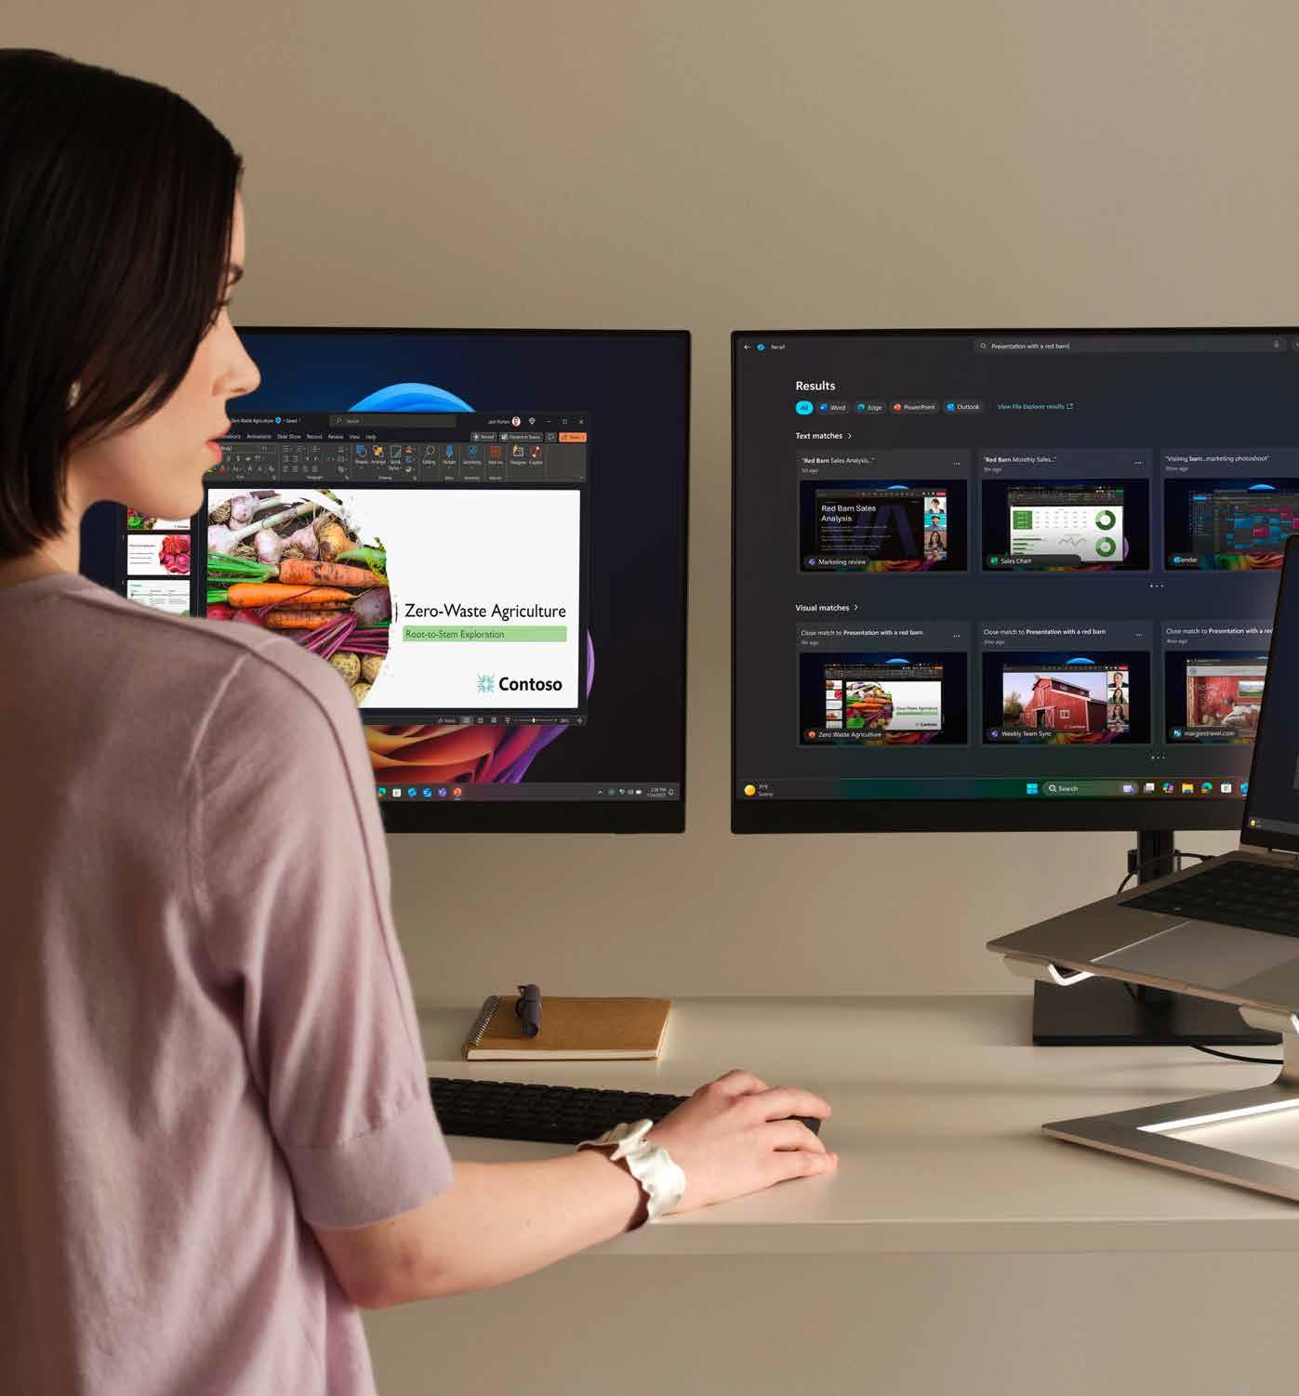


Five features. Five shortcuts. Available right now.
Each of these works from a single keystroke and needs no setup.
The feature | The shortcut | What does it do?
Improved Windows Search | Windows key + S The search bar in File Explorer The taskbar | Describe a file in your own words — be it in image, text or something else — and get relevant results (even when the name doesn’t match).
Click to Do | Windows key + click | Highlight text or images anywhere on screen to open content in Word, set up a Teams meeting from a highlighted email address, copy images, blur backgrounds, or run a visual search with Bing.
Live Captions (with translation) | Windows key + Ctrl + L Windows Accessibility settings | Real-time translation from over 40 languages into English and over 25 into Simplified Chinese, in Teams or other tools, with pre-recorded content, and even offline.
Windows Studio Effects | Windows key + A Taskbar volume icon | Adjust the camera with creative filters, lighting adjustment, standard or portrait blur, auto eye contact, and automatic framing.
Recall (preview) | Windows key + J | Retrieves past work from a description such as “presentation with arrows,” and Agent in Settings (Windows key + I) changes device settings from a plain request like “Can I make my screen brighter?”

Slide 4



AI that meets people inside the work they already do.
These are not separate applications to learn; these Copilot features sit inside the workflow and are reached from a keystroke.
Here’s a few exercises to try:
Describe instead of remembering.
Search by content and description rather than exact file names, across text, images
and documents.
Act without switching apps.
A highlight becomes a Word draft, a Teams meeting, an email reply or a visual search.
Work across languages and conditions.
Captions and translations cover live and recorded content, work in any conferencing tool and even
function offline.
Show up well and stay in control.
Try on-device video enhancement, plus Recall’s Windows Hello Enhanced Sign-in Security requirement and IT policy controls.

Slide 5
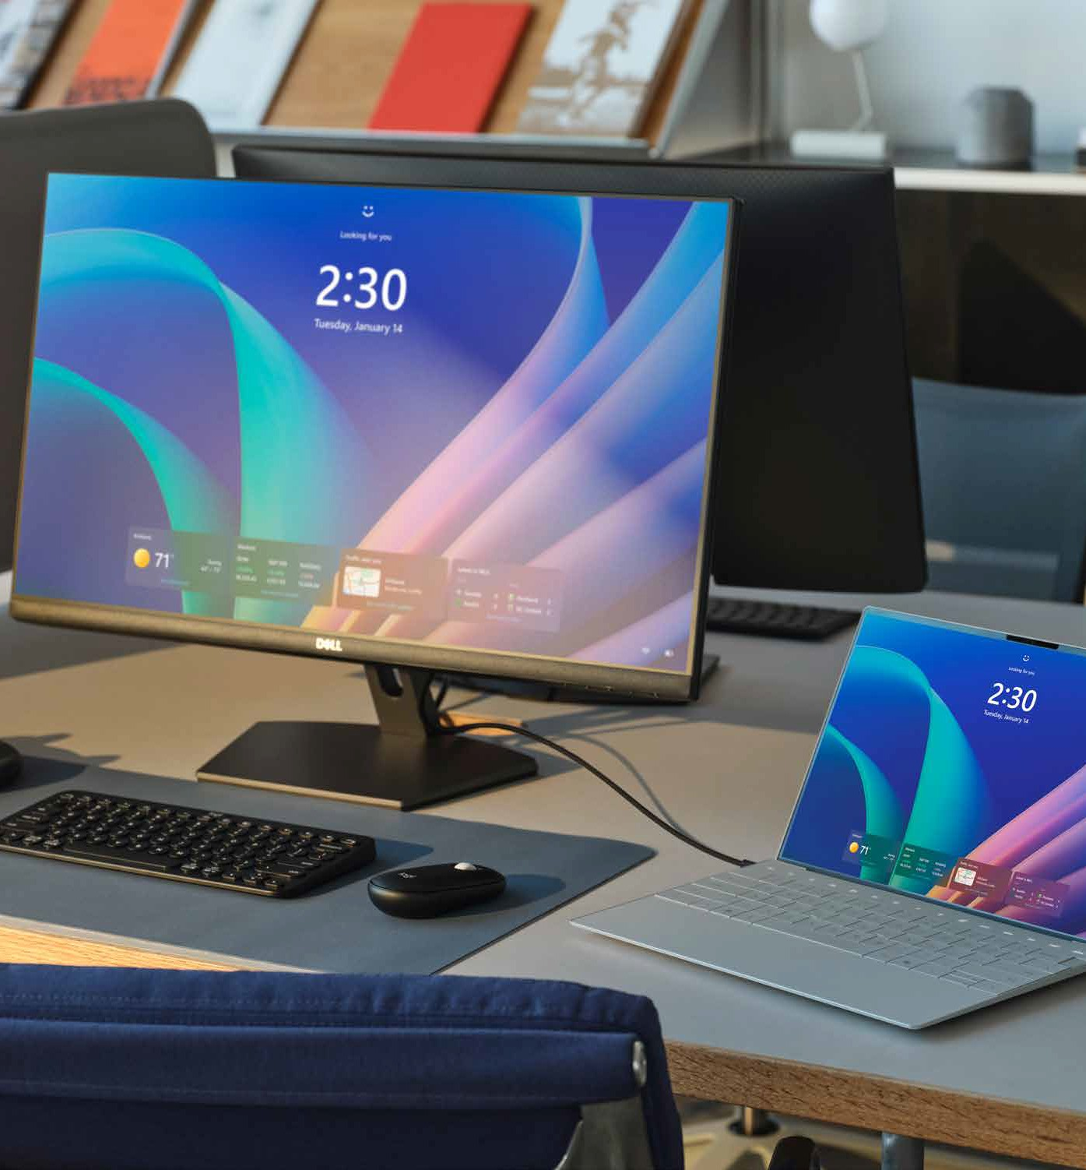





The same five features. Five different days.
Copilot+ PC’s value is universal, but the proof is role-specific — every function has its own version of the same time savings.
HR and Legal
Find policy guides, employee records, contract drafts, and case files by description
Summarize a resume with a click or extract key obligations from a highlighted clause.
IT
Find device policies, deployment reports, and system logs.
Start an instant reply on a support ticket.
Tetrace previous troubleshooting and configuration moments with Recall.
Finance and Ops
Locate budget files, audit docs, and logistics trackers instantly.
Open financial models in Excel or email a supplier straight from a highlighted item.
Sales and Marketing
Surface pitch decks, proposals, and creative assets fast.
Stay engaged in global customer calls with translated captions.
Look polished in virtual pitches and client presentations.
Everyone
Agent in Settings removes the menu-digging.
People adjust their device by describing what they want.

Slide 6
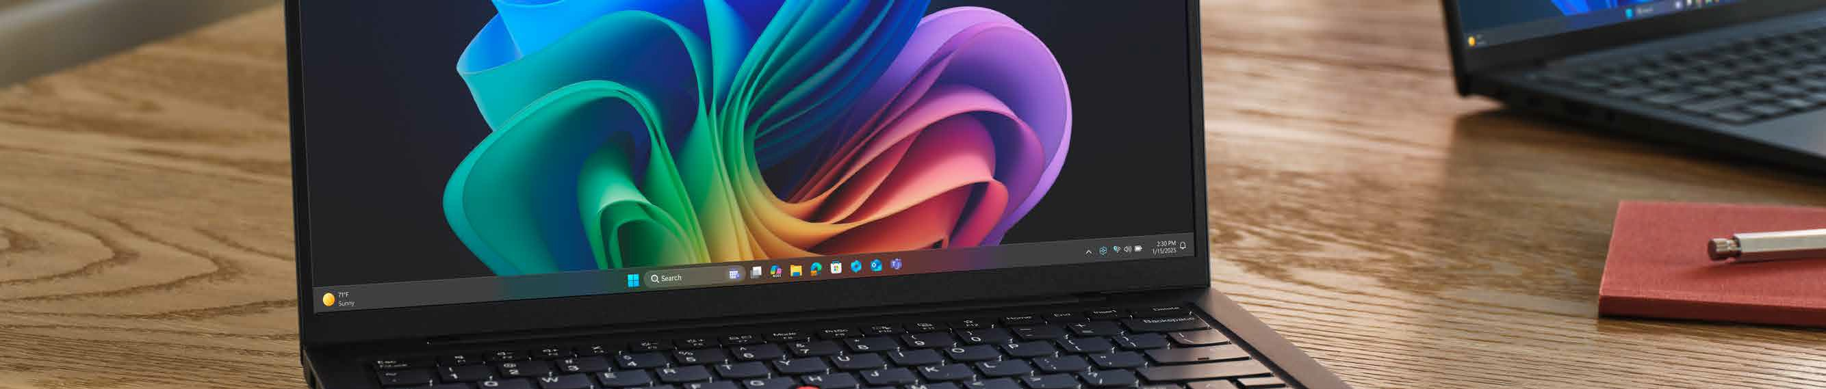

Adoption is the attach point.
The device is just the beginning; the enablement wrapped around Copilot+ PCs is what makes your investment land and what keeps end users engaged.
Here’s how you can start moving the needle with your company’s Copilot+ PC adoption rate:
₁ Understand best ₂ Make benefits ₃ Host a forum or
4
Get support:
₅ Bring in additional
use cases:
Pair every Copilot+ PC refresh opportunity with enablement resources built around the five included features.
role-specific:
use the HR, finance, IT, sales, marketing, ops, and legal examples to tailor the pitch to your own teams.
cadenced training:
Offer tips, real-world scenarios and updated information on Copilot+ PC features in meetings with your peers.
resources:
Take advantage of our solution expertise, sales enablement, and go-to-market guidance to help you package refresh and adoption together.
From pre-sales and technical support, demo and proof-of-concept help, to deployment and lifecycle services, financing options, and marketing assets, you can carry this same
messaging to various end users and increase adoption rates throughout your company.

Slide 7
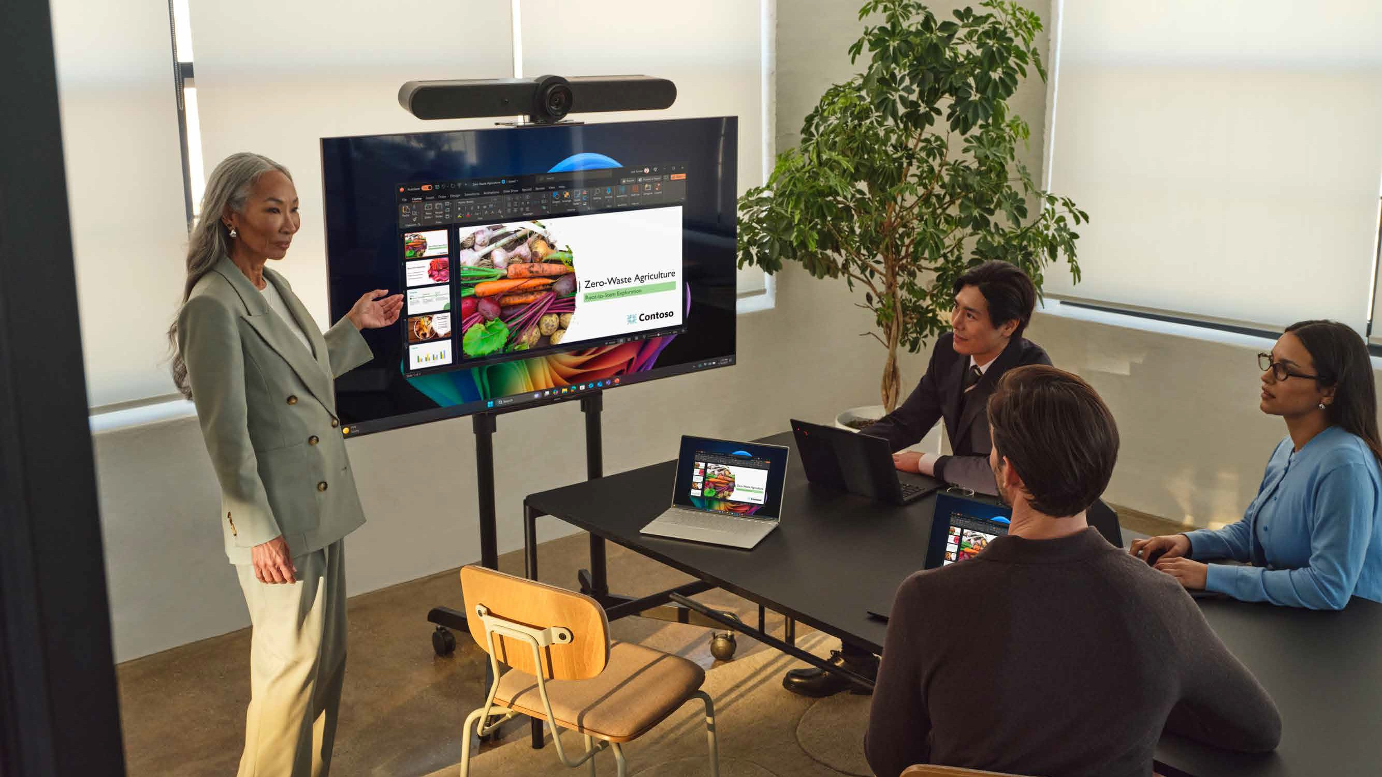
Where to go from here?
Work with our team to package this enablement path into a repeatable, revenue-generating offer:
Presenter’s Full Name
Presenter business title, Company name Email: Presenter-Email@domain.com Phone: (###) ###-####, ext. ####
Website: www.partnerwebsite.com

