Slide 1
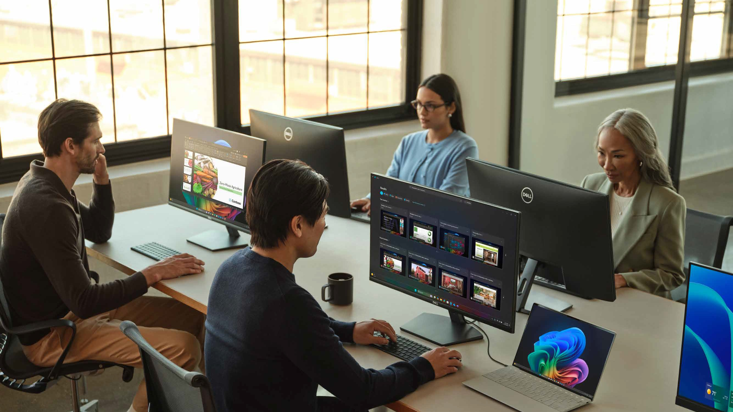

Windows as the platform for work.
Thriving businesses are balancing security with AI innovation to drive operational efficiency.
40%
82%
of business leaders say now is the time to rethink strategy and operations.¹
of data security professionals report an increase in data security incidents from AI.¹
The mission?
Bring secure, business-ready AI to every organization, so
people work smarter and IT stays in control.
How we’ll achieve it?
Use Windows, the operating system (OS) that people use every
day, to serve customers, innovate and keep businesses running.

Slide 2
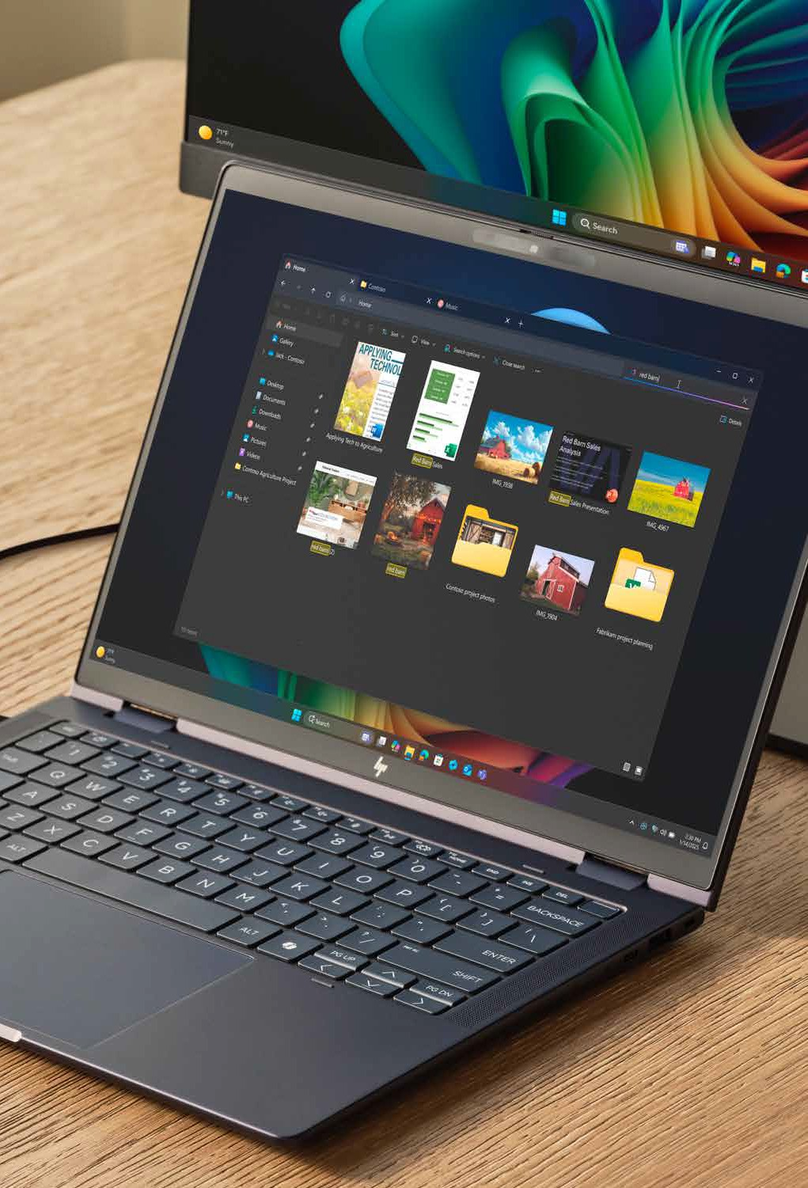















Today’s business landscape.
Pressure is coming from many directions, and IT platforms are expected to absorb all of it:
Top trends Current challenges
Generative AI
Machine learning and automation
Economic uncertainty/ Budget constraints
Organizational efficiency
Geopolitical change/Supply chain disruption
Employee growth
Cyberattacks and data breaches
Workforce capacity
What must IT now provide?
Integrated AI solutions
Scalability/flexibility
Real-time insights, security and compatibility
The numbers that prove it.
83% 2.7^{x}
82%
Of leaders say AI will let employees take on more complex and strategic work.¹
Ransomware attacks almost tripled year over year amid other escalating threats.¹
Of leaders say AI will
let employees take on more complex and strategic work.¹

Slide 3
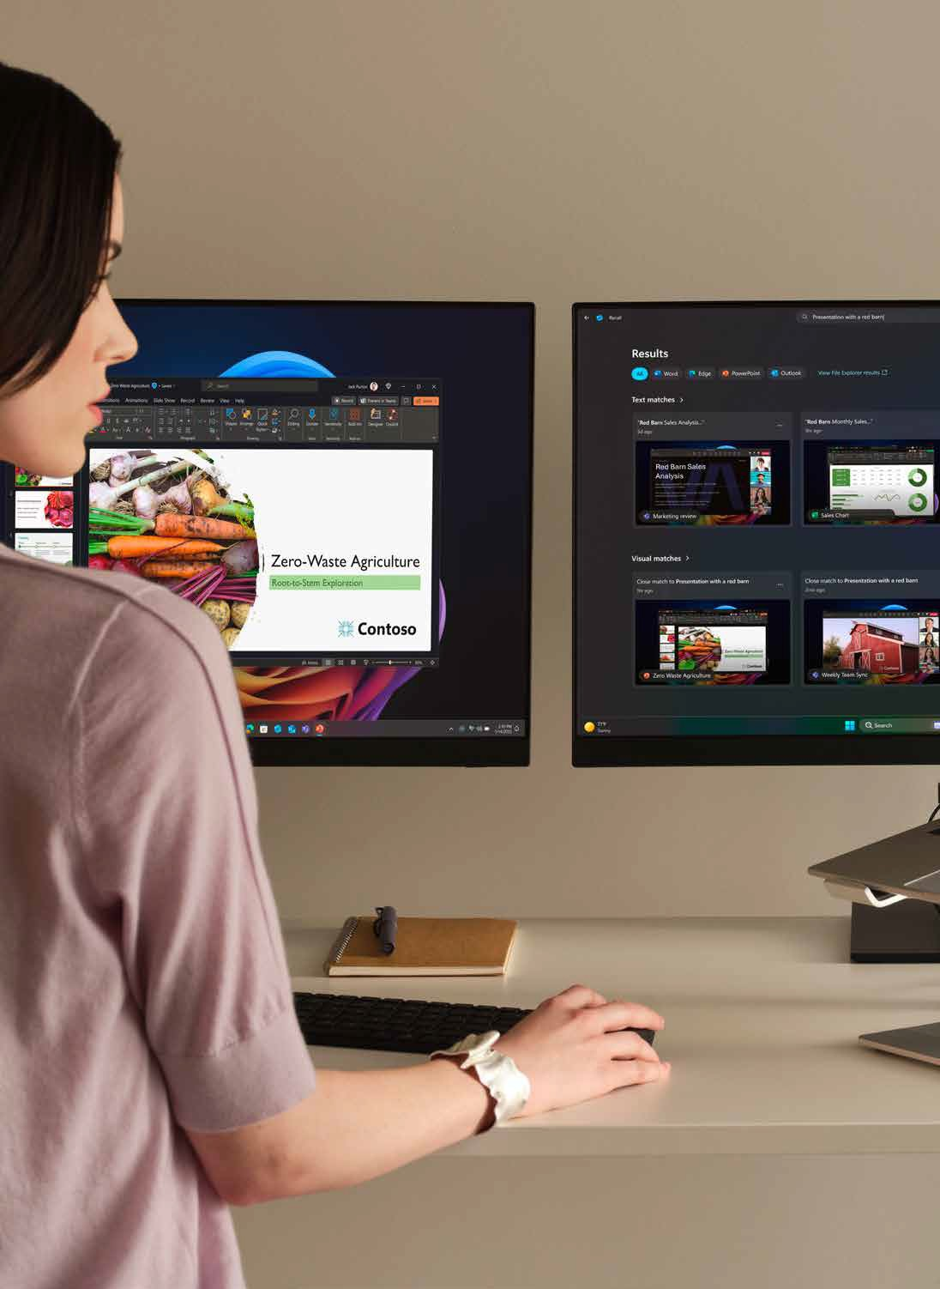


Your canvas for AI and agents.
Windows powers the business with smart tools that work, security by default and performance you can count on.
Windows for AI and agents.
Microsoft 365, Copilot and agents integrate deeply into the shell for seamless workflows and intelligent automation.
Security and management.
Advanced security and streamlined management in Intune, simplifying IT and reducing total cost of ownership.
Fundamentals and resiliency.
High-performing devices built on strong, consistent fundamentals with planet-scale resiliency for mission-critical operations.
The Microsoft Cloud.
Extend Windows capabilities beyond the device and unlock business-ready AI and agent perks on Windows endpoints.
The future of AI is hybrid.
Cloud scale and model access, combined with local AI that runs small language models behind hardware-backed safeguards.

Slide 4

Business runs smarter on Windows.
Productivity, performance, security and IT agility improve together rather than trading off against each other.
Your smart business move | How Windows 11 PCs make it happen?
Productivity | 50% faster workflows on average² AI in familiar apps through helpers like Click to Do and Recall (preview) Improved Windows search⁴ Live Captions with real-time translation
Performance | Up to 22 hours of streaming battery life⁴ 40+ TOPS NPU² Instant start-up² The best videoconferencing and AI features on a Windows PC yet
Your smart business move | How Windows 11 PCs make it happen?
Security | A reported 62% drop in security incidents² Secured-core PC protection² Microsoft Pluton² Windows Hello Enhanced Sign-in Security^{2,4} BitLocker on by default⁴
IT agility | Up to a 30% expected drop in device management time³ Autopilot, Autopatch and Hotpatch⁴ Quick machine recovery Broad compatibility through the App Assure program

Slide 5
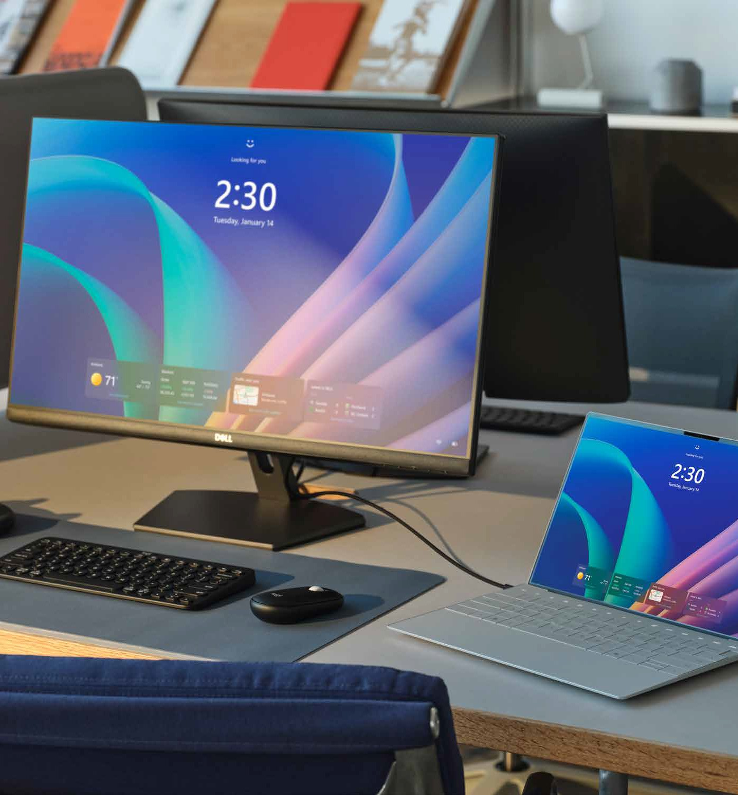



Substantial ROI projected over three years.
Return on investment (ROI) shows up in four places: Security exposure, help-desk load, device management time and the hours given back to employees.
Copilot+ PCs are estimated to block 70% of typical breach vectors, for up to a 15% reduction in threat exposure.³
Device management time is anticipated to drop by up to 30%, driven by improved reliability and support for proactive diagnostics.³
Help-desk effort is expected to fall 10% to 50% through faster provisioning, quick remote setup and improved content discovery.³
Employees are expected to save up to five hours each week
through speedier workflows, freeing time for other value-added work.³
For small businesses specifically… Setup time is cut by up to 75% (15 minutes versus 45-60), help-desk tickets go down 10%-50% easing pressure on small IT teams and AI features save 1-5 hours per user per week..³

Slide 6
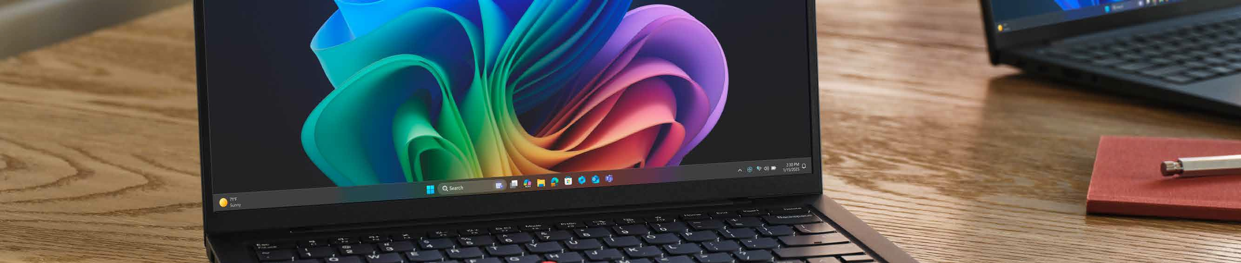
Transition to a modern business environment.
Three strategic objectives frame every customer conversation: Replace outdated devices, enable agile and efficient operations and create an AI-ready roadmap for growth.
₁ Start with the estate:
Aging hardware is your qualifying signal,
and the refresh is the entry point to the whole AI conversation.
2 3
Lead with the business case:
Fewer security incidents, less help-desk load, hours returned each week (and let the device specification follow).
Attach the full stack:
Copilot+ PCs, Microsoft 365 Copilot, Intune management and security services, then extend into custom apps and agents built on Microsoft Foundry on Windows and Copilot Studio.
TD SYNNEX supports the motion.
Boost your offering with TD SYNNEX solution and technical expertise, sales enablement and go-to-market guidance to help partners build and run the campaign. Bring in TD SYNNEX resources for:
Pre-sales support
Demo and proof-of-concept help
Deployment and lifecycle services •
Financing options
Marketing assets that carry the same messaging into the field.

Slide 7
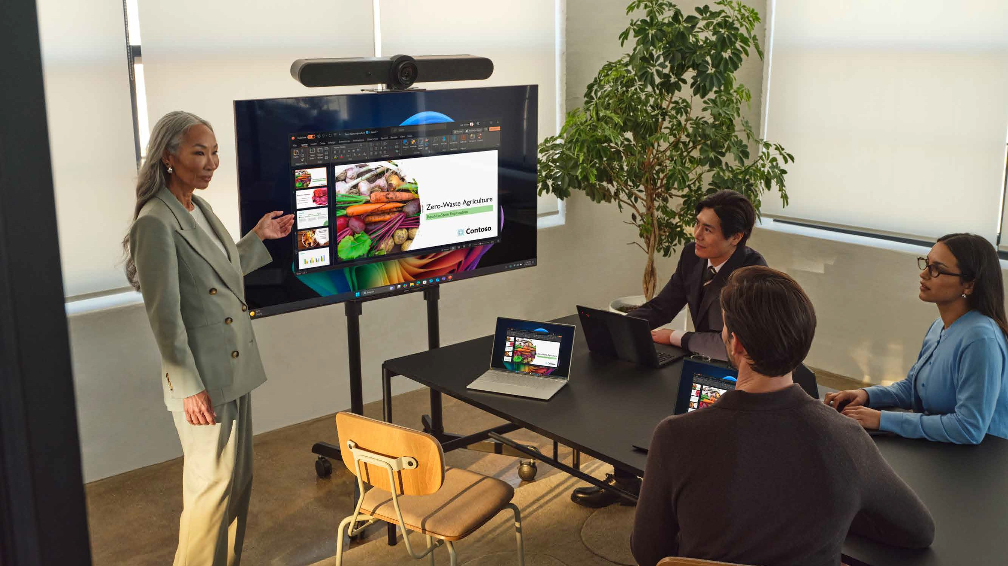
Your journey starts now.
The future of work starts with Copilot+ PCs, and it builds on a foundation of trust and security. Here is how to take your customer there.
Modernize their estate with Windows 11 for a secure, manageable foundation for AI and future work.
Refresh aging hardware
with secure, high-performance devices, and standardize
the account on Copilot+ PCs to deliver the best of Windows 11.
Attach Microsoft 365 Copilot to make AI the front door to work, then open the Microsoft Foundry on Windows conversation for custom agents and workflows.
Work with your TD SYNNEX team at MicrosoftDPS@ tdsynnex.com to scope
the refresh, build the business case and take the offer to market.
1.
2.
Workforce and AI adoption figures (83%, 82%, 81%, 80%): 2025: The Year the Frontier Firm Is Born, Microsoft Work Trend Index, April 2025. Ransomware figure: Microsoft Digital Defense Report 2024. AI-related security incidents: Data Security Index 2024, Microsoft.
50% faster workflows: Improve your day-to-day experience with Windows 11 Pro laptops, Principled Technologies, April 2023, commissioned by Microsoft, in comparison to Windows 10 PCs. 62% drop in security incidents: Windows 11 Survey Report, Techaisle LLC, September 2024, commissioned by Microsoft, compared with Windows 10 devices.
ROI, help-desk, device management, five-hour, and SMB figures: New Tech: The Projected Total Economic Impact of Microsoft Copilot+ PCs, a Microsoft-commissioned study by Forrester Consulting, July 2025. Projected benefits for a single composite organization with US$1 billion annual revenue and 2,000 employees, 80% using Copilot+ PCs over three years, compared with a mixed environment of conventional Windows 11 and Windows 10 PCs.
Battery life varies significantly by device and with settings, usage, and other factors. Microsoft 365 Copilot requires a per-user license sold separately and an eligible Microsoft 365 plan. Click to Do actions vary by device, region, language, and character set, and some require a subscription. Recall (preview) requires Windows Hello Enhanced Sign-in Security, is optimized for select languages, carries content and storage limitations, and requires an enterprise license for some policy-enabled management controls. Autopatch and Hotpatch require Windows 11 E3 or E5; Autopilot requires Microsoft Intune and Entra ID, sold separately.
3.
4.

